Slide 1
Georgia Procedures for Decommissioning Stage II Vapor Recovery Systems at Gasoline Dispensing Facilities
Presented by:
Yasra Adowar
Petroleum Industry Regulatory Team

Slide 2
Purpose
Instruct the owner on how to verify if the contractor has followed the decommissioning procedures as specified in the Rules For Air Quality Control, 391-3-1-.02, and steps defined in the EPD Stage II decommissioning checklist.

Slide 3
Applicability
Decommissioning required by April 30, 2016.
One of the following Types of Stage II VR Systems may be installed at your site:
  Systems with one or two vacuum pumps at each fueling point
    Gilbarco
    Dresser/Wayne
    WayneVac
    Tokheim
    OPW vapor EZ
    Franklin Electric INTELLIVAC
    Catlow ICVN-V1
    Healy 800 ORVR
  Systems with one centrally located vacuum pump: Hasstech and Healy
  Systems ( with no vapor pumps): Balance

Slide 4
Stage II Decommissioning Checklist
Decommissioning checklist should be filled out by a qualified contractor who performed the decommissioning to ensure all steps for decommissioning are accomplished.
The checklist has to be completed & signed by the contractor. The form must be submitted by either the owner or the decommissioning contractor to the testing company. The testing contractor must complete and sign for steps 13,14, & 15 of the Stage II decommissioning checklist.
A copy of the decommissioning tests notification form along with the Stage II decommissioning checklist form must be submitted by the testing contractor to EPD at the same time.

Slide 5
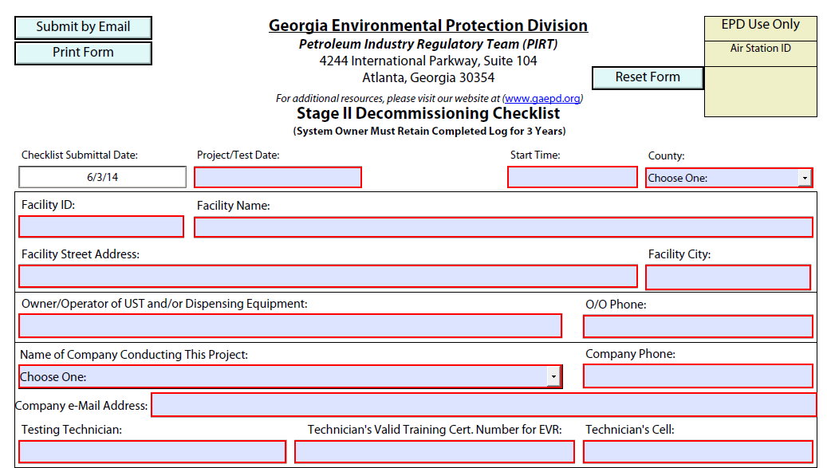
Stage II Decommissioning checklist

Slide 6
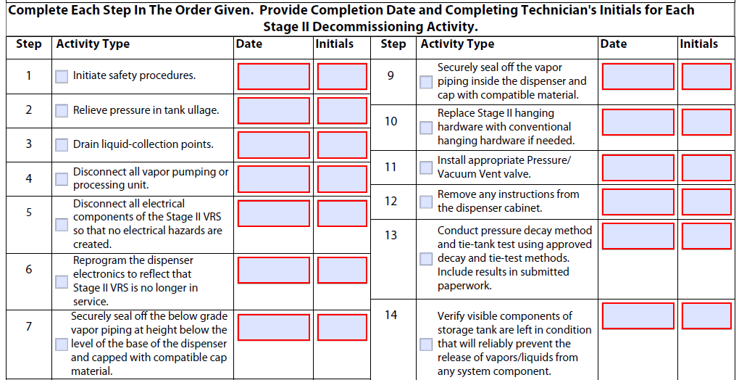
Stage II Decommissioning checklist(cont.)

Slide 7
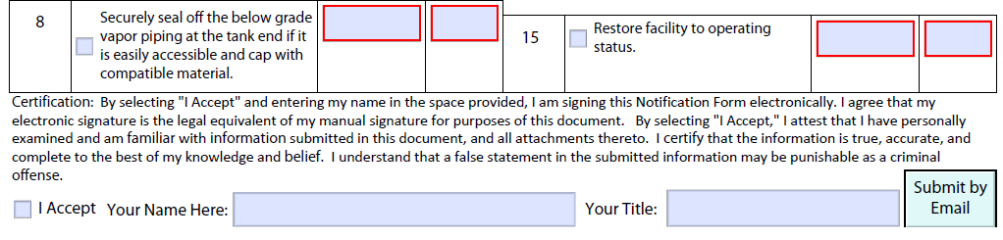
Stage II Decommissioning checklist(cont.)

Slide 8
Next series of slides will demonstrate all locations that need to be plugged or capped to decommission the Stage II Vapor Recovery System

Slide 9
Liquid collection points
Verify if Liquid Collection Points or condensate traps were installed at your site during the installation of the Stage II VRS. If you do have a liquid collection point, confirm the following:
  The liquid collection point/trap has been emptied from any fluid.
  The copper tube ends at the STP and at the collection unit have been disconnected and capped by flare fitting.
  A plug in the submersible pump to seal the vacuum port has been installed and the cap on the liquid collection sump has been replaced.

Slide 10
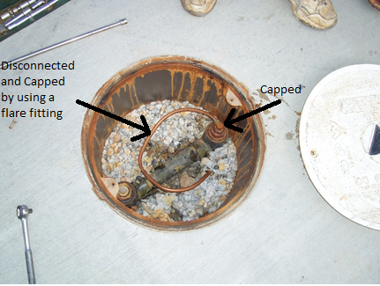
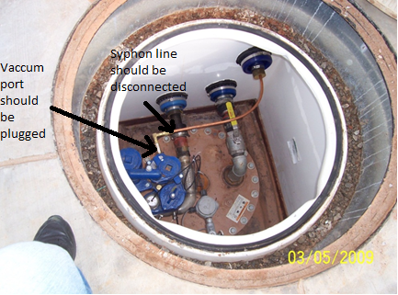
Liquid collection points(cont.)

Slide 11
Disconnecting Vapor Pumps or Processing Units
If the Stage II vapor recovery system in your site includes a vapor pump for each fueling position check the following:
  The wiring at the pump motor has been disconnected and all wires have been capped off by using appropriately-sized wire nuts to insulate the wires as it was recommended.
  The replaced wires has been either installed in the electrical junction box or inside the vacuum motor hosing. Otherwise it should be completely removed.
  The vacuum pump has been disabled or removed.
  The vacuum pump tubing at the vapor inlet and the outlet have been disconnected and plugged.

Slide 12
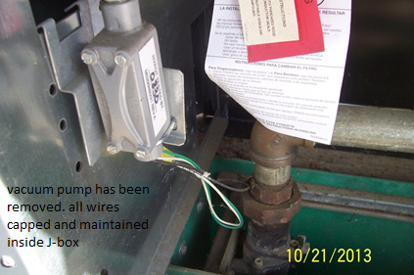
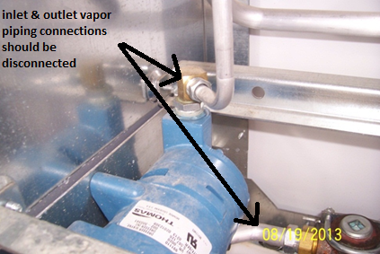
Disconnecting Vapor Pumps or Processing Units (cont.)

Slide 13
Disconnecting Vapor Pumps or Processing Units (cont.)
  If the Stage II vapor recovery system in your site includes a centrally located vacuum pump check that:
  The vacuum pumping mechanism has been removed and a plug with thread has been installed into the tank top bung(e.g Mini-jet Healy vacuum pumps), or at the inlet and outlet of vapor piping (e.g Vane Pump 500), to create a vapor-tight seal
  The vapor piping that was attached to the centrally vapor pump has been either capped by using a threaded plug, threaded cap, or glued fitting if the piping is fiberglass.
  Make sure that the contactor dose not use any type of rubber cap held in place by a hose clamp to seal the vapor piping.

Slide 14
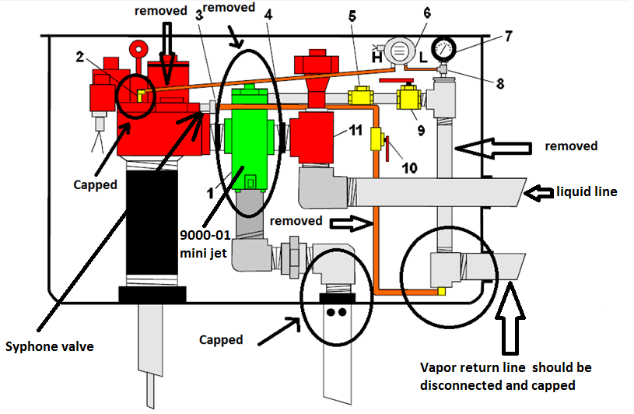
9000-01 MINI-JET INSTALLATION WITH RED JACKET PUMP

Slide 15
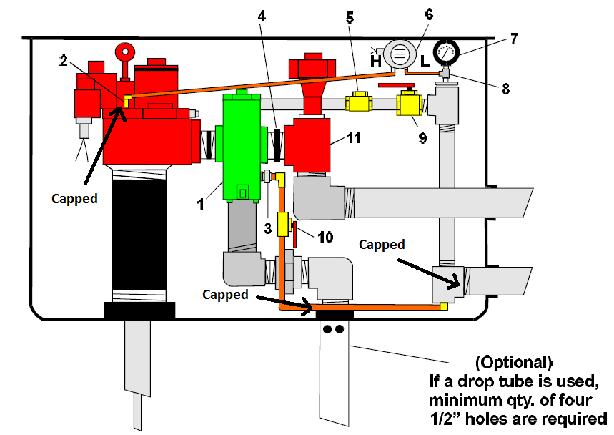
9000-02 MINI-JET INSTALLATION WITH RED JACKET PUMP

Slide 16
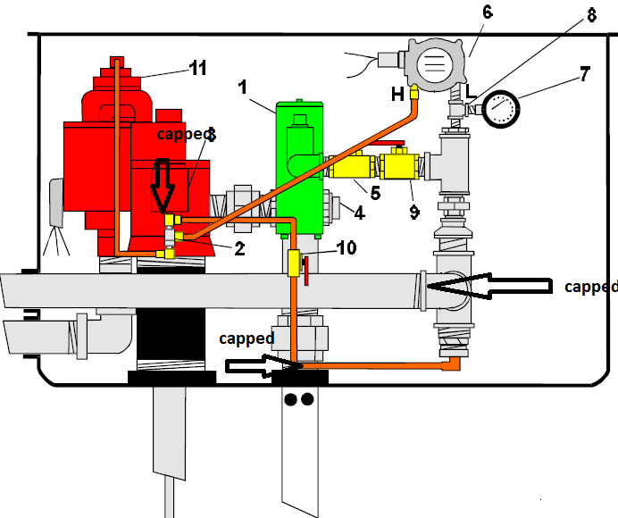
9000-01 MINI-JET INSTALLATION WITH FE PETRO PUMP

Slide 17
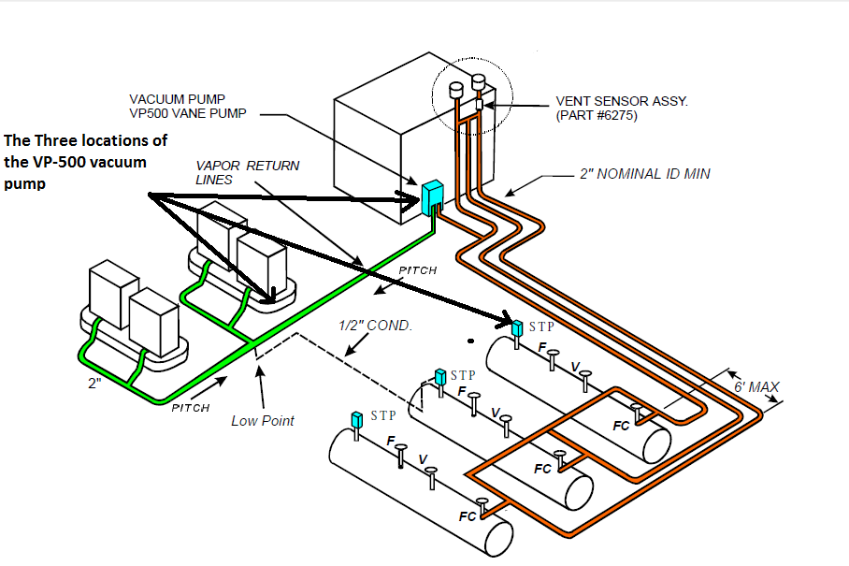
Installation of theVP-500 vane pump

Slide 18
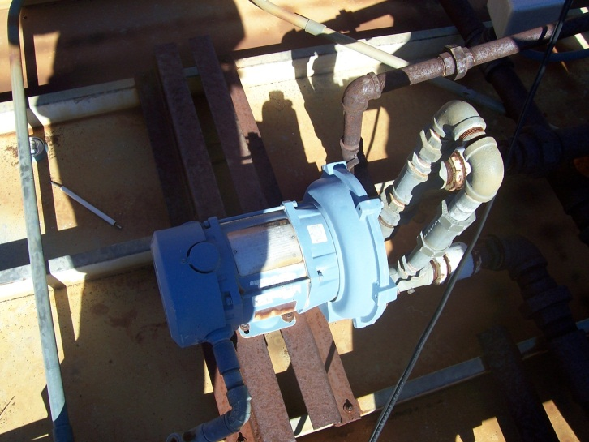
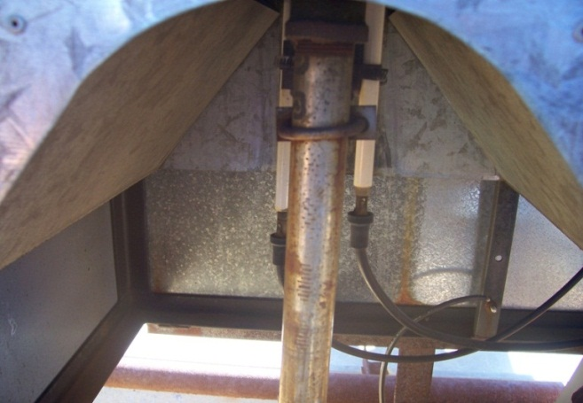
Disconnecting Vapor Pumps or Processing Units (cont.)
If your Stage II vapor-recovery system is Hasstech, check that the collection unit and the processing unit have been removed from service and all vapor piping connected to the system have been capped or plugged.
Hasstech collection unit
Processing unit with the burner and two electrodes

Slide 19
All electrical components of the Stage II VRS
Check if all other electrical components of the stage II VRS has been safely disconnected to avoid any electrical hazards as it was recommended.
  Open the junction box and check the wires have been disconnected and capped with appropriate sized wire nuts and all wires have been sealed off in the electrical junction box.
Note: Removing all electrical components is to avoid confusion and mistakes of deciding the presence or the decommissioning of the stage II VRS by the inspector during his inspection.

Slide 20
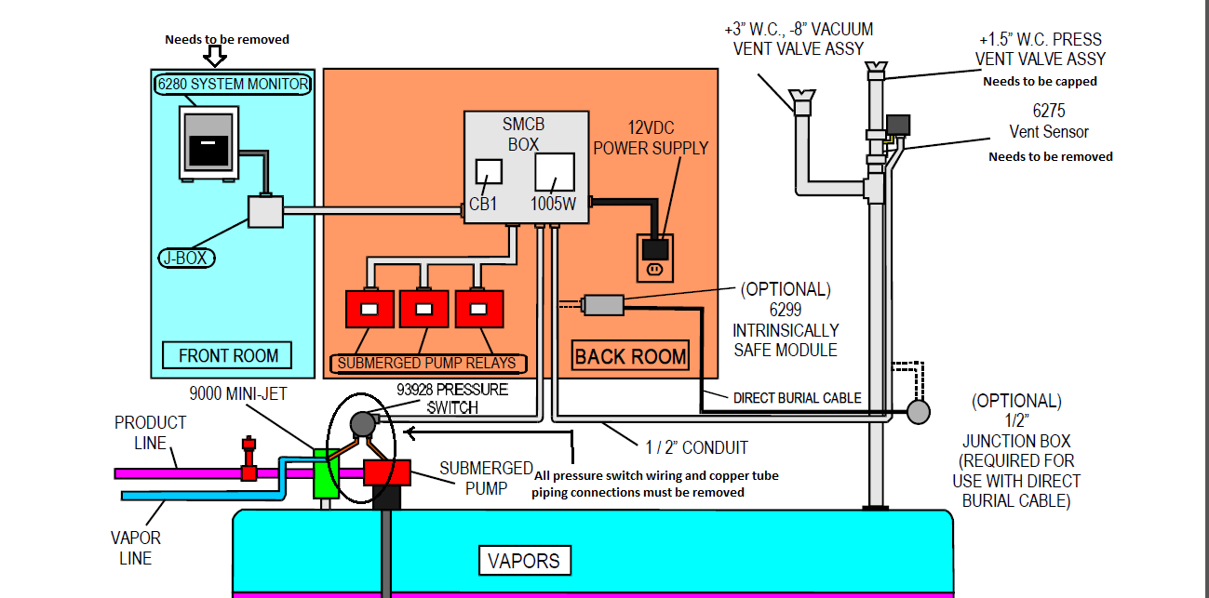
All other electrical components of the Stage II VRS
Healy monitoring system layout

Slide 21
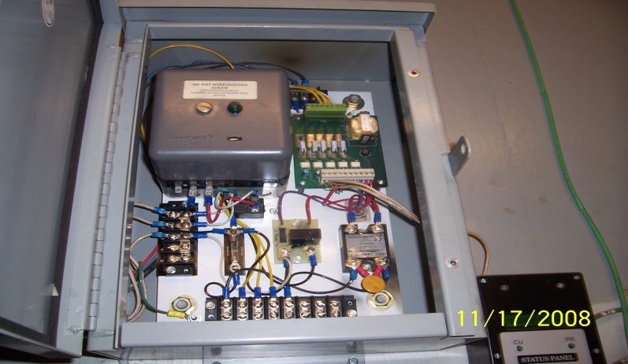
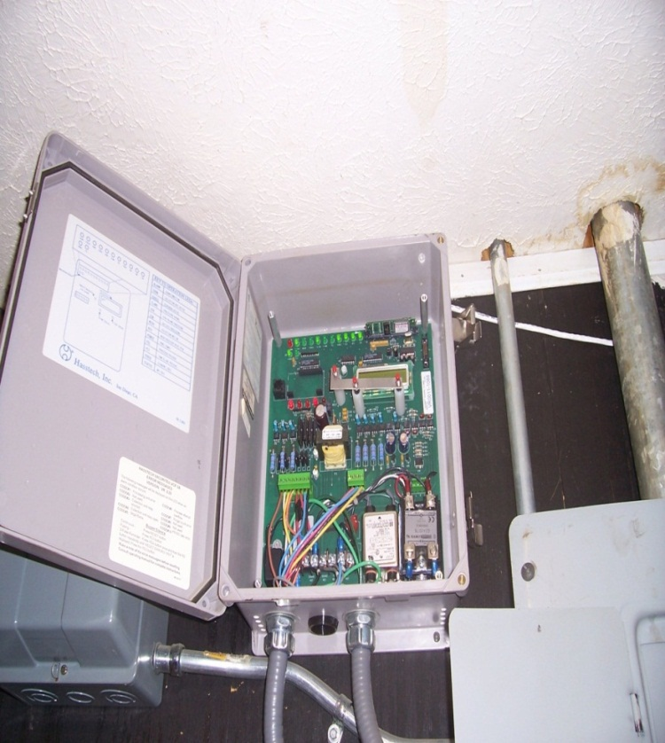
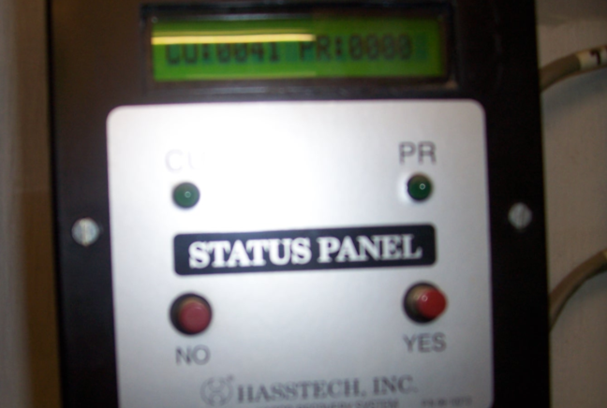
All other electrical components of the Stage II VRS
G-70-7-AD-Vacu Rite VCP-2A Control box and status panel
G-70-7-AD VCP-2A Hasstech status panel
Vacu Rite VCP-3A
G-70-164-AA Hasstech System
Hasstech control panel

Slide 22
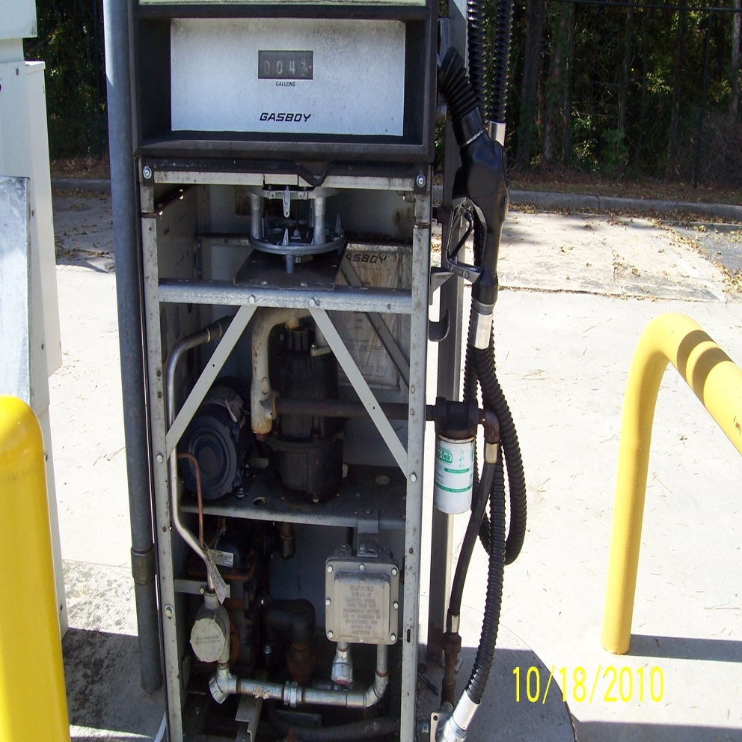
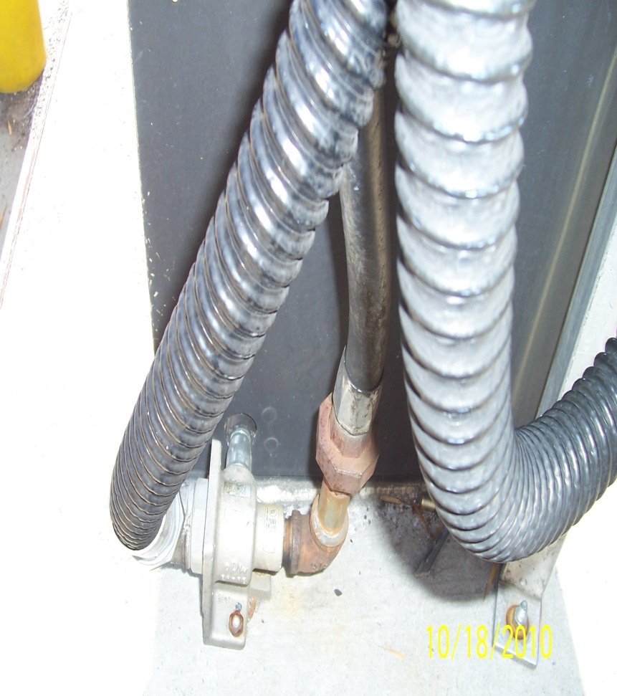
Stage II VR Balance System
Decommissioning

Slide 23
Reprograming of Dispenser Electronics
Make sure the all dispensers are cleared from any error codes and have no any malfunctions and the vapor pump motors control circuits have been disabled.

Slide 24
Sealing off below grade vapor piping
Check that the vapor return piping has been capped at a height below the level of the dispenser’s base and seals must be vapor tight.
  All vapor piping at the VP 500 cabinet must be below the level of the cabinet’s base and seals must be vapor tight.
  Make sure that the contactor dose not use any type of rubber cap held in place by a hose clamp to seal the vapor piping.

Slide 25
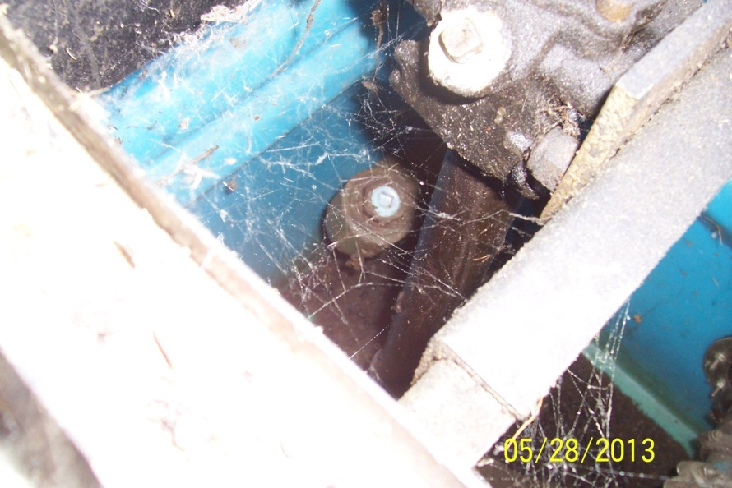
Sealing off below grade vapor piping

Slide 26
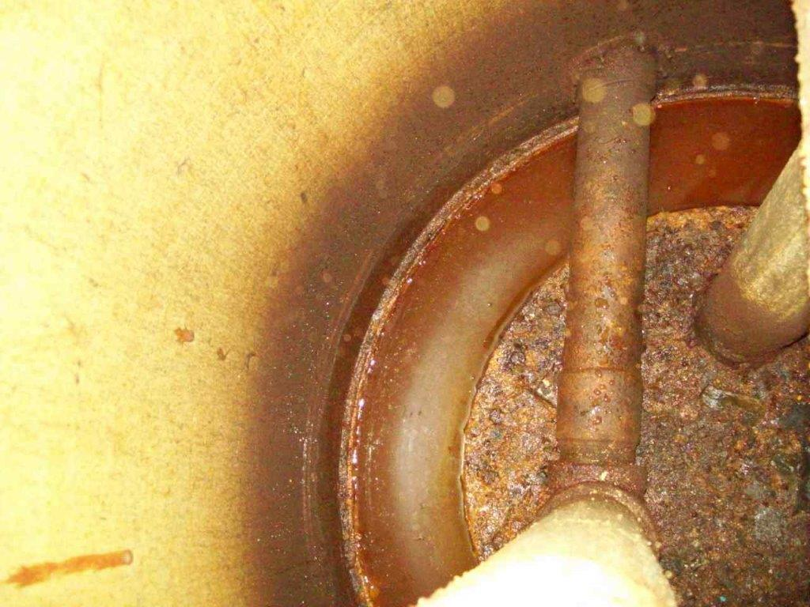
Sealing off Vapor Piping at the Tank
Check your non-gasoline tanks are not manifolded with the gas tanks below grade(at either the vent lines or at the vapor return lines). Gasoline tanks should remain manifolded (if a manifold exists).
Ensure vapor piping has been plugged at the extractor fitting when piping is located at the tank sump and is accessible from grade. If the piping is fiberglass, it may need to be cut.
Vapor return line is connected to the extractor and Should be disconnected and capped .Extractor needs to be plugged

Slide 27
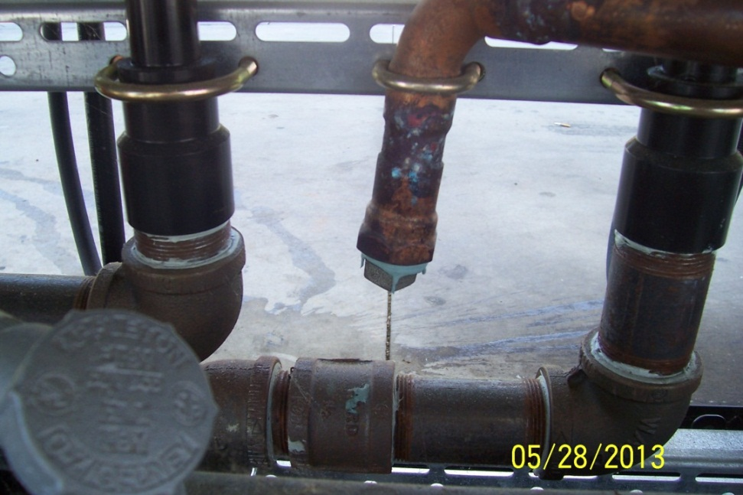
Sealing off dispenser vapor piping
Observe that both ends of the vapor piping inside the dispenser cabinet have been securely capped and sealed.
  Ensure that a rubber cap held in place by a hose clamp is not used to seal the vapor piping.

Slide 28
Stage II Hanging Hardware
Replacing the Stage II nozzle, hoses, and breakaways with conventional equipment is voluntary.
Note: In the absence of the top off decal warning, liquid may collect in the vapor path and may lead to excess fugitive liquid and/or vapor loss from nozzle during normal operation if the Stage II nozzle is not replaced with a conventional nozzle.
If you have chosen to replace the Stage II hanging hardware with conventional, then a compatible adaptor fitting must be used in the coaxial fuel outlet to isolate the vapor path in the piping and to convert the fuel outlet to non vapor recovery.

Slide 29
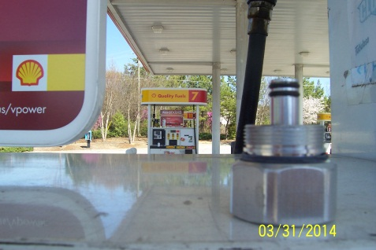
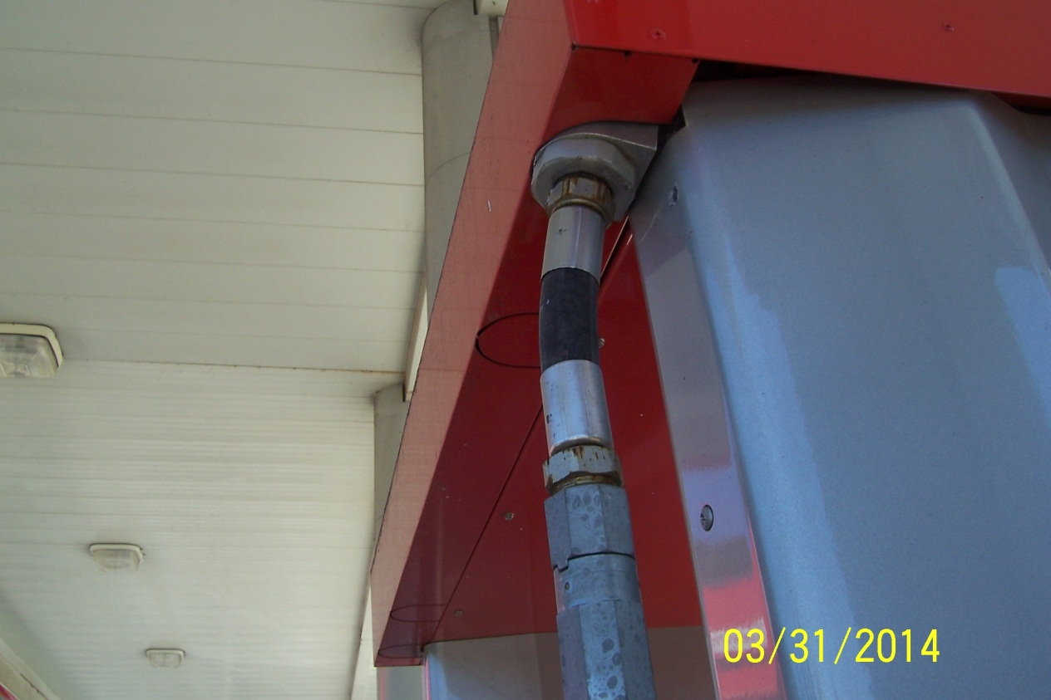
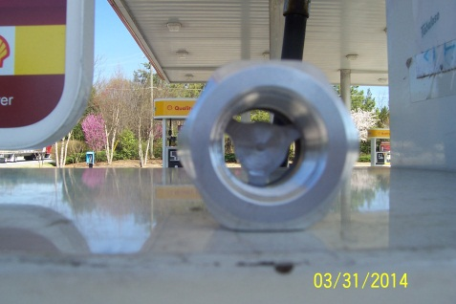
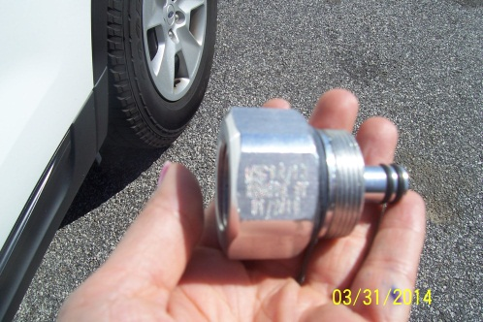
Non-Stage II Hanging Hardware and Adapter
This adapter shown above is for non stage II hanging hardware and cannot be used with Stage II hanging hardware because it has different sizes and different type of threads

Slide 30
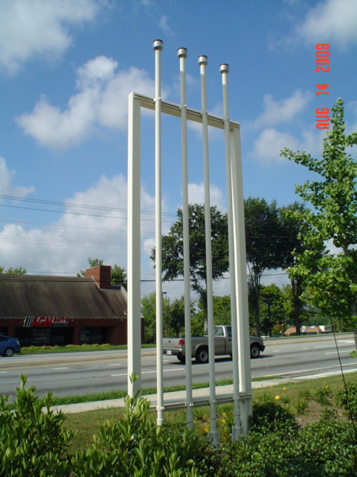
Installation of Pressure/Vacuum Vent Valve
Most, if not all, facilities should already have the required type and numbers of P/V Vent Valves per Stage I EVR Executive Orders (EOs).
Check that no more than three P/V vent valves have been installed in your site.
Photo attached is for a site that has violated the installation requirement per the EVR EOs.
Check that the p/v vent valve of healy system has been removed and capped( see slide #18).

Slide 31
Removal of Stage II Instructions
Ensure that no instructions related to Stage II VRS have been left on dispenser cabinets.

Slide 32
Performing and testing results
Ensure that all required testing has been conducted and that all tests have passed. The tests are required within 30 days of the Stage II system being decommissioned. Tests required include:
  Pressure Decay Test (must be conducted twice – once before and once after the Tie Tank Test
  Tie Tank Test
Read the test results and make sure that all gasoline tanks are manifolded above or below ground, pressure /vacuum vent lines are still functional, and gasoline vapor return lines are not manifold with non-gasoline (diesel) tanks.

Slide 33
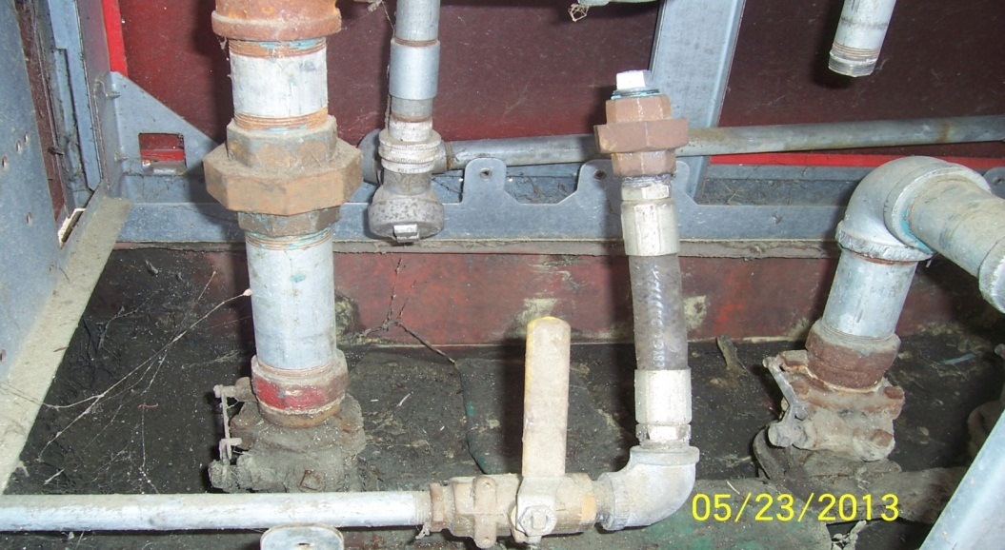
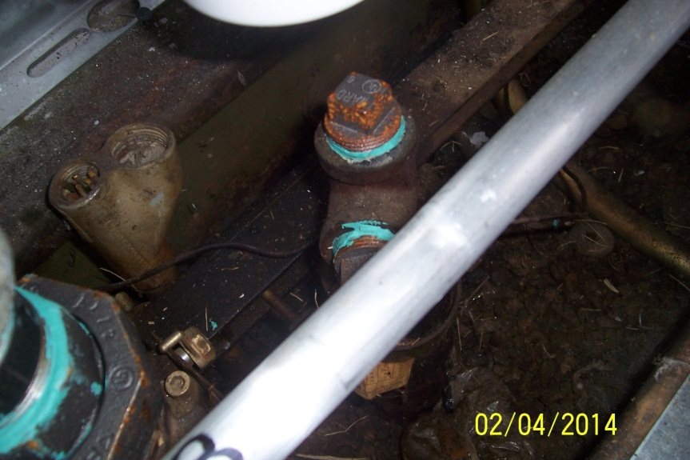
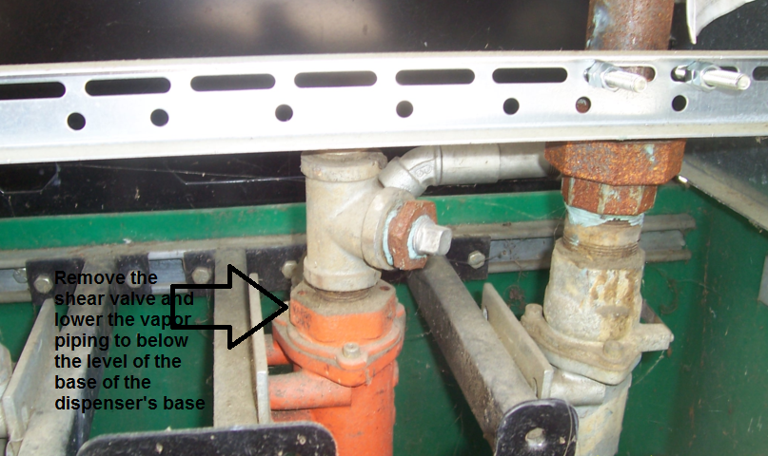
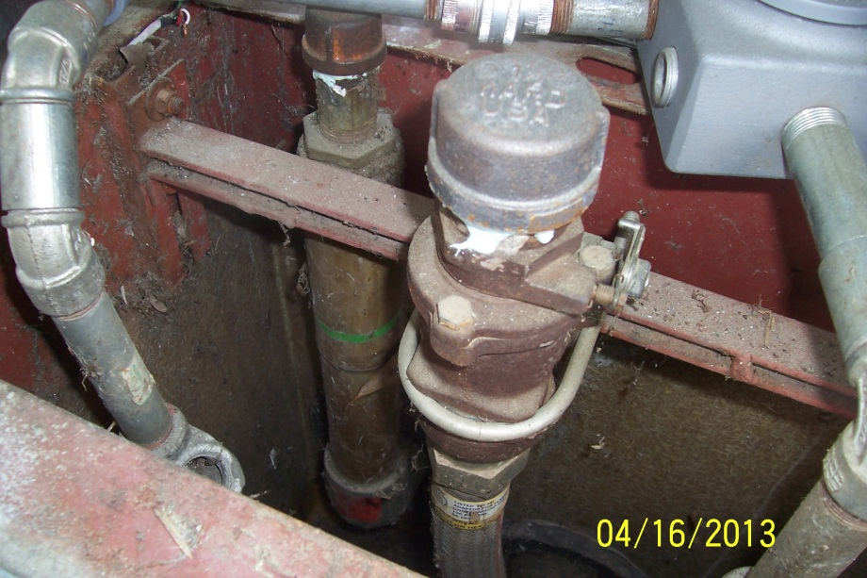
Troubleshooting
Vapor return lines were not sealed off correctly !

Slide 34
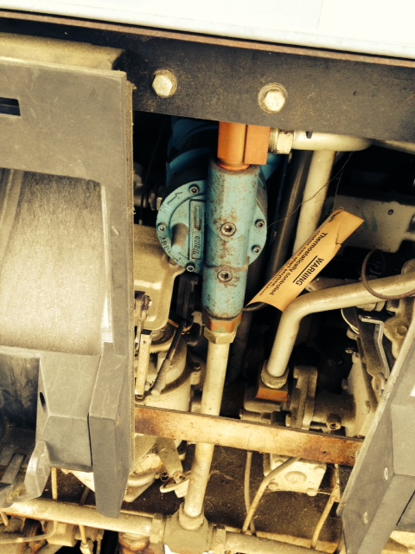
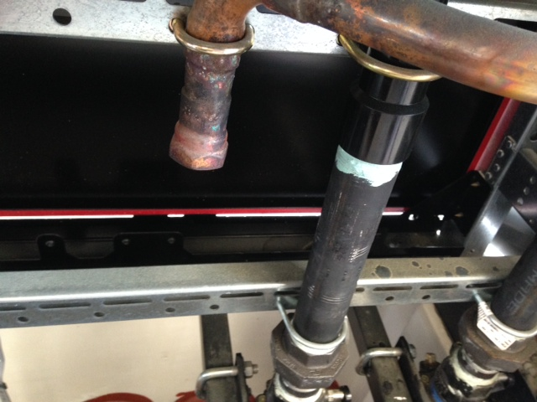
Unplugged Vapor Piping
Dispenser vapor line was unplugged!

Slide 35
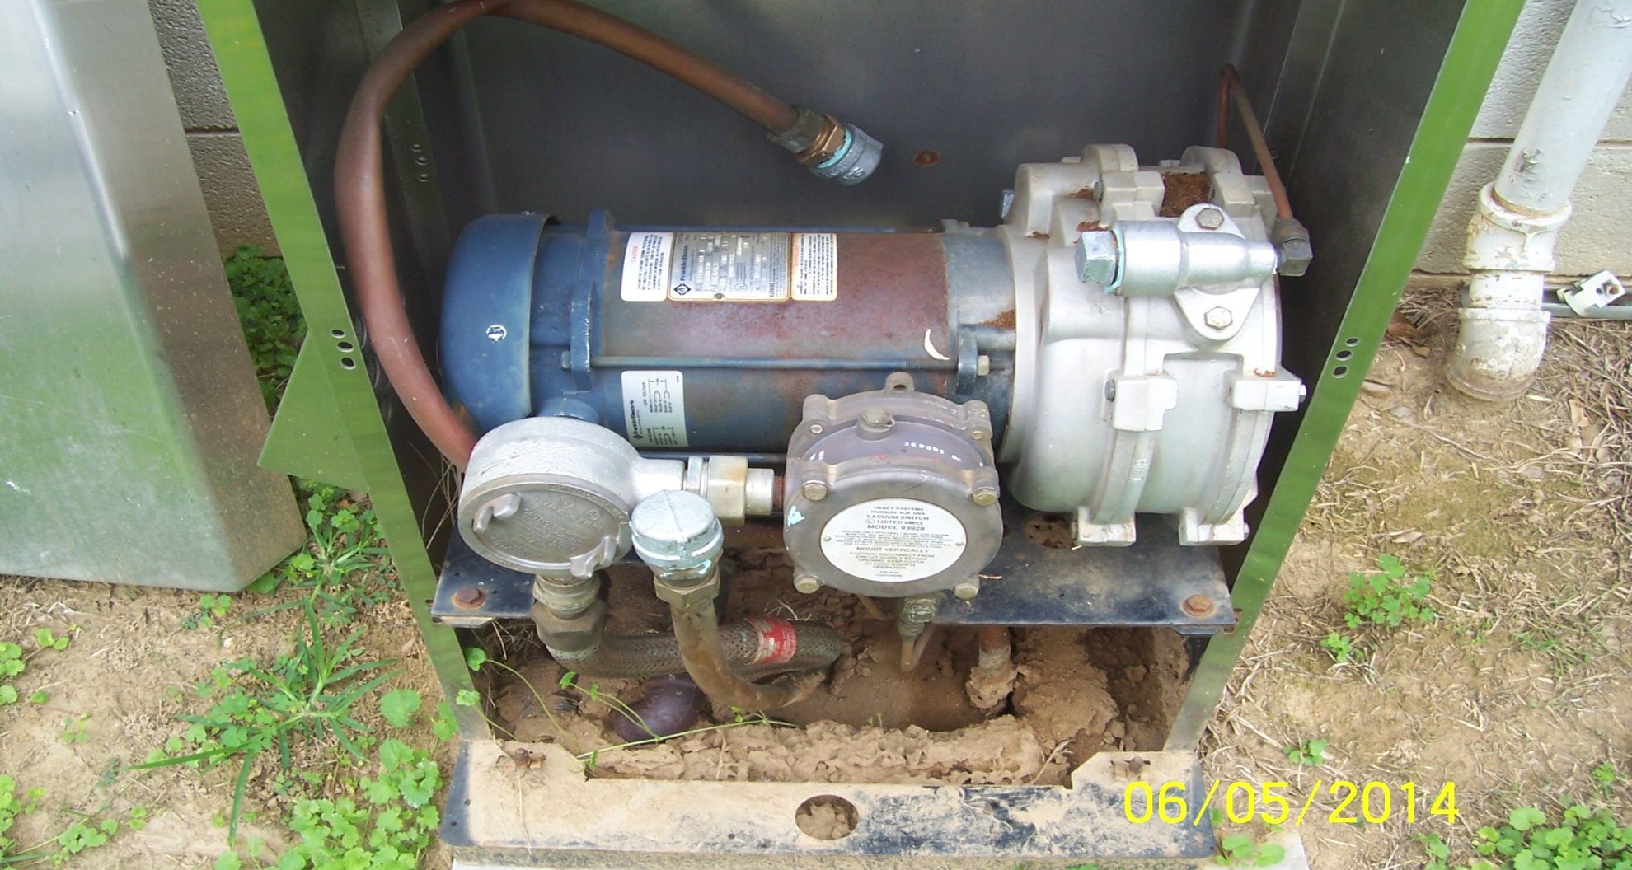
VP 500 Healy Vapor Pump Not Removed and Vapor Return Piping Not Properly Sealed
From the disp. to pump
From the pump to the underground storage tank

Slide 36
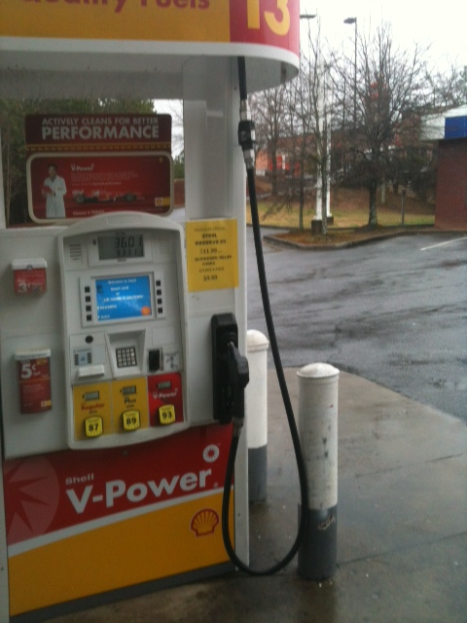
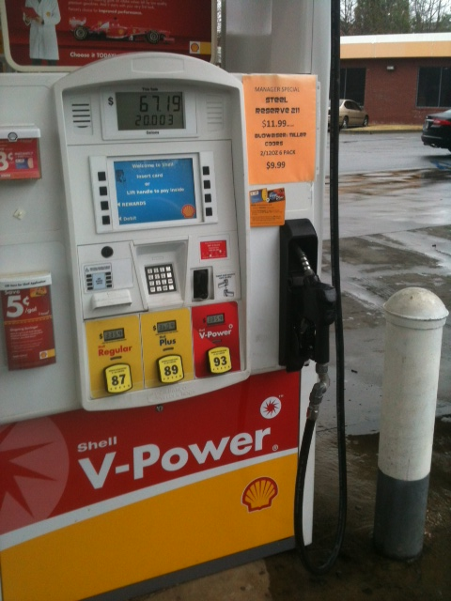
Site Not Fully Decommissioned

Slide 37
Conclusion
Following these procedures should ensure the safe and effective decommissioning of the Stage II Vapor Recovery System.
Decommissioning may begin on May 1, 2014 and must be concluded by April 30, 2016.
Decommissioning must be completed before facility returns to dispensing gasoline.

Slide 38

Questions

