Slide 1
Drought Indicators Report
Georgia Environmental Protection Division
July 2016

Slide 2
Background
Pursuant to the Rules for Drought Management, Section 391-3-3-.04 Drought Indicators and Triggers, the Director of EPD monitors climatic indicators and water supply conditions to assess drought occurrence and severity, and its impact upon the ability of public water systems to provide adequate supplies of water. These indicators and conditions may include, but not be limited, to the following:
U.S. Drought Monitor;
Precipitation;
Streamflow;
Groundwater;
Reservoir levels;
Short term climate predictions;
Soil moisture; and
Water supply conditions.

Slide 3
Background
The Rules require EPD to report on current climatic indicators at least semi-annually or monthly when any part of the state has experienced at least two consecutive months of severe drought.
This reports compare current conditions to historical levels (and/or reservoir rule curves) for each of the following indicators:
  Precipitation during the prior 3, 6, and 12 months;
  Streamflow at the select United States Geological Survey gages;
  Groundwater levels at select United States Geological Survey monitoring wells; and
  Reservoir levels at Allatoona Lake, Lake Hartwell, Clarks Hill Lake, and Lake Lanier.
The following sections of this presentation provide the data and information sources analyzed by EPD in developing this drought indicators report for conditions as of July 11, 2016.

Slide 4
Drought Indicator Analysis Summary (slide 1 of 2)
Drought Monitor - According to the US Drought Monitor, there is severe drought across most of Georgia north of the fall line, while extreme drought now covers some or all of 30 counties in the Atlanta area, northwest Georgia, and northeast Georgia.
Precipitation - 3 month records show considerable deficit, particularly in northwest Georgia and the southern portions of the Atlanta area. 6 month records indicate increasing dryness, while 12 month records show near normal rainfall.
Streamflow - Continuous low flows have been occurring for 5-12 weeks depending on location. Sharp drops in flows occurred in mid-spring and have persisted.
Groundwater – Groundwater levels vary by location and a majority are above median levels. The remainder are below, but near median levels while one is below the 20th percentile and one is below the 10th percentile of the historical record.
Reservoir Levels – A majority of the state’s major reservoirs are experiencing diminishing inflows. Current ACF reservoir levels are tracking near 2011 levels. ACT levels remain near the top of conservation pool, though the reservoir level forecast for Carters Lake indicates decreases. Savannah Basin reservoirs are tracking at or above 2011 levels. Releases are being made in accordance with operational rules.

Slide 5
Drought Indicator Analysis Summary (slide 2 of 2)
Short-term Climate Prediction - The Climate Prediction Center outlook for temperature and precipitation for July-September, 2016 calls for a chance of above normal temperatures and equal chance of normal precipitation for most of the state.
Soil Moisture – Much of the state shows deficits, with the central and northwestern portions of the state experiencing the greatest severity.
Water Supplies – Water systems with their own storage are not reporting issues, while some systems that rely on direct withdrawals from rivers or streams are expressing concern about dropping streamflows. Some systems are implementing voluntary public awareness campaigns and/or utilizing secondary water sources (i.e., purchase agreements). A number of systems report seeing the increased demand often associated with dry conditions.

Slide 6
US Drought Monitor
Data Source:
http://droughtmonitor.unl.edu/

Slide 8
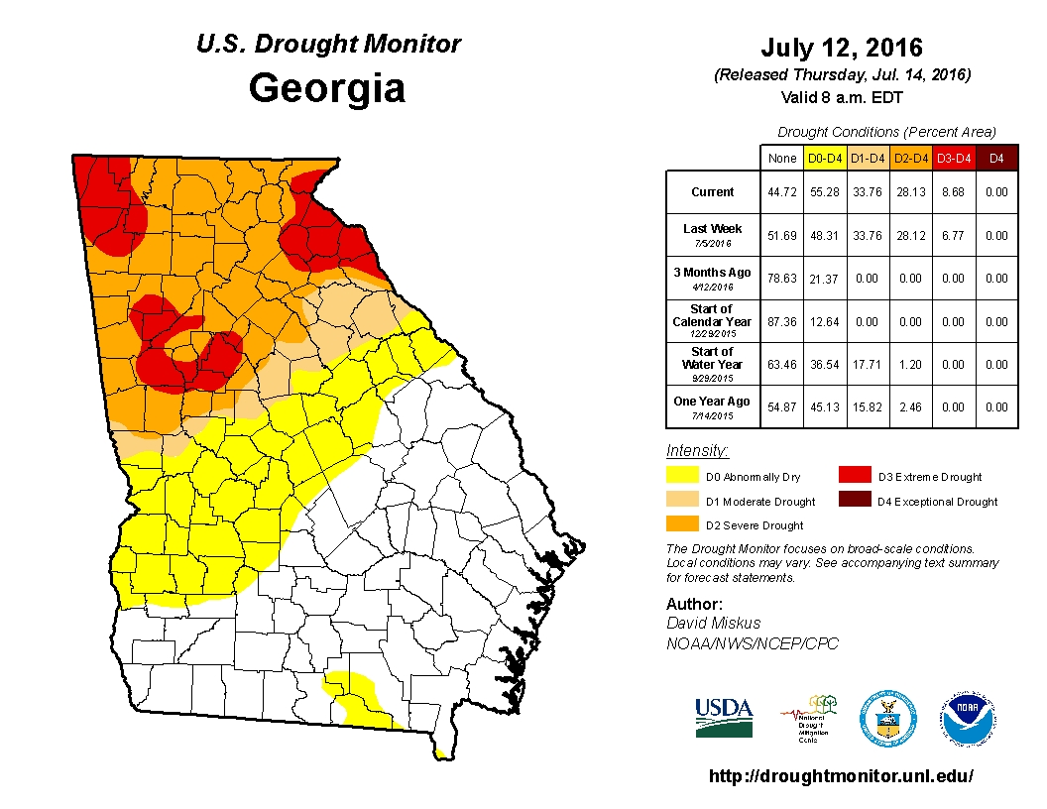

Slide 9
3, 6, and 12 Month
Percent of Normal Precipitation
Data Source:
http://climate.ncsu.edu/drought

Slide 10
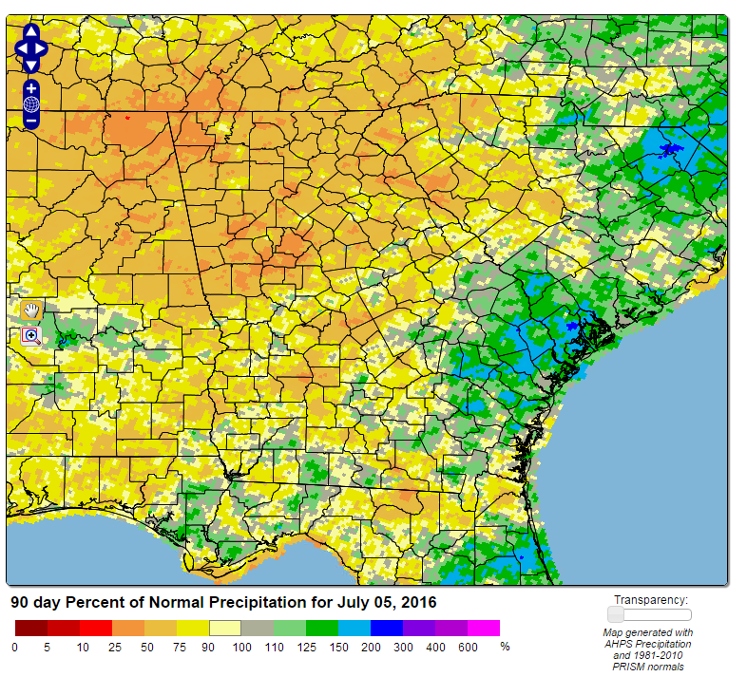
3 Month Percent of Normal Precipitation

Slide 11
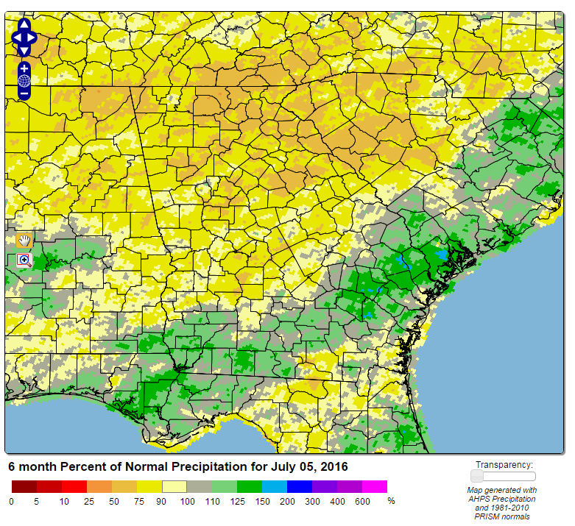
6 Month Percent of Normal Precipitation

Slide 12
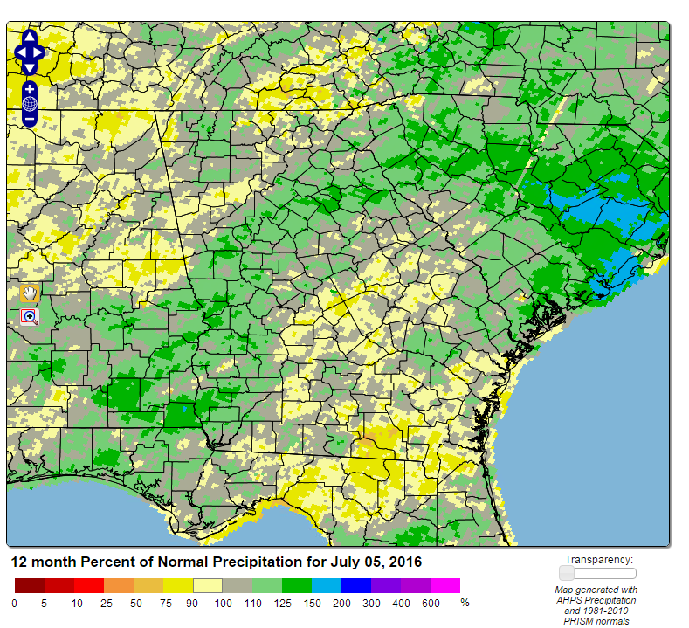
12 Month Percent of Normal Precipitation

Slide 13
Soil Moisture Conditions
Data Source:
http://www.hydro.washington.edu/forecast/monitor/curr/conus.mexico/east.vic.sm_qnt.gif

Slide 14
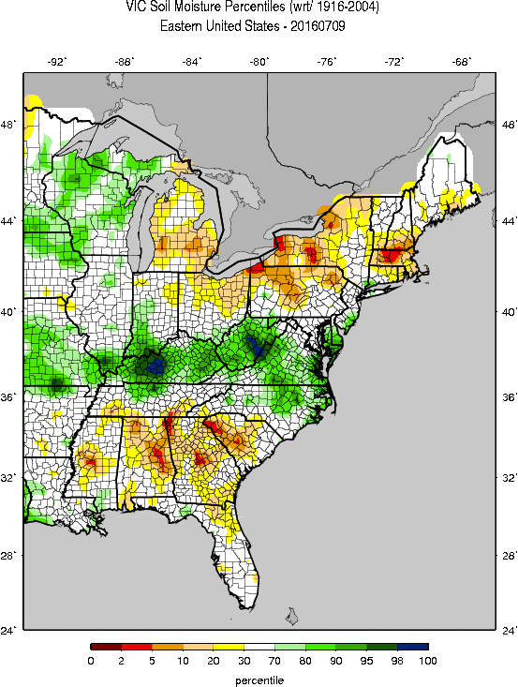
Current (daily updated) percentiles for soil moisture (SWE) with respect to the climatological period (1916-2004).

Slide 15
Streamflow Conditions
Data Source: USGS

Slide 16
Streamflow Monitoring
As shown on the following slide, EPD Monitors 34 USGS stream gages in 13 of the State’s major river basins to assess drought conditions.
These gages were selected because each has:
  Long-term and relatively complete records for recent decades; and
  Relatively low consumptive water use implications and streamflows are not heavily influenced by dams.
Note: Hydrologic conditions of major rivers with streamflows that are heavily influenced by dams can be assessed by reviewing status of major storage reservoirs

Slide 17
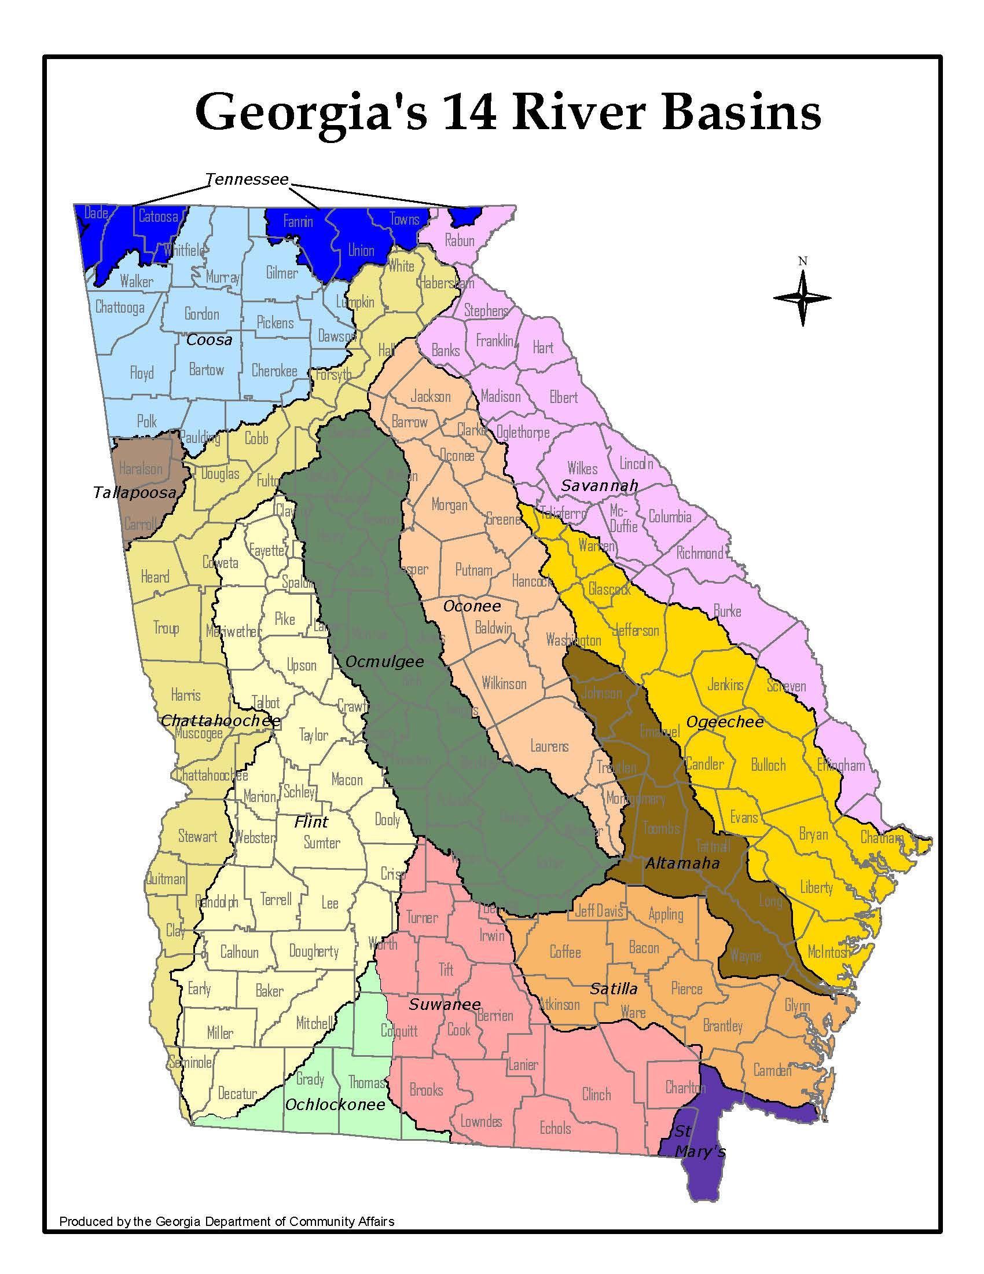
USGS Stream Gages Monitored by EPD to Assess Drought Conditions
1
2
6
22
Gage# Basin Gage Name
1 Tennessee LOOKOUT CREEK NEAR NEW ENGLAND
2 Tennessee NOTTELY RIVER NEAR BLAIRSVILLE
3 Coosa Chattooga River at Summerville
4 Coosa TALKING ROCK CREEK NEAR HINTON
5 Coosa Etowah River at Canton
6 Chattahoochee Chattahoochee River at Cornelia
7 Chattahoochee Chestatee River near Dahlonega
8 Chattahoochee New River at GA 100 NEAR CORINTH
9 Chattahoochee Upatoi Creek at Columbus
10 Flint Flint River at GA26 near Montezuma
11 Flint Flint River at Albany
12 Flint Ichawaynochaway Creek at Milford
13 Flint Spring Creek near Iron City
14 Ocmulgee ALCOVY RIVER ABOVE COVINGTON
15 Ocmulgee Ocmulgee River at Macon
16 Ocmulgee TOBESOFKEE CREEK NEAR MACON
17 Ocmulgee TUCSAWHATCHEE CREEK NEAR HAWKINSVILLE
18 Oconee MIDDLE OCONEE RIVER NEAR ATHENS
19 Oconee LITTLE RIVER NEAR EATONTON
20 Oconee Oconee River at Dublin
21 Altamaha OHOOPEE RIVER NEAR REIDSVILLE
22 Savannah CHATTOOGA RIVER NEAR CLAYTON
23 Savannah Broad River near Bell
24 Savannah BEAVERDAM CREEK NEAR SARDIS
25 Savannah BRIER CREEK AT MILLHAVEN
26 Ogeechee CANOOCHEE RIVER NEAR CLAXTON
27 Ogeechee Ogeechee River near Eden
28 Ochlockonee OCHLOCKONEE RIVER NEAR THOMASVILLE
29 Suwanee Withlacoochee River near Pinetta FL
30 Suwanee Alapaha River at Statenville
31 Suwanee SUWANNEE RIVER AT US 441, AT FARGO
32 Satilla Satilla River near Waycross
33 Satilla LITTLE SATILLA RIVER NEAR OFFERMAN
34 St Mary ST MARYS RIVER NEAR MACCLENNY FL
3
4
7
5
14
18
23
8
19
15
24
25
16
9
20
10
17
26
21
27
11
12
33
32
13
28
30
31
29
34

Slide 18
Streamflow Graphs
For each of the 34 gages, EPD has prepared a graph that shows monthly average streamflow from January 1, 2016 through June 30, 2016;
To help put these streamflow conditions into perspective, for comparison purposes, each graph also shows:
  Monthly average streamflows for the years 2007 and 2011 when streamflows were at or near recorded low levels across much of the state; and
  A statistical composite of historical conditions showing the “driest” 50, 20, 10, and 5 percent of all recorded monthly average stream flows at the same gage.

Slide 19
How to Read the Streamflow Graphs
Example #1: Etowah River at Canton
The streamflow graph for Gage #5, USGS Etowah River gage at Canton shows :
  Average stream flow for June 2016 was 565 cfs. The statistical composite of all historical data for this gage shows that average streamflow in June has historically been lower than June 2016 about 20% of the time; about 80% of the time in June it has been higher.
  Average stream flow in June 2011 was 459 cfs. The statistical composite of all historical data for this gage shows that average streamflow for June has historically been lower than June 2011 only 10% of the time; 90% of the time in June it has been higher.
  Average stream flow in June 2007 was 359 cfs. The statistical composite of all historical data for this gage shows that average streamflow for June has historically been lower than June 2007 only 5% of the time; 95% of the time in May it has been higher.
  The lowest recorded average stream flow for June was 263 cfs.

Slide 20
How to Read the Streamflow Graphs
Example #2: Flint River at Albany
The streamflow graph for Gage #11, USGS Flint River gage at Albany shows:
  Average stream flow for June 2016 was 1834 cfs. The statistical composite of all historical data for this gage shows that average streamflow in June has historically been lower than June 2016 about 20% of the time; about 80% of the time in June it has been higher.
  Average stream flow in June 2011 was 759 cfs. The statistical composite of all historical data for this gage shows that average streamflow for June equal to the historically lowest recorded average stream flow for June.
  Average stream flow in June 2007 was 1045 cfs. The statistical composite of all historical data for this gage shows that average streamflow for June has historically been lower than June 2007 only 5% of the time; 95% of the time in June it has been higher.

Slide 21
Back to Map

Slide 22
Back to Map

Slide 23
Back to Map

Slide 24
Back to Map

Slide 25
Back to Interpretation
Back to Map

Slide 26
Back to Map

Slide 27
Back to Map

Slide 28
Back to Map

Slide 29
Back to Map

Slide 30
Back to Map

Slide 31
Back to Interpretation
Back to Map

Slide 32
Back to Map

Slide 33
Back to Map

Slide 34
Back to Map

Slide 35
Back to Map

Slide 36
Back to Map

Slide 37
Back to Map

Slide 38
Back to Map

Slide 39
Back to Map

Slide 40
Back to Map

Slide 41
Back to Map

Slide 42
Back to Map

Slide 43
Back to Map

Slide 44
Back to Map

Slide 45
Back to Map

Slide 46
Back to Map

Slide 47
Back to Map

Slide 48
Back to Map

Slide 49
Back to Map

Slide 50
Back to Map

Slide 51
Back to Map

Slide 52
Back to Map

Slide 53
Back to Map

Slide 54
Back to Map

Slide 55
Groundwater Levels
Data Source: USGS

Slide 56
Rationale for Choosing USGS Monitoring Wells
EPD monitors 14 groundwater USGS monitoring wells shown on the following slide to assess drought conditions. These wells were selected for monitoring because they have:
Long-term monitoring records consisting of three decades or more of data; and
Real-time monitoring that represents the most up-to-date conditions.

Slide 57
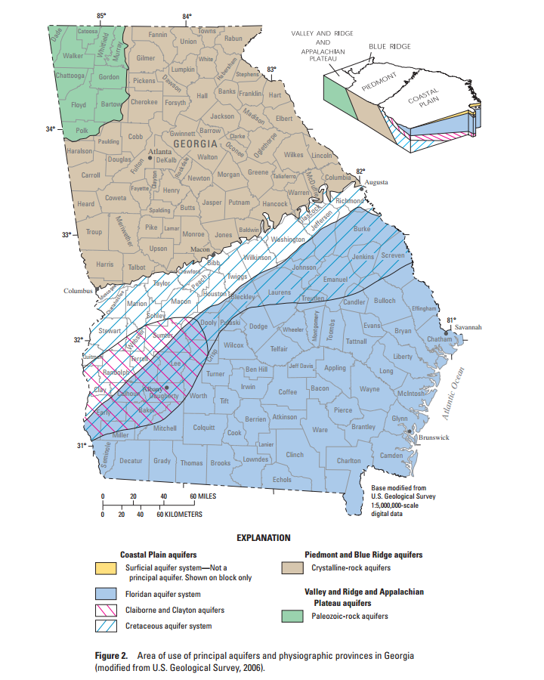
USGS Wells Monitored by EPD to Assess Drought Conditions
  Flint Basin
  1. 11AA01
  3. 13L180
  4. 12M017
  5. 08K001
  6. 11K003
  7. 12K014
  8. 13J004
  9. 08G001
  10. 10G313
  11. 09F520
  Oconee Basin
  12. 21T001
  Altamaha Basin
  13. 26R001
  Savannah Basin
  2. 30AA04
  Suwanee Basin
  14. 19E009
1
2
12
13
3
4
5
6
7
8
9
10
11
14

Slide 58
Groundwater Level Graphs
For each of the 14 groundwater wells, EPD has prepared a graph that shows monthly average groundwater levels from January 1, 2016 through June 30, 2016;
To help put these levels into perspective, for comparison purposes, each graph also shows:
  Monthly average levels at that same well for the years 2007 and 2011 when groundwater levels were at or near recorded low levels across much of the state; and
  And a statistical composite of historical conditions at that same gage showing the “lowest” 50, 20, 10, and 5 percent of all recorded monthly average levels at the same well.

Slide 59
How to Read the Groundwater Level Graphs
Example: Well #11, 09F520, Flint River Basin
The groundwater level graph for Well #11, USGS 09F520 shows:
  The average monthly groundwater level for June 2016 was 44ft below land surface. The statistical composite of all historical data for this well shows that monthly average groundwater levels in June have historically been lower than June 2016 about 50% of the time; about 50% of the time in June they have been higher.
  The average monthly groundwater level in June 2011 was 54ft below land surface. The statistical composite of all historical data for this well shows that average monthly groundwater elevation levels for June equal to the historically lowest recorded average elevation for June.
  The average monthly groundwater level in June 2007 was 53ft below land surface. The statistical composite of all historical data for this well shows that average monthly groundwater elevation levels for June have historically been lower than June 2011 only 5% of the time; 95% of the time in June they have been higher.
  The lowest recorded average monthly groundwater level for June was 54ft below land surface.

Slide 60
Back to Map

Slide 61
Back to Map
Notes:
30AA004

Slide 62
Back to Map
Notes:
30AA004

Slide 63
Back to Map

Slide 64
Back to Map

Slide 65
Back to Map

Slide 66
Back to Map

Slide 67
Back to Map

Slide 68
Back to Map

Slide 69
Back to Map

Slide 70
Back to Interpretation
Back to Map

Slide 71
Back to Map

Slide 72
Back to Map

Slide 73
Back to Map

Slide 74
Reservoir Levels
Data Source:
US Army Corps of Engineers

Slide 75
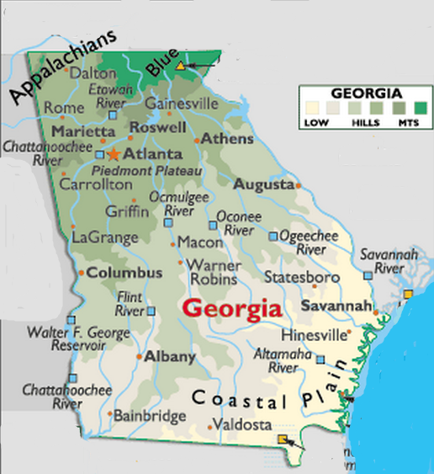
Coosa Basin
1. Carters
2. Allatoona
Chattahoochee Basin
3. Lanier
4. West Point
5. W.F. George
Savannah Basin
6. Hartwell
7. Thurmond
1
2
3
6
7
4
5
EPD monitors the water levels of seven reservoirs to assess drought conditions.

Slide 76
Reservoir Elevation Graphs
The following graphs show the reservoir elevation curves for January 1, 2015 through June 30, 2016.
Each graph also shows the Action Zone Divides (or Levels) for each reservoir
  Zone 1 is the top layer of the conservation pool
  Zone 2 is the layer below Zone 1
  Zone 4 is the lowest layer in the conservation pool
  There is no conservation storage below the bottom of Zone 4
To put 2016 reservoir elevations into perspective, elevations for 2007 and 2011 are also shown.

Slide 77
Back to Map

Slide 78
Back to Map

Slide 79
Zone 1
Zone 2
Zone 3
Zone 4
Back to Map

Slide 80
Zone 1
Zone 2
Zone 3
Zone 4
Back to Map

Slide 81
Zone 1
Zone 2
Zone 3
Zone 4
Back to Map

Slide 82
Level 1
Level 2
Level 3
Level 4
Back to Map

Slide 83
Level 1
Level 2
Level 3
Level 4
Back to Map

Slide 84
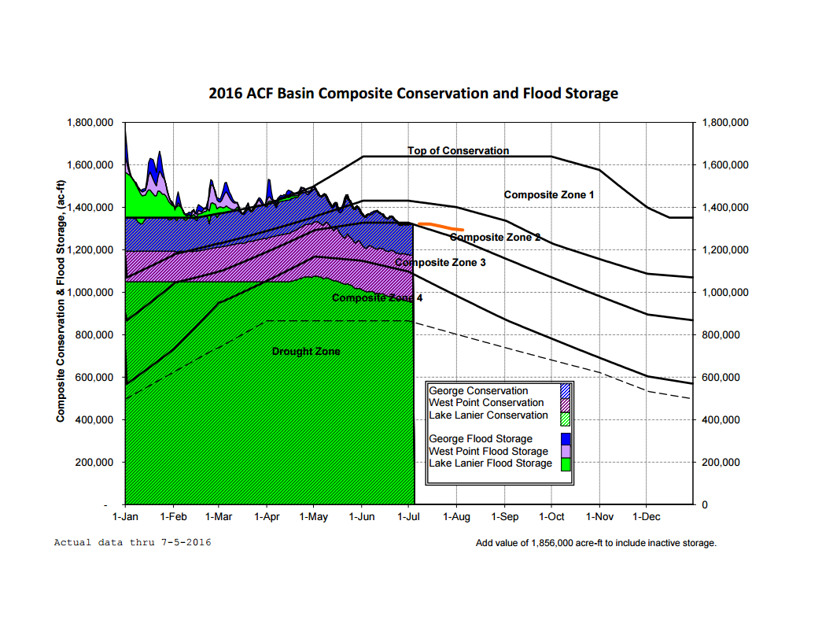
Compiled by US Corp.

Slide 85
Climate Prediction Center
3-month Temperature and Precipitation Probability Outlook and Seasonal Drought Outlook
Data Source:
http://www.cpc.ncep.noaa.gov/

Slide 86
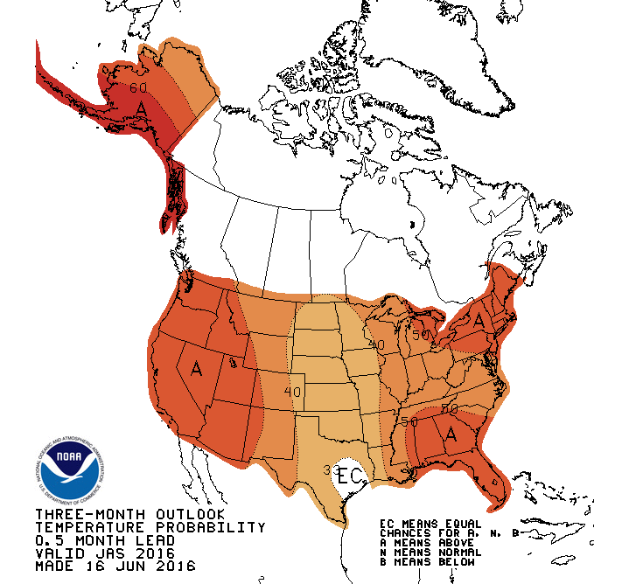
Temperature Outlook
The Climate Prediction Center 3-month temperature probability outlook for July-September 2016 calls for a 50% chance of above normal temperatures in the whole state.

Slide 87
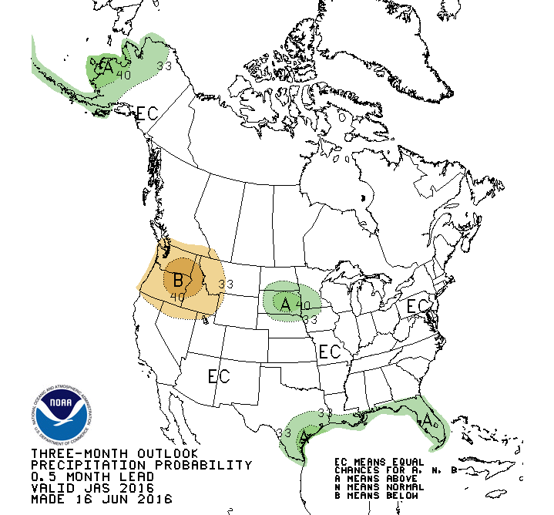
Precipitation Outlook
For July-September 2016, the outlook calls for an equal chance of above or below normal precipitation in the whole state.

Slide 88
