Slide 1
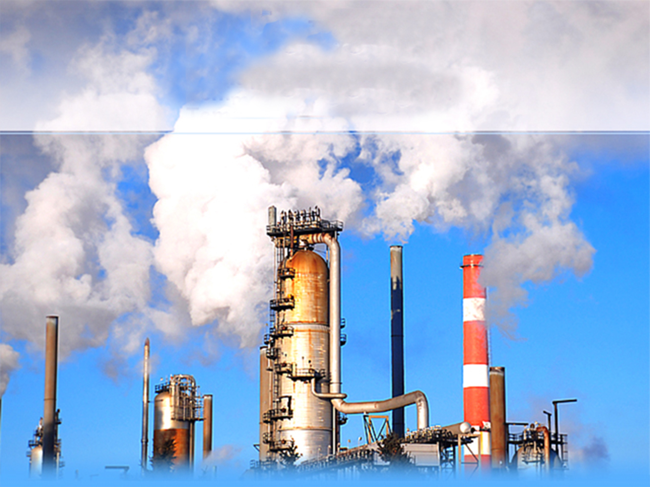
OPACITY
QUALITY ASSURANCE, LEGAL PERSPECTIVE AND METHODS
Bob Scott

Slide 2
OPACITY
QUALITY ASSURANCE AND LEGAL PERSPECTIVE
DOCS II - Digital Opacity Compliance System II
FORMS & DOCUMENTATION
METHOD 9 - (METHODS 203A, B, C)
METHOD 22 - Subpart Dc Boilers
SLIDE PRESENTATION
SUBPART OOO
SUPART UU
AIR CURTAIN DESTRUCTORS

Slide 3
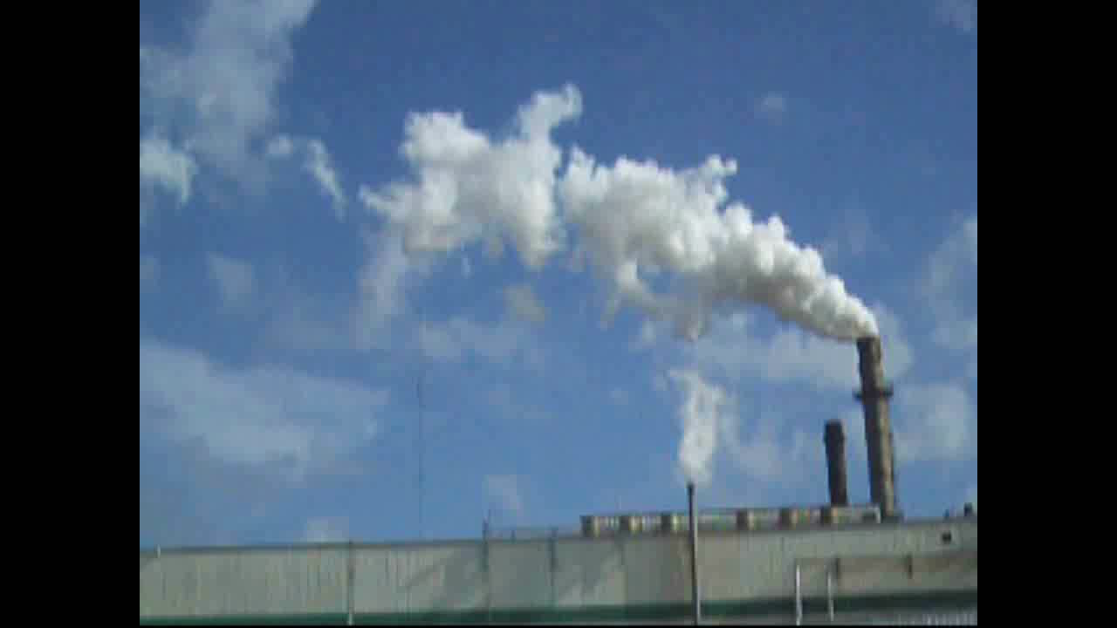

Slide 4
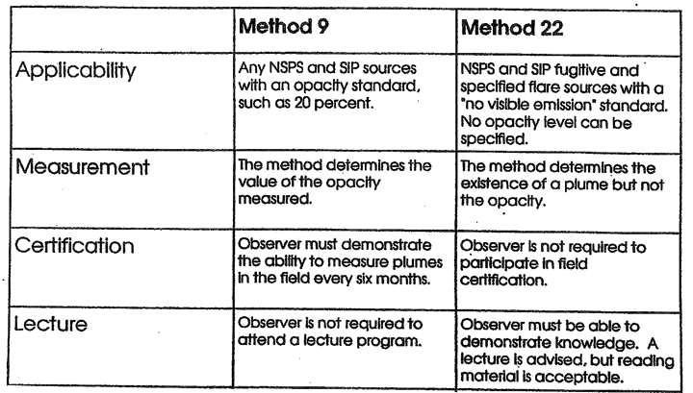
Comparison of Method 9 and 22

Slide 5
Comparison of Method 9 and 22
 | METHOD 9 | METHOD 22
Distance From Source | No distance is specified, but the observer must have a clear view of the emissions. | From 15 feet to 0.25 mile.
Viewing Angle | Observer views the plume from a position that minimizes the line of slight through the plume to minimize positive bias. | Observer simply observes the plume.
Light Source | The sun is implied as the light source and it is required to be at the observer’s back. | Light sources other than the sun are acceptable but must be documented. The light must be at least 100 lux. But, it is not required to be at the observer’s back
Viewing Times | Momentary observation every 15 seconds for a period determined by the standard. Each observation is recorded. | Continuous viewing with observer rest breaks every 15 to 20 minutes. The observer times the emissions with a stopwatch and records the duration of emissions.

Slide 6

Digital Opacity Compliance System II (DOCS II)
DOCS II aligns with most aspects of Method 9:
  Smoke school certification
  Certification records
DOCS II certified to ASTM 7520-09 method
DOCS II can be applied as an equivalent to Method 9
DOCS II can be used as a field data acquisition support tool in conjunction with traditional human observations
DOCS II sets a new standard for Credible Evidence in the Visible Emissions measurement.
(USAF) Field validation study:
www.serdp.org/content/download/5888/80446/file/SI-0119-FR.pdf

Slide 7
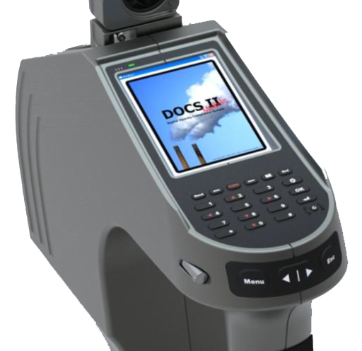
Handheld Real Time Climatic Sensor
Handheld Data Collection Device for DOCS II Application
  One Device Collects all Required Data
  Error-Free Automated Data Collection
Integrated Weather Meter, GPS, Rangefinder, & Camera
  Measures all Required Report Data: Weather Conditions, Wind Speed, Wind Direction, Temperature & Humidity
  GPS Position Location, Sun Position, & Time
  Distance to Target Missions Source
  Digital Images of Visual Emissions & Source
Creates Digital Reports in the Selected Format
Only Works as an Upgrade with PC based DOCS II

Slide 9
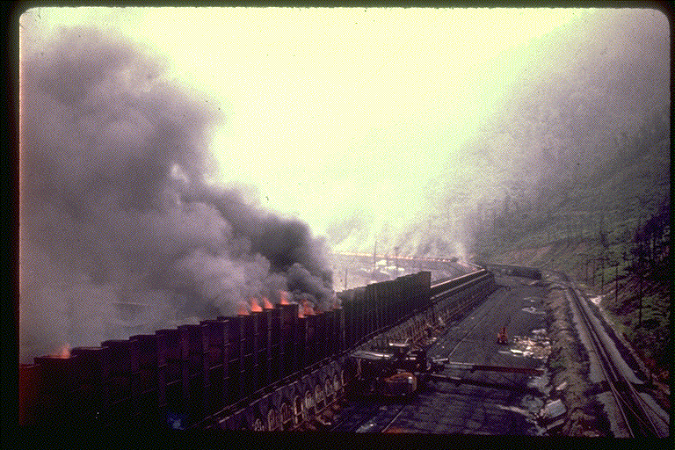
LEGAL ASPECTS OF VISIBLE EMISSIONS

Slide 10

LEGAL ASPECTS
WHO IS AN EXPERT?
Has Special Knowledge or Talent (i.e.., SMOKE SCHOOL)
May Testify As To His Opinions or Conclusions Based Upon Training and Experience.

Slide 11
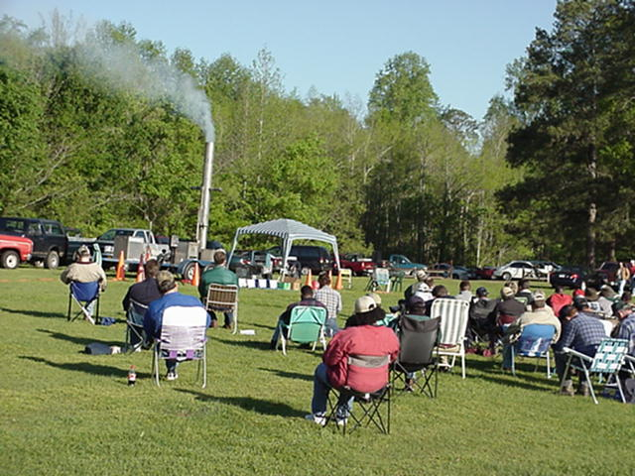
LEGAL ASPECTS
BECOMING AN EXPERT WITNESS
ATTENDING a Course Such as this One.
Successfully PASSING a Test.
Successfully COMPLETING the Required Observations with the Required Proficiency.

Slide 12

LEGAL ASPECTS
ATTEND LECTURE, PASS TEST, PASS FIELD WORK...
...AND YOU’RE
AN EXPERT!!!

Slide 13

LEGAL ASPECTS
EXPERT WITNESS’ COMPETENCY
If there is a question of the witness’ qualifications, it will reflect on the WEIGHT that is given his testimony, NOT on admissibility of his testimony.

Slide 14


LEGAL ASPECTS
On the Witness Stand
IMPORTANT TO LIMIT YOUR OPINIONS TO YOUR AREA OF EXPERTISE.
AN EXPERT (FOR OUR PURPOSES) MAY NOT TESTIFY AS TO CONCLUSIONS OF LAW (i.e.., WHETHER OR NOT AN OBSERVATION INDICATES A VIOLATION OF A STATUTE OR REGULATION)
HOWEVER, ONE COULD TESTIFY THAT AN OBSERVATION INDICATES AN OPACITY OF 10%, 20%, 50%, etc....

Slide 15
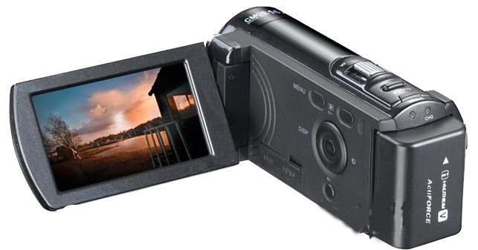
LEGAL ASPECTS
Filming
May Not Be Used as Evidence of Shade of the Plume or background.
Useful To Depict Distances and Locations (Position).
Have Complete Record of the Chain of Custody Film and Photos.
Make Sure You Know Camera and Film Data and Settings.
Make Sure You Know Which Facility Processes Your Have Photographed.

Slide 16
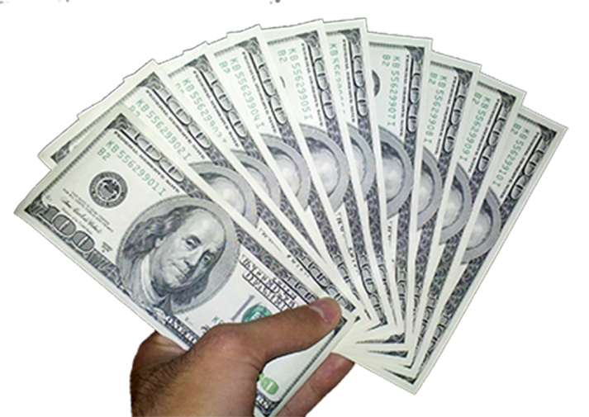

LEGAL ASPECTS
      VIOLATIONS
$100 PER day
PER Violation
$25,000 PER day
PER Violation

Slide 17

LEGAL ASPECTS
UP TO $250,000
IN ANY ONE ORDER

Slide 18

LEGAL ASPECTS
UP TO 1 YEAR IN COUNTY JAIL

Slide 19
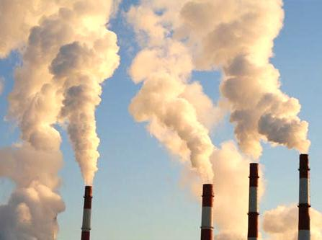
PLUME BEHAVIOR
Attached
Detached
Acid

Slide 20
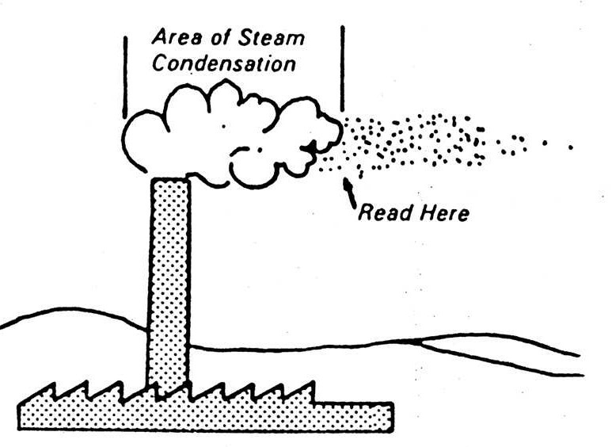
Attached steam plume
Read Here

Slide 21
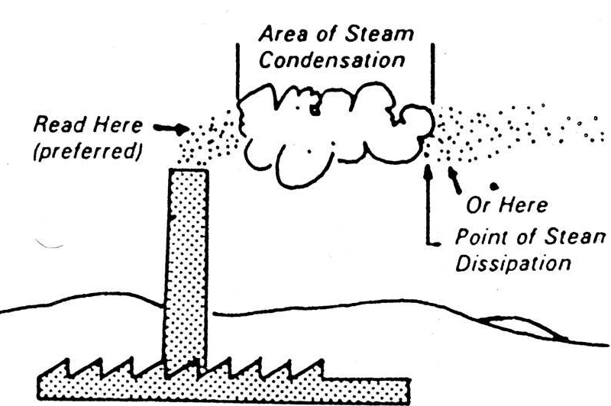
Detached steam plume
In rare cases, it may be necessary to make readings at the point of steam dissipation if the plume is more opaque at that point.
Read Here
(Preferred)
Read Here
(preferred)
Or Read Here
Point of Steam Dissipation

Slide 22
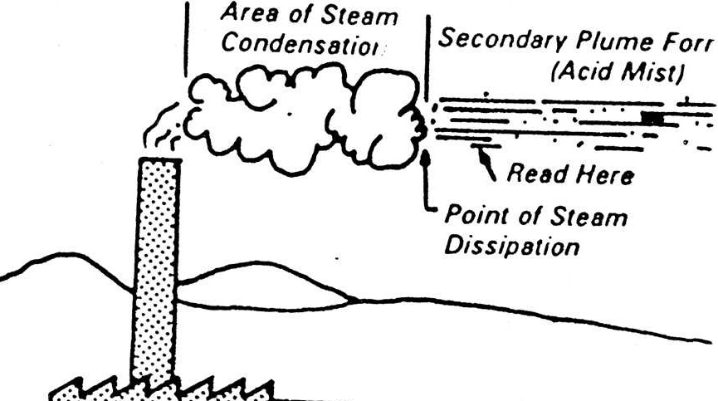
Acid plume
Below is a plume from a sulfuric acid plant with a detached steam plume. Plume is clear at the stack exit. Secondary acid mist is formed in area of steam condensation.
Read Here
Read Here
Point of Steam Dissipation

Slide 23
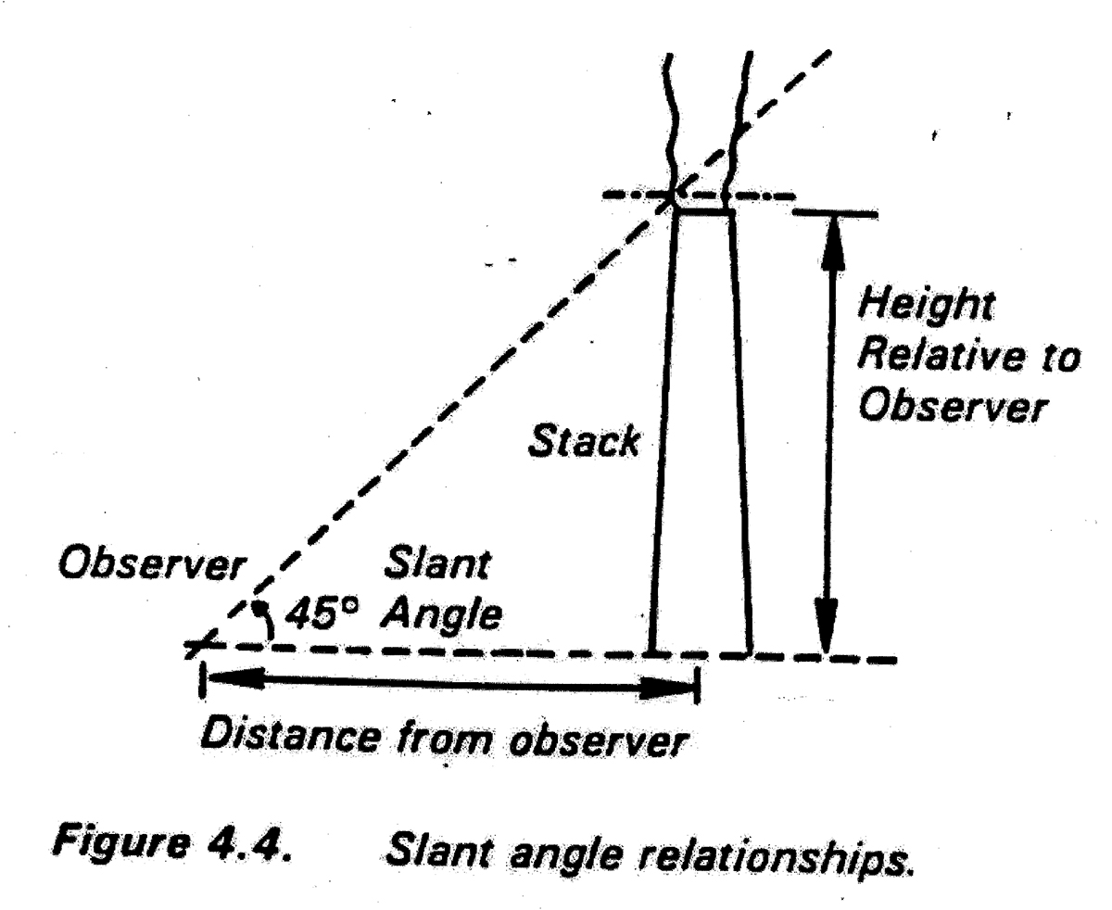
Slant Angle

Slide 24
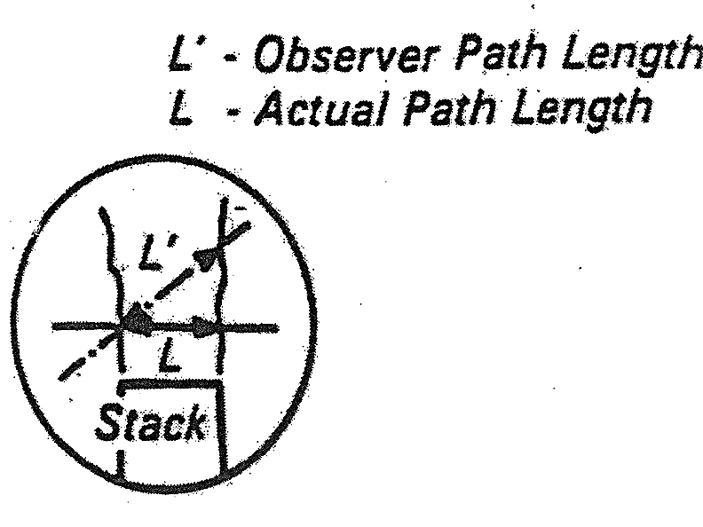
L Prime

Slide 25
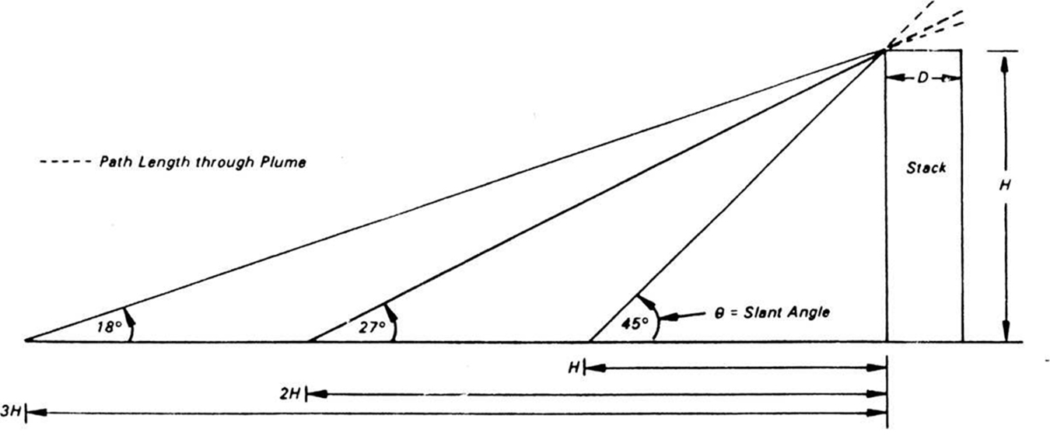
Slant angle accuracy
Variation of observation angle and path length with distance from an elevated source.

Slide 26
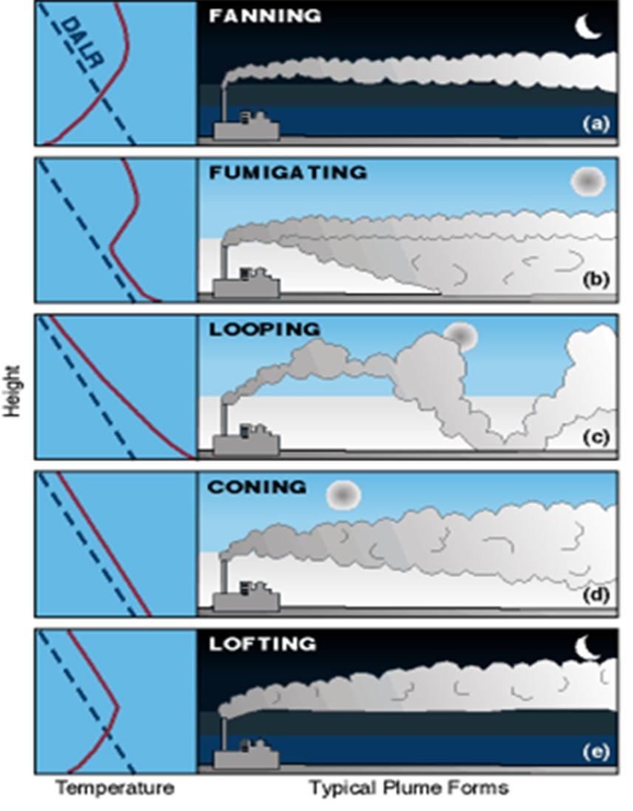
Typical Plumes

Slide 27
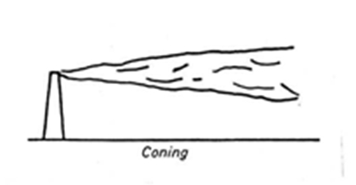
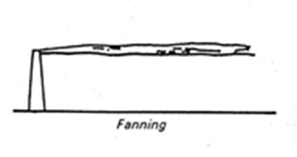
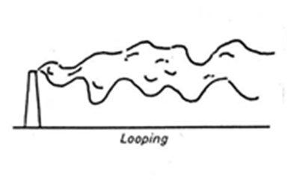
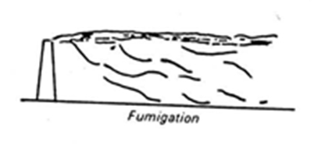
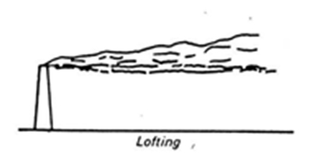
Plume Graphics

Slide 28
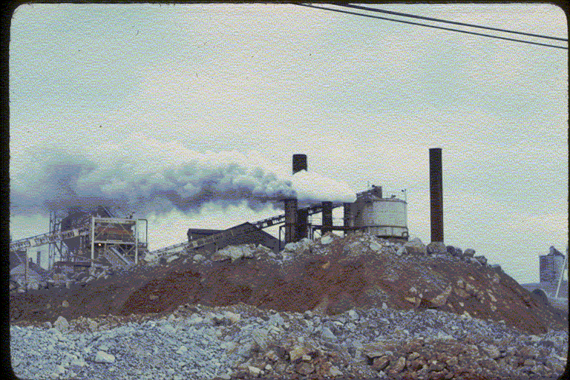
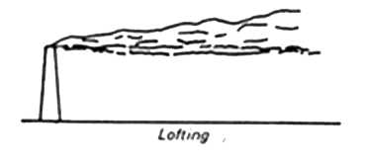
Lofting
LOFTING
Notes:
FUMIGATING PLUME

Slide 29
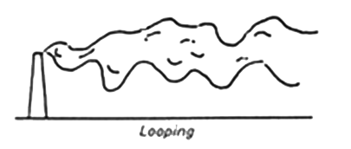
Looping 2

Slide 30
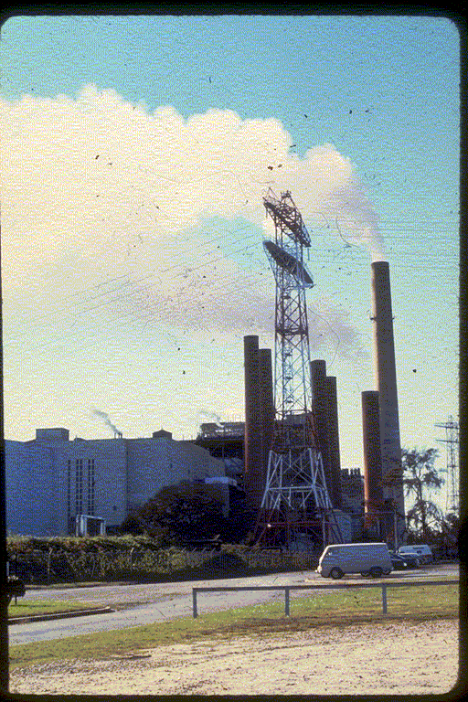
Coning

Slide 31
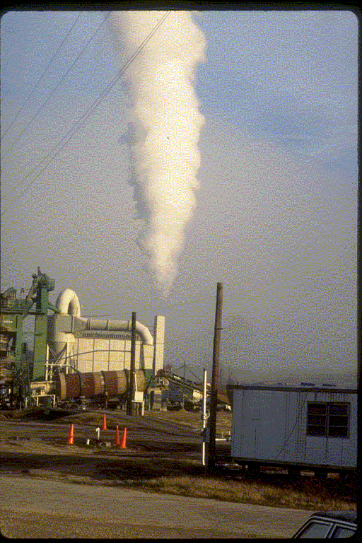
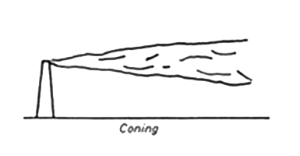
Coning detached
Coning

Slide 32
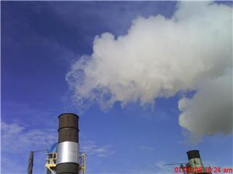
Detached Plume 3

Slide 33
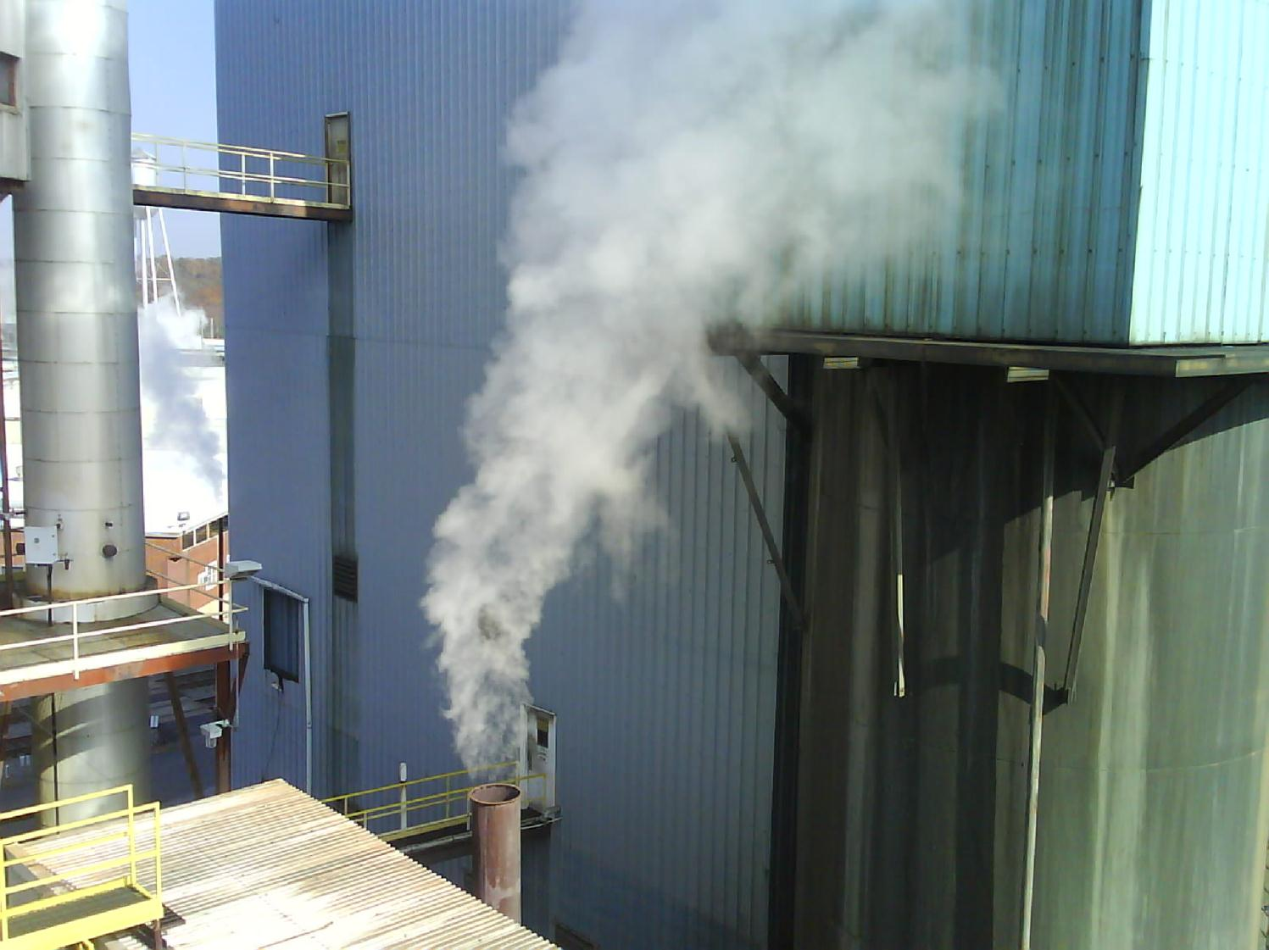
Attached Steam Plume

Slide 34
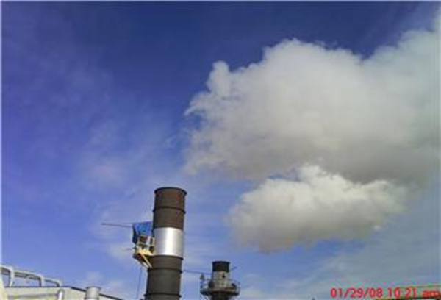
Detached Steam Plume 4

Slide 35
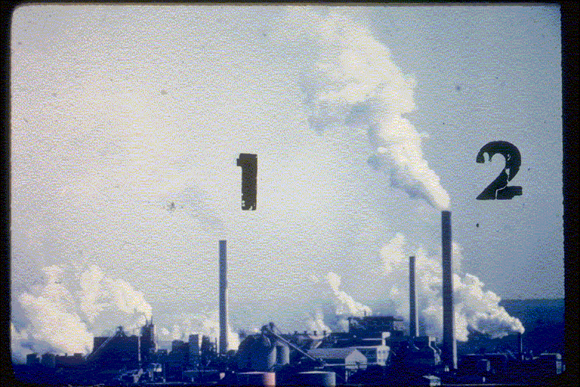
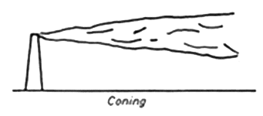
Coning 3

Slide 36
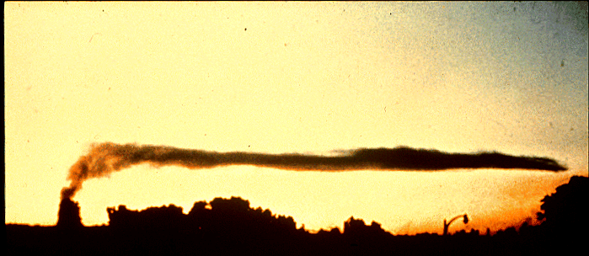
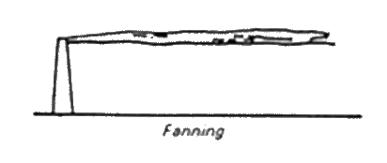
Fanning

Slide 37
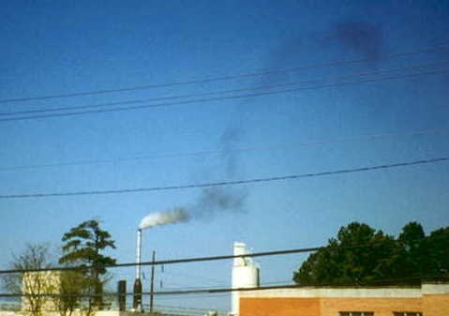

Slide 38
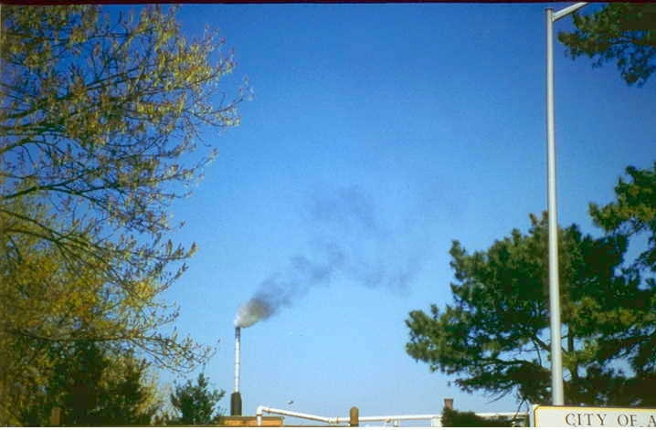

Slide 39
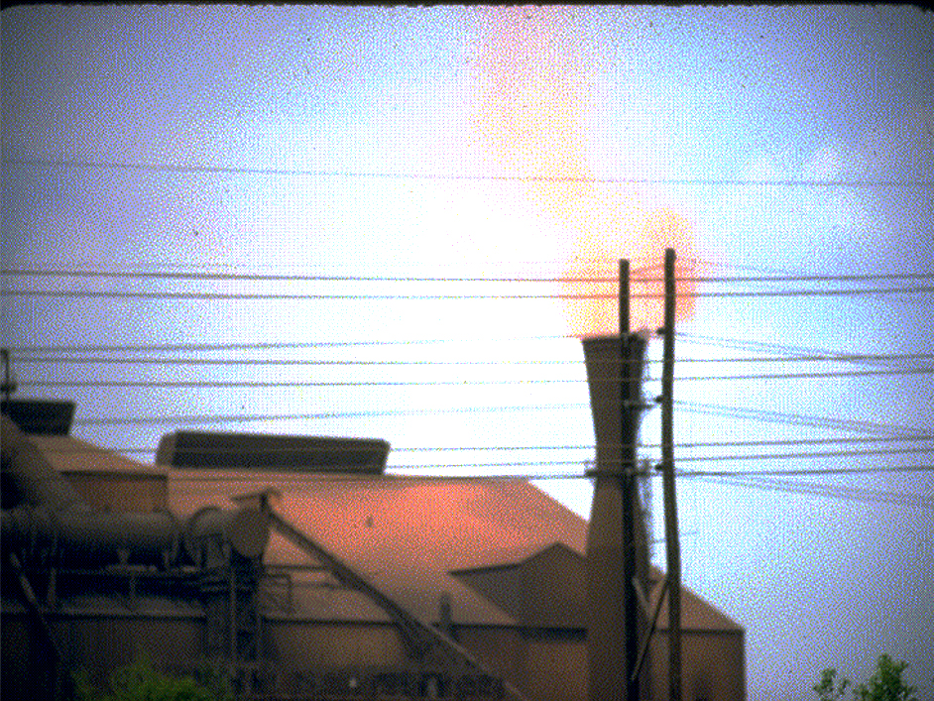
Steel Production

Slide 40
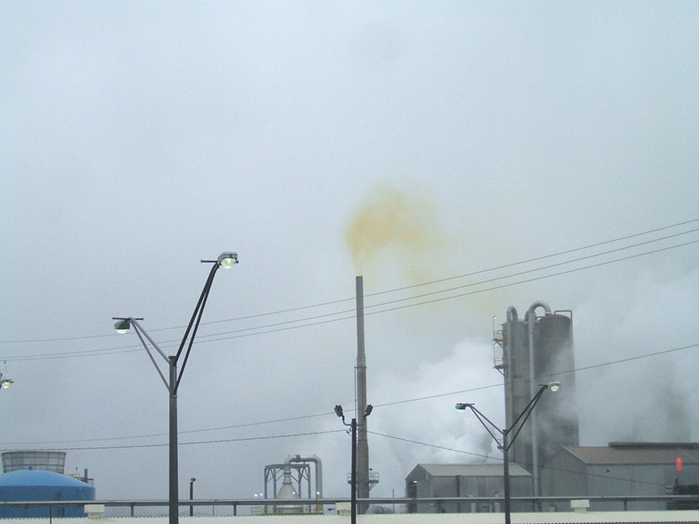

Slide 41
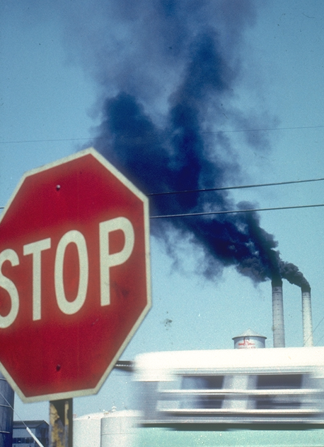
Interference

Slide 42
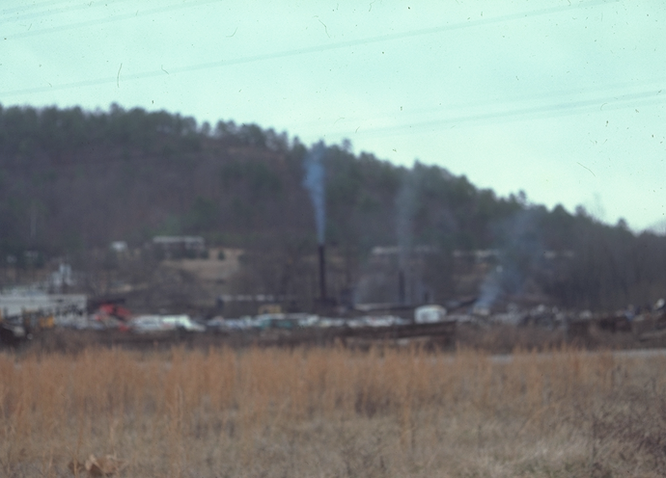
Contrast

Slide 43
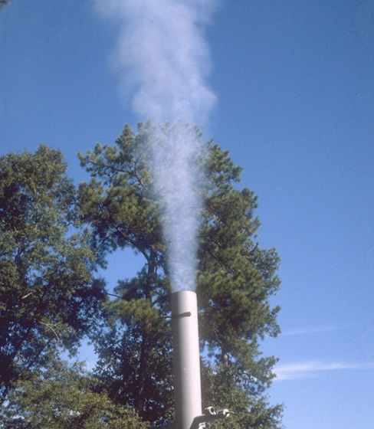
Contrast 3

Slide 44
White Smoke

Slide 45
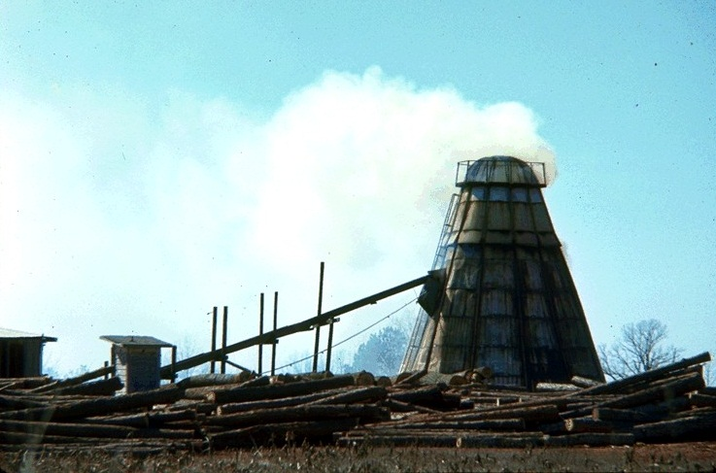
Wood Dryer White

Slide 46
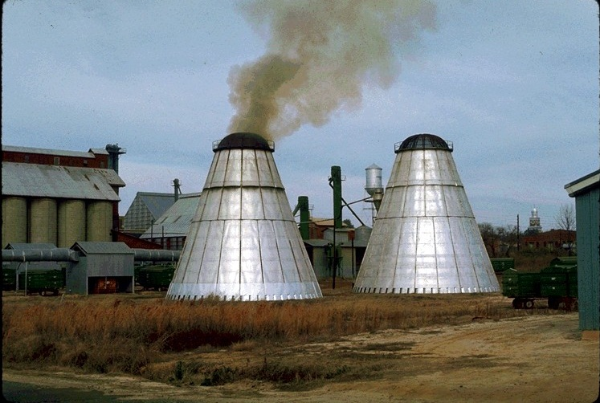
Wood Dryer Black

Slide 47
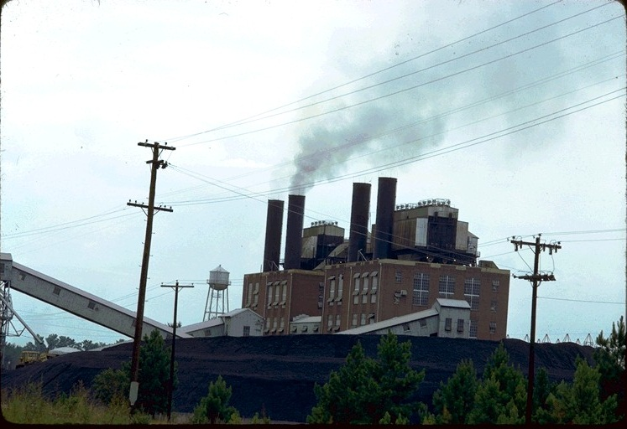
4 stacks
Interference

Slide 48
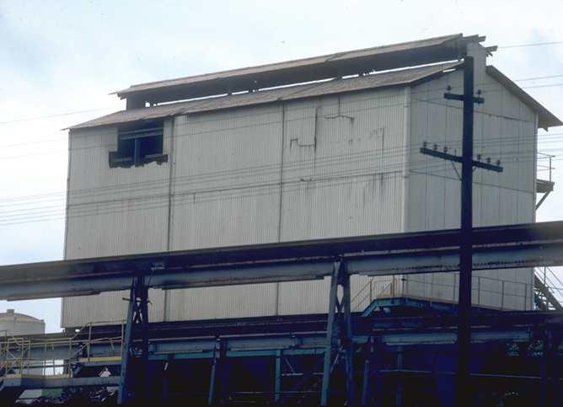

Slide 49
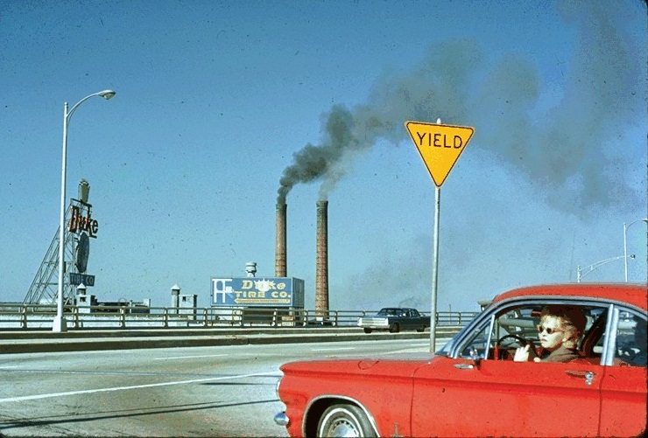
Interference

Slide 50
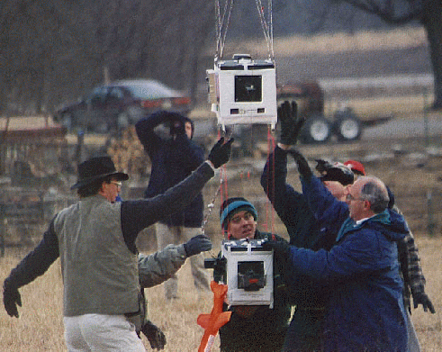
Meteorological
Instruments

Slide 51
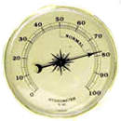
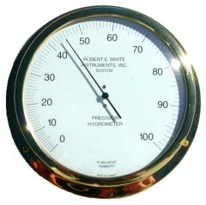
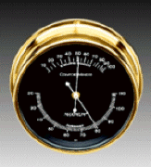

Hygrometer
Measures Relative Humidity

Slide 52



Thermometer
Measures Temperature

Slide 53


Anemometer
Measures Wind Speed

Slide 54
METHOD 9
METHOD 9 INCLUDES:
Procedures for Training and Certification of Observers
Procedures to Be Used In the Field for Determination of Plume Opacity

Slide 55


Slide 56
Field Procedures
SIX MINUTE AVERAGE
  Shall be determined by calculating the arithmetic mean of twenty-four (24) consecutive opacity observations
  Taken at intervals of fifteen seconds

Slide 57
Field Procedures - Alternates
Method 203A
VARIABLE AVERAGING TIME (e.g. TWO MINUTE AVERAGING TIME)
Shall be determined by calculating the arithmetic mean of eight (8)consecutive opacity observations
Taken at intervals of fifteen seconds
Method 203B
SIX MINUTE AVERAGE
Shall be determined by calculating the arithmetic mean of twenty-four (24)consecutive opacity observations
Taken at intervals of fifteen seconds
Allows for time exceptions – (e.g., allowing exceedances of 20 percent opacity for 3 minutes in 1 hour.)

Slide 58
Field Procedures - Alternates
Method 203C
SIX MINUTE AVERAGE
Shall be determined by calculating the arithmetic mean of Seventy-two (72) consecutive opacity observations
Taken at intervals of five seconds
M 203A data-reduction procedures which provide for averaging times other than 6 minutes. M203B. A time-exception regulation means any regulation that allows predefined periods of opacity above the otherwise applicable opacity limit (e.g., allowing exceedances of 20 percent opacity for 3 minutes in 1 hour.) M203C Allows for 5-second reading intervals and the data-reduction procedures, which have been modified for instantaneous limitation regulation

Slide 60

5 10 5 20 5 5 5 5
5 5 5 5 10 5 5 5
10 25 5 5 10 5 10 5
15 10 10 5 5 5 5 5
5 5 10 5 10 15 20 5
5 5 5 5 5 5 5 5
5 10 25 10 5 5 5 5
5 5 10 5 5 5 5 5
15 25 45 10 20 5 10 5
5 10 5 10 5 10 5 10
20 30 40 40 5 10 5 10
15 10 5 10 10 5 10 5
5 15 10 5 10 15 20 5
5 10 5 5 10 5 5 5
5 0 0 0 5 5 5 5
5 5 5 5 5 5 5 5
0 5 5 0 5 5 5 5
5 5 5 5 5 5 5 5

Slide 61
5 10 5 20 5 5 5 5
5 5 5 5 10 5 5 5
10 25 5 5 10 5 10 5
15 10 10 5 5 5 5 5
5 5 10 5 10 15 20 5
5 5 5 5 5 5 5 5
5 10 25 10 5 5 5 5
5 5 10 5 5 5 5 5
15 25 45 10 20 5 10 5
5 10 5 10 5 10 5 10
20 30 40 40 5 10 5 10
15 10 5 10 10 5 10 5
5 15 10 5 10 15 20 5
5 10 5 5 10 5 5 5
5 0 0 0 5 5 5 5
5 5 5 5 5 5 5 5
0 5 5 0 5 5 5 5
5 5 5 5 5 5 5 5

Slide 62
5 10 5 20 5 5 5 5
5 5 5 5 10 5 5 5
10 25 5 5 10 5 10 5
15 10 10 5 5 5 5 5
5 5 10 5 10 15 20 5
5 5 5 5 5 5 5 5
5 10 25 10 5 5 5 5
5 5 10 5 5 5 5 5
15 25 45 10 20 5 10 5
5 10 5 10 5 10 5 10
20 30 40 40 5 10 5 10
15 10 5 10 10 5 10 5
5 15 10 5 10 15 20 5
5 10 5 5 10 5 5 5
5 0 0 0 5 5 5 5
5 5 5 5 5 5 5 5
0 5 5 0 5 5 5 5
5 5 5 5 5 5 5 5

Slide 64
METHOD 22
1 2
TWO TIME PIECES NEEDED
1. Observation period
2. Totalize emissions

Slide 65

HYBRID M9-M22

Slide 66

Flare Plume

Slide 67

High Flare Opacity

Slide 68

M22 Indoor
Form

Slide 69

M22 Outdoor Form

Slide 70

Roofing Plant Graphic

Slide 71

M22 – 3

Slide 72

M22 - 2
Duplicate? Other pics underneath.

Slide 73

Quarry graphic

Slide 74

Wet Suppression System

Slide 75

Rock Quarry

Slide 76

Quarry Safety

Slide 77

Quarry Positioning

Slide 78

Quarry Positioning 1

Slide 79

Quarry Primary

Slide 80

Quarry Road Wetting

Slide 81

Quarry Wind-Stockpile

Slide 82
HOW DO I PASS ?
HOW TO AVOID FAILING

Slide 83
<3 Increments 3>
5
10
15
20
25
30
35
40
45
X

Slide 84

Transmissometer

Slide 85

Contrast 2

Slide 86
White Plume

Slide 87
Black Plume

Slide 88
BLACK SMOKE

Slide 89

WIND SPEED
Effects plume dispersion.
  High Winds - Greater dispersion.
  Low Winds - Less dispersion.
Effects plume rise.

