Slide 1
2024 DERA Application Walkthrough
Ama Maiki, DERA Contact
Environmental Engineer
State 2024 DERA Application
06/27/2025
Ruben Gijon-Felix
Unit Manager, Emissions and Control Strategies
Notes:
Good Afternoon, All. My name is, an Environmental Engineer of the Emissions and Control Strategies Unit, and I would like to welcome you to the 2024 State DERA Application Walkthrough. This should be relatively quick. I will be taking questions at the end of the presentation, so feel free to wait until then or post your questions in the chat. I want the process to be as fair and equitable as possible, so I will be positing the questions and answers in this session on the EPD website for all to view.

Slide 2
2024 DERA Application is open!
The Diesel Emissions Reduction Act (DERA) funding is part of the National Clean Diesel Campaign. The state offers grant funding to school systems to install emissions control devices or replace buses early.
Georgia’s Request for Applications (RFA) opened on June 27, 2025
This year’s funding amount is $636,968.
2024 DERA Application are Due: July 28, 2025
Since 2008, Georgia EPD estimates that 46 tons of NOx, 11 tons of PM, 38 tons of VOCs, and 154 tons of CO were eliminated or prevented by replacing or retrofitting Georgia school buses using DERA State Grants.

Slide 3
State DERA Application FORM
In 2020, GA EPD developed an electronic application for a quick and easy application experience
Please email application and supplemental materials to Ama Maiki at:
Ama.Maiki@dnr.ga.gov
Any questions asked will be answered and made available to the public via the EPD website. Please visit:
https://epd.georgia.gov/2024-dera-state-grant

Slide 4
Let’s do a Quick walkthrough!

Slide 5
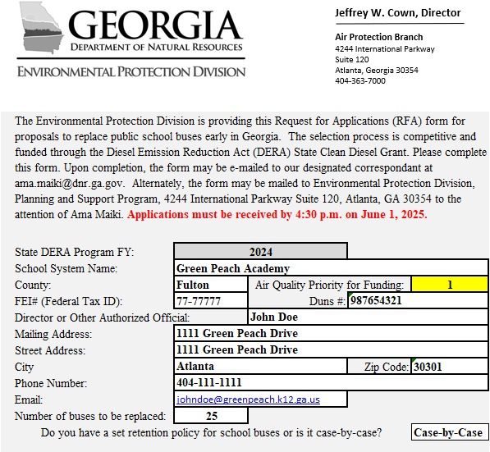
Enter contact and facility info
*Note: Cells highlighted in yellow will be filled out automatically.*
Notes:
Be sure to unprotect the sheet you are working on to ensure that you can fill in the spots that require typing in information. Type in all your school and Authorized Official information.

Slide 6
Enter fuel type and cost of new bus
*Note: The new bus must be the same type of bus as the old bus being replaced (e.g., Type C must replace a Type C).*

Slide 7
Fill out old bus information

Slide 8
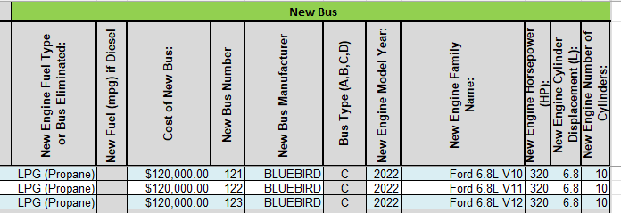
Fill out new bus information

Slide 9
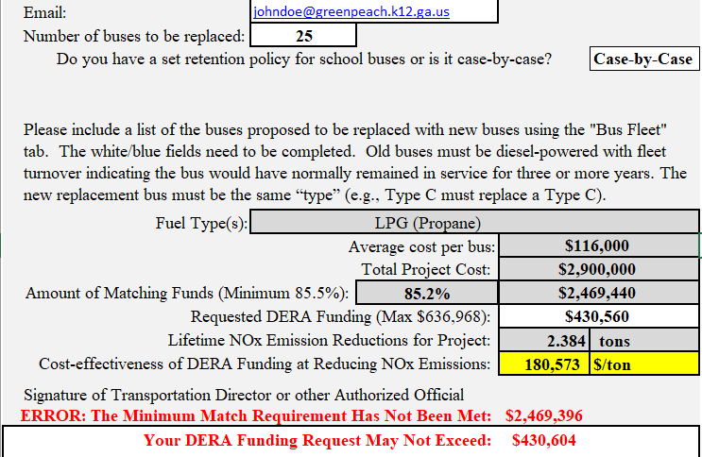
verify that the information filled out is correct
*Note: The cost-effectiveness of the project is automatically calculated and based on U.S. EPA’s Diesel Emissions Quantifier (DEQ).*

Slide 10
Sign the document
*Note: The Director or Authorized Official must sign the application for it to be considered a valid submittal.*

Slide 11
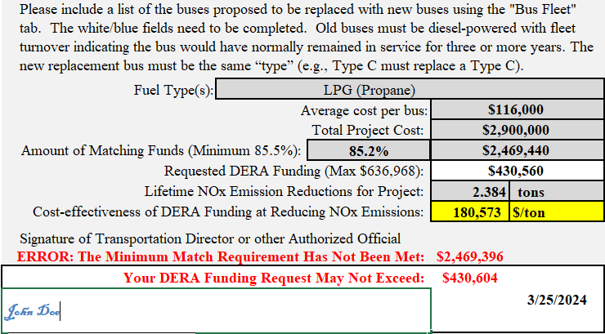
Complete application
Note: Applications are due June 1st, 2025 at COB 4:30 PM EST. We will not review applications submitted past the deadline.
*Note: Send the completed application (email-preferred) to Ama Maiki at Ama.Maiki@dnr.ga.gov*

Slide 12
Questions?
Notes:
I will also update the QA list with questions discussed today. This presentation will be sent out to the email list along with an updated Q&A and application form. Please direct any questions to my email at tamara.hayes@dnr.ga.gov.

