Slide 1


Combined Air Emissions Reporting System (CAERS)
Reporting Control Devices in CAERS
04/14/2021
Notes:
On behalf of the US EPA, I’d like to welcome you to the Combined Air Emissions Reporting System or CAERS.

Slide 2
Housekeeping:
This training is being recorded
Everyone muted, please don’t put us on hold
Type your questions in the chat box
PPT and recording will be made available on the CAER website

Slide 3
Disclaimer
This training is intended for instructional purposes only. Any data or facility information shown in the training, is illustrative only, and should not be confused with a facility’s live report for any given inventory year.

Slide 4
Outline of Training
New “Path” Approach Concepts
Examples & How to Enter Data for:
  No Controls
  One Control Device
  More than One Control Device
Questions & Answers

Slide 5
New “Path” Approach Concepts

Slide 6
Basic Definitions: Release point apportionment
Percent release point apportionment: The percentage of an exhaust gas stream that is actually collected for routing to a set of control devices. This value could be obtained from the vendor, or measured at the facility. Previous terminology: Percent capture efficiency. Percent captured = Percent going to “stack” type release points. Percent not captured = percent going to “fugitive” release point.
Stack
Control (s)
…
Process
Uncontrolled Emissions
Fugitive

Slide 7
Basic Definitions: Percent Control Effectiveness
Percent control effectiveness: The percentage of time or activity throughput that a control approach is operating as designed, including the capture and reduction devices. This percentage accounts for the fact that controls typically are not 100 percent effective because of equipment downtime, upsets and decreases in control efficiencies. This could be estimated from the amount of time the control is operational, versus down for maintenance or repairs. When the control is not effective, the pollutant is not removed from the emissions stream.
Controlled Emissions
% when control is effective
Stack
Control (s)
% when control is not effective

Slide 8
Basic Definitions: Percent Pollutant Reduction Efficiency
Percent Pollutant Reduction Efficiency: The percent reduction achieved for the pollutant when all control measures are operating as designed. This could be obtained from the vendor.
Controlled Emissions
% pollutant reduction efficiency
Stack
% when control is effective
Control (s)

Slide 9
Previously - “Approach Method”
Approach: Contained a collection of controls applied to a unit or process.
Could contain:
    Multiple control measures (scrubber, precipitator, etc.), some controls listed could be a “group” of controls
    Multiple pollutants being controlled with an overall % reduction efficiency reflecting all of the control devices in the control approach
    Implicit is that every measure controls every pollutant (which we know is not true)
Overall % capture efficiency, and % effectiveness
Allowed us to show the overall reduction % for a given process –pollutant - release point combination, but not at individual control level

Slide 10
Previously – “Approach Method”
We couldn’t:
  Describe controls configuration at a facility
  Define the relationship between controls and units, process, and / or release points
  “Reuse” controls that are shared with other components (units, processes, and release points) – i.e. had to enter an approach containing the relevant control for each unit/process/release point combination
  Change the property values of the control information with ease

Slide 11
Previously – “Approach Method”
We couldn’t:
  Describe controls configuration at a facility
  Define the relationship between controls and units, process, and / or release points
  In reporting data, “reuse” controls that are shared with other components (units, processes, and release points) – i.e. had to enter an approach containing the relevant control for each unit/process/release point combination
  Change the property values of the control information with ease

Slide 12
New – “Path Method”
A list of individual controls exist for the facility
Only the pollutants controlled by each individual piece of control equipment are listed with the control. The % reduction for the pollutant is the amount reduced due to this one piece of equipment.
Control configuration is defined:
  Single
  In series
  In parallel
  Combinations
Controls are placed in paths and can be:
  “Reused” in reporting
  Associated and linked between a unit/process and a release point

Slide 13
New – “Path Method”
A Path contains:
  One or more controls that are connected
  A child path contains:
    one or more controls
    a “smaller” child path containing one or more controls
A Main Path contains:
  One or more controls or children paths
  Associates the controls/paths it contains from a unit/process to a release point

Slide 14
Single Control
For a single control one path is needed. The control is placed in that path. That path will be the main path and it will associate the process to the release point. Because there’s only one control, path assignment is just equal to 1.
Path A (Main)
Unit 1
Process 1
Control A
Release Point 1
Need: pollutant reduction efficiency, effectiveness of control, release point apportionment, path assignment = 1, control apportionment = 100%.
Notes:
For a single control one path is needed. The control is placed in that path. That path will be the main path and it will relate the process to the release point. Because there’s only one control, path assignment is just equal to 1.

Slide 15
Single Control on Multiple Units/Processes
Note that once this path is created for a single control, any process sending emissions to the same release point can use that path. So you only have to set that path up once, then reuse it as needed for each process.
Process 1
Path A (Main)
Release Point 1
Unit 1
Process 2
Control A
Process 3
Old Approach method would have required creation of one approach per unit/process/release point combination. New path method “reuses” Path A.
Need: pollutant reduction efficiency, effectiveness of control, release point apportionment, path assignment = 1, control apportionment = 100%.

Slide 16
Multiple “Single Controls”
Path A (Main)
Process 1
Control A
Release Point 1
The case of multiple controls that are “single” controls between a unit/processes and release point is the same as for a single control. One path is created for each control and each path associates the unit/process with the respective release point.
Unit 1
Process 2
Process 3
Path B (Main)
Process 1
Unit 1
Process 2
Control A
Release Point 2
Process 3
Path C (Main)
Process 1
Unit 1
Process 2
Control A
Release Point 3
Process 3

Slide 17
Single Control on Multiple Units/Processes/Release Points
Process 1
Unit 1
Process 2
A path can be shared by units/processes if they all direct their emission through the control(s) in that path and also “share” release points
Release Point 1
Path A
Process 3
Control A
Process A
Unit A
Process B
Release Point 2
Process C
Old Approach method would have required creation of one approach per unit/process/release point combination (6 approaches). New path method “reuses” Path A.

Slide 18
Multiple Controls – In Series
Multiple controls in series can be placed in on path and that path can be reused if it is the main path, as in the previous slide. Instead of a single control, now we have several in series.
In Series Path
Unit 1
Process 1
Control A
Control B
…
Release Point 1
Need: pollutant reduction efficiency, effectiveness of control, release point apportionment, path assignment (position of control in the sequence; control A=1, Control B=2,…), control apportionment = 100%.

Slide 19
Multiple Controls – In Parallel
Multiple controls in parallel can be placed in on path and that path can be reused if it is the main path, so long as it associates units/processes with the same release point(s).
In Parallel Path
Control A
Unit 1
Process 1
Control B
Release Point 1
…
Need: pollutant reduction efficiency, effectiveness of control, release point apportionment (capture efficiency), path assignment (position of control in the sequence, if parallel, all controls have the same sequence number), control apportionment (e.g. 30% per control).

Slide 20
Additional Definitions
A Path Assignment defines the order in which controls are configured, each control or child path is given a sequence number:
  Increasing “sequence number” if in sequence
  The same “sequence number” if in parallel
Ultimately, there will be a parent or “master” path that will define the controls that are encountered from the emissions generation point (unit/process) to the release point.
  Movement of emissions from one control to the next will be tracked via the Control Apportionment
  Capture of the emissions will be tracked via a Release Point Apportionment

Slide 21
Additional Definitions
Control Apportionment:
  % of the emissions that are coming from a previous control or path
  100% of the emissions are tracked, a control apportionment percentage < 100% for a control means that some emission are also being routed to another control device or path.
Release Point Apportionment:
  Emissions generated at the unit/process must be accounted for in terms of where they ended up being released:
    Different types of release points
      Stack
      Fugitive
    100% of the original emissions must be assigned to one or more release points

Slide 22
Examples & How to Enter Data

Slide 23
General Steps
Enter control data (pollutant and % pollutant reduction efficiency)
Place the control into a path (assignment or sequence #, control apportionment)
  Control into path
  Child path into parent path
  Controls and/or children paths into a main path
Apportion emissions from the process to the release point

Slide 24
No Controls
Stack 2
Stack 3
Stack 1
Process 1
Boiler 1
No path needs to be created. You would note a percentage going to stack and a percentage going to fugitives if some of the emissions from the process are fugitive.

Slide 25
One Control
Stack 2
Stack 3
Stack 1
Path 1
Fugitive
Control A
Unit: Test Boiler 1
Process: Test 1

Slide 26
Numerical Example for One Control
Old Approach Method
Unit ID | Process ID | Control Applicability Level | Control Description | % Capture | % Effectiveness | Control Comment | Pollutant | % Reduction Efficiency
Test Boiler 1 | Test 1 | PROCESS | Control A | 85% | 97% | Control approach | NOX | 90%

Slide 27
New Path Method
Control ID | % Effectiveness | Pollutant | % Efficiency | Overall % Reduction
Control A | 97% | NOX | 90% | 74%
Path Data
Path ID | Sequence Number | Assignment (Control or Path) | Apportionment (Control or Path)
Path A | 1 | Control A | 100%
Release Point Data
Unit ID | Process ID | Path ID | Release Point ID | Release Point Apportionment
Unit 1 | Process 1 | Path 1 | Stack 1 | 85%
 |  |  | Fugitive | 15%
Path A
Control A
E.g. Overall% Reduction = apportioned to stack * effectiveness * efficiency = 85% * 97% * 90% = 74.21%

Slide 28
One Control in User Interface

Slide 29
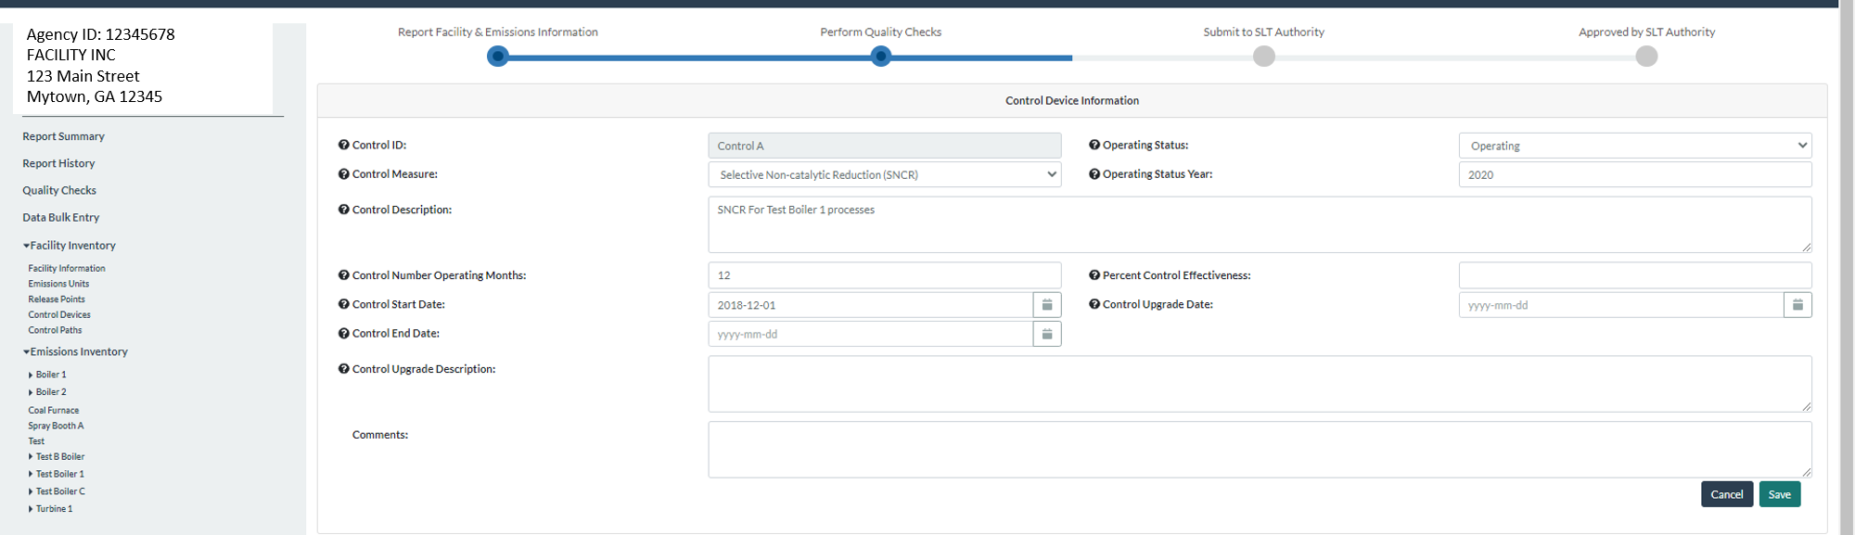
Add New Control in Controls Devices List
Note: Operating Status Year in UI and Bulk Upload starting next Monday
Notes:
Add data about new control device suc has control ID, control measure, operating status and status year, operating months, and percent control effectiveness.

Slide 30
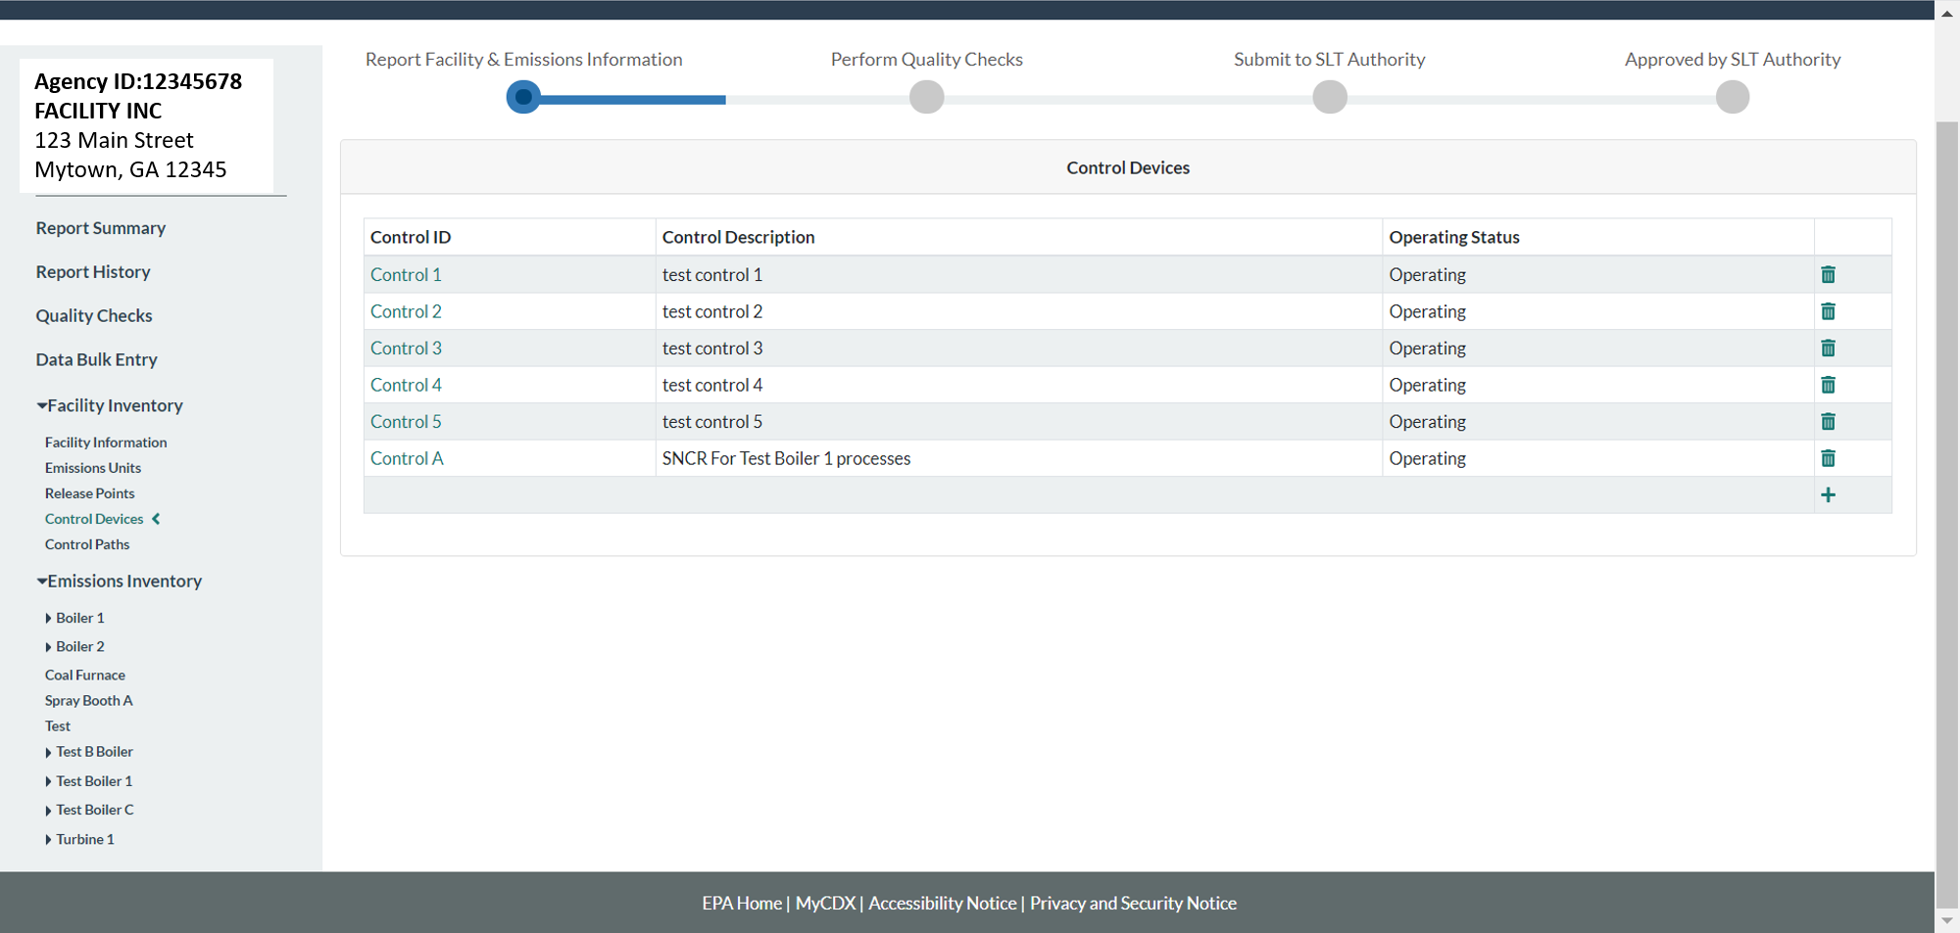
See New Control in List of Controls
Notes:
After adding the control it can be seen in the list of existing control devices for the facility.

Slide 31
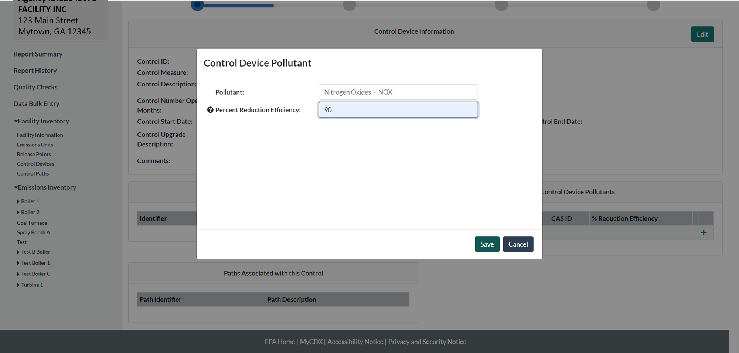
Select Control and Add Data
Notes:
Click on the control device from the list, and it will open it again, now allowing you to add more data. Add pollutant and pollutant control efficiency.

Slide 32
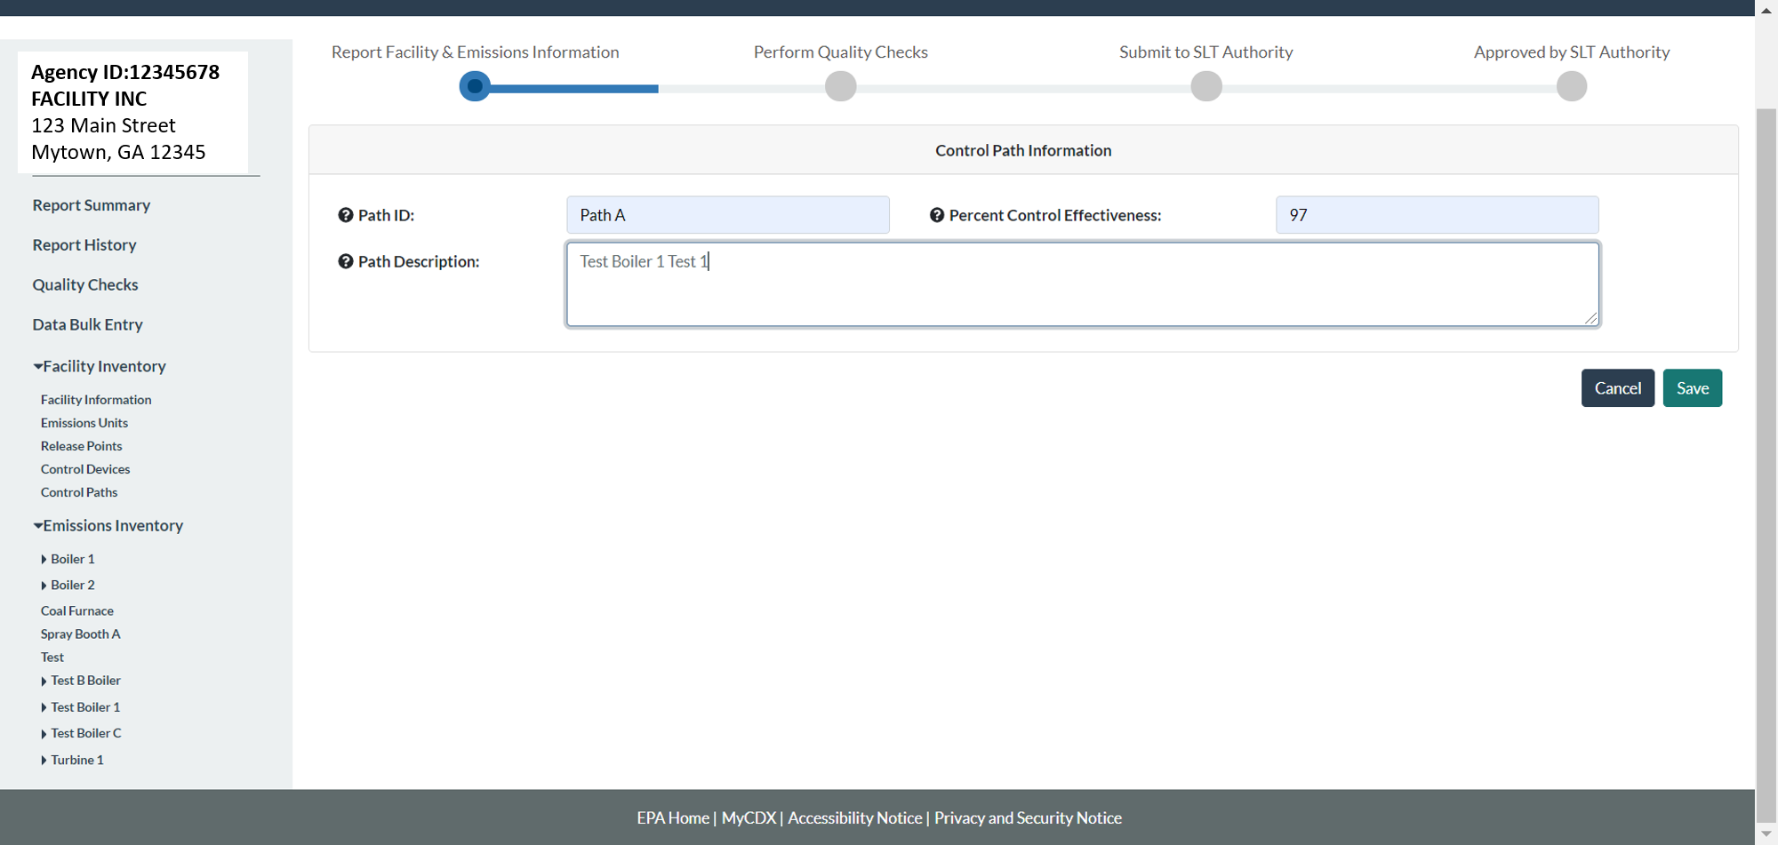
Create Path for Control in Path List
Note: QA check being implemented, if you submit your report before it is, you should check your PM numbers. PM 10 and 2.5: Error if Percent Reduction Efficiency of PM10 on a control or path is less than PM2.5 on the same control/path.
Notes:
Click on “Control Paths” on the left hand side menu and this will take you to a list of existing paths. Click on the plus sign to add path data. Add path data. Control device effectiveness is the same as that for the control device for the case of a single control.

Slide 33
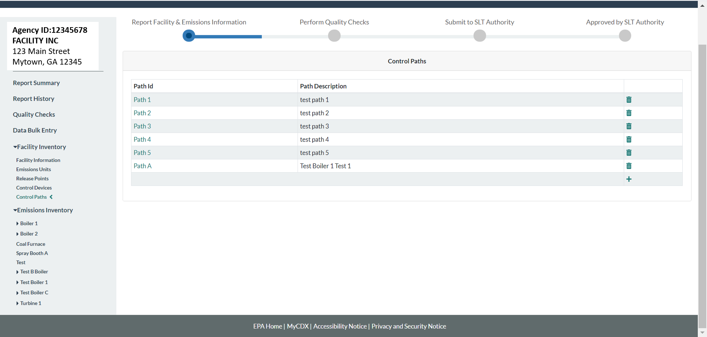
See New Path in List of Paths
Notes:
Click save and you’ll be able to see the path in the list of control paths.

Slide 34
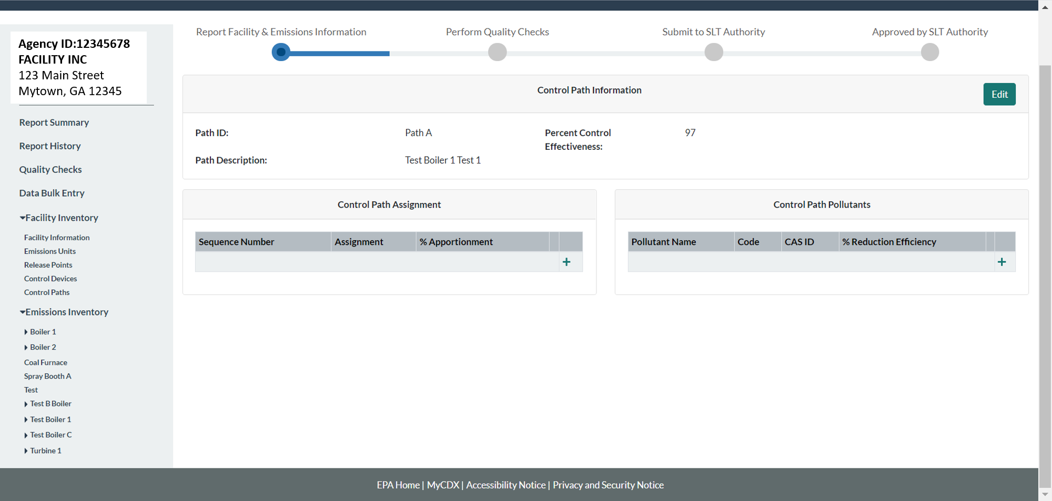
Select Path and Add Data
Notes:
Click on the newly created path from the list of paths. Add Control Path assignment and pollutants

Slide 35
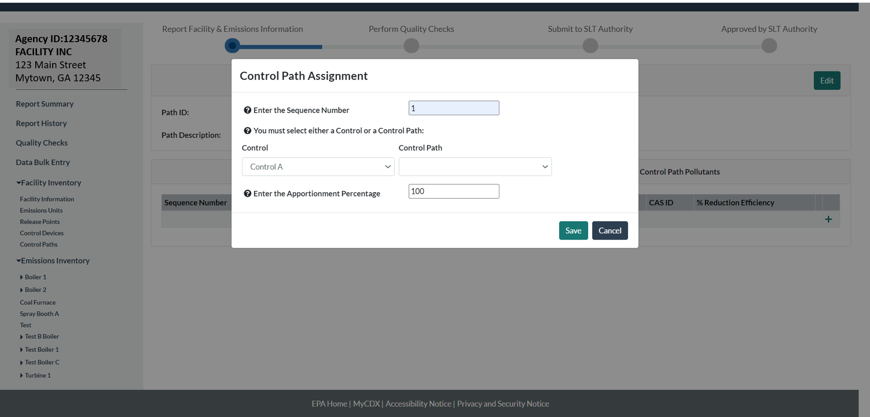
Control Path Assignment Data
Notes:
Add control sequence number and the percentage of the pollutant stream coming from the process.

Slide 36
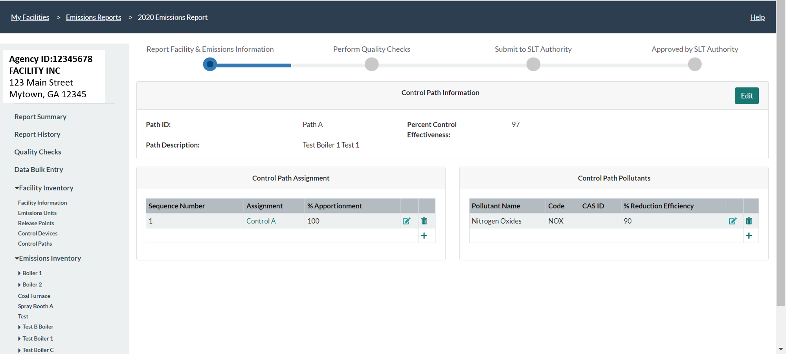
Control Path Pollutants
Path % Reduction Efficiency
For one control, or several controls for different pollutants each, the path pollutant control efficiency is the same as for each of those controls, but,
If there is more than one control for a given pollutant, then that becomes an estimate of efficiency of pollutant removal of all those controls, for that specific pollutant.
Notes:
Add control path pollutant information (pollutant and percent pollutant control reduction efficiency). Now your path information is complete.

Slide 37
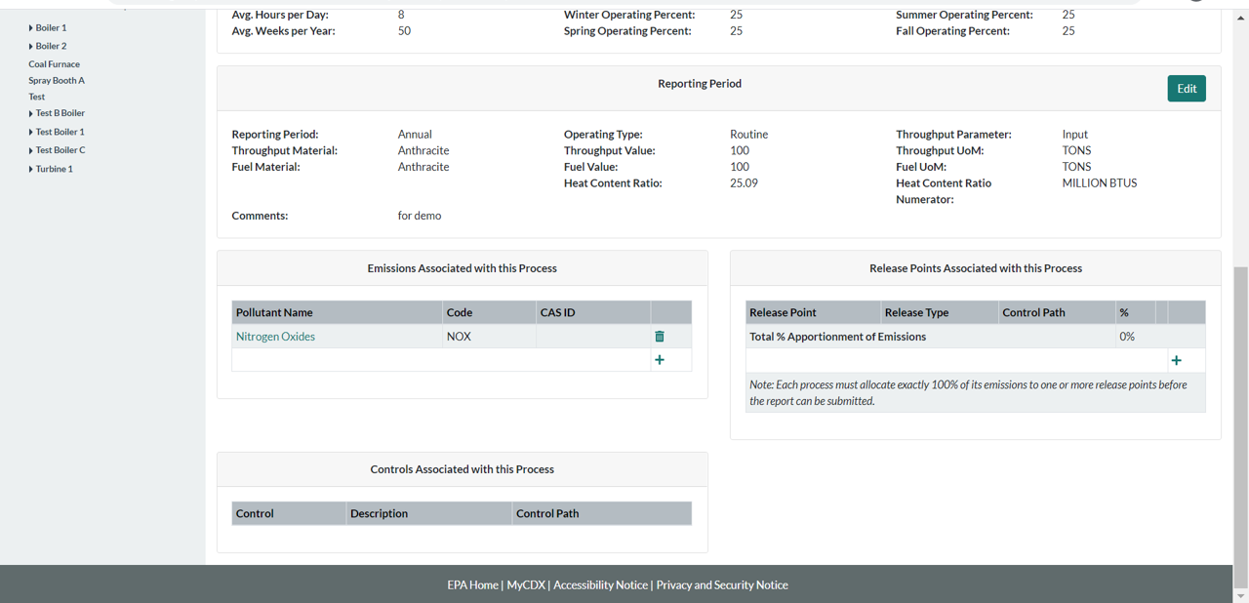
Select the Process for the Control
Notes:
Now you need to tell the system which release points these emissions go to. Go to the process page by clicking on the unit and process you are looking for from the left hand side menu. Once in the page for that process, add a release point.

Slide 38
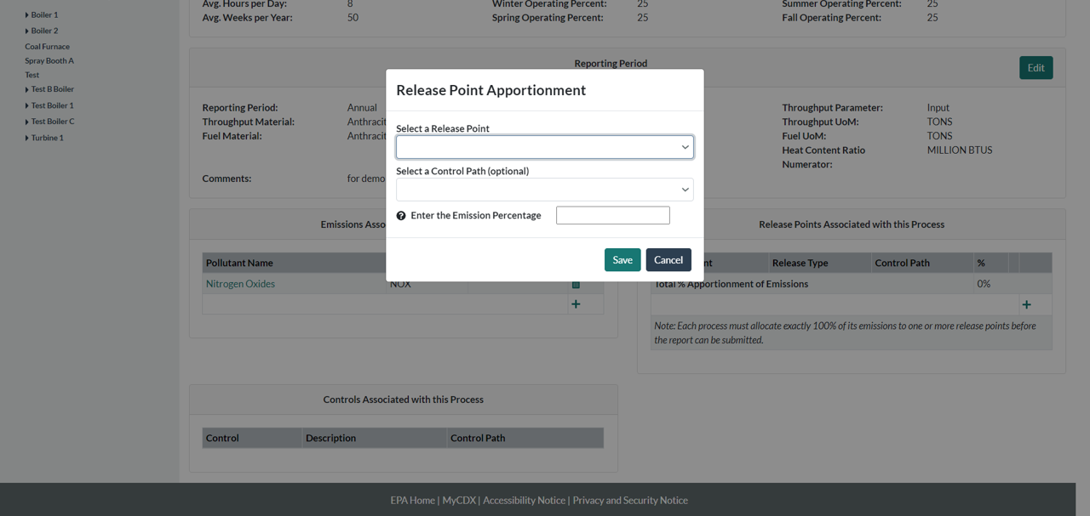
Select Release Point
Notes:
Add a release point apportionment. Or if a release point already exists there that you want to associate with the pollutant just click on it to edit it.

Slide 39
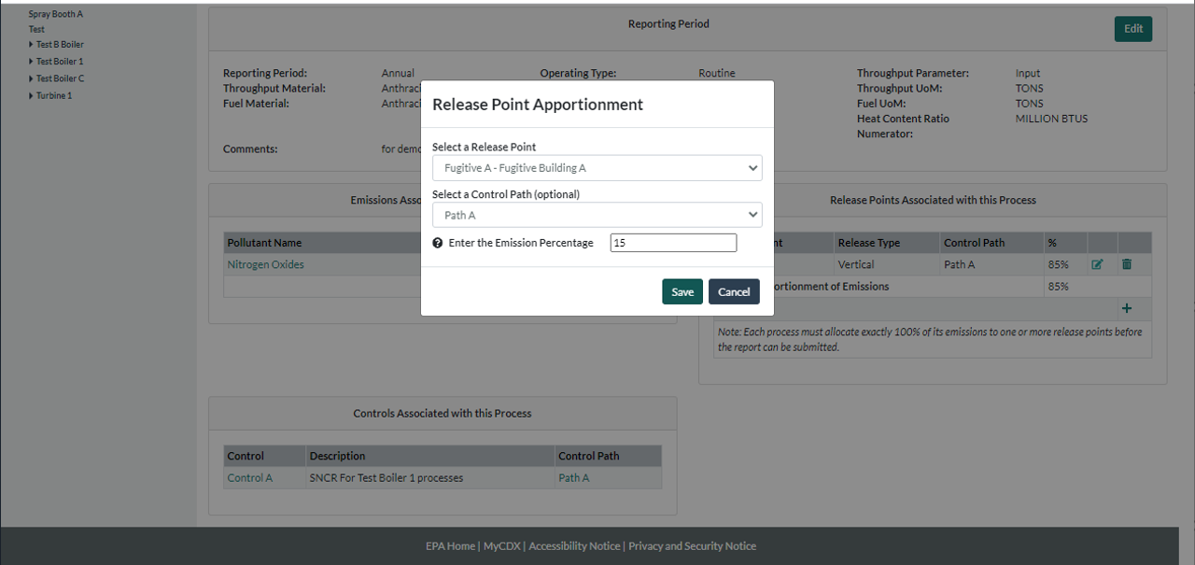
Associate Process and Release Point
Notes:
If your device capture isn’t 100% then you have fugitives and you would enter those as well.

Slide 40
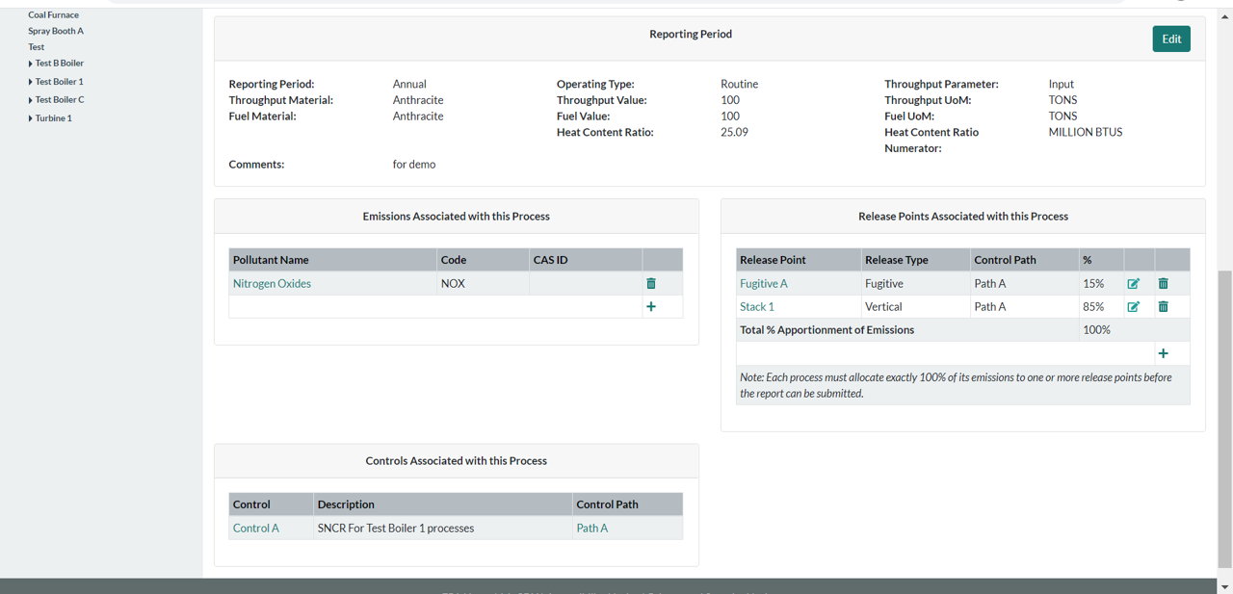
See Release Point(s) Linked to Process by Path
Notes:
Note that release point apportionment of emissions from that process to its release point(s) should add up to 100% (i.e. all emissions from the process have to go somewhere).

Slide 41
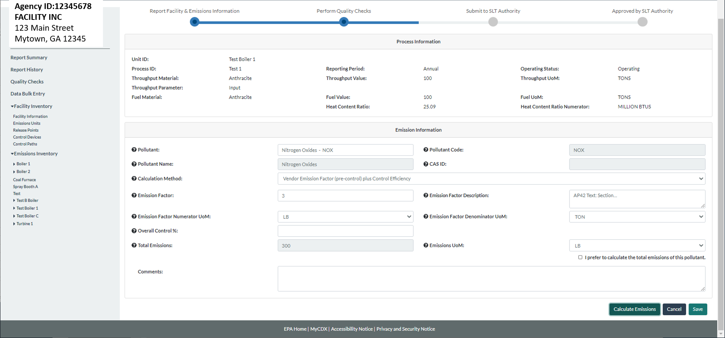
Can Use Post-Control Emission Factor
Notes:
If the “plus control efficiency” emission factor is available for the control, you can select it.

Slide 42
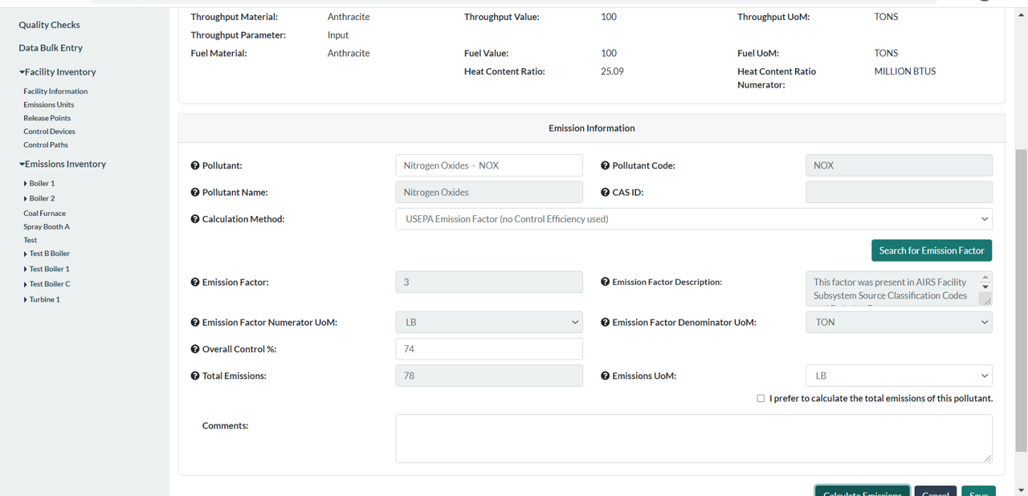
Can Use Pre-Control Emission Factor
Notes:
Conversely you can select a “pre-control” emission factor and include an overall control %. If you chose that overall control % then your emissions will be calculated using that %.

Slide 43
One Control in Bulk Upload

Slide 44
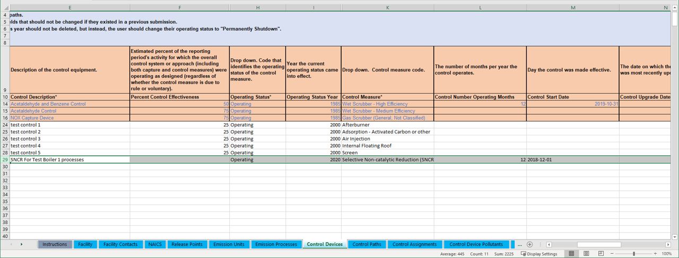
Enter Data in Control Devices Tab
Notes:
Click on the Control Devices tab. Data to enter includes the control description, percent control effectiveness, operating status and operating status year, and the control measure. Other data include control start, end date, and modification date if it has been modified.

Slide 45
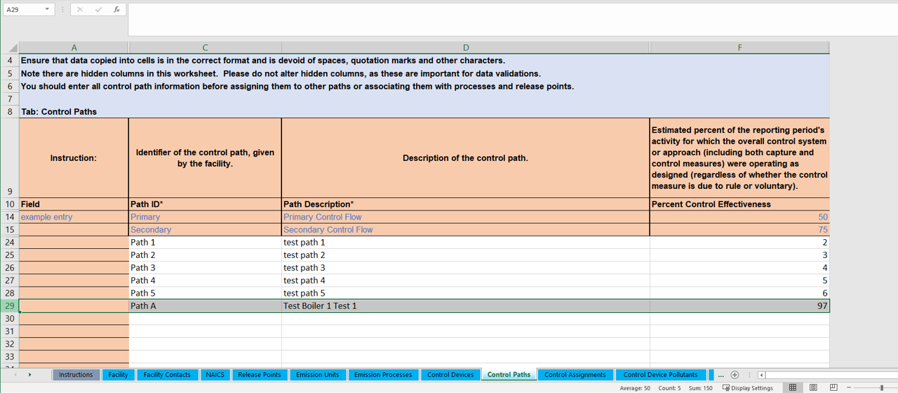
Enter Data in the Control Paths Tab
Notes:
In the Control Paths tab enter the Path ID, description and percent control effectiveness. The effectiveness is the same as for the control device when there is only one control.

Slide 46
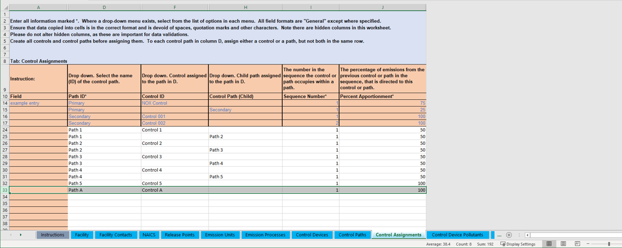
Enter Data in the Control Assignments Tab
Notes:
In the Control Assignments tab enter Path and the control it contains. A main path can contain a child path. However, you do not need to enter both the control and the child path that contains it in a parent path or main path, you only need to enter the child path if that is the case. In the case of one control you only enter the control into the main path.

Slide 47
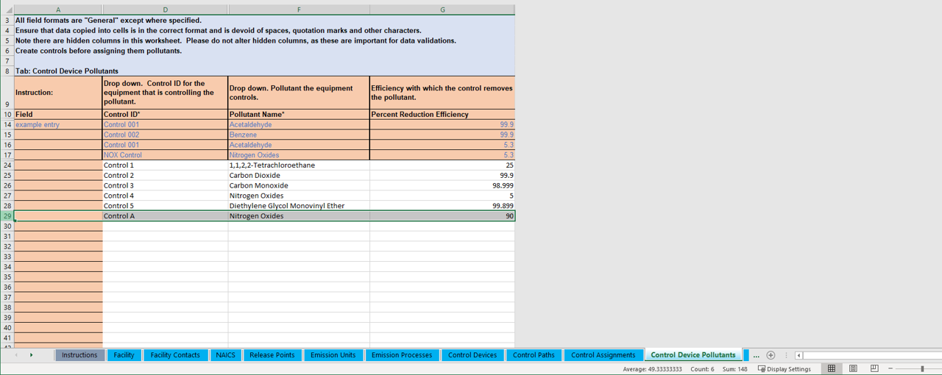
Enter Data in the Control Device Pollutant Tab
Notes:
In the Control Device Pollutant Tab enter the control ID and the pollutant and percent reduction efficiency.

Slide 48
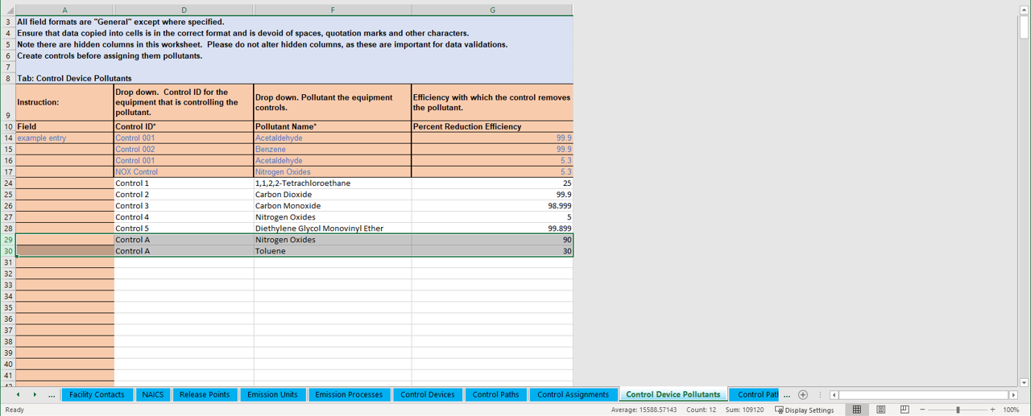
Enter All Pollutants if More than One
Notes:
Note that if your control device controls more than one pollutant, you should enter all of those pollutants here. In this case we show as an example, Toluene, which is a hazardous air pollutant.

Slide 49
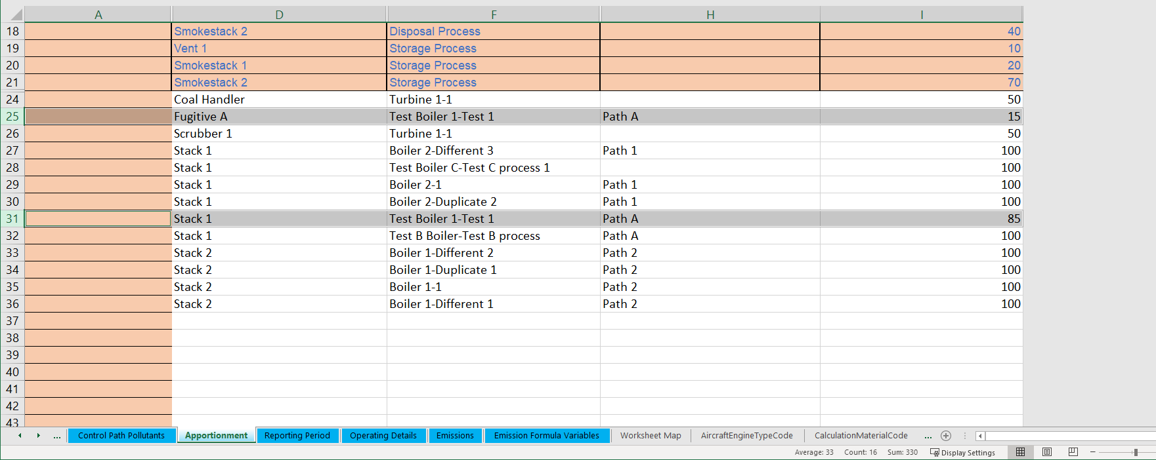
Enter Data in the Apportionment Tab
Notes:
In the apportionment tab, enter data for the release point such as the type, description and the apportionment from its path. In this example, Path A captures 85% of emissions and those are routed to Stack 1. 15% of emissions aren’t captured so they are apportioned to a fugitive release point.

Slide 50
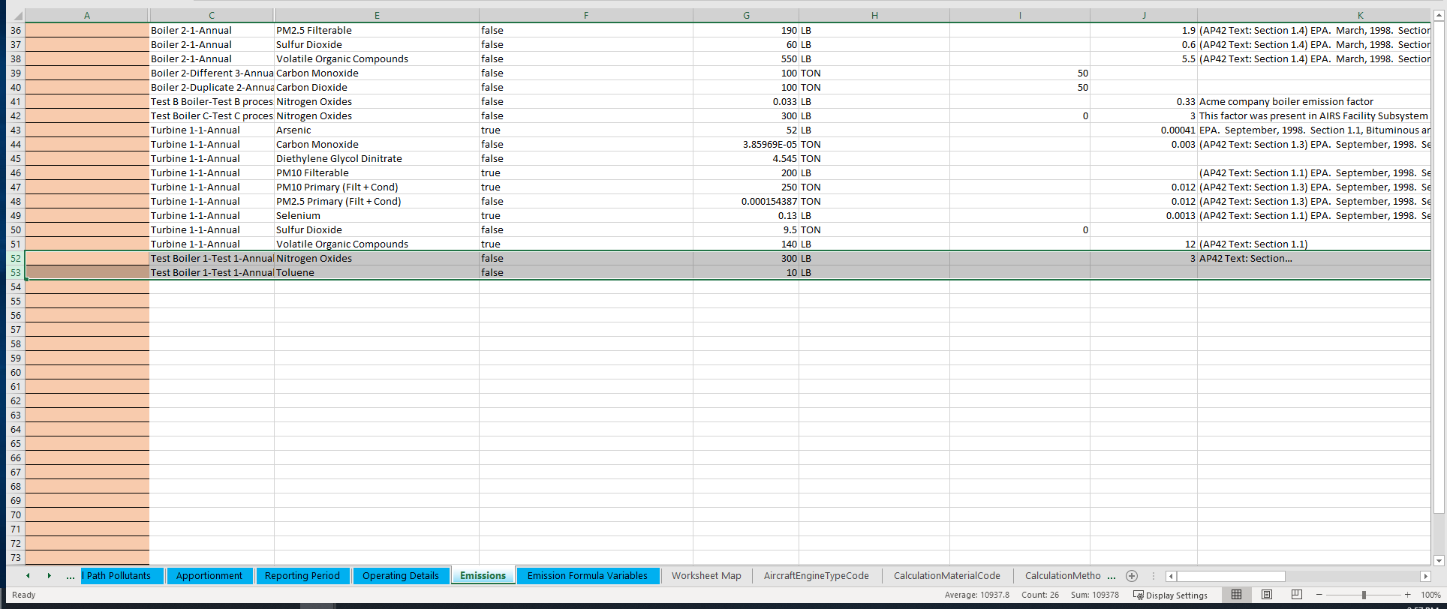
Ensure Process Lists Pollutants
Enter emissions or allow CAERS to calculate/recalculate for you if you have an emission factor, e.g.
Notes:
Make sure that the same pollutants listed in the control, are listed in the process associated with it in the Emissions tab.

Slide 51
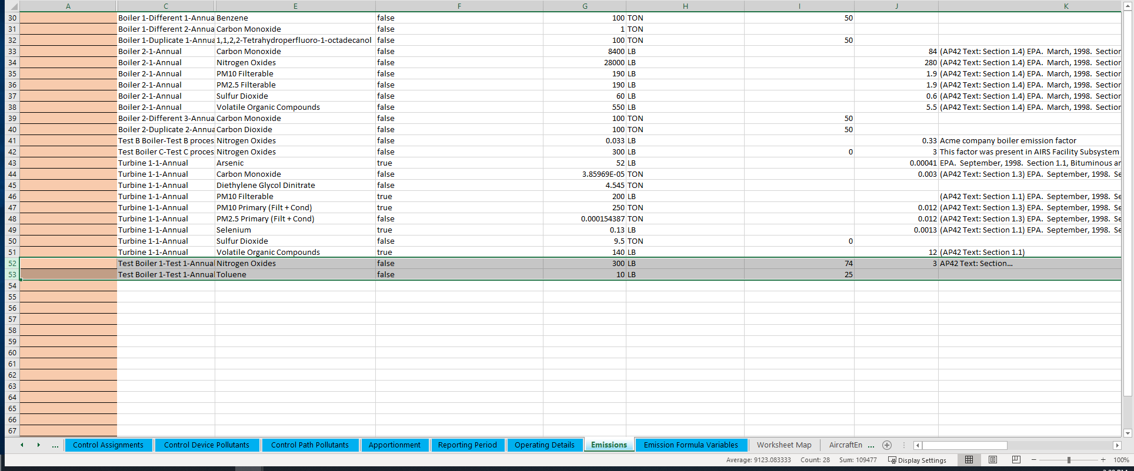
List Overall % if Applicable
Enter overall % here and emissions, or recalculate in User Interface.
Notes:
Note that in the Emissions tab you can enter a pre-control emission factor and include the overall percentage control. When you upload the workbook CAERS will give you a QA check to recalculate your emissions.

Slide 52
Considerations to Keep in Mind
Please don’t re-label or delete controls that existed in a previous year report, instead, mark them as “Permanently Shut Down” or your inventory in EPA will be out of sync. Seeking input on when/how/why facilities relabel components, send to caer@epa.gov.
You could enter your control data in UI to help guide you, then download in BU template to continue the rest of your report and viceversa.
If you enter a control device you must also enter its: pollutant reduction efficiency, effectiveness, release point apportionment, and path assignment

Slide 53
Real Example 1
In this example we have two processes sending emissions into the Planer Mill Cyclofilter. Path 1 can be the main path for the single control and can be used for both processes.
Planer
Planer Mill Cyclofilter
Release Point
Planer Trim Block Hog
Path 1

Slide 54
One Control Device Q&A

Slide 55
More than One Control

Slide 56
In Series
Stack 2
Stack 3
Control 4
Stack 1
Path 2
Path 1
Control 3
Control 2
Control 1
Boiler 1
Boiler 2
Process 1
Process 2
Controls 1, 2, 3, and 4 are set up in sequence. Boiler and Process 2 send emissions to control 1. Boiler and process 1 send emissions to control 2. Path 1 is the main path between Boiler and Process 1 to Stack 1. Path 2 is the main path between boiler and process 2 and stack 1. Path 1 is a “child” path of Path 2. Path 2 is a “main” path.
Notes:
Controls 1, 2, 3, and 4 are set up in sequence. Boiler and Process 2 send emissions to control 1. Boiler and process 1 send emissions to control 2. Path 1 is the main path between Boiler and Process 1 to Stack 1. Path 2 is the main path between boiler and process 2 and stack 1.

Slide 57
Numerical Example for Controls in Series
Old Approach Method
For Boiler 1 you might have a separate approach similar to this one but excluding Control 1.
Notes:
The approach listed all pollutants but not the specific controls or their sequence. Also, the approach wasn’t “reusable” and had to be re-entered for each unit/process.

Slide 58
New Path Method
Path 2
Control ID | R.P. Apportiont. | % Effectiveness | Pollutant | % Efficiency | Overall % Reduction
Control 1 | 100% | 95% | VOC | 80% | 76%
 |  |  | CO | 95% | 90%
Control ID | R.P. Apportiont. | % Effectiveness | Pollutant | % Efficiency | Overall % Reduction
Control 2 | 100% | 90% | PM10-PRI | 90% | 81%
 |  |  | PM-CON | 100% | 90%
Control ID | R.P. Apportiont. | % Effectiveness | Pollutant | % Efficiency | Overall % Reduction
Control 3 | 100% | 90% | NOX | 90% | 81%
Control ID | R.P. Apportiont. | % Effectiveness | Pollutant | % Efficiency | Overall % Reduction
Scrubber 1 | 100% | 90% | SO2 | 90% | 81%
Path Data
Path ID | Sequence Number | Assignment (Control or Path) | Apportionment (Control or Path)
Path 1 | 1 | Control 2 | 100%
Path 1 | 2 | Control 3 | 100%
Path 1 | 3 | Scrubber 1 | 100%
Path 2 | 1 | Control 1 | 100%
Path 2 | 2 | Path 1 | 100%
Release Point Data
Unit ID | Process ID | Path ID | Release Point ID | Release Point Apportionment
Boiler 1 | Process 1 | Path 1 | Stack 1 | 100%
Boiler 2 | Process 2 | Path 2 | Stack 1 | 100%
Path 1
Control 4
Control 3
Control 2
Control 1
Notes:
The new path method provides more detailed data. The table shows how the different data elements would be entered in CAERS for this example. The numbers are fictious and are for illustration purposes only.

Slide 59
In Parallel
Stack 2
Stack 3
Control 6
Stack 1
Path 3
50%
Path 2
50%
Control 5
Path 1
Control 4
Control 2
60%
Control 3
Boiler 2
40%
Control 1
Process 1
Path 1 is a child path of Path 2. Path 2 is a “main path” between the process and Stack 3. Path 2 is a child path of Path 3. Path 3 is a “main path” between the process and Stack 1.

Slide 60
Numerical Example for Controls in Parallel
Old Approach Method
Notes:
The approach again would have listed the pollutants but no details on the controls or their configuration.

Slide 61
New Path Method
Control ID | R.P. Apportiont. | % Effectiveness | Pollutant | % Efficiency | Overall % Reduction
Control 1 | 90% | 95% | VOC | 80% | 68%
Control ID | R.P. Apportiont. | % Effectiveness | Pollutant | % Efficiency | Overall % Reduction
Control 2 | 100% | 90% | PM10-PRI | 90% | 81%
 |  |  | PM-CON | 100% | 90%
Control ID | R.P. Apportiont. | % Effectiveness | Pollutant | % Efficiency | Overall % Reduction
Control 3 | 100% | 90% | CO | 95% | 86%
Control ID | R.P. Apportiont. | % Effectiveness | Pollutant | % Efficiency | Overall % Reduction
Control 4 | 80% | 95% | NOX | 99% | 75%
Control ID | R.P. Apportiont. | % Effectiveness | Pollutant | % Efficiency | Overall % Reduction
Control 5 | 95% | 90% | Pb | 95% | 81%
Control ID | R.P. Apportiont. | % Effectiveness | Pollutant | % Efficiency | Overall % Reduction
Scrubber 1 | 100% | 98% | SO2 | 97% | 95%
Path Data
Path ID | Sequence Number | Assignment (Control or Path) | Apportionment (Control or Path)
Path 1 | 1 | Control 2 | 100%
Path 1 | 2 | Control 4 | 100%
Path 2 | 1 | Control 1 | 100%
Path 2 | 2 | Control 3 | 40%
Path 2 | 2 | Path 1 | 60%
Path 2 | 3 | Control 5 | 100%
Path 3 | 1 | Path 2 | 100%
Path 3 | 2 | Scrubber 1 | 100%
Release Point Data
unit ID | Process ID | Path ID | Release Point ID | Release Point Apportionment
Boiler 2 | Process 1 | Path 2 | Stack 3 | 47%
Boiler 2 | Process 1 | Path 3 | Stack 1 | 47%
Boiler 2 | Process 1 | Path 2 | Fugitive | 3%
Boiler 2 | Process 1 | Path 3 | Fugitive | 3%
Path 3
Control 6
Path 2
Control 5
Path 1
Control 4
Control 3
Average path release point apportionment 94%, could be weighted average or other as estimated by the facility reporter
Control 2
Control 1
Notes:
The new path method provides more detailed data. The table shows how the different data elements would be entered in CAERS for this example with a combination of controls in parallel. The numbers are fictious and are for illustration purposes only.

Slide 62
Additional Considerations about Overall % Controlled
When calculating emissions, if you have more than one control for the same pollutant, e.g. controls 1 and 3 both remove SO2, then your Overall % controlled may be:
  In series: overall % control 1 * overall % control 2 * …
  In parallel: (overall controlled emissions 1 + overall controlled emissions 2+…)/uncontrolled emissions
  Really complex controls configuration: estimate:
    e.g. (controlled emissions in series + controlled emissions in parallel)/uncontrolled emissions,
    e.g. weighted average of the % pollutant control efficiency for all controls

Slide 63
Real Example 2
1. The emissions only go to the VCU when the VRU is not working, per permit. The VCU is a backup to the VRU and only was used about 1% of 2019, about 100 hours.
2. Only one runs at a time, taking 100% of the inlet/emissions.
3. Two different release points. A vent off the VRU, the VCU is a stack/flare.
4. Gasoline vapor is only emissions off the loading rack. So VCU emissions are VOCs. Because we use propane in the VRC it’s has VOC and NOx/CO.
Tanks
Liquid return
Loading Rack
vapors
VRU (VOC)
Release Point
Bypass N/C
VCU (VOC, NOx, CO)
Release Point
Propane

Slide 64
Process 1
VRU
Release point 1
VOCs
Path 1
Process 2
VCU
Release point 2
Propane
VOC, NOX and CO
Path 2
If individual control capture isn’t 100% then rel apportionment should be adjusted to reflect fugitives.
Process 1 (VOC)
Path 1:
VRU sequence 1
Process 2 (VOC, NOX and CO)
Path 2
VCU Sequence 1
Recall VCU is a “backup” for the first process.

Slide 65
There are two different processes with different SCCs:
Evaporation recovery unit of gasoline vapors, for VOC and HAP-VOC pollutants.
Propane combustion process including all combustion pollutants, plus whatever VOC wasn’t combusted. How long each control runs (100 hours), etc. would be entered with the process information.

Slide 66
“Take Home” Messages about Path Approach
An inventory of controls is defined at the facility level
The relationship between the controls is defined by one or more “control paths”
  You must define a path for each unique set of controls encountered between the emissions generation point and the release point
  A path is composed of controls AND / OR paths
  You define the order of the controls through these associations
  You may define sets of controls that operate at the same time (parallel controls) by defining the percentage of the stream that flows in one direction or another.
Associate a release point apportionment record to a given path

Slide 67
Additional Considerations for More than One Control
How you set up the paths and controls in them for complex control set ups is up to you so long as the basic rules of child/parent/main paths are followed and all required data is entered.
Path level pollutant efficiency may be an estimate, for paths containing several controls for a single pollutant. E.g. two controls that remove NOx.
  In series: multiplication of control efficiencies
  In parallel: controlled emissions from efficiency/total uncontrolled, average, weighted average
  More complex controls: average, weighted average

Slide 68
How to Get Help
Regardless of what help you need always send:
1. Facility name and ID
2. Screenshot(s) of error you are getting
3. BU template you are using that is giving you errors
4. Diagram/even if by hand and scanned in of the controls set up you have (especially for complex controls)
Steps:
1. Help Desk first (Click Help in UI top right of your screen)
2. Your SLT (they will elevate to EPA as needed)

Slide 69
Upcoming Help Sessions
GA EPD HAPs Reporting in CAERS for 2020 NEI
      Tuesday, April 20 2:30 – 3:30 PM
      Register: https://geco.gaepd.org/EventRegistration/Default.aspx
GA Live Virtual Help Sessions (April – June)
      Email sign-up will be offered
      Attendance Requirements:
          Send questions to emissions.inventory@dnr.ga.gov with a screen shot of your problem
          We will try to address by email first
          If not resolved by email, we will provide a live help session time slot
      Help Session Times
          Every other Tuesday & Thursday from April 27 – May 27
          Every Tuesday & Thursday in June
          Tuesdays: 10-11 AM; Thursdays: 2-3 PM

Slide 70
Help Sessions for Other SLTs
To be scheduled. Reach out to your SLT if you need help via office hours, if help desk have not been able to help you resolve your issue.

Slide 71
Q & A

