Slide 1
Stage II Gasoline Vapor Recovery Decommissioning Workshop
June 11, 2014
EPD Tradeport Training Room

Slide 2
Today’s Agenda
Presentations are available on website: www.georgiaair.org
Welcome & Purpose of Workshop
Overview of Stage II Rule Changes
Decommissioning Procedures
Decommissioning Testing
Enforcement
Officially Decommissioned
Summary & Questions

Slide 3
Stage II Rule Amendments
Rule Amendment Process
  Briefed DNR Board on intent to submit amendments – January 31, 2014
  Held Public Hearing – March 6, 2014
  No public comments given at hearing or in writing
  DNR Board approved rule amendments – March 25, 2014
  Decommissioning commences May 1, 2014
  Decommissioning complete by April 30, 2016
State Implementation Plan Revisions
  Draft SIP revision – April 2014
  Submit to EPA for approval – June 2014
  EPA publishes approval in Federal Register (can take up to 18 months)

Slide 4
Stage II Rule Amendments
Subsection 3(xi) adds definition of “Reconstruction”:
  “replacement of any stationary gasoline storage tank and/or the replacement of all gasoline dispensers.”
Section 4 discontinues Stage II requirements for decommissioned facilities
  Once a gasoline dispensing facility becomes subject to this rule, it will continue to be subject even if the gasoline throughput rate falls below the applicability threshold until the facility decommissions its approved Stage II vapor recovery system as specified under paragraph 21. of this subsection.
Section 5 inserts provision to allow facilities to decommission Stage II rather than continue to capture displaced vapors from vehicle storage tanks:
  …Beginning on May 1, 2014, gasoline dispensing facilities subject to regulation under 391-3-1-.02(2)(zz) may decommission its approved Stage II vapor recovery system as specified under paragraph 21 of this subsection. Once a facility has decommissioned its Stage II vapor recovery system, it is no longer required to recover the displaced vapors from vehicle gasoline tanks.
Section 8 provides exemption for newly constructed or reconstructed facilities after December 31, 2011:
  …(iii) Any new gasoline dispensing facility or gasoline dispensing facility having undergone reconstruction that commenced or recommenced dispensing of gasoline to motor vehicles after December 31, 2011.
  Newly constructed facilities and those undergoing reconstruction do not have to submit additional letters.

Slide 5
Stage II Rule Amendments
Section 9 adds “Decommissioning” to requirements for testing:
  Stage II vapor recovery systems at each gasoline dispensing facility shall be certified as being properly installed and properly functioning. Certification, compliance testing, and recertification, and decommissioning shall be made by a trained, qualified technician who has a thorough knowledge of the system. Tests shall be conducted in accordance with test procedures as approved by the Division. The fill cap and vapor cap must be removed when performing any test to determine vapor tightness for a vapor recovery system for certification, compliance testing, and recertification, or decommissioning purposes.
Section 10 adds decommissioning testing to 5 business days notification requirement (subsection 21(iv) also covers this)
Section 19 allows Stage II records to no longer be kept after facility is decommissioned:
  “The following records shall be maintained for two years or until the Stage II vapor recovery system is decommissioned, whichever is less:
    (i) Maintenance records including any repaired or replacement parts and a description of the problems.
    (ii) Compliance records including warnings or notices of violation issued by the Division.
    (iii) Gasoline throughput records which will allow the average monthly gasoline throughput rate to be continuously determined.
    (iv) Inspection results including self-inspection weekly summaries.
    (v) Records of operator employee training for current employees.”

Slide 6
Stage II Rule Amendments
Section 21 provides the requirements for decommissioning:
  “Owners or operators of gasoline dispensing facilities subject to the Stage II vapor recovery control requirements shall fully decommission their Stage II vapor recovery systems in accordance with the provisions of this subsection.”
  Decommissioning may begin on May 1, 2014.
  Decommissioning must be completed by April 30, 2016
  Facilities subject to Stage II must continue to operate, maintain, and test their Stage II System until it is decommissioned.
  Gasoline dispensers must be taken out of service prior to the start of decommissioning and cannot be put back into service until decommissioning has been completed for whole facility.
  Provides requirements for disconnecting and removing Stage II system components. (Yasra will cover in more detail)
  Facility must be tested within 30 days.
  Test report must be submitted within 30 days of test.
  Facility must keep decommissioning records for two years.

Slide 7
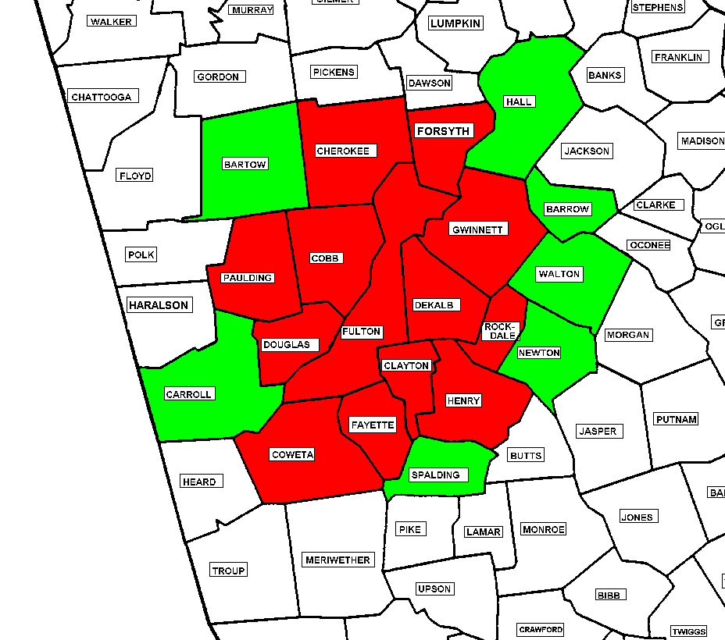
Stage II in Georgia
Until a facility with Stage II has decommissioned, it must:
  Operate Stage II equipment
  Test it annually
  Maintain it
New Facilities / Major Modification
  Exempt from having to install Stage II after 12/31/2011
  Facilities who have submitted letters will receive notification that they are exempt - eventually
  Facilities who did not submit letters may force enforcement actions for removing Stage II equipment early. (i.e. no documentation on when equipment was removed)

Slide 8
Stage II Vapor Recovery Rule
Enforcement

Slide 9
Enforcement
Violation of the Stage II rule will continue to be enforced.
Stage II Vapor Recovery Systems must continue to be operated, maintained, and tested until they are decommissioned.
As a reminder, the Stage II rule requires the owner to test the stage II vapor recovery system every year and recertify the system every five years.
Facilities not testing as required will continue to be subject to enforcement actions until decommissioning occurs.

Slide 10
Enforcement
Common Stage II violations have included:
  Failure to accomplish required Stage II testing
  Failure to maintain a Division Approved Stage II vapor recovery system.
  Failure to maintain daily inspection records
  Failure to have Stage II training certificate.
Average penalty range:
  Between $300 to $1,000 (per year)
  Multiply penalty by the number of the years facility was in violation

Slide 11
Decommissioning Enforcement
Subparagraph 21 requires owner/operators of gasoline dispensing facilities to fully decommission their Stage II Vapor Recovery Systems in accordance with the procedures presented today.
Potential Violations
  Failure to decommission entire facility prior to reopening (e.g. decommissioning one dispenser at a time).
  Failure to follow decommissioning procedures specified in subparagraph 21 (e.g. not disconnecting vapor pump, not capping vapor lines, etc.)

Slide 12
Decommissioning Enforcement
Potential Violations
  Decommissioning prior to May 1, 2014 (certain exemptions apply)
  Decommissioning after April 30, 2016
  Not removing Stage II instructions from dispensers
  Not Keeping on-site records such as decommissioning contracts, invoices, and test results

Slide 13
Decommissioning Enforcement
Potential Violations
  Testing
    Failure to conduct and pass Pressure Decay and/or Tie Tank tests
    Failure to conduct tests within 30 days of decommissioning
    Failure to submit test reports within 30 days of tests
  Failure to submit final checklist along with test notification, and test report

Slide 14
Decommissioning Enforcement
Procedural violations range between $300 to $500
Failure to conduct required tests and meet performance requirements after decommissioning Stage II VRS - $1,000
Average costs
  Decommission (not including hanging hardware) ~ $1,600 (based on GTEC estimate for 6 unihose dispensers and 4 USTs)
  Testing ~ $400 to $600

Slide 15
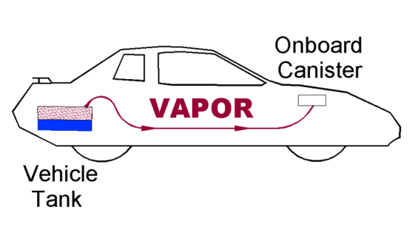
Officially Decommissioned
Stage II Vapor Recovery

Slide 16
Officially Decommissioned Section 21(vii)
(vii) A gasoline dispensing facility is considered fully decommissioned once the following conditions have been met:
  (I) All of the requirements in Subparagraph 21.(ii) have been met;
  (II) All tests required in Subparagraph 21.(iii) have been conducted and performance requirements met; and
  (III) Test report(s) as required in Subparagraph 21.(v) have been submitted to and approved by the Division.

Slide 17
Officially Decommissioned (cont.)
Requirements of 21(ii)
  Disconnected and capped all necessary Stage II piping.
  Disconnected and/or removed all required Stage II equipment.
Testing: Pressure-Decay and Tie Tank Test have been conducted and passed
Test reports submitted and approved
  Stage II Decommissioning checklist
  Test Notification
  Approved Test Report

Slide 18
Outreach on Decommissioning
Website: www.georgiaair.org
  Click on Mobile & Area Sources Program
  Then click on Engines and Fuels Unit
  Then click on Stage II
Held two workshops
  April 10, 2014 workshop
  Informational letter
  June 11, 2014 workshop
Association Letters
  Georgia Association of Convenience Stores
  Georgia Oilmen’s Association
  Georgia Tank and Environmental Contractor’s Association
Word of Mouth

Slide 19
Summary
Decommissioning begins and ends on ?
May 1, 2014 and April 30, 2016
Facilities with Stage II must do what until they decommission?
Operate, Maintain, and Test Stage II Equipment
What must be done to be fully decommissioned?
Disconnect and remove required system components
Conduct Pressure-Decay and Tie Tank Tests
Submit Stage II checklist, test notification, and test reports

Slide 20
Resource Information
EPD Website:
  www.georgiaair.org/airpermit/html/mobilearea/engines.htm
  www.gaepd.org
Petroleum Industry Regulatory Team
  Yasra Adowar, Engineer
  404-583-8997
  Yasra.adowar@dnr.state.ga.us
  Shaheer Muhanna, Unit Manager
  404-362-2579
  Shaheer.muhanna@dnr.state.ga.us
Bassey Udosen
  404-363-7050
  Bassey.udosen@dnr.state.ga.us
William Cook
  404-363-7031
  William.cook@dnr.state.ga.us

Slide 21
Questions
Announcements From GTEC – Bill Greer
?

