Slide 1


Introduction and Overview
Migrating from paper to electronic plan submissions

Slide 2
Electronic Submissions
The Environmental Protection Division will soon accept electronic plan submissions through the goPost software.
This software will provide a direct link from our customers to reviewers utilizing the e-Plan software.

Slide 3
goPost-Making Life Easier
Applicants may create and manage many (unlimited) plan review application projects
Reduces the plan review processing times by eliminating the need for trips to submit plans in person, printing cost and shipping fees.
Applicants receive automated email notifications when their project application's status changes
Fully web-based application that is tightly integrated into e-PlanREVIEW®

Slide 4
What is goPost
goPost is a web-based citizen self-service portal that allows applicants to upload and submit plans for review, manage document versioning, access reviewer comment reports, and download reviewed and approved plans.
goPost provides public access at anytime and is a no cost service to our customers.

Slide 5
Know Your Portal
The GA. Environmental Protection Division will issue a specialized URL to their specific customer base.
The URL guides the user to the Program specific dashboard that will allow them upload plans specific to that Program.

Slide 6
In order to begin the electronic submission process, you will need to become an applicant.
The Applicant is a member of the public who needs to submit a project application to an agency for approval.
In goPost, Applicant tasks include:
Create a new Applicant account
Create a project application for each new project.
  At a minimum, fill out the required DETAILS, PROPERTY LOCATION, and ADDITIONAL INFORMATION fields under the “INFORMATION” tab.
  Provide contact information.
  Upload appropriate project application documents.
  Communicate back to agency staff as needed.
Review the project application information and documents to ensure they are ready for submittal.
Submit the project application to signal to agency staff that it is complete.
Download the Deliverables Package when instructed by agency staff.
  Deliverables will either include marked-up plans that require resubmittal or an approved, stamped plan set.
Resubmit documents as instructed whenever necessary.
Communicate with agency staff throughout the process as necessary using goPost.
Applicant

Slide 7
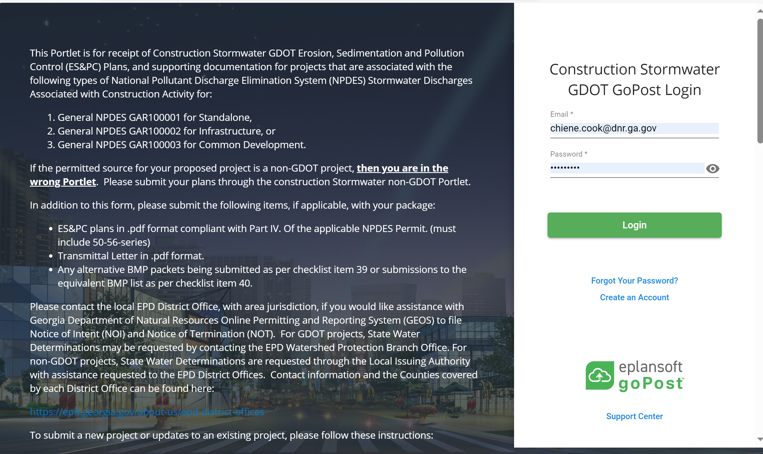
Once on the log-in page to the left of the log-in credentials you will find Program specific instructions for uploading your plan set. Please take the time to read over these requirements.

Slide 8
Creating a goPost account
Applicants that are signing into goPost for the first time, will need to create a new user account.
Steps to create the account
From the login page, click Create an Account.
At a minimum, fill in the required fields (indicated by asterisks ( * )). See Figure 1.
Click SAVE.
Click Ok on the confirmation message.
You have now created an account. An email with your login credentials will be sent to your inbox.

Slide 9
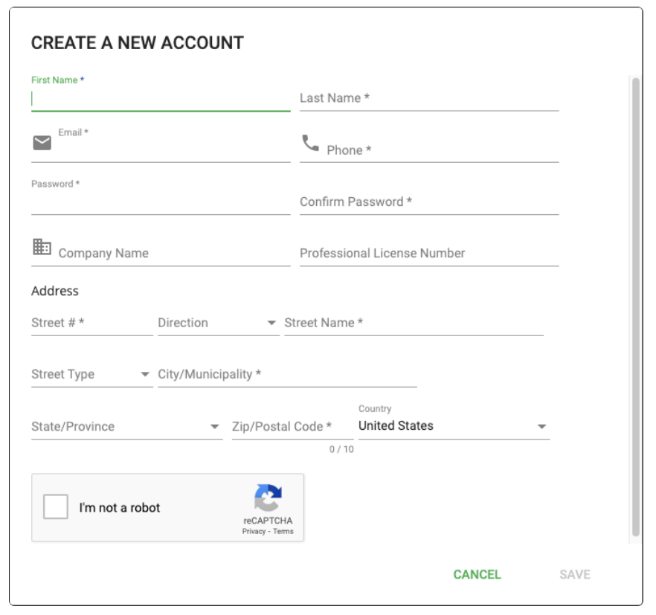










Creating a goPost account

Slide 10
Creating a goPost account
After you have received the email with your account information you will then log into the goPost system.
If you’re still on the login page, enter your email and password, and click Login.
OR from your email, click the link, enter your email and password, and click Login.
If you are just signing up for goPost you will need to do a two-factor authentication process.
Two-factor authentication protects your account from unwanted access.
Select three security questions for which only you will know the answers.
Fill in your answer for each security question.
Click SUBMIT.
Passwords and security answers are stored in such a way that no one else will know them.
If you cannot remember your security answers, consult Resetting Security Questions.

Slide 11
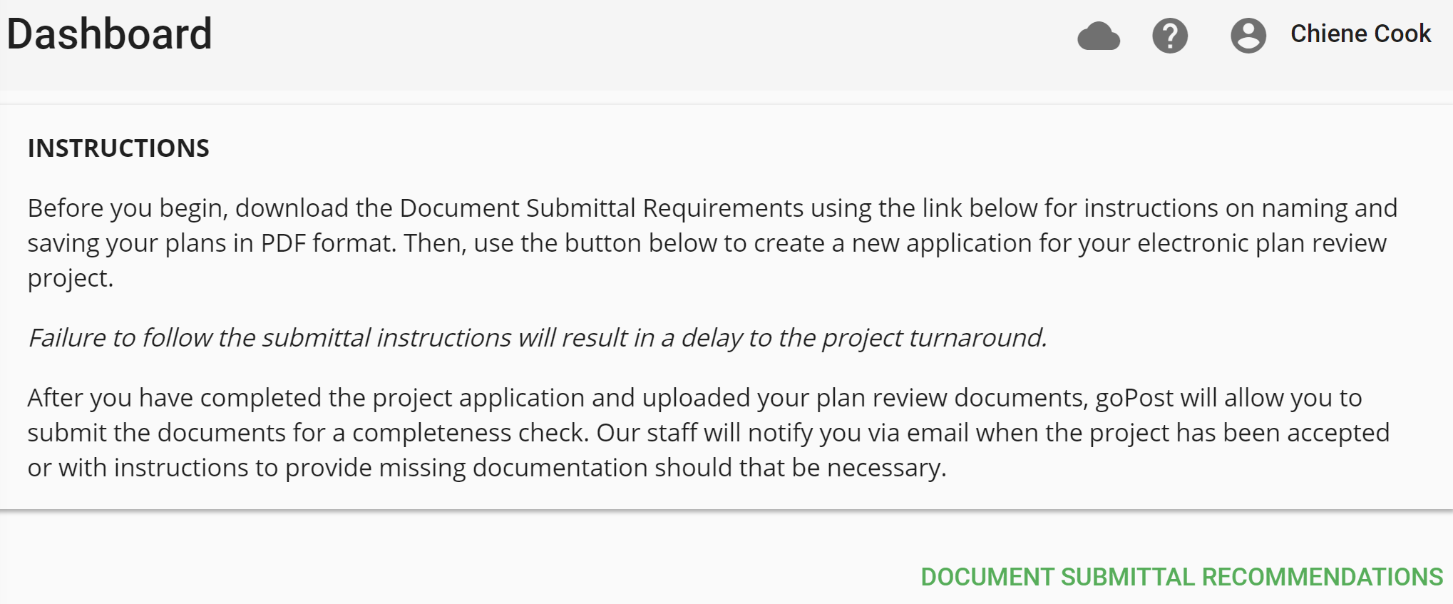
plans
Ready to Submit Plans
After logging into the system you will be on the dashboard page, please take a moment to read the instructions and submittal requirements which are located at the top of the page.
goPost - Dashboard (eplansoftreview.com)

Slide 12
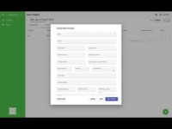
Creating a submission in goPost

Slide 13
Project Intake Process: things to note
1. After you have submitted your project application and documents for an intake completeness check, the project status will be changed from Created to Pending. Intake/Review personnel will review the project information and submitted documents to determine whether the project is acceptable. You will receive an email when the Intake/Review staff have accepted your project.
2. You must be sure to list your contact information to receive email notifications related to your project submission.
3. If documents do not meet submittal requirements or if the required project information has not been provided, you will receive an email with instructions on how to proceed. The email will notify you that the project application has been placed on hold until you respond. Once you have gathered the required information, log in to your goPost account, open the project application and either replace the named documents with the correct documents or provide the missing project information as instructed and submit to intake staff again.
4. If intake staff determines that everything looks appropriate then the application will be accepted. You will receive an email updating you on the status. Staff will then assign plans for review.
5. You will receive additional emails when:
Staff needs to communicate with you regarding the application.
Review has been completed and staff determines that corrections are required.
Download or update of the deliverable package is required.
You will receive a system generated email to inform you when your deliverable is ready. Please note- the deliverables tab will only display in goPost when there are items to download.
Review has been completed and your application has been approved. Your approved plans will be made available for download via goPost or you may be given other instructions.

Slide 14
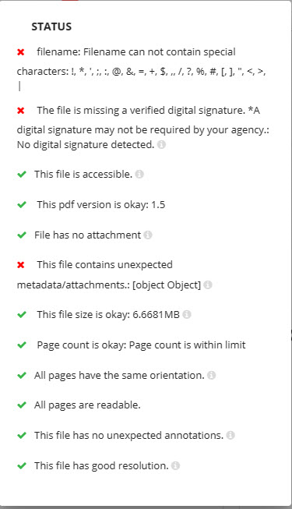
Errors and Troubleshooting
The goPost system provides a built–in safeguard known as Scout that will check submittals for adherence to upload requirements. Scout will provide a message indicating the error and what needs to be addressed in order for the upload to be successful.
This sample Scout error message shows the problems associated with upload indicated by those items marked with a red X

Slide 15
Errors and Troubleshooting
Eplan Review also provides an extensive wiki page for any issues that may arise with the system. While in goPost on the dashboard page, in the top right corner there is a ? icon click this symbol to access the wiki.
goPost - Dashboard (eplansoftreview.com)
If you are unable to resolve your issue via the wiki page you may reach out to our System Admin team at the following link:
Zendesk support link :
To create a ticket, click here: Zendesk

Slide 16
In Closing . . .
Questions
and
Comments

Slide 17

Thank You!

