Slide 1
Stage II Vapor Recovery Decommissioning Testing
1. Test Notification & Protocols 2. Test Procedures

Slide 2
Test Notifications and Protocols
Enhanced Vapor Recovery Stage I (State Rule) is required in blue, purple, and red counties (23 counties)
Stage II – red counties
EPA Stage I Rule covers all other counties

Slide 3
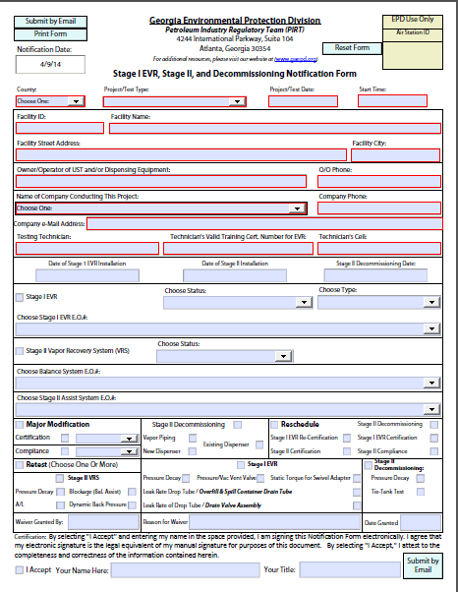
Test Notification - Decommissioning
Notification using appropriate form
Form has been updated
Supply all the information required on the form
Test Notifications
Must be submitted Five (5) or more work days prior to the test (Holidays and weekends do not count as work days)
Tests cannot be scheduled during non-working hours - which includes holidays, weekends, and times where the tests that cannot be completed by 4:30 p.m.
Bad Test Schedules
Two tests with same start time, one testing crew
Late tests: anything after 1:30 p.m. (Later tests can be scheduled, however, tests must be completed by 4:30 p.m.)

Slide 4
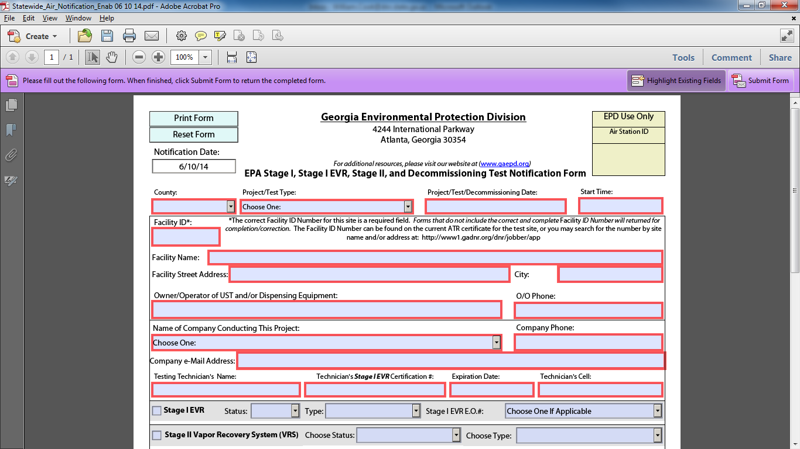
Test Notification - Decommissioning
Facility Information Section
Date Stage II system is disconnected

Slide 5
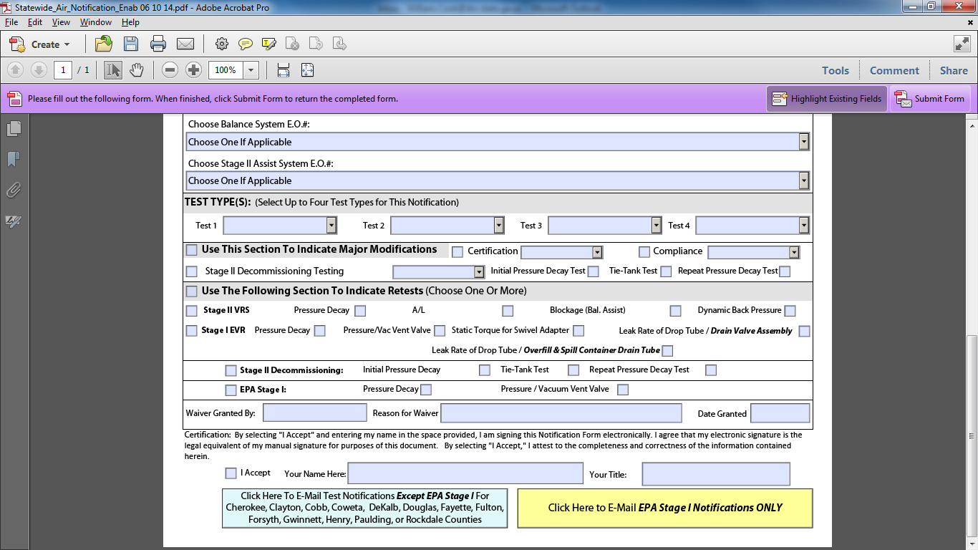
Test Notification - Decommissioning
Indicate type of test – EVR and Decommissioning tests can be done on the same date.

Slide 6
Test Equipment
Accurate and calibrated test equipment
Complete test equipment
Readable Flow meter (should note units of measurement)
Readable Pressure Gage (with units of measurement)
Accessible to inspector
Pressure Decay
Gauge must be on 2.0” w.c. and nothing more
Count starts when the gauge is on 2.0” w.c.
Readable from the same angle

Slide 7
Test Reports
Test Reports must be submitted 30 days after the test.
Owners are responsible for report submission.
If submitting the report is not a part of your contract, please make sure the owner knows that they are responsible for submitting it to EPD within 30 days.
EPD will not send a “friendly reminder”.
Notice of Violation for not submitting test report within 30 days.
Yasra will cover more details on the report form.

Slide 8
Decommissioning Tests
Two tests are required
TP-201.3: “Determination of 2 Inch WC Static Pressure Performance of Vapor Recovery Systems of Dispensing Facilities” (adopted April 12, 1996)
TP-201.3C: “Determination of Vapor Piping Connections to Underground Storage Tanks (Tie-Tank Test)” (adopted March 17, 1999)
Other Stage I Enhanced Vapor Recovery tests can be conducted if facility desires to combine the Decommissioning and EVR tests.

Slide 9
Pressure Decay Test – TP201.3
Pressure Decay test must be conducted first
Ensures that the Stage I EVR system has no major leaks
Conduct tests per CARB Test Procedure

Slide 10
Tie Tank Test – TP201.3C
Primary purpose of test
Ensure that all vent lines are still connected to USTs
Secondary purposes
Determine if all gasoline underground storage tanks ullage spaces are manifolded
Ensure that diesel tanks are not manifolded to gasoline tanks

