Slide 1
Tie Tank Test Form
By
Yasra Adowar
Petroleum industry Regulatory Team

Slide 2
Tie Tank Test Form-Dashboard
Select project type from the list.
Click on the link to look up the facility ID.
Select county from the list.
The first part of the dashboard is the information for the site and contractor(s) performing the Stage II decommissioning. Please complete all fields. The information will auto-populate on the option forms (see slide 7).
Select the specific option type used for this test.
Click on the link to the form you wish to complete.

Slide 3
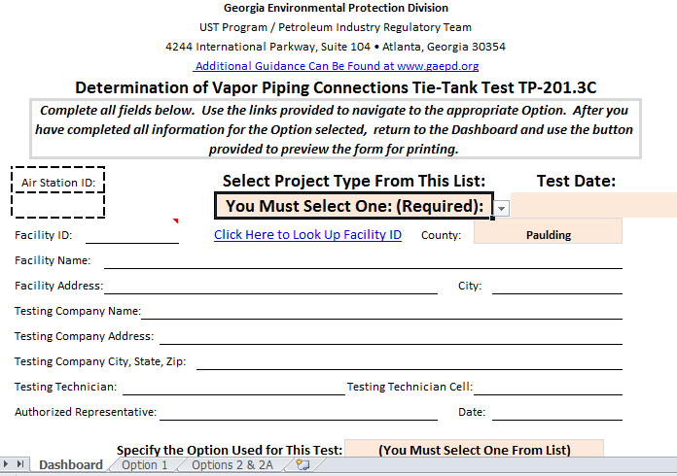
Tie Tank Test Form-Dashboard

Slide 4
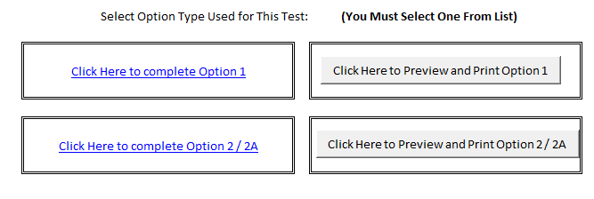
Tie tank test form

Slide 5
Tie tank test form-test procedure option 1
Stage I remaining system must pass the pressure decay test before and after conducting the tie tank test.
Disconnect the above ground manifold if present.
When system under pressure (for condition A) chose your vapor flow point one at a time and avoid dropping the pressure to zero in order to reduce vapor and nitrogen losses. However, for tanks with liquid manifolds, pressure must be dropped to zero when testing each tank.
The test must verify that only gasoline tanks are manifolded either above or below ground and all vent lines are functional.

Slide 6
Tie tank test form
The test report contains the following parts:
First section collects information on the site and companies performing the Stage II decommissioning work and testing.
Second section includes option 1 for tie tank test in conjunction with pressure decay and option 2 & 2A for Tie Tank test in conjunction with Blockage test.

Slide 7
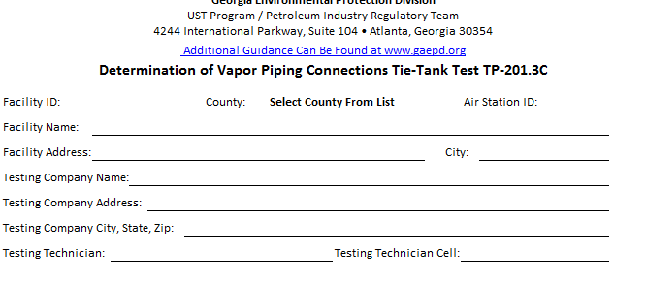

Tie tank test form

Slide 8
Tie tank test form
Please list the number of tanks and vents.
Follow the test procedures as it is written in the test report form.
Answer all questions for yes and no.
Enter pressure gage reading for test option chosen.
Answer all questions listed at the bottom of the test form page for all options.

Slide 9
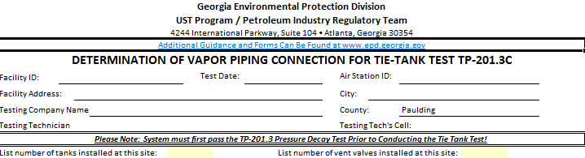
Tie tank test form

Slide 10
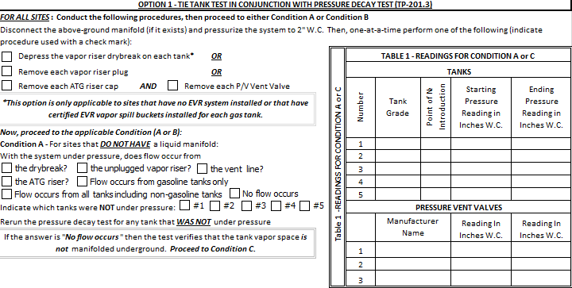
Tie tank test form

Slide 11
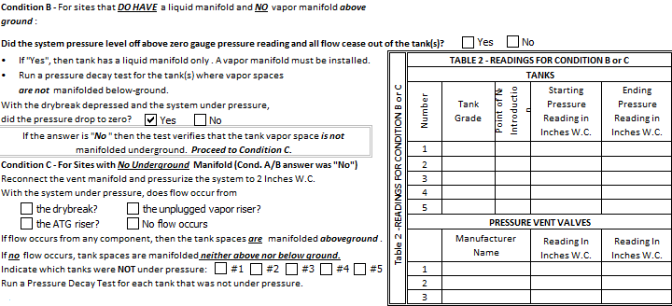
Tie tank test form

Slide 12
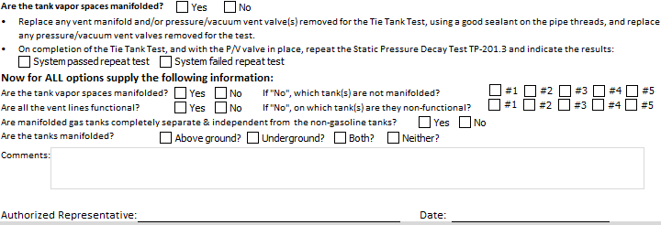
Tie tank test form

Slide 13
Tie tank test form
The lower section is for the certification of the accuracy of the information submitted and that it is true and accurate to the best of the knowledge of the authorized agent. Typed name of company representative will be auto-populated as signature when e-mailed.
The comment section is to be used if you have additional information.
After completing the form return to Dashboard and use the preview and print your form.
If you have questions about the test form information, please contact Yasra Adowar at 404-583-8997.
For Data Entry problems, please contact Maggie Williams at 404-362-2697.
Email the completed form along with the pressure decay tests performed.

Slide 14

Questions

