Slide 1
AWWA Water Loss Audit Software v6.0 Pilot Program Results
Johanna Smith, P.E.
Georgia Environmental Protection Division
GAWP Annual Conference
July 2021

Slide 2
Presentation Outline
Water Efficiency Requirements in Georgia
Water Efficiency Activity in Georgia
What’s New?
Considerations for Version 6 Migration
Version 6 Pilot Program Overview & Results
Planning for Version 6 Use
Summary

Slide 3
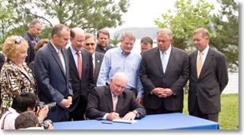
Origins of tracking water loss in Georgia
Originated with the Water Stewardship Act (WSA) enacted by 2010 Georgia General Assembly
Recognized the imminent need to:
Create a culture of water conservation in the State of Georgia
Plan for water supply enhancement during future extreme drought conditions and water emergencies
Georgia Rule 391-3-33 promulgated to implement WSA
Source: https://www.gawp.org/page/WaterLossAudits
Notes:
If you have seen me present on water loss or water efficiency before, you might recognize this slide. I think it’s always good to have a reminder about where these policies and practices come from and why they are important.

Slide 4
Rules for Public Water Systems to Improve Water Supply Efficiency
Georgia Rule 391-3-33 promulgated to implement WSA
Applies to:
Systems serving >3,300 individuals
All permit renewals and modifications to increase permitted water withdrawal limits or number of service connections
Requirements Include:
Conduct Annual Water Loss Audits (due March 1)
Development of Water Loss Control Program
Development of individual goals to set measures of water supply efficiency (defined by water system)
Demonstration of progress toward improving water supply efficiency

Slide 5
Water efficiency activity in georgia
2011
Audits:
2012-13
Audits:
2014
Audits:
2015-16
2017-19
2020
Annual AWWA Auditing Begins
Resources:
GAWP Water Loss Control Committee Formed
V1.0 GA Water Loss Control Manual (Manual) Published
Validation of 2011 Audits
Resources:
Statewide Training on Water Auditing & Technical Assistance Projects
(Small Systems)
Validation of 2012,2013 Audits
Version 5 Software Released
Resources:
V1.2 Manual Published
Statewide Technical Assistance Projects (Small Systems)
Audits:
Audit Validation Certification Program (QWLA) begins with 2015 Audits
Resources:
V2.0 Manual Published
Statewide Technical Assistance Projects (Large Systems)
Audits:
Validation of 2014 Audits
Resources:
Guidance for Demonstrating Progress toward Improving Water Efficiency Released
Statewide Technical Assistance Projects (All Systems)
Audits:
Version 6 Software Released
Resources:
Water Loss Control Program Template Released
Notes:
This is a general timeline of the activity stemming from the passage of the Water Stewardship Act and promulgation of the Water Efficiency Rules. As you can see, activities involve both completion of annual water loss audits (using the AWWA Water Loss Audit software) and creation of resources to build off the results of the water loss audits completed. For the purposes of this presentation, the two points to note here are the releases of Version 5 and Version 6 of the audit software.

Slide 6
What’s New?
In December 2020, AWWA released an updated version of this software (Version 6)
To better understand potential implications of this update, EPD launched a voluntary Version 6 Pilot Program.
Updates to format
Adjustments to assumptions and some calculations
The results of this Pilot Program have helped inform EPD policy to implement Version 6 usage in Georgia.
Next year, each system will have the option to submit Version 5 or Version 6 to satisfy its water audit requirement.
Notes:
The following slides in this presentation will discuss the components on the Version 6 Pilot Program

Slide 7
Considerations for version 6 migration
Regulatory Impacts
Water supply efficiency improvement determines ability to renew or modify water withdrawal and drinking water permits (from Rule 391-3-33)
Progress informed by trends in water audit indicators
Currently Available Resources & Training
AWWA M36 Manual
Georgia Water Loss Control Manual
Annual Basic Water Loss Audit Training
Annual Qualified Water Loss Auditor (QWLA) Training
Photo Source: https://www.lonelyplanet.com/articles/koalas-endangered-species-australia

Slide 8
Version 6 pilot program Overview
Basic Requirements
Mandatory submission of V5
Voluntary submission of V6
Feedback Request
EPD Survey
Follow-Up Meetings with EPD
Responses
What were their experiences with using V5 vs. V6?
What is missing to make V6 experience easier, more efficient, and more effective?
EPD Evaluates Responses and Results
Who responded?
Results
How do the outputs generated by V5 & V6 compare?

Slide 9
How do Results generated by v5 and v6 compare?
Results Breakdown | Number of Systems | Percent of Systems
V6 Received | 21
No/Little Change (DV + Real Loss) | 10 | 48%
DV Change, No/Little Change to Real Loss | 7 | 33%
No/Little DV Change, Real Loss Change | 2 | 10%
DV Change, Real Loss Change | 2 | 10%
Notes: “No/Little Change” defined as <10% change in value
DV = Data Validity Score
Majority of DV changes decrease in V6 (compared to V5)
Majority of Real Loss changes increase in V6 (compared to V5)

Slide 10
Who Participated?
Pilot Program Participating Systems | Number of Systems | Percent of Systems
V6 Audits Received | 21 | -
System Population Served
> 100,000 | 6 | 29%
10,000 to 100,000 | 8 | 38%
3,300 to 10,000 | 7 | 33%
Survey Respondents | Number of Respondents | Percent of Respondents
Survey Responses Received | 17 | 81%
Certified QWLA | 17 | 100%
Years of Experience Validating V5 Audits
Less than 1 | 1 | 6%
1 - 2 | 3 | 18%
3 - 5 | 7 | 41%
5+ | 6 | 35%
Previous V6 Exposure (Beta, GAWP presentation) | 5 | 29%
Notes:
Should I split these into 2 slides? I thought it might be good to see them side by side

Slide 11
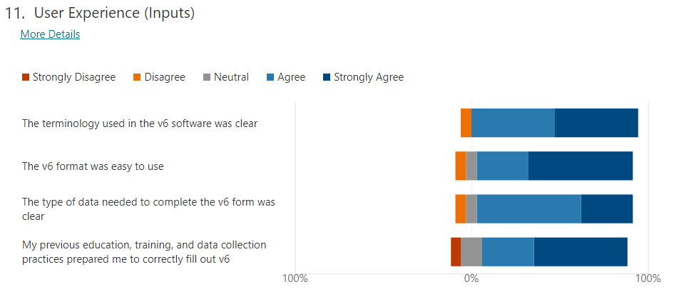
Experiences using v6
5.9%
47.1%
47.1%
5.9%
29.4%
58.8%
5.9%
58.8%
29.4%
5.9%
29.4%
52.9%
11.8%
Note: Not all respondents answered all questions

Slide 12
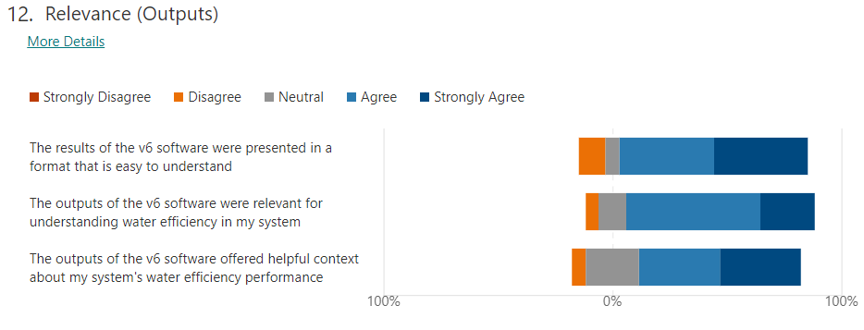
Experiences using v6
5.9%
41.2%
41.2%
11.8%
5.9%
58.8%
23.5%
11.8%
5.9%
23.5%
35.3%
35.3%
Note: Not all respondents answered all questions

Slide 13
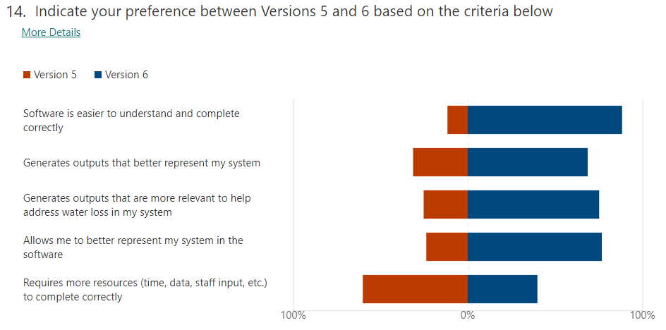
How do experiences using V5 and V6 Compare?
88.2%
68.8%
75%
76.5%
40%
Note: When asked whether they preferred to use V5 or V6 for next year’s water loss audit submission, 16 of the 17 respondents (94%) preferred to use V6.

Slide 14
What is missing to enhance the V6 Experience?
Other Suggestions:
Workshop with other state AWWA sections to discuss V6 validation
Training for small municipalities
Software training day for V6

Slide 15
Planning for version 6 use in georgia
Regulatory Impacts
Resources
Training
Water Loss Control Program education and implementation
Version 6 Pilot Program for 2020 water loss audit submissions
EPD coordinating with other states/provinces to create standardized North American educational materials
Georgia Basic Water Audit
Creation of a new “QWLA Booster” training
AWWA updating M36 Manual
Water Research Foundation Project #5057 “Level 1 Water Audit Validation Guidance Manual, Second Edition”
Updates to Georgia training anticipated by Fall 2021
Possibility for more frequent training in the future
GAWP Water Loss Committee to update GA Water Loss Control Manual
QWLA training
Source: https://positiveprints.com/product/hydrological-map-of-north-america/

Slide 16
Summary
Pilot Program is complete
Most systems saw minimal changes in results generated by V6 vs. V5
Clear preference for V6 use
Suggestions obtained for useful resources to fully implement V6 usage in Georgia
Coordination with AWWA, GAWP, and other states/provinces ongoing to create standard, updated resources and training for V6
Georgia-specific training updates (Basic, QWLA Booster, QWLA) expected to be complete by Fall 2021
Systems will have the option to submit either V5 or V6 next year

Slide 17
Training updates opportunity
EPD is seeking professionals to become Certified v6 Trainers
Email Johanna Smith with interest by July 31, 2021
Requirements
Be a current QWLA (v5)
Demonstrate completion of at least 4 water audit validations in GA
Complete training as shown:
Step | Dates | Time Commitment
Inaugural QWLA Booster Course | 8/31 | 8 AM – 5 PM (Virtual)
Pass QWLA v6 Exam | 9/1 | Up to 4 hr (In-Person, GAWP HQ Marietta)
Shadow Public QWLA Booster | 9/9 | 8 AM – 5 PM w/30-min call on 9/8 (Virtual)
Shadow Public QWLA (v6) | 9/13 – 9/16 | 1 PM – 5 PM each day (Virtual)
Review Meeting | TBD | 1 hr (Virtual)

Slide 18
Questions?
Johanna Smith, P.E.
Surface Water Unit Manager
Water Supply Program
Phone: 470-607-2904
Email: Johanna.Smith@dnr.ga.gov
Wei Zeng
Water Supply Program Manager
Phone: 404-463-2883
Email: Wei.Zeng@dnr.ga.gov

