Slide 1
Water Supply Efficiency Improvement: The EPD Approach
Johanna Smith, P.E.
Georgia Environmental Protection Division
GAWP Fall Conference
November 19, 2020

Slide 2
Presentation Outline
Water Loss Control Program (WLCP) Requirements in Georgia
Georgia’s Strategy to Encourage Improvement of Water Supply Efficiency
WLCP Evaluation at EPD
Implications for EPD Processes
Reminder: Demonstration of Progress
Summary

Slide 3
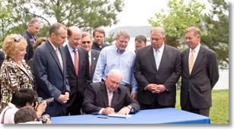
Origins of tracking water loss in Georgia
Originated with the Water Stewardship Act (WSA) enacted by 2010 Georgia General Assembly
Recognized the imminent need to:
Create a culture of water conservation in the State of Georgia
Plan for water supply enhancement during future extreme drought conditions and water emergencies
Georgia Rule 391-3-33 promulgated to implement WSA
Source: https://www.gawp.org/page/WaterLossAudits

Slide 4
Rules for Public Water Systems to Improve Water Supply Efficiency
Georgia Rule 391-3-33 promulgated to implement WSA
Applies to:
Systems serving >3,300 individuals
All permit renewals and modifications to increase permitted water withdrawal limits or number of service connections
Requirements Include:
Conduct Annual Water Loss Audits (due March 1)
Development of Water Loss Control Program
Development of individual goals to set measures of water supply efficiency (defined by water system)
Demonstration of progress toward improving water supply efficiency
Notes:
*Go through quickly, more detail later in the slides

Slide 5
Detail in the Rules: Water Loss Control Program Elements
391-3-33.05(1) Water Loss Control Programs
Water Loss Control Programs must be updated periodically as needed
Should include, but may not be limited to:
Leakage Management (includes distribution system leak detection and repairs)
Finished Water Meter Flow Verification
Customer Water Meter Testing and Calibration
Resource Allocation (includes planned preventative maintenance)
Revenue Recovery Activities
Notes:
Everything we do at EPD stems from the Rules;
Here, the Rules give us a general guideline of the desired elements of an adequate Water Loss Control Program and how to evaluate it in two ways:
Possible sections of a WLCP
Acknowledging the need for the creation of concrete goals and timelines (by the system) that are tied to indicators in the annual water loss audit

Slide 6
Detail in the Rules: Water Loss Control Program Elements
391-3-33.05(2) – Individualized Goals
Each public water system shall establish individual goals to set measures of and improve water supply efficiency
Should include, but may not be limited to:
Infrastructure Leakage
Water Audit Data Validity Score
Operational Basic Apparent Losses
Operational Basic Real Losses
Economic Level of Leakage
Notes:
The Rules give us some guidance about the types of individual goals that might be considered in a WLCP. Note that they don’t limit the types of goals to be included, but they specify clearly that systems should create and implement their own specific goals.

Slide 7
Water Efficiency Elements in Georgia Regulations
Demonstration of Progress
Water Loss Control Program
Water Audit
Individualized Goals
Implementation Timelines
Action Items to Achieve Goals
Notes:
The three main elements of the Rules are extremely interconnected. All data used to determine individual goals, courses of action, and gage demonstration of progress stems from the water audit.

Slide 8
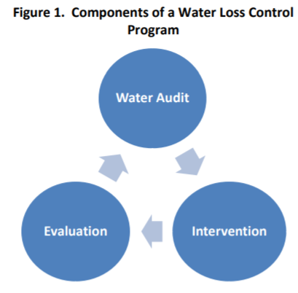
Development of Water Loss Control Program
EPD’s approach combines 391-3-33-.05(1) and 391-3-33-.05(2) – Water Loss Control Programs and Individualized Goals
EPD Criteria for Water Loss Control Program Review
Completion and implementation for public water systems as required
Prioritization of activities based on results of annual water audits
Establishment of measurable goals and timelines for implementation
Reflection of needs and abilities of the individual system
Reference: Water Audits and Water Loss Control for Public Water Systems, Environmental Protection Agency (EPA)
Notes:
What makes a WLCP “adequate?” It is in the best interest of the system, both for operations and justifying future “progress toward improving water supply efficiency” to EPD, to have a detailed program with well-documented steps for achieving specific goals. These allow clear demonstration of progress at any point in the process of improving operations.

Slide 9
Water Loss Control Program Criteria Details
EPD will review all WLCPs submitted as part of the permitting process for adequacy. A WLCP:
Must consider at least 3 areas recommended by the annual audit;
Must acknowledge any audit recommendation that was not prioritized and explain the reason;
Must reflect the needs and abilities of the individual system;
Can pursue other priorities based on specific needs and characteristics of system; and
May consider other applicable goals (i.e. Metro District Water Loss Targets, etc)
Note: All proposed actions, goals, and timelines in the program should be proposed by the system, not EPD
Notes:
How does analysis of these criteria look in practice? These are the basic guidelines EPD is using to evaluate WLCPs received as part of the permitting process.

Slide 10
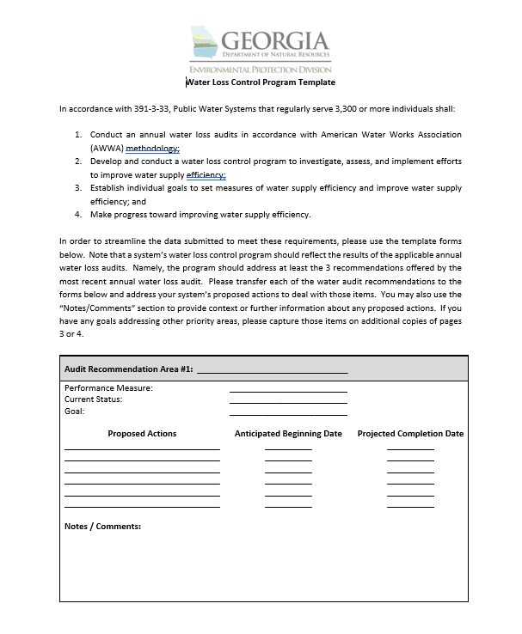
Water Loss Control Program Evaluation
To streamline the review process, EPD has created a Water Loss Control Program Template
The template provides a format to provide information related to the criteria outlined in the previous slide
References 3 recommendations provided in all audit results and provides space to add other priorities
Available by request from Georgia EPD or online at: https://epd.georgia.gov/watershed-protection-branch/water-efficiency-and-water-loss-audits

Slide 11
Implications for EPD Processes
Reminder, the Rules for Public Water Systems to Improve Water Supply Efficiency require the following:
Conduct Annual Water Loss Audits (due March 1)
Development of Water Loss Control Program (as of July 2016)
Development of individual goals to set measures of water supply efficiency
Demonstration of progress toward improving water supply efficiency
Notes:
As a reminder – All of the criteria and requirements we have discussed so far are building toward a more structured way of demonstrating progress toward improving water supply efficiency. We’ve already discussed the elements a WLCP must contain to be considered “adequate” by EPD and the materials EPD is providing to aid systems toward reaching that goal. Now we’ll talk about how ensuring compliance with the Rules and encouraging systems to increase their water supply efficiency plays out in existing EPD permitting processes.

Slide 12
EPD Procedural changes
Additional Permit Requirements (Withdrawal Permits)
WLCPs now requested as part of application
If a system doesn’t yet have one, submission may be required in the applicable permit
Annual progress reports required in permits related to implementation of WLCPs
Purchase water systems are subject to all rule requirements but are not affected by requirements in withdrawal permits at this time
Submission and Review of Water Loss Control Programs
Ensures system complies with requirements of the Rule (391-3-33)
Encourages system to consider specific, measurable actions to improve its water supply efficiency
Establishes framework and context for EPD’s evaluation of “progress toward improving water supply efficiency” in future permit requests
Notes:
This slide outlines new requirements systems will notice in their water withdrawal permitting processes. A reminder that these requirements flow from existing Rules. These tasks are EPD’s current approach toward fairly and transparently implementing the Rules.

Slide 13
Reminder: Demonstration of progress
What is Progress? (from Rule 391-3-33)
Improvement of Data Validity Score (DV)
Development and implementation of a Water Loss Control Program
Improvement in performance measures once a reliable DV score has been achieved
Apparent Losses (gal/conn/day)
Real Losses (gal/conn/day or gal/length of main/day)
Note: Do not use % based indicators for this analysis
Economic Level of Leakage has been achieved and maintained
How does EPD evaluate it?
Data trends and comments available from past Water Audits
EPD may request a narrative explaining variability and any programs or measures you have implemented to reduce water loss
Notes:
This slide should look familiar if you saw my previous presentation about “demonstration of progress” last year. I wanted to bring it back up to remind you of how the Rules define “progress” and how EPD evaluates it in our permitting processes. You’ll notice that in our evaluation we consider two main sources of data: the audits themselves and reports from systems. The type of content a narrative would contain, such as information about programs or policies planned or in place to reduce water loss, is similar (if not identical) to the type of content we would want to see in a WLCP or associated progress report.

Slide 14
Summary
Water Loss Control Programs are part of Georgia’s overall strategy to encourage progress toward improving water efficiency
Requirements come directly from Rule 391-3-33
EPD has developed a template to focus submission of relevant Water Loss Control Program data
EPD is requesting annual updates on progress toward goals in WLCPs
Information provided in WLCP and associated progress reports by systems helps to construct narrative and provide data to demonstrate “progress toward improving water efficiency”

Slide 15
Questions?
Johanna Smith
Surface Water Unit Manager
Water Supply Program
Phone: 404-656-6937
Email: Johanna.Smith@dnr.ga.gov
Wei Zeng
Water Supply Program Manager
Phone: 404-463-2883
Email: Wei.Zeng@dnr.ga.gov
Bill Frechette
Groundwater Unit Manager
Water Supply Program
Phone: 404-656-6937
Email: Bill.Frechette@dnr.ga.gov
Tim Cash
Water Supply Program
Phone: 404-463-3948
Email: Tim.Cash@dnr.ga.gov

