Slide 1
GEOS Training for Applications & Reporting
The Georgia Environmental Protection Division
GEOS Technical Assistance site: https://epd.georgia.gov/geos

Slide 2
Account Groups or User Types
Fee Payment
  Only makes payments using GEOS
Preparer
  Only fills out permits, applications & reports with GEOS
Responsible Official or RO
  Manages preparers but can also prepare and make fee payments

Slide 3
What is GEOS?
The Georgia EPD Online System (GEOS) is a portal for online electronic permit applications including:
Brownfield
Construction Storm Water
EAF Fee Remitter
Hazardous Substance Fee
Hazardous Waste Fee
Industrial Pre-treatment Program
Industrial NPDES
Lead-Based Paint & Asbestos
Municipal LAS Permits
Municipal Wastewater GEFA
NPDES Wastewater
Scrap Tire
Solid Waste
Storm Water Industrial
Title V
Trust Fund
Invoice Payment Only
Underground Storage Tank
Underground Injection Control Permit
Waste Reduction
Voluntary Remediation Program
New applications will be added to GEOS over time.

Slide 4
What are the benefits of GEOS?
Improves program effectiveness and efficiency.
Reduced workload for managing data.
Reduction in printing and mailing costs.
Gives permittees the ability to track their permit status electronically.
Web Based – no software to install

Slide 5
GEOS Website:
This should be your starting point
http://epd.georgia.gov/geos
Training material and documentation
FAQ
Training calendar
Important Links (GEOS testing and live site)
Information about GEOS

Slide 6
General Agenda Overview
Understanding GEOS account groups and types.
Creating an account for GEOS.
Managing an account for GEOS.
Fill out/Submit application(s) within GEOS.
Managing/Tracking Applications within GEOS
Fee Payment & Public Portal

Slide 7
Account Groups & Privileges
User Type | Purpose | Account Privileges
Fee Payment | Fee Payment Account Type is designed for users who only want to use GEOS to make payments. | View and submit Online Payment Track account transactions
Preparer | A preparer is someone who is assigned by a RO to create and prepare applications for their facility. The preparer “generally” has no right to actually submit an application but can prepare applications for a single or multiple ROs that they have been associated with. The types of application and the facilities that the preparer can prepare applications for are all defined by the RO. An RO can be associated as a preparer for another RO. | View and prepare an electronic data entry form in GEOS View submitted data in GEOS Keep track of the status of submitted records Keep track of issuances

Slide 8
Account Groups & Privileges
User Type | Purpose | Account Privileges
Responsible Official (RO) | Only the RO account can certify and submit applications in GEOS. An RO can only maintain one User Account; this account inherently has Preparer privileges. This one account may be assigned RO privileges for certain facilities and Preparer privileges for others. Generally, for an RO to submit an application, they must first be approved by the EPD as the RO for that facility. An RO can request additional Account Types through the GEOS system | Certify and submit a data entry form in GEOS Associate a consultant to their account to prepare applications View and submit Online Payment Track account transactions View and prepare an electronic data entry form in GEOS View submitted data in GEOS Keep track of the status of submitted records Keep track of issuances

Slide 9
Account Groups & Types
GEOS has three account groups and twenty two account types for the regulated community. Your access to these account types will be determined by the account group you belong to.
Account Group | Account Type
Fee Payment | Fee Payment
Preparer | Preparer
Responsible Official | RO for: Brownfield, Construction Storm Water, EAF Fee Remitter, Hazardous Substance Fee, Hazardous Waste Fee, Industrial Pre-treatment Program, Industrial NPDES, Lead-Based Paint & Asbestos, Municipal LAS Permits, Municipal Wastewater GEFA, NPDES Wastewater, Scrap Tire, Solid Waste, Storm Water Industrial, Title V, Trust Fund, Invoice Payment Only, Underground Storage Tank, Underground Injection Control Permit, Waste Reduction & Voluntary Remediation Program

Slide 10
Identity Proofing
In order to be approved as a Responsible Official for a facility you may first have to have your identity proofed
The type of Identity Proofing that you must use is dependent on the types of applications you are requesting
Identity Proofing is done by e-verify or ESA (Subscriber Agreement)

Slide 11
Identity Proofing
All identity proofing is a two step process
  First you submit your information to EPD
    ESA or E-Verify
  Second EPD reviews your information and if qualified they will approve you
Once approved by EPD you will receive email notification that you are approved

Slide 12
Identity Proofing
Identity Proofing is Not Required if you are only requesting any of the following
  Invoice Payment Only
  RO/Owner for Brownfield
  RO/Owner for Hazardous Waste Fee
  RO/Owner for Hazardous Substance Fee
  RO/Owner for Voluntary Remediation Program

Slide 13
Identity Proofing
If you request any of the previous application types and/or RO/Owner for any of the application types below then the Identity Proofing Required
SIP
Municipal LAS Permits
Title V
Lead-Based Paint and Asbestos
Underground Injection Control Permit
Municipal Wastewater
EAF Fee Remitter
Scrap Tire
Industrial LAS Permits
Municipal Wastewater GEFA
Solid Waste
Industrial NPDES
Storm Water Construction
Trust Fund Reimbursement Request
Industrial Pre-treatment Program
Storm Water Industrial
Underground Storage Tank

Slide 14
Identity Proofing Opt Out
  If you are only going to be an RO/Owner for Storm Water Construction then you have the option of Opting Out of Identity proofing at the moment
  In the future there may be a requirement for you to go through identity proofing
  If that occurs at that time you will be required to either use the E-verify or the ESA option to go through identity proofing

Slide 15
RO Delegation of Authority
It is possible for a Responsible Official (RO) to delegate their authority for permit submissions to another individual.
This can be done using the ‘RESPONSIBLE OFFICIAL AUTHORIZATION OF DELEGATION’ form which can be found on the EPD site under documents

Slide 16
Responsible Official Air Branch
The definition of Responsible Official used by the Air Protection Branch is from 40 CFR 70.2.
Responsible official means one of the following:
  1) For a corporation: a president, secretary, treasurer, or vice president of the corporation in charge of a principal business function, or any other person who performs similar policy or decision-making functions for the corporation, or a duly authorized representative of such person if the representative is responsible for the overall operation of one or more manufacturing, production, or operating facilities applying for or subject to a permit and either:
    i. The facilities employ more than 250 persons or have gross annual sales or expenditures exceeding $25 million (in second quarter 1980 dollars); or
    ii. The delegation of authority to such representatives is approved in advance by the permitting authority;
  2) For a partnership or sole proprietorship: a general partner or the proprietor, respectively;
  3) For a municipality, State, Federal, or other public agency: Either a principal executive officer or ranking elected official. For the purposes of this part, a principal executive officer of a Federal agency includes the chief executive officer having responsibility for the overall operations of a principal geographic unit of the agency (e.g., a Regional Administrator of EPA); or
  4) For affected sources:
    i. The designated representative in so far as actions, standards, requirements, or prohibitions under title IV of the Act or the regulations promulgated thereunder are concerned; and
    ii. The designated representative for any other purposes under part 70.

Slide 17
Responsible Official Water Branch
The definition of Responsible Official used by the Water Protection Branch is from 40 CFR 122.22
Responsible official means one of the following:
  1) For a corporation. By a responsible corporate officer. For the purpose of this section, a responsible corporate officer means:
    i. a president, secretary, treasurer, or vice president of the corporation in charge of a principal business function, or any other person who performs similar policy or decision-making functions for the corporation, or
    ii. the manager of one or more manufacturing, production, or operating facilities, provided, the manager is authorized to make management decisions which govern the operation of the regulated facility including having the explicit or implicit duty of making major capital investment recommendations, and initiating and directing other comprehensive measures to assure long term environmental compliance with environmental laws and regulations; the manager can ensure that the necessary systems are established or actions taken to gather complete and accurate information for permit application requirements; and where authority to sign documents has been assigned or delegated to the manager in accordance with corporate procedures.
  2) For a partnership or sole proprietorship: a general partner or the proprietor, respectively;
  3) For a municipality, State, Federal, or other public agency: Either a principal executive officer or ranking elected official. For the purposes of this part, a principal executive officer of a Federal agency includes:
    i. the chief executive officer of the agency, or
    ii. a senior executive officer having responsibility for the overall operations of a principal geographic unit of the agency (e.g., Regional Administrators of EPA)

Slide 18
Responsible Official for Land Protection Branch
Tire Management Unit
  Owner/Operator/Consultant/CPA/Designe
Surface Mining Unit
  Owner/Operator/Consultant

Slide 19
Responsible Official for Land Protection Branch
Solid Waste Permitting, Environmental Monitoring, and Recovered Materials
  1) For a corporation. By a responsible corporate officer. For the purpose of this section, a responsible corporate officer means:
    i. a president, secretary, treasurer, or vice president of the corporation in charge of a principal business function, or any other person who performs similar policy or decision-making functions for the corporation, or
    ii. the manager of one or more regulated facilities, provided, the manager is authorized to make management decisions which govern the operation of the regulated facility including having the explicit or implicit duty of making major capital investment recommendations, and initiating and directing other comprehensive measures to assure long term environmental compliance with environmental laws and regulations; the manager can ensure that the necessary systems are established or actions taken to gather complete and accurate information for permit application requirements; and where authority to sign documents has been assigned or delegated to the manager in accordance with corporate procedures.
  2) For a partnership or sole proprietorship: a general partner or the proprietor, respectively;
  3) For a municipality, State, Federal, or other public agency: Either a principal executive officer or ranking elected official. For the purposes of this part, a principal executive officer of a municipality, State, Federal or other public agency includes, but is not limited to:
    i. the chief executive officer of the entity, or
    ii. a senior executive officer having responsibility for the overall operations of a principal Departmental unit of the entity (e.g., Director of Public Works, Director of Sanitation, etc.)
  4) The designated representative delegated with such authority and approved in advance by the Division.

Slide 20
Responsible Official UST
Underground Storage Tank Program Responsible Official (RO) Means:
The UST Responsible Official is the individual or company responsible for registering their tank system, maintaining compliance of their UST system, and conducting corrective action in the case of a release. In most cases, the responsible official will be a current or former UST owner or operator. However, when the owner or operator is not viable or unable, the RO can be any individual or company (state contractor, project officer, property owner, etc.) the Program acknowledges to submit electronic documents on behalf of the tank owner or operator.
Responsible Official can be any delegated employee of the company (does not have to be the company owner) but it cannot be someone that is contracted by the company, they actually have to be employed directly by the company.

Slide 21
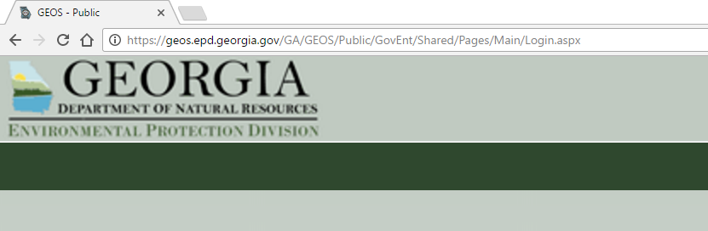
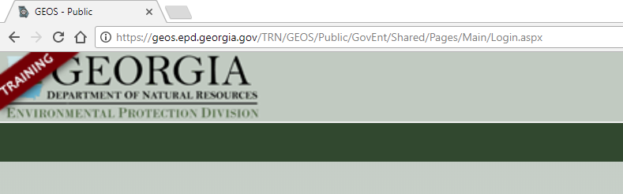
Live versus Training

Slide 22
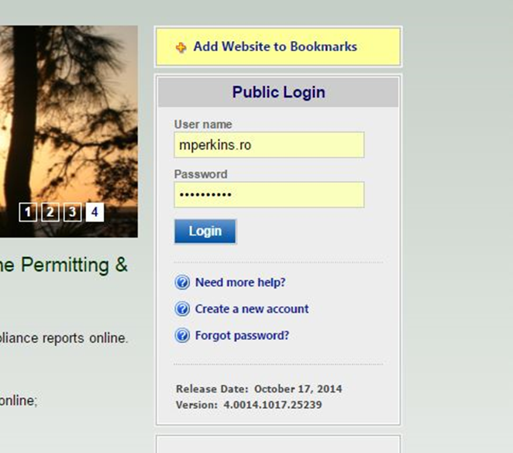
Account Creation (Universal)
Navigate to GEOS Training Site
Click the “Create a New Account” link on the login page.

Slide 23
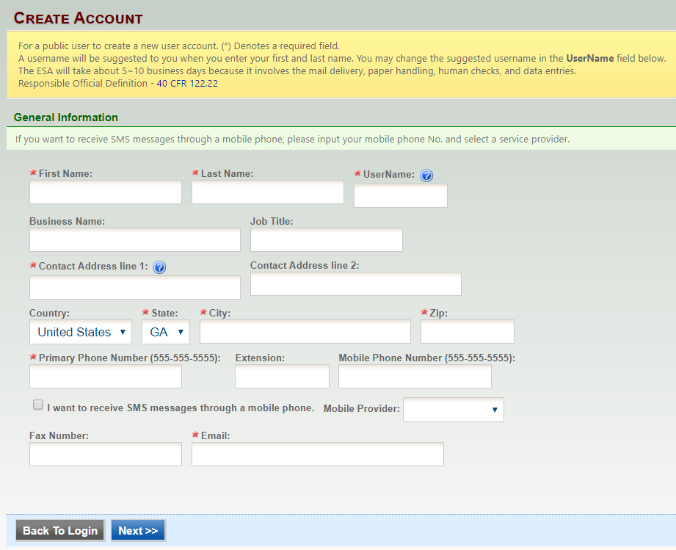
Account Creation (Universal)
Enter in your personal identification and contact information.
Make sure to use your legal name (will be used for e-verify later)
Pay attention to the auto generated username. If you would prefer to have a different name you may change it.

Slide 24


Account Creation (Universal)
Any field that contains a * is required and must be filled to continue.
By placing the mouse over the , a help box will display to provide additional information

Slide 25
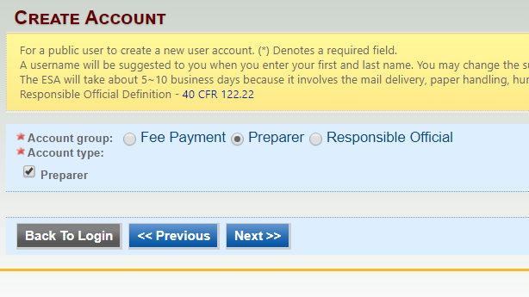
Account Creation (Preparer)
Select preparer for both account group and account type.
  Note: We will discuss the RO creation process in a moment
  Note: If you are of Account Group “Fee Payment” then select Account Type “Fee Payment”

Slide 26
Account Creation (RO)
RO account is essentially the same except for a few minor differences
  You have to select one or more “Account Types”
  You have the option to associate one or more facilities with your account. You may choose to do this at a later time.
  Depending on the “Account Types” you select you will be required to perform an identity proofing for each facility.

Slide 27
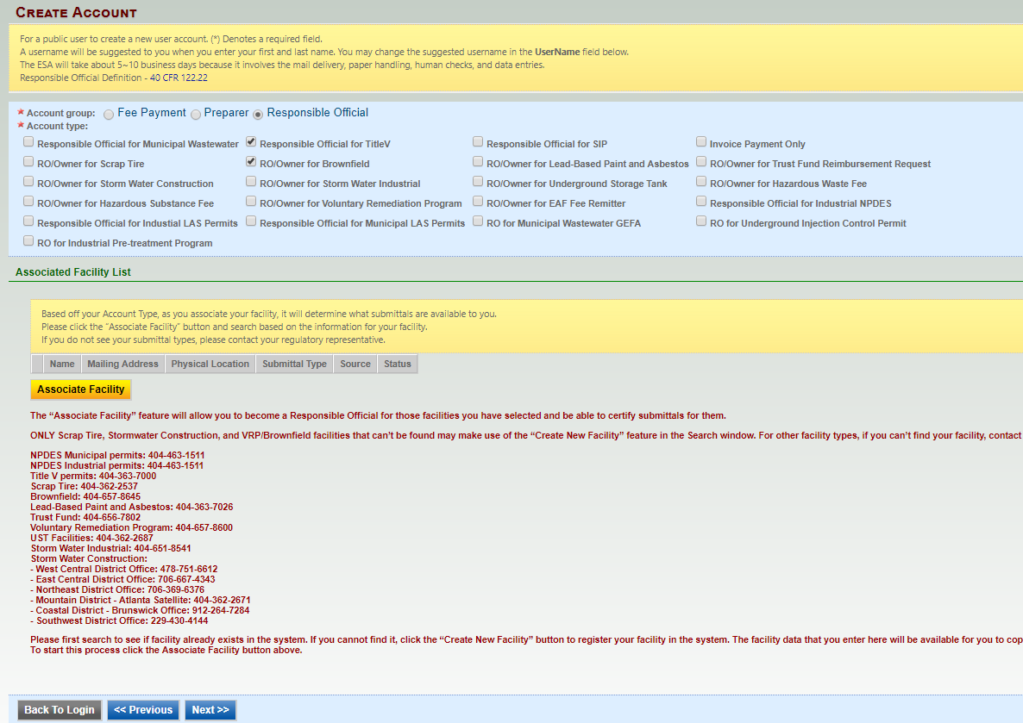
Account Creation (RO)
Select the account type reflecting the Application(s)
for which you are responsible.
Click ‘Associate Facility’ to choose the name of your associated master facility from the provided list.

Slide 28
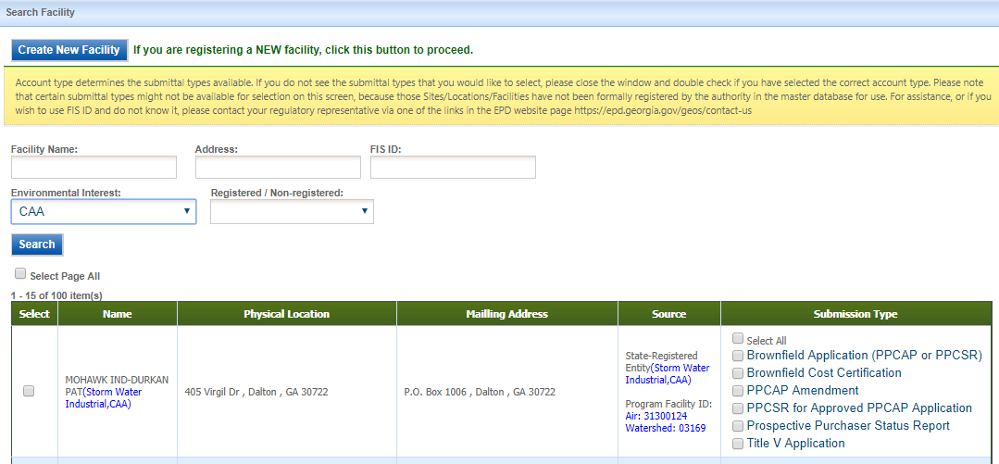
Account Creation (RO)
RO Facility Association
After clicking “Associate New” use the Search Master Facility tool to locate your facility
  Leaving the search field blank and clicking search will return all facilities in the system.
Check the facility(s) and application(s) for which you are responsible and the source matches the application type

Slide 29
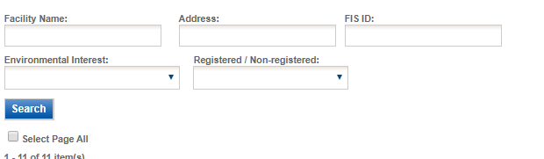
Searching for a Facility
Less is more
  Search items must match exactly
  Items such as Environmental Interest can help limit results
  Don’t try and fill out
  FID ID is not the same as Location ID

Slide 30
Multiple Sources are Possible

Slide 31
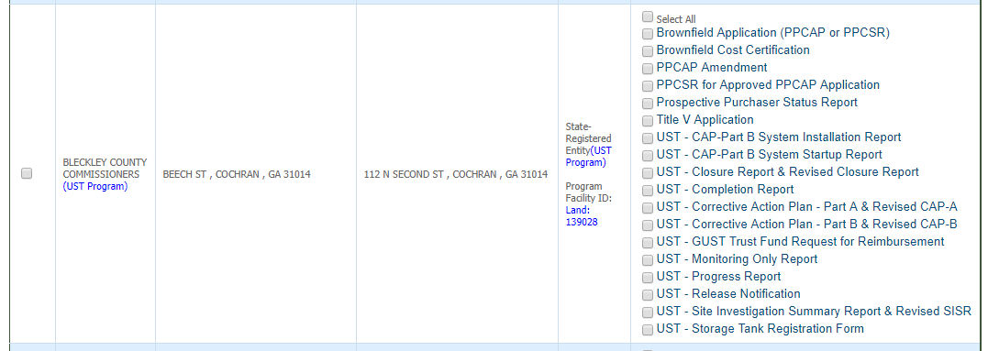
Make sure to select the correct one

Slide 32
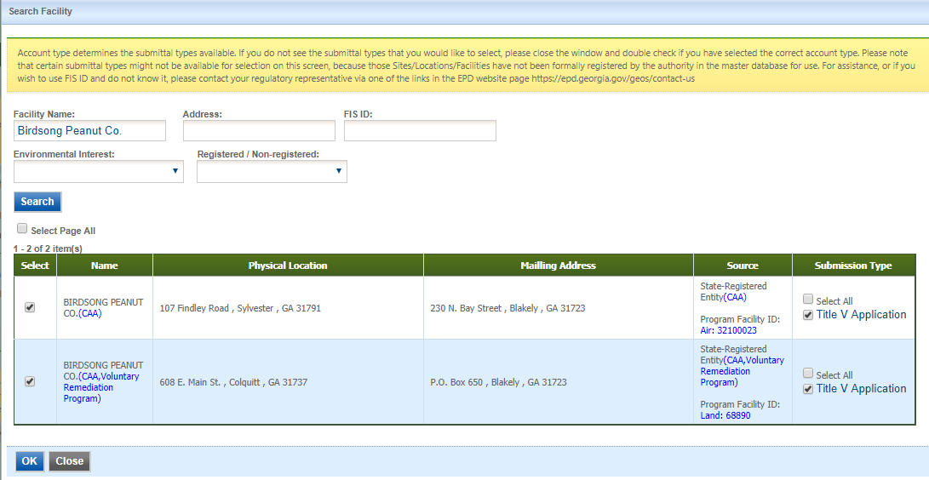
Selecting and Exiting
Once you have selected your facility and the different permit types you will click the “OK” button at the bottom of the page.

Slide 33
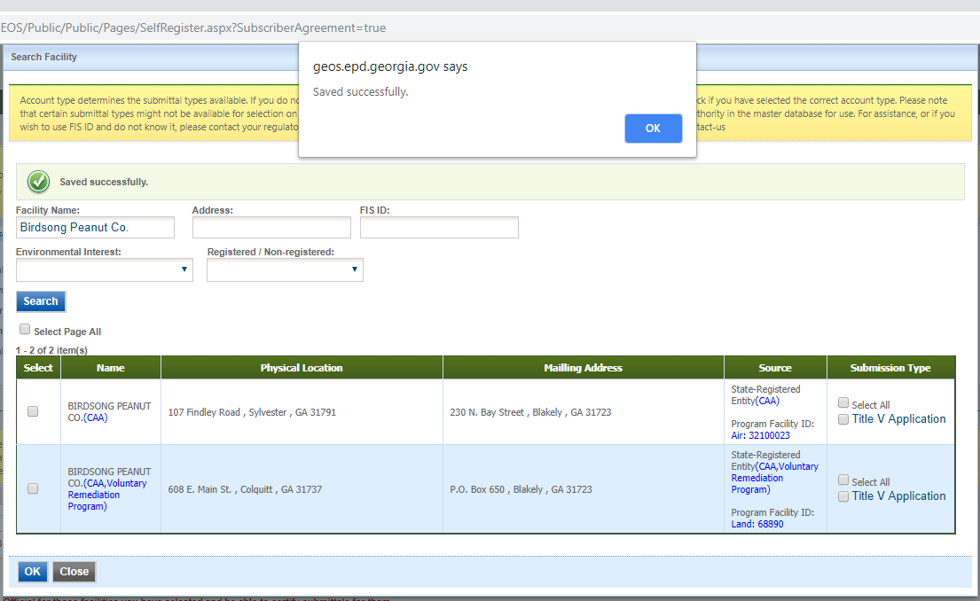
Saving Your Selected Facilities
The system will save the selected information. You will need to click on the “OK” in the popup. It will remain in the facility selection screen until you select “Close”.

Slide 34
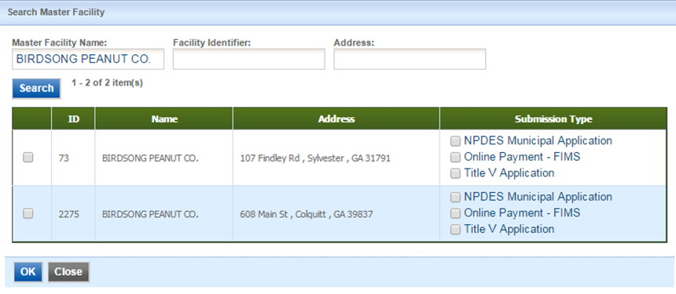
What if my facility is not in the list?
Unless the facility that you want to associate is one of the following Account Types: Brownfield, Invoice Payment Only, Scrap Tire, Storm Water Construction or Voluntary Remediation Program - EPD will need to add it to the list. You will be able to associate your facility at a later date once it has been added by EPD. You may continue the account creation process if your facility is not listed by selecting “Close” and then selecting “Next>>”.

Slide 35
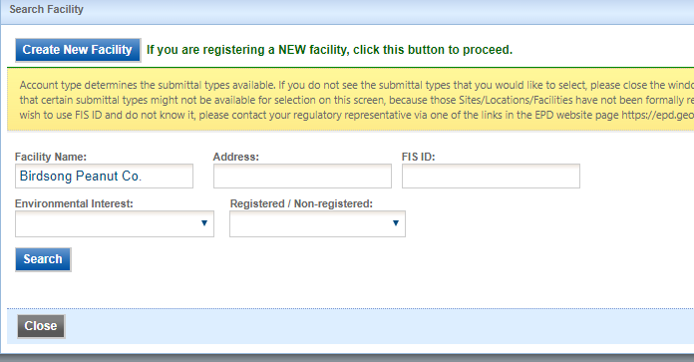
What if my facility is not in the list?
For Brownfield, Invoice Payment Only, Scrap Tire, Storm Water Construction or Voluntary Remediation Program if your facility is not present after you have searched you may use the “Create New Facility” button to add your facility.

Slide 36
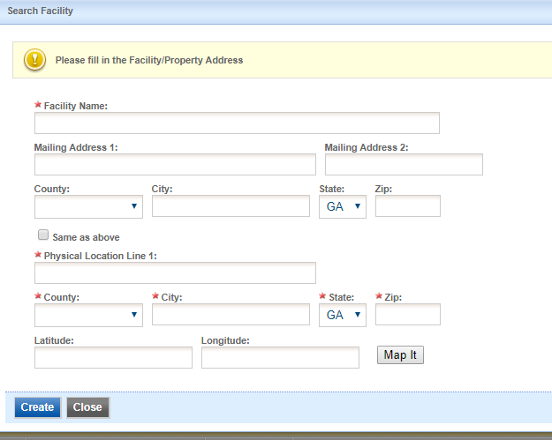
Creating a facility
To create a new facility you will need to fill out the required fields.
It is best to fill out all fields if you have the information.
You may map the location of the facility using the “Map It” button.
We will cover the mapping tool in detail later in the class.
Once you have filled out the required fields hit the “Create” button.
Once the facility has been created you may select both your newly created facility and the submission types you would like.
Once you have done that click on the “OK” button at the bottom of the screen and then select “Next>>” on the subsequent screen.

Slide 37
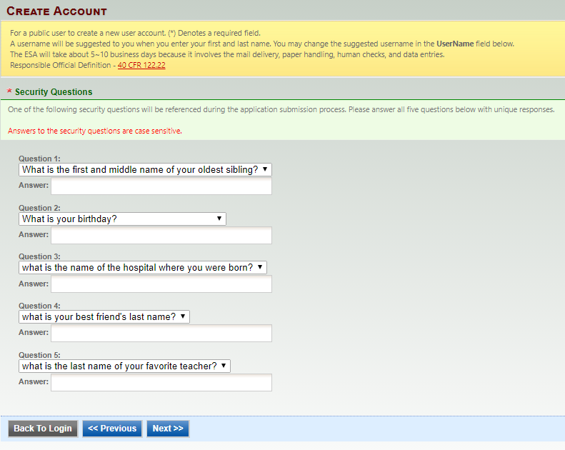
Account Creation (Universal)
Next you will need to provide answers to a few security questions. These questions will be used later to retrieve a lost password and used to submit applications.
Answers are case sensitive!!

Slide 38
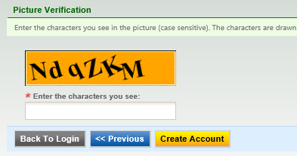
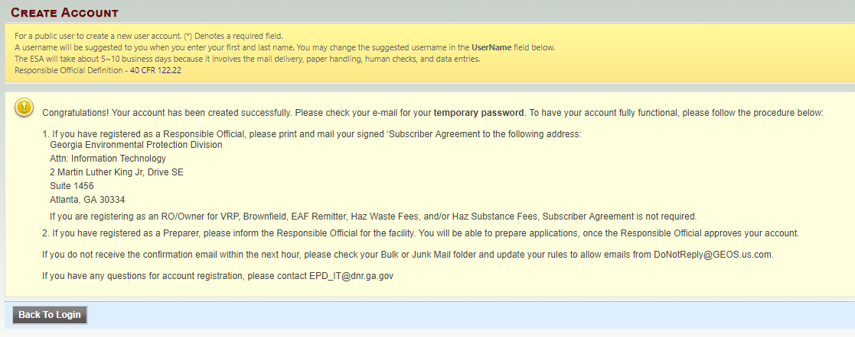
Account Creation (Preparer)
To finalize account creation, a CAPTCHA needs to be verified. Once verified, the account will be created.
The system will display instructions on how to activate the account so that all features can be opened.

Slide 39
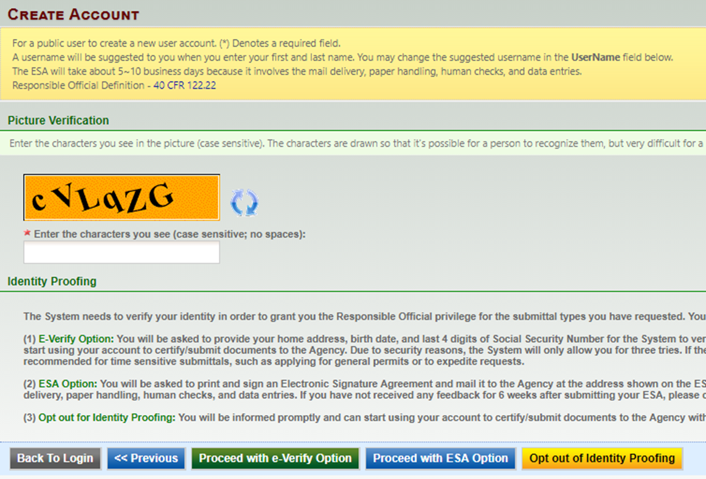
Account Creation (RO)
Depending on the “Account type” RO’s may be required to provide proof of identity
Two methods
  E-Verify
  ESA (Subscriber agreement)

Slide 40

RO/Owner for Storm Water Construction Only
If the only account type you have is Storm Water Construction then you have the option to Opt Out

Slide 41
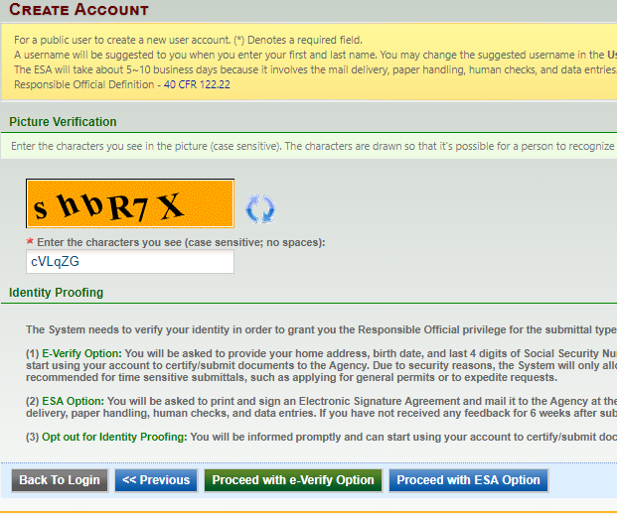
E-Verify Identity Verification (RO)
The E-Verify option is recommended for time sensitive submittals, such as applying for general permits or to expedite requests.
The E-Verify process notifies EPD for review.
EPD will verify your identity and make a decision on your RO request.
Once approved you can start using your account to certify/submit documents to the Agency.

Slide 42
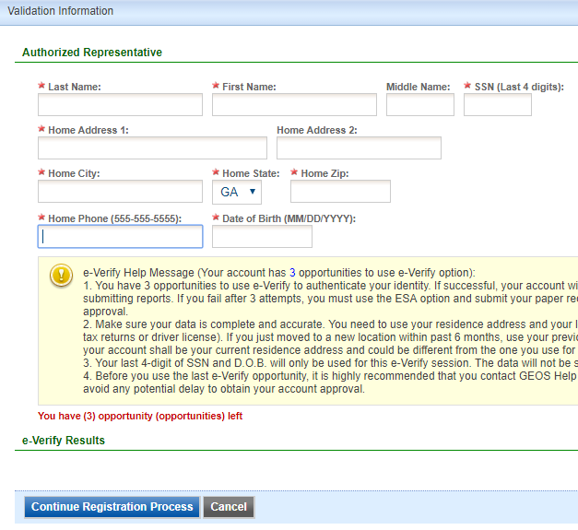
E-Verify Identity Verification (RO)
E-Verify Option
  You will be asked to provide your home address and phone
  birth date (MM/DD/YYYY )
  last 4 digits of Social Security Number
The System will then attempt to verify your identity
Due to security reasons, the System will only allow you 3 attempts.

Slide 43
E-verify common issues
The important pointers for e-Verify is that the user is doing the following:
  Using their legal first and last names
  Correct last 4 digits of SSN
  Entering their correct HOME address with correct zip code. Some users are entering business address and that will fail
  Entering date of birth as month/day/year (MM/DD/YYYY). Many of our users are used to day/month/year and that has most likely been causing many failures
  Entering home phone number

Slide 44

ESA Option Identity Verification (RO)
You will be asked to print and sign an Electronic Signature Agreement and mail it to the Agency at the address shown on the ESA.
EPD will verify your identity and make a decision on your RO request.
You will receive an email notification after an Agency’s decision is made.
The ESA will take some time because it involves mail delivery, paper handling, human checks, and data entries.

Slide 45
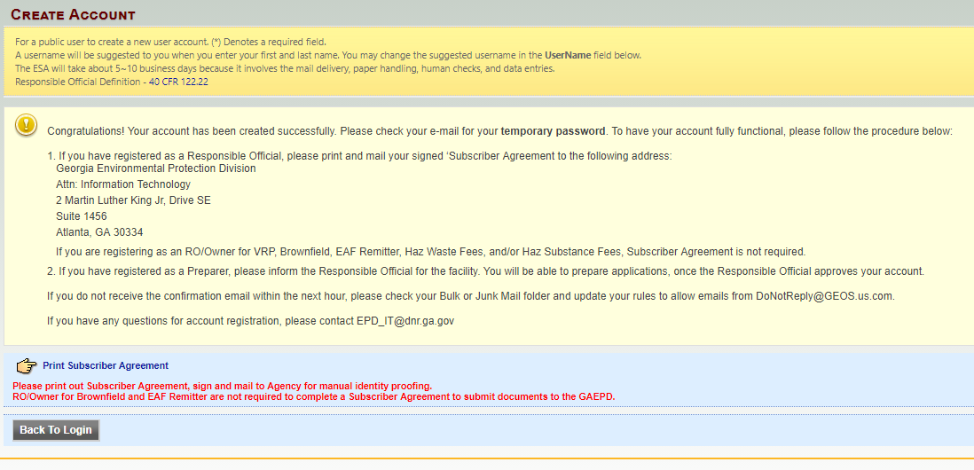
ESA Option Identity Verification (RO)
Click the “Print Subscriber Agreement” link, GEOS will auto-fill the subscriber agreement form.

Slide 46
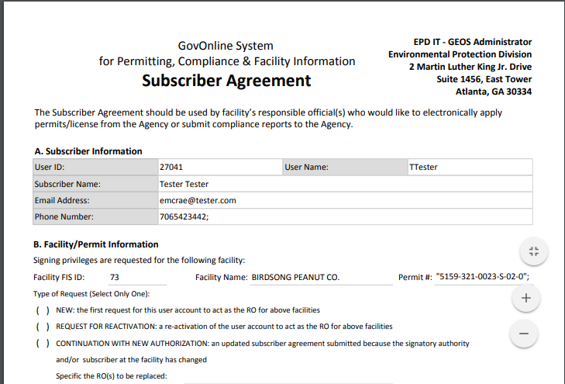
Subscriber Agreement
Fill out Section B (Type of Request)
Sign and date Section E (Signatory Authorization)
Sign and date Section F (Subscriber Signature)
Mail to the address in the upper right hand corner

Slide 47
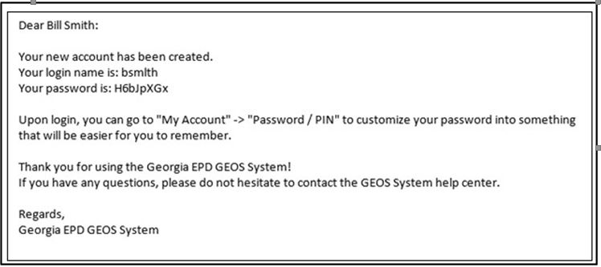
Account Creation (Universal)
You will receive an e-mail notification of the account creation with your login name and randomly generated password.
You can use this information to login to the GEOS Public Portal.

Slide 48
Password and PIN
Once you log back in you will be required to create a password and a PIN number and confirm each of these.
Password must have at least one uppercase letter, one lowercase letter and one digit number and be a minimum of 8 characters long.
Your PIN number must be at least 4 digits.

Slide 49
Exercise 1 – Create Account

Slide 50
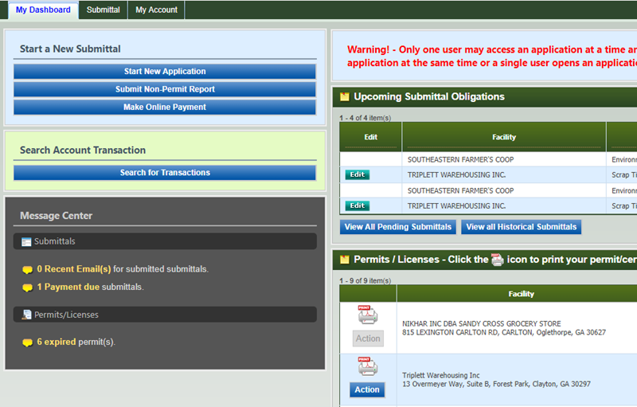
Dashboard
3. ‘Search Account Transaction’ allows user to search all transactions in FIMS by searching account ID. The
user will be required to type in the pin number to access account information.
4. ‘Message Center’ provides information that needed the user’s attention. Information includes link to any communication done via GEOS. This provides a shortcut for the user to see e-mails or correspondence messages that were sent to them.
5. ‘Permit/Licenses’ here the user can view all permit/licenses/issuance that have been issued to the user. The user can access related submittal form by clicking through the link of submission name.
1
2
3
4
5
1. ‘Start a New Submittal’ allows the user to start a new submittal from the dashboard.
2. ‘Upcoming Submittal Obligations’ is specifically prepared for site to submit obligation report. Under monitoring period, the site can see all obligation reports under this section. When the date passes report start date, the “Edit” button will be enabled.

Slide 51
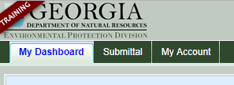
Managing Account Settings
It’s important to keep your information up to date in GEOS. You can manage your account information by clicking ‘My Account’ in the menu bar:

Slide 52
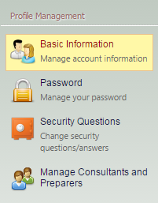
Managing Account Settings
In ‘Basic Information’, you can change your name and contact information
Click the ‘Password’ and/or the ‘Security Questions’ links to modify these settings.
If you are an RO you are to review and edit consultant information by clicking the ‘Manage Consultants and Preparers’ link

Slide 53
Basic information section
Everyone will have at least three tabs. These will be ‘General Information’, ‘Address Information’ and ‘Attachment’.
The ‘General Information’ and ‘Address Information’ allow for updating and managing these data items.
The ‘Attachment’ tab will allow you to upload documents.
If you are a preparer, the ‘Associated RO’ tab allows you to see RO and facility information as well as permission level and application types.
If you are an RO, the ‘Associated Facilities’ tab allows you to see your facilities as well as associate a new facility for which you will serve as a Responsible Official. An RO may add additional account types here.

Slide 54
Associate Facilities
You can determine if you have been approved by EPD by the “Status” column
You also have the ability to replace existing ROs without having to contact EPD
When associating facilities please pay attention to source column as to whether or not the Facility you are selecting is registered for that application type
You may also use e-verify when adding new facilities

Slide 55
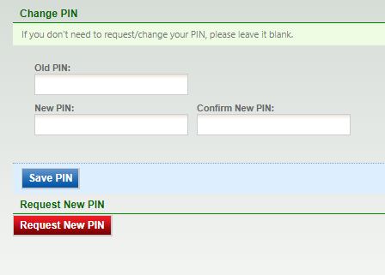
Password Section
This section contains two tabs. One allows you to change your password the other allows you to change your PIN or request a new PIN.
There is a Forgot Password on the Login Page.
Changing the PIN and
Requesting a new PIN
are two separate
actions.

Slide 56
Security Questions Section
This section allows you to update and change your security questions.
The security questions and PIN are the credentials used for certification and submission.
Don’t forget to fill out the section on the reason for changing the answers

Slide 57
Manage Consultants and Preparers Section
In this section, an RO user can see a grid view of preparers that have been associated to their account.
  The grid view lists out who they have associated with them and for which facility and application type, as well as the effective dates of this association.
This is also where you can add a new ‘Preparer’

Slide 58


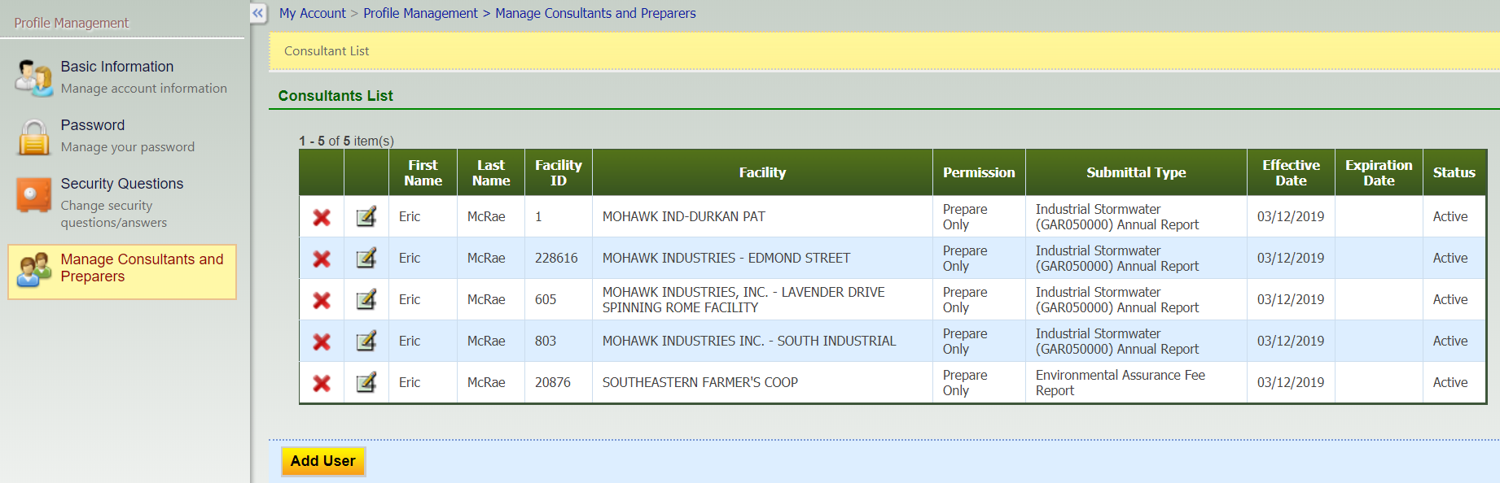
Manage Consultants and Preparers Section
If you wish to remove a consultant, simply click the red x . If you wish to modify a consultant click on the pencil and paper icon .

Slide 59
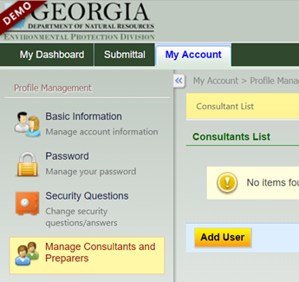

Adding a new ‘Preparer’
Select “Manage Consultants and Preparers”.
To add a new preparer, click the “Add User” button.

Slide 60
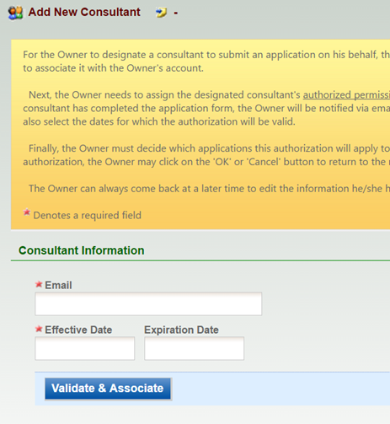
Adding a new ‘Preparer’
To add a new preparer, the system first prompts for the preparer’s e-mail, which means the preparer is required to have an account in GEOS first.
Next, GEOS asks for the effective date and expiration date of this association, if any.

Slide 61
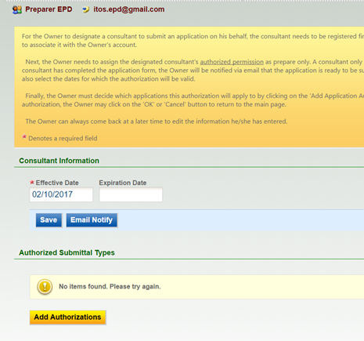

Adding a new ‘Preparer’
The RO needs to 'Add Authorizations’ to the preparer.
‘Application Authorization’ defines the facility(s) and the application type(s) (i.e. Title V or NPDES) the preparer is allowed to prepare, as well as the permission access.

Slide 62
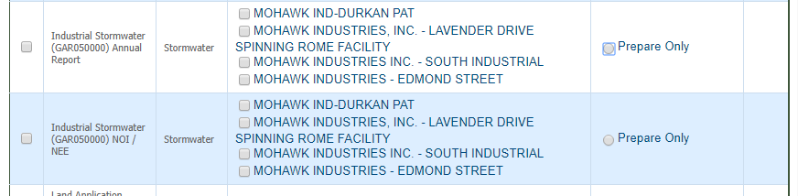
Adding a new ‘Preparer’
The RO must select the App Name, Permission and Facility that the preparer will need access to.
After you have selected all three of these hit the “OK” button at the bottom of the screen.
Please note you may not select your facility until you have been approved by EPD.

Slide 63
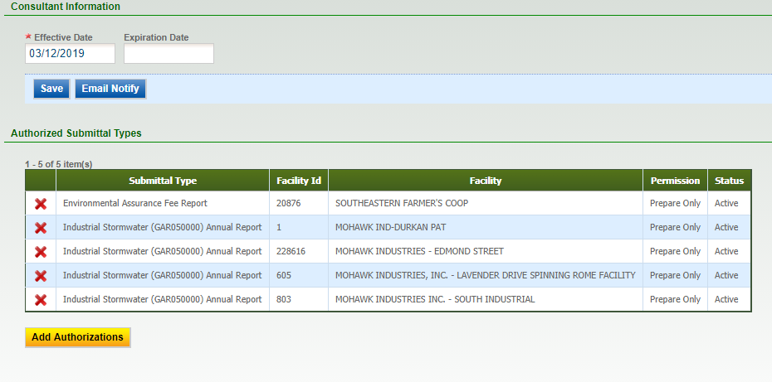

Adding a new ‘Preparer’
After you have added the Application Authorizations you will need to “Save” everything in order to commit it to GEOS.
Once the association is completed, the preparer can log in and begin working on applications.
*You may also send the consultant/preparer an email notifying them. The system does not automatically send them an email.

Slide 64
RO Preparer Relationship
In the traditional RO/Preparer relationship the following hold true –
  These application types requires that there is an RO account in order to submit the application to EPD
  The RO must associate a facility with their account in order to complete the application
  There must be a facility associated with the submittal
  A preparer may be designated by the RO to prepare for the facility
  When finished the preparer will notify the RO that the application is ready to be submitted to EPD
  The preparer cannot submit directly to EPD
  There is some form of identity proofing required for the RO for each facility

Slide 65
RO Preparer Relationship
In some instances if a preparer is designated by the RO then they can directly submit to EPD with the potential of the RO not knowing or ever being able to see the submission. In this scenario the following hold true –
  These application types requires that there is an RO account in order to submit the application to EPD
  The RO is not required to associate a facility with the account depending on the application type
  No facility is required to submit to EPD
  A preparer may be designated by the RO to prepare on behalf of the RO if and only if the RO has associated with a facility
  When finished the preparer can submit directly to EPD

Slide 66
Hazardous Waste/Substance Fee
For these applications a preparer can directly submit to EPD without the need of an RO
  These application types do not require an RO account in order to submit the application to EPD
  The facility that is required to submit to EPD is entered via an EPA ID # or TRI ID #
  When finished the preparer can submit directly to EPD
  There is a no identity proofing required for the Preparer for each facility

Slide 67
Facility Not Required
Pre-Post Training Notification
Retail Tire Dealer / Scrap Tire Generator ID Number Application
RRP Pre-Post Training Notification
Scrap Tire Processor Pre-Application
Tire Retreader Registration
Application for Lead-Based Paint Discipline Certification
Application for Lead-Based Paint Discipline Certification (Spanish worker)
Application for Renovator Certification
HSR Fee Invoice Report
HWM Fee Invoice Report

Slide 68
Default Preparer Application Types
Traditional Scenario -
  Title V Air
  NPDES Municipal Application
  SIP Application
HSR & HWM Scenario –
  HSR Fee Invoice Report
  HWM Fee Invoice Report

Slide 69
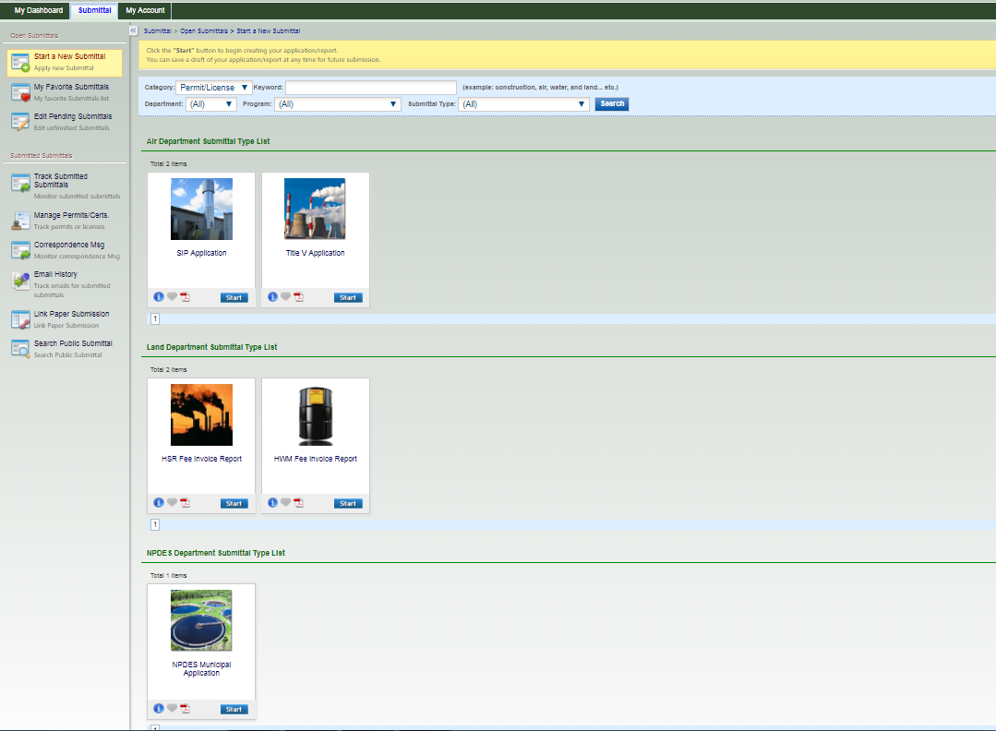

Slide 70
Preparers Please Note
If your account group and type is “Preparer”
  You will only see the default applications types until a Responsible Official requests that you prepare a particular application type for their facility
  You may fill out the default applications but you will be unable to submit them to the Responsible Official until they have requested you to do so
  If the application you need to fill out is not present call your Responsible Official do not call EPD

Slide 71
Exercise 2 – RO/Preparer Designations

Slide 72
Submitting an Application
Select a submittal type
Select a facility
Enter necessary information on the application form
Insert attachment(s)
Data validation and completeness check
Pay Submittal Fee (If needed)
Certification and submission
Acknowledgement receipt and confirmation email

Slide 73
Fill out/Submit GEOS application(s)
GEOS will work with any modern browser
In order to choose a facility for your application, you must be associated with a facility as an RO or be designated for a facility by an RO.
Save/Next both ‘Save’.
  Next will validate the page.
  Save will only highlight required items.
You may hop around to different sections leaving forms incomplete. Please ‘Save’. You will be prompted if you do not.
Many places where you add records require you click the green check when you are done

Slide 74
Fill out/Submit GEOS application(s)
In order to save some items and return to the application, you must select ‘Cancel’. This is counterintuitive but how the system works.
Don’t overthink what you need to enter into GEOS. GEOS allows for a lot of data to be entered but only the required fields are necessary.
  When in doubt, put what you think you should and explain in the comments.
Emailing questions is better than calls. When a question is emailed, it is easier to get the info to you and the question can be added to the FAQs thereby helping others.

Slide 75
Title V
The system is not being used to cross check with other electronic systems.
  With Title V, continue to enter stack data as in the old application. It does not need to match the Emissions Inventory or Fees collection data exactly
Effective March 1, 2019 air permit applications are subject to fees.
Please contact the Air Branch at 404-363-7000 or visit https://epd.georgia.gov/air/air-permit-fees for additional information.

Slide 76
Scrap Tire
When looking for your facility if you are unable to find it please contact Timothy Gilliland at EPD. Often times they have your facility and it is just hard to find.

Slide 77
Hazardous Waste & Substance Fees
You don’t have to associate a facility with your account
  When beginning a HWF or HSF submittal you will put your EPA ID # or TRI ID # and this will bring up your facility that matches and the fee can be paid in GEOS
If Classified as a large quantity generator, but had a small quantity for the year, you can complete an 8700-12 form for EPA and report at the level of generation you have for the year.

Slide 78
Hazardous Waste & Substance Fees
System only allows users to make one submittal per year through GEOS with EPA ID or TRI #; if a correction is needed then user must contact EPD

Slide 79
Underground Storage Tanks
Annual Tank Registration is currently done via GEOS
  A new facility will have to be done on paper
  Any modifications (new tanks, new piping, etc..) will be coordinated with EPD. They will make the corrections based on information that you provide and then you will verify in GEOS

Slide 80
Underground Storage Tanks
PART 1: If your answer brings up a yellow warning box will need to contact EPD to resolve prior to continuing
PART 3 & 4: Operator of Tanks – this information can be found on your certificate and is required to be updated.
PART 5: When you search you must know your location identifier in order to find your site and to “Add to form”

Slide 81
Underground Storage Tanks
PART 6: This is how you are insured
PART 7: Jobber Information is not required
PART 8: You must review all of the units and if any changes are necessary coordinate with EPD to make those changes.
Make sure that you upload all of your attachments

Slide 82
Underground Storage Tanks
Most tank registrations will be automatically approved
Once it has been approved the certificate will be generated through the GEOS system and you will need to print it out
Jobbers that pay into trust fund will be required to submit report through GEOS if they elect to opt in to the trust fund

Slide 83
Underground Storage Tanks
Helpful Websites –
  https://epd.georgia.gov/underground-storage-tanks
    Excel spread sheet with all facility IDs
    Available in the Related Files section

Slide 84
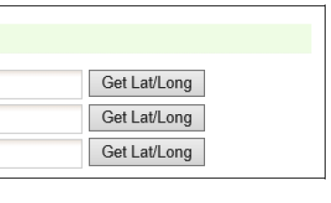
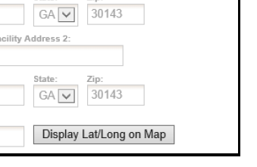
Mapping Information
GEOS provides a GIS function so that the applicant can view the location of the facility selected in order to verify that the facility selected is correct.
The GIS function can also be utilized in allowing the user to use a map to pinpoint the GIS location.

Slide 85
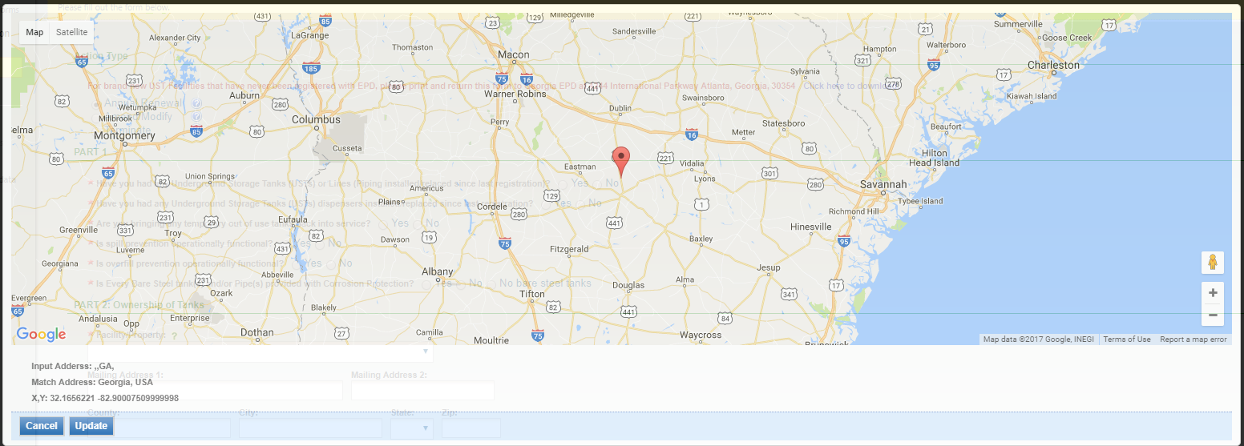
Mapping Information
The user can click on the ‘Get Lat. /long’ button and move the cursor to the desired location. Once the desired location is selected, the user can click the ‘Update’ button to populate the lat. /long with the pinpoint location’s lat. /long.

Slide 86

Protected Information
All information input and/or uploaded as attachments into the GEOS system should be considered Publically Available and should be treated that way by the Preparers.
If a Preparer feels that there is a need to include information not subject to disclosure an applicant should do the following:
  Checkmark the box stating that “Information not subject to disclosure under the Georgia…” is included in the application.

Slide 87
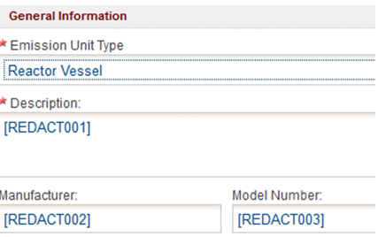
Protected Information
Instead of entering the protected piece of information, the phrase [REDACT###] should be used in the entry field.
  ### should be incremented by the Preparer for each subsequent piece of information that is “not subject to disclosure…”

Slide 88
Protected Information
Once the application is finished, the Preparer will be able to generate and download the “Redact Report” in the Attachment section
  The Preparer will then fill in the “Redacted Information” on the “Redact Report” with the Privileged Information
  This report will only be able to be submitted by hard copy
  Do not include electronic versions of the Redact Report or any Privileged Information within GEOS

Slide 89
Attachments
GEOS supports uploading of required and optional attachments. The file format of the attachments include
  WORD (doc, docx)
  EXCEL (xls, xlsx, and csv)
  PDF
  Image (JPEG, PNG, GIF, etc.)
30mb is the maximum file size

Slide 90
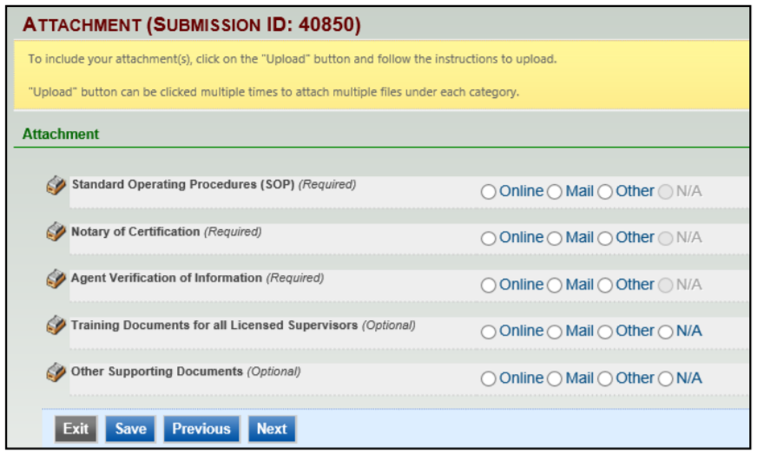
Attachments

Slide 91
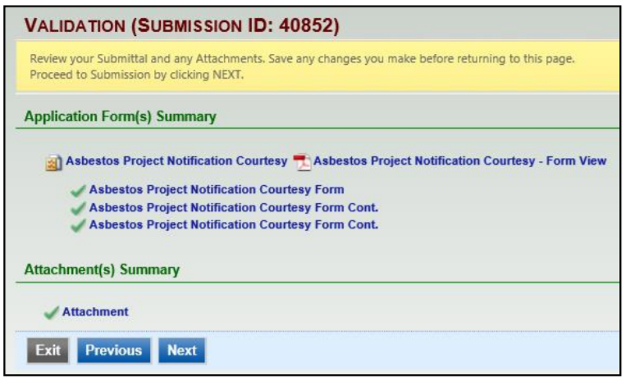
Validation
GEOS will automatically validate the online form.
GEOS confirms that all required fields have been filled and all required attachments have been submitted.

Slide 92
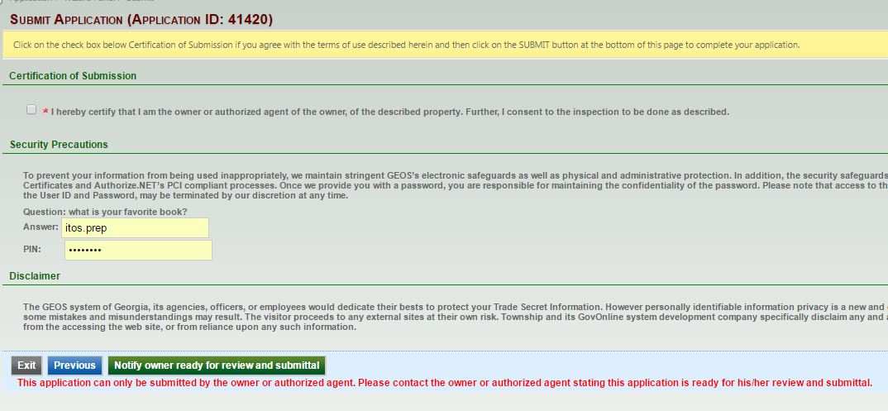
Preparer Submission

Slide 93
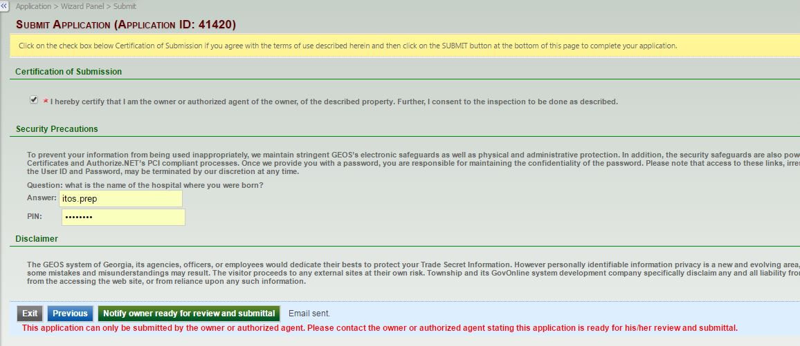
Preparer Submitted

Slide 94
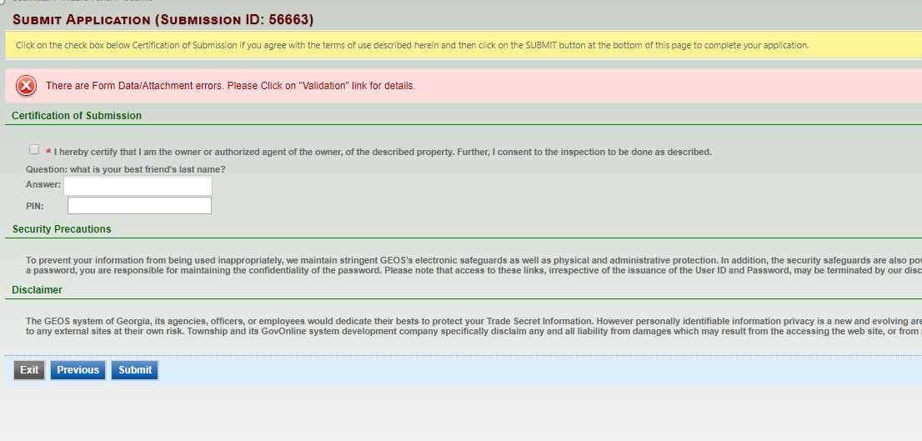
RO Submission

Slide 95
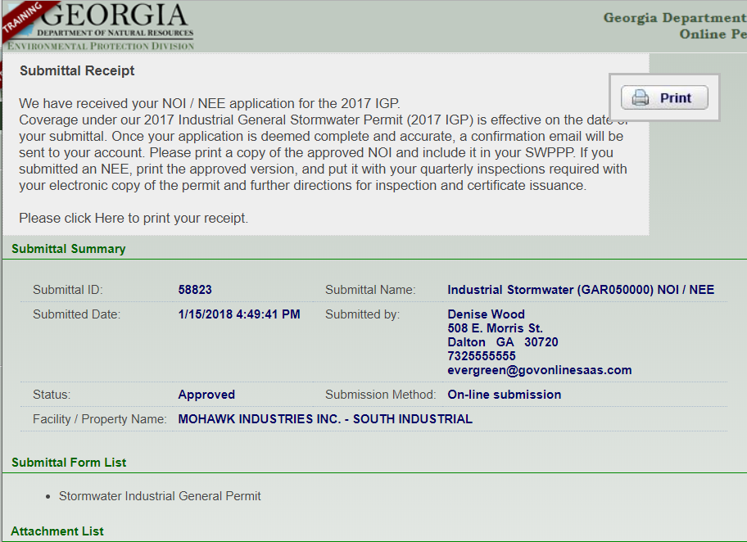
RO Receipt from GEOS

Slide 96
Exercise 3 – Filling out an Application

Slide 97
Managing Applications within GEOS
Tracking Submittals
GEOS provides the following features to track submittals:
  Ability to review submittal
  Tracking Submission Status and Work Activities
  View issuance status
  Communicate with EPD
  E-mail tracking of notifications from EPD

Slide 98
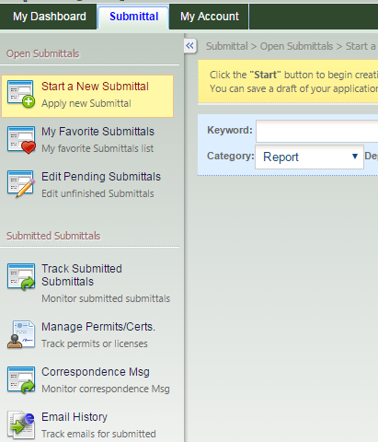
Managing Applications within GEOS
Tracking Submissions
To track applications, navigate to the ‘Submittal’ menu bar and click “Track Submitted Submittals”.
From here you may find submittals using the search toolbar to filter your selection.

Slide 99
Managing Applications within GEOS
Review Submissions
From the Submitted Applications list, click ‘View’ to see a submitted application’s details. The applications details are broken down into the following tabs:
  Submittal: View information related to the submission and status
  Attachment: Displays any attachments that have been uploaded to GEOS during submission process. The applicant can upload additional sets of attachments in this page.
  Payment: Displays total application fee, payment made and fee balance as well as any pending balances on the application fee.
  Work Activities: The status of an application’s work activity is noted as either: Scheduled, Cancelled, Overdue, or Completed.
  Correspondence: Allows applicant to initiate email correspondence with agency users, but visible to third-party users as well.
  Email History: Displays a list of emails that have been system generated.
  Issuance: Any issuance documents may be accessed here.

Slide 100
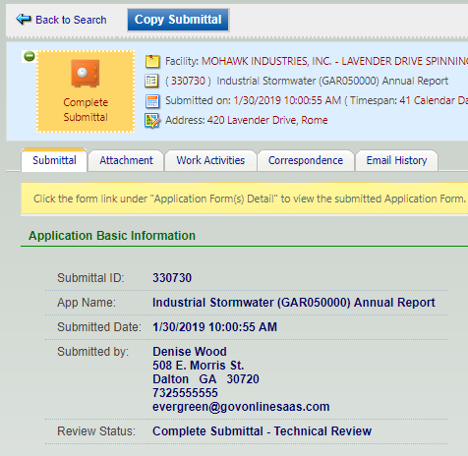
Managing Applications within GEOS
Review Submissions
If you need to copy your submission because of the similarities with a new submission, the ‘Copy Submittal’ button will create a new application and transpose all the data that was filled in on the previous application.
Please note the copy function is not available for all application types

Slide 101
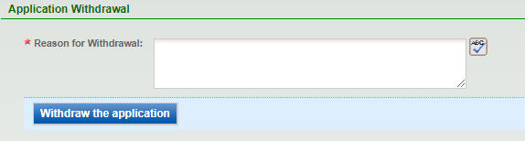
Request for Application Withdrawal
GEOS currently only allows the user to request for a withdrawal.
The request for withdrawal option is located in the ‘Track Submitted Application’ tab in the detailed view.
EPD will make a decision of whether or not to approve or deny the request.
If the withdrawal was approved, the status will mark the submission as withdrawn and no further action can be taken.

Slide 102
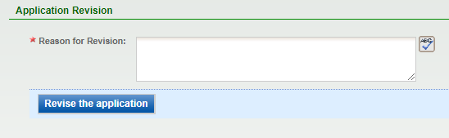
Request for Application Revision
The request for revision option is located in the ‘Track Submitted Application’s tab’ tab in the detailed view.
EPD will make a decision of whether or not to approve or deny the request.
If the submission is approved for revision, a new application will be created with the status set as ‘Revision’.
  This will let the user revise their past submission and the old submission will be marked as ‘Revised Archived’.
  No further action can be taken on the old submission.

Slide 103
Request for Permit Termination
If a final permit has been issued by the EPD through a GEOS submission and the applicant decides that the permit is no longer needed
The request for termination option is located in the ‘Track Submitted Application’s’ tab in the detailed view and can also navigate to this section through the ‘Manage Permit/Certification’ module.
By doing so, the EPD will make a decision of whether or not to approve or deny the request.
If the agency approves of the termination, the submission will then be terminated and no longer be modified.

Slide 104
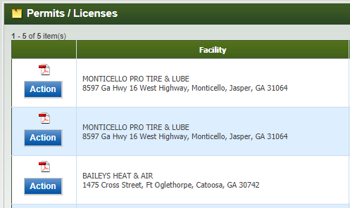
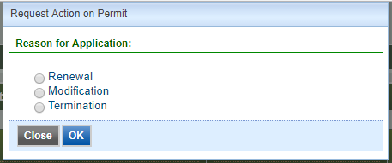
Action Button
From the dashboard if you have a permit or license that has an action button you may take the action without prior approval from EPD

Slide 105
Exercise 4 - Managing Submittals
Under the Submittal tab go to “Track Submitted Submittals” and look up Submittal ID that is provided in class. For this Submittal ID please answer the following questions:
  What permit type was this submittal?
  How many attachments were submitted online?
  What was the total payable amount?
  What was the sent date for the confirmation email by the GovOnline System?
We will go over the answers as a group when everyone has finished.

Slide 106

Submit Online Fee Payment
Click on the “Make Online Payment” button to submit a Payment.

Slide 107

Submit Online Fee Payment
Click the ‘Start’ button to begin an online payment
Click next to continue to the next part of the wizard.

Slide 108

Submit Online Fee Payment
The User must enter their FIMS Account ID and the Invoice Number.
Once they do, they will be able to see the general invoice information and how much they have remaining on the invoice.
Click ‘Next’ to continue.

Slide 109
Payments in GEOS
There are three ways to make payments in GEOS
  Automated Clearing House (ACH)
  Check
  Money Order
Please remember that if you are reporting online but not paying online you need to make sure that you minimally put the submittal ID from GEOS on the check that you send

Slide 110
Submit Online Fee Payment
User must select a Payment Method.
A User that is making an Online Payment for their invoice will select the eCheck option.

Slide 111

Submit Online Fee Payment
For the final step, the User will need to certify the submission and enter an answer to one of their security questions and enter their GEOS Account PIN Number.

Slide 112

Verify Account Balance
From the GEOS Public Portal Dashboard, the User can view their current FIMS Account Balance by clicking on the ‘Search for Transactions’ button.

Slide 113
Verify Account Balance
The User will be prompted for their FIMS Account Number and their GEOS PIN.
If you do not have your FIMS Account Number, please contact the relevant GAEPD authority to them provide it.

Slide 114

Public Portal

