Slide 1

NetDMR Training for NPDES Permittees
The Georgia Environmental Protection Division
Watershed Protection Branch
NetDMR Technical Assistance site: https://epd.georgia.gov/netdmr

Slide 2

Module 1: Getting started
Creating and activating
a NetDMR account
http://vincentchong-vincent.blogspot.com

Slide 3
What is NetDMR?
NetDMR is an on-line data entry system that accepts DMR data, and delivers it directly to EPA
It creates a signed digital document as a copy of the DMR known as the Copy of Record or COR.
It improves discharge data flow from facilities to EPD and EPA

Slide 4
What are the benefits of NetDMR?
Eliminates paper data entry
Improves data quality and availability
Encourages consistency of data
Provides email confirmation of DMR submission
Greatly speeds up the whole DMR process (once you get used to it)

Slide 5
The Overall NetDMR Path
Creating an account for NetDMR in CDX
Figuring out your “role”.
Requesting access to permits
Searching, editing, and saving DMRs
Signing and submitting DMRs

Slide 6
NetDMR Test Environment:
This is where you will first create a NetDMR account in CDX
Notice that the word “test” appears on the web address! That’s how you will know that you are in the “test” environment
https://netdmrtest.epacdx.net

Slide 7
Notes on CDX
CDX stands for Central Data Exchange
  One CDX Account will allow you to have access to various electronic reporting programs, such as:
    NeT, NetDMR, and other EPA Program Services
  Contact CDX to make account changes

Slide 8
Creating a NetDMR account in CDX

Slide 9
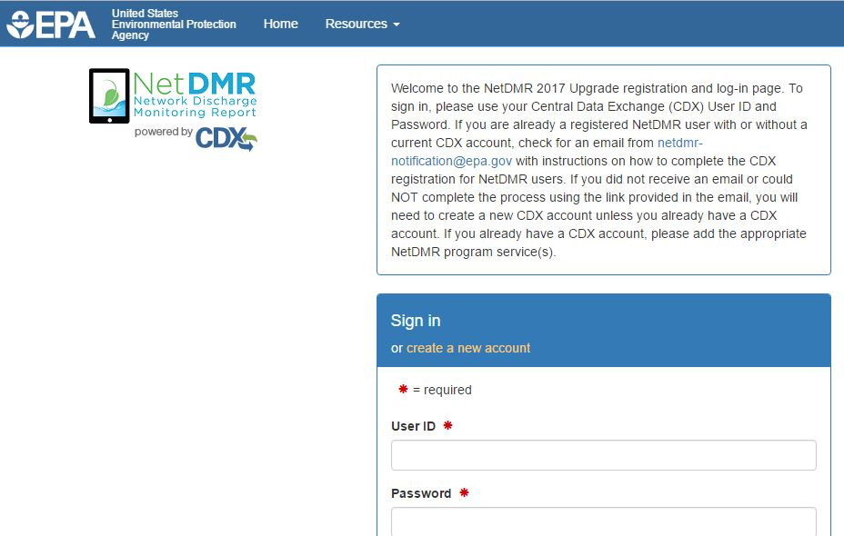
Creating a New Account in CDX

Slide 10
Selecting the correct “State Agency or EPA Region”
This is very straightforward BUT VERY IMPORTANT:
For all users reporting for facilities in the state of Georgia the correct state agency to choose is Georgia Environmental Protection Division!
If the wrong agency is chosen in this step you will not be able to access your permits.

Slide 11
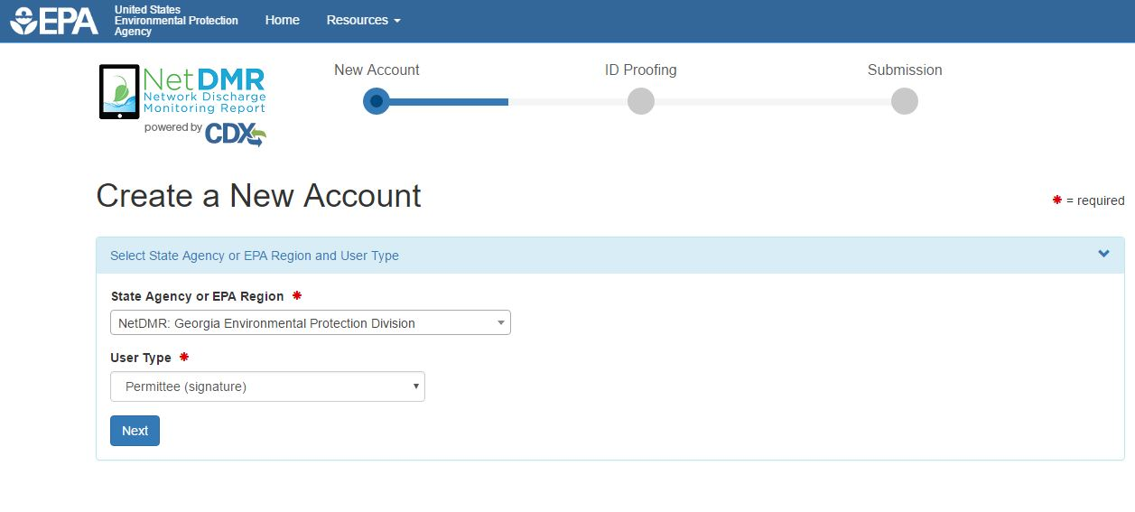
Choose “Georgia Environmental Protection Division”

Slide 12
User Type: Very important!
Regulatory Authority: means you work for EPD or EPA
  Internal User: means you work for or support EPD or EPA and need to look at DMRs. “Read-only”
Regulated Community: means you work for a facility or lab
  Data Provider: means you support a permittee that is required to submit DMRs (such as a testing lab or consulting firm). “Data Entry Only”
  Permittee User (no signature): means you work for a facility that is required to submit DMRs. “Can Edit”
  Permittee User (signature): means you work for a facility that is required to submit DMRs. ”Can Edit, Sign and Submit DMRs”

Slide 13
Choose “Permittee (Signature)” for training today

Slide 14
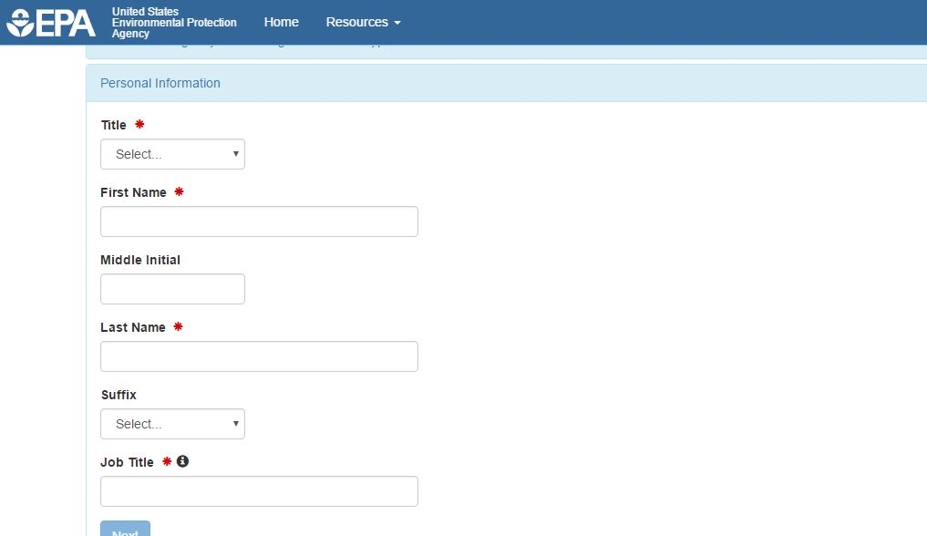
Fill in your Personal Information
Fields with * are required

Slide 15
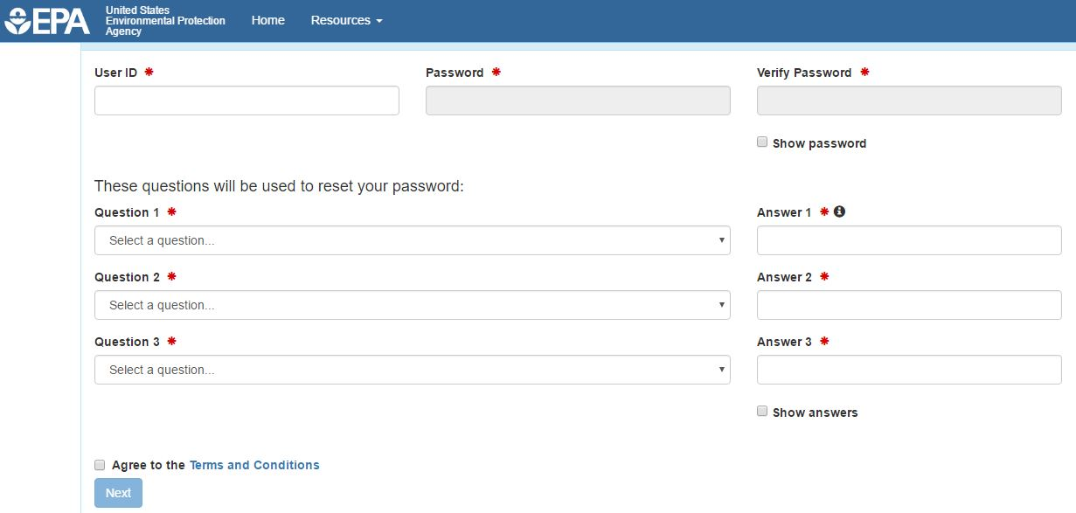
Create User ID and Password
Fill out security questions

Slide 16
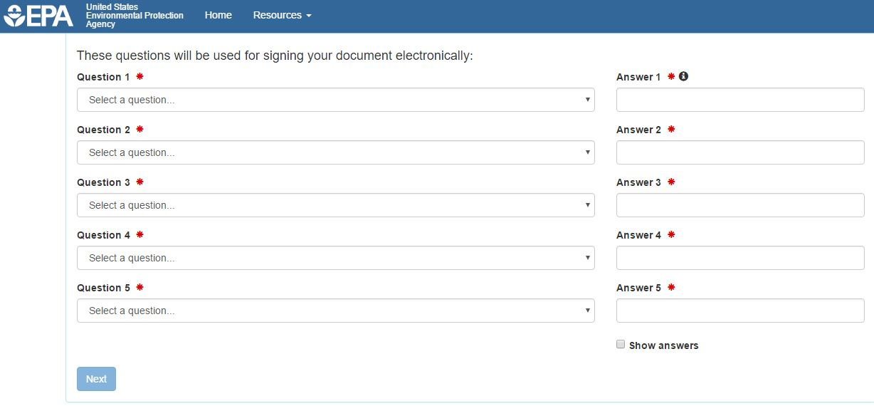
Fill out additional security questions
This step is for Permittee (Signature) users

Slide 17
Organization Information
The test system currently doesn’t have organizations loaded in
For our purposes today, we will need to add our organizations. It is likely that the live system may have your organization already loaded.

Slide 18
Organization Information (continued)
To add your organization in the test system today:
  Type at least 3 letters in the “Organization Name” search box
  Choose “Georgia” from the “State” dropdown menu
  At the bottom of the returned results, click the blue link that says “request that we add your organization”

Slide 19
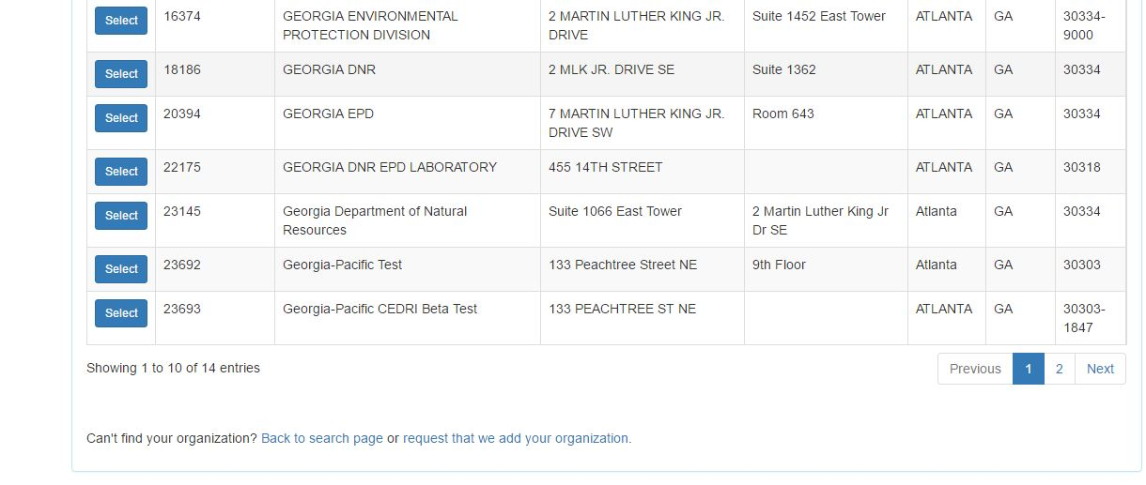
Organization Information (continued)

Slide 20
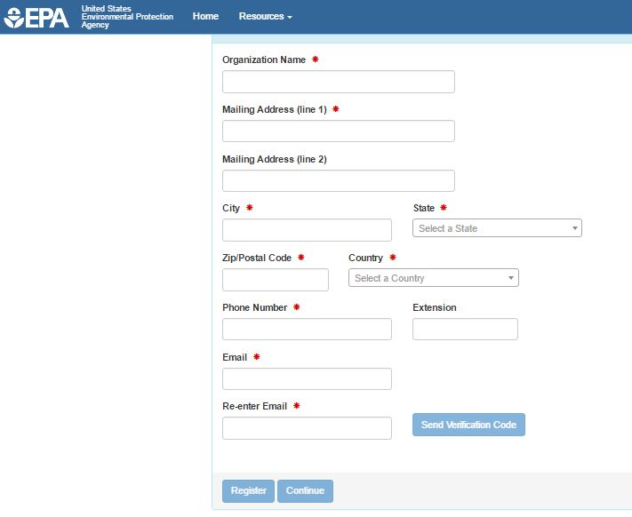
Adding an Organization to the system

Slide 21
Adding an Organization to the system
Once you enter your email address, click “Send Verification Code”
You will receive a code via email that you then enter into the next line that will appear once you click “Send Verification Code”

Slide 22
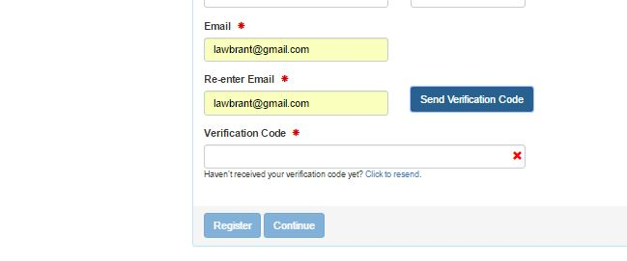
Adding an organization to the system

Slide 23
Adding an organization to the system
Once the Verification Code has been entered click “Register”
After this you will need to fill out personal information for identity proofing in order to complete the Account Creation process

Slide 24
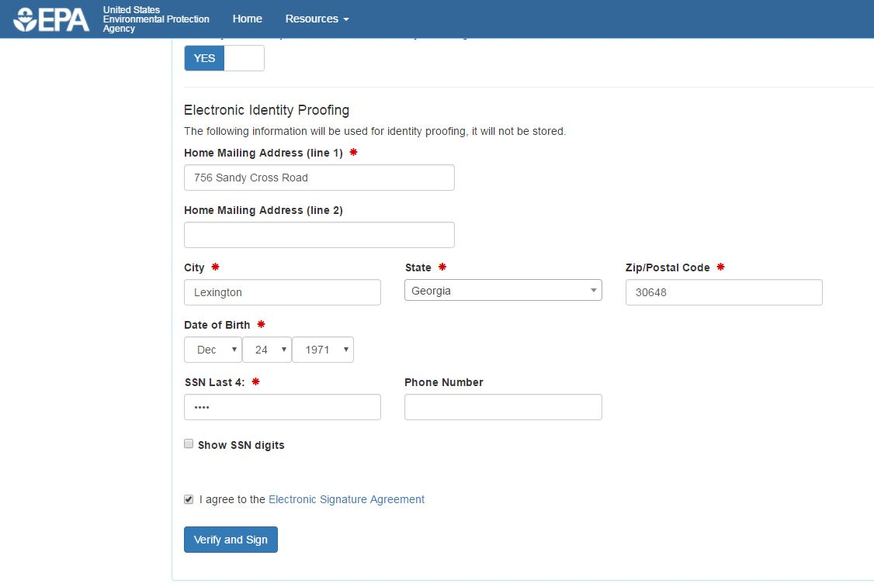
Electronic Identity Proofing

Slide 25
Completion of Account Creation
Once you click “Verify and Sign” the system will process and should return a message indicating successful account creation
You can then use your new credentials to login to the NetDMR system
Click on the blue link under the “Role” column. It should say “Permittee (Signature)”

Slide 26
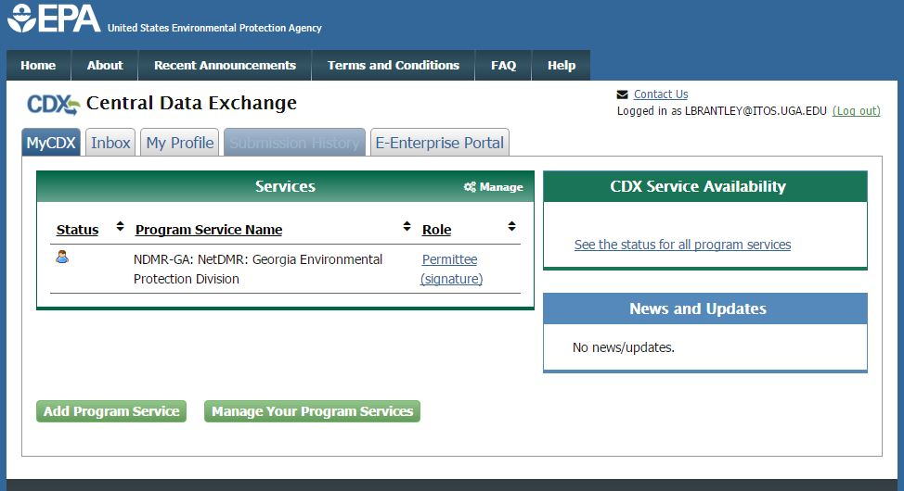
NetDMR Login

Slide 27
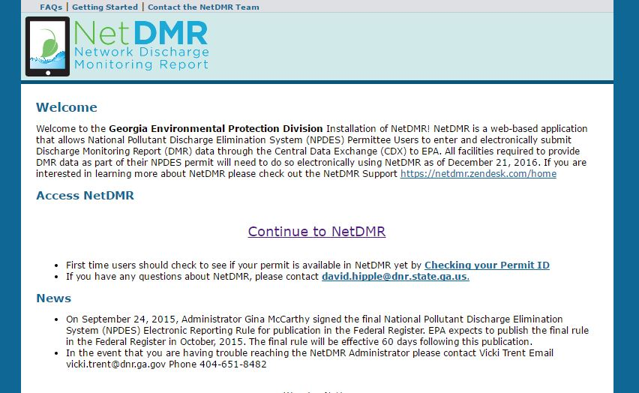
NetDMR Login
Click “Continue to NetDMR”

Slide 28
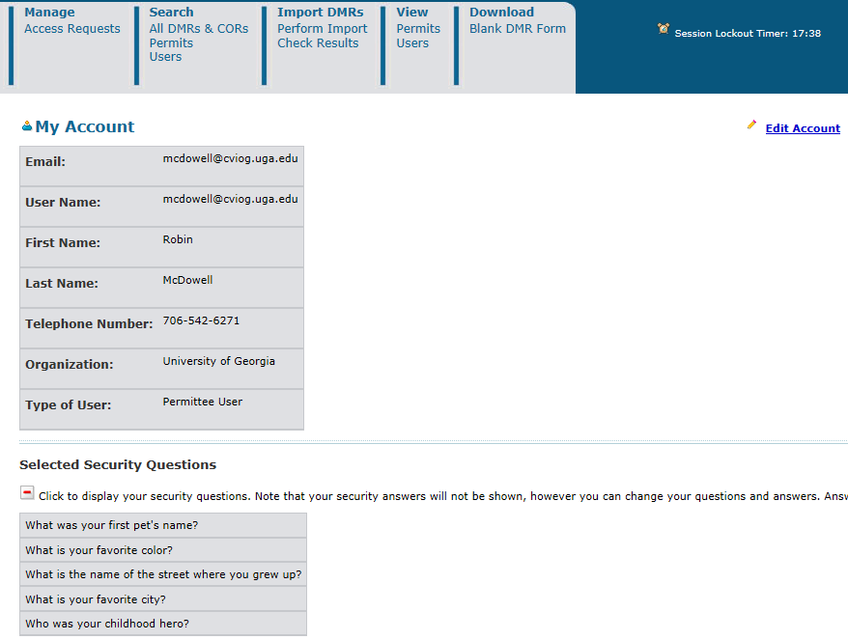
When you click on “My Account”, the top of the next page will look like this. It is your basic User information.
You will see your security questions, but not the answers.

Slide 29
Congratulations!
You Have Successfully Created a NetDMR Account.
At this point there is almost nothing you can do in NetDMR!!
The next step is to request roles.

Slide 30
Requesting NetDMR Roles
NetDMR has the following roles for external users:
View
Edit
Signatory
Permit Administrator
One person may have multiple roles, or each role may have only one person assigned to it. Each facility MUST establish who will have what role!

Slide 31
View Role
  You can only look at and review DMR CORs.
  You cannot change or edit anything.
  Can be facility employee, EPD or EPA staff.
  The view role privileges are also automatically granted to all other role requests (Edit, Permit Admin., etc.)

Slide 32
Role | Who approves? | Manage access | View DMR CORs | Download blank DMRs | Edit DMRs | Sign and submit DMRs
View | ALL
Edit | P.A.
Signatory | EPD
Permit Admin. and Signatory | EPD
Permit Admin. and Edit | P.A.
Permit Admin. and View | P.A.

Slide 33
Edit Role
This is for lab and facility staff who typically enter data into DMRs.
Having the Edit role DOES NOT mean that you have the ability to submit a DMR.

Slide 34
Role | Who approves? | Manage access | View DMR CORs | Download blank DMRs | Edit DMRs | Sign and submit DMRs
View | ALL
Edit | P.A.
Signatory | EPD
Permit Admin. and Signatory | EPD
Permit Admin. and Edit | P.A.
Permit Admin. and View | P.A.

Slide 35
Signatory Role
  The FIRST person requesting access to a permit must request the signatory role. They will automatically be given the Permit Administrator role.
  That first person must submit either a signed “Subscriber Agreement” to EPD by mail and wait approval or they can make an electronic request.
  EPD must always approve any Signatory Role.
  Once EPD approves the Signatory Role, other people can request the other roles from the Permit Administrator.

Slide 36
Role | Who approves? | Manage access | View DMR CORs | Download blank DMRs | Edit DMRs | Sign and submit DMRs
View | ALL
Edit | P.A.
Signatory | EPD
Permit Admin. and Signatory | EPD
Permit Admin. and Edit | P.A.
Permit Admin. and View | P.A.

Slide 37
Permit Administrator Role
  The first person from your facility requesting access will automatically be given the Permit Administrator Role after EPD approval.
  That first person can then hand off the P.A. role to someone else but that someone else will have to create their own NetDMR account and request access.

Slide 38
Permit Administrator Role
The Permit Administrator is the “head honcho” who manages access for other Roles.
The Permit Administrator does NOT need EPD approval to approve Edit, View, Permit Administrator, or Partial DMR Role requests. The Permit Administrator cannot approve Signatory role requests. Remember EPD approval is always needed for Signatory!
The Permit Administrator may have other Roles, but they still have to request them, and they can approve themselves. They can also remove their own Permit Administrator role so be careful.

Slide 39
Role | Who approves? | Manage access | View DMR CORs | Download blank DMRs | Edit DMRs | Sign and submit DMRs
View | ALL
Edit | P.A.
Signatory | EPD
Permit Admin. and Signatory | EPD
Permit Admin. and Edit | P.A.
Permit Admin. and View | P.A.

Slide 40
Role | Manage access | View DMR CORs | Download blank DMRs | Edit DMRs | Sign and submit DMRs
View
Edit
Signatory
Permit Admin. And Signatory
Permit Admin. And Edit
Permit Admin. And View
One person may have all these roles

Slide 41
Notes on Roles in CDX and NetDMR
If you have an existing CDX account, you may need to change your Role to a different one depending on what activities you need to perform in NetDMR
You would need to “Deactivate your role” and “Create New Role” in CDX prior to creating your account in NetDMR

Slide 42
Notes on Roles in CDX and NetDMR
CDX ROLES NETDMR ROLES
  PERMITTEE (SIGNATURE)
    SIGNATORY, PERMIT ADMINISTRATOR, EDIT, VIEW
  PERMITTEE (NO SIGN)
    PERMIT ADMINISTRATOR, EDIT, VIEW
  DATA PROVIDER
    EDIT, VIEW

Slide 43
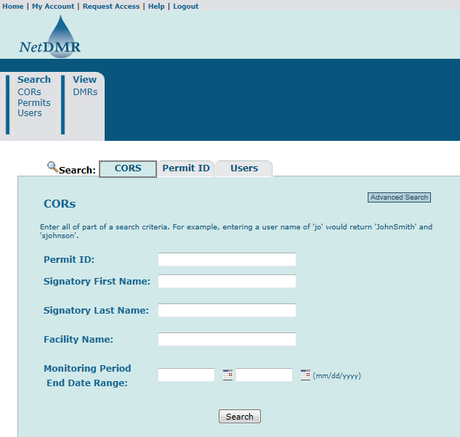
Requesting Access

Slide 44
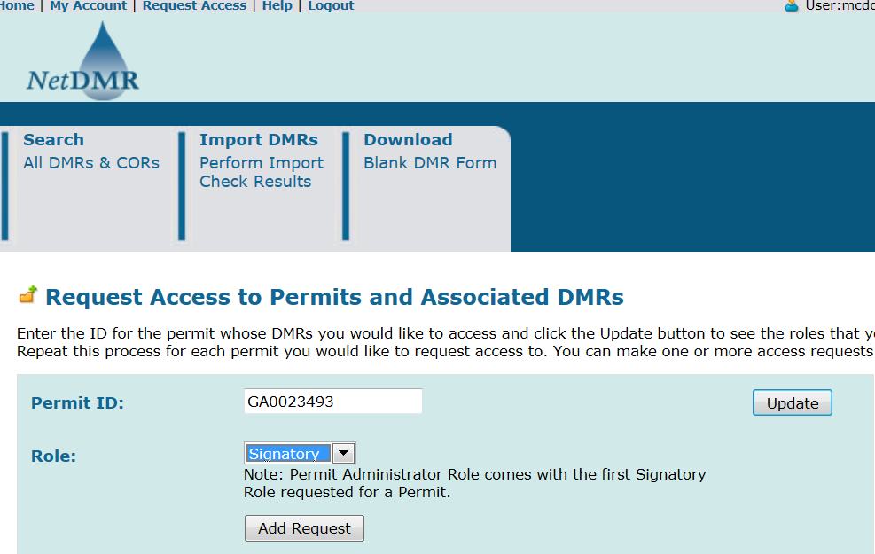
Fill in all YOUR permit ID number. Don’t forget to click the “Update” buttons! Lastly, click on “Add Access Request”.

Slide 45
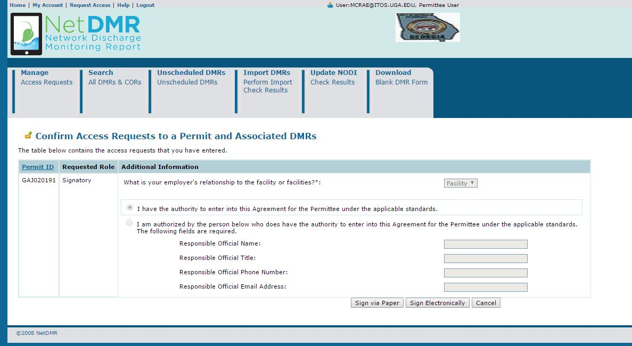
If you are requesting the Signatory role, you will be asked for more information about your relationship to the facility. If you are employed directly by the facility, select “Facility” otherwise select “Other.” For example, if you work for a company that manages the facility, select “Other.”

Slide 46
You now have the ability to sign the agreement Electronically

Slide 47

Duly Authorized Representative
If an electronic signatory request is made and the user requesting signatory role is a Duly Authorized Representative (or DAR). In such a case, the DAR provides the Responsible Official's name, title, phone number with dashes and email address.

Slide 48
Duly Authorized Representative
The RO has to have a CDX/NetDMR signatory account for the permit to be able to approve the DAR before EPD can approve the signatory role.
If the email address is incorrect the request may sit pending for a long time as the RO will never get the email notification.
NetDMR does not verify that the RO's email exists in NetDMR and it also does not validate the email address format.
Even if the DAR sends in a paper request EPD cannot approve the request.

Slide 49
Duly Authorized Representative
If the RO does not have a CDX/NetDMR signatory account and will not create one, then the DAR has to delete the request and redo the request as a paper ESA.
To delete the pending request, the DAR clicks “My Account” in NetDMR then clicks “Edit Account” and scrolls down to the pending request, place a checkmark in the “Delete Access Rights” column and click “Save” twice to complete the deletion.
The DAR situation is where most issues appear.

Slide 50
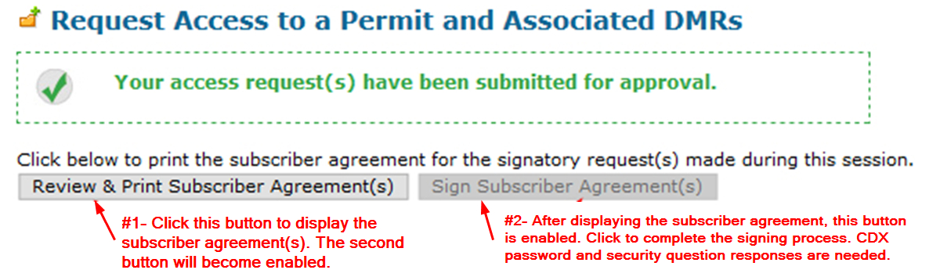
Signing the agreement at Account Creation
If you chose to “Sign via Paper” click “Review & Print Subscriber Agreement(s).” Sign the agreement. If you are a delegated RO, also have the actual RO sign their section. Mail the agreement with original ink signature(s) to the address on the form.
Remember, if you chose the electronic option there is no need to submit the agreement.

Slide 51
Misleading Message
When a user stops at the point where they get the message "Your access request(s) have been submitted for approval" EPD will never know that situation exists unless the user contacts them.
The pending status that this creates is different from the pending status where the user completes the signature process.
Completed signature processes appear on the pending requests page whereas incomplete ones do not.

Slide 52
Signing the Subscriber Agreement Electronically after Account Creation
Click the “My Account” link at the top of the page
Scroll down to your requested Signatory role and click sign

Slide 53
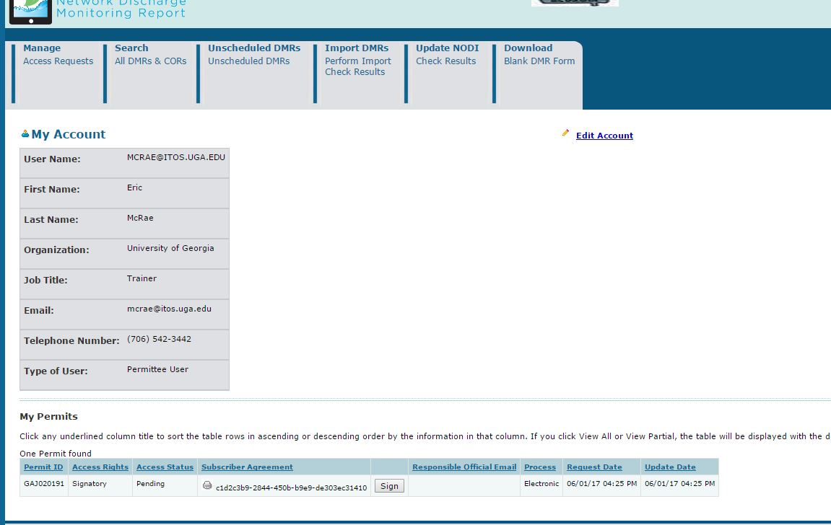
Signing the Subscriber Agreement Electronically

Slide 54
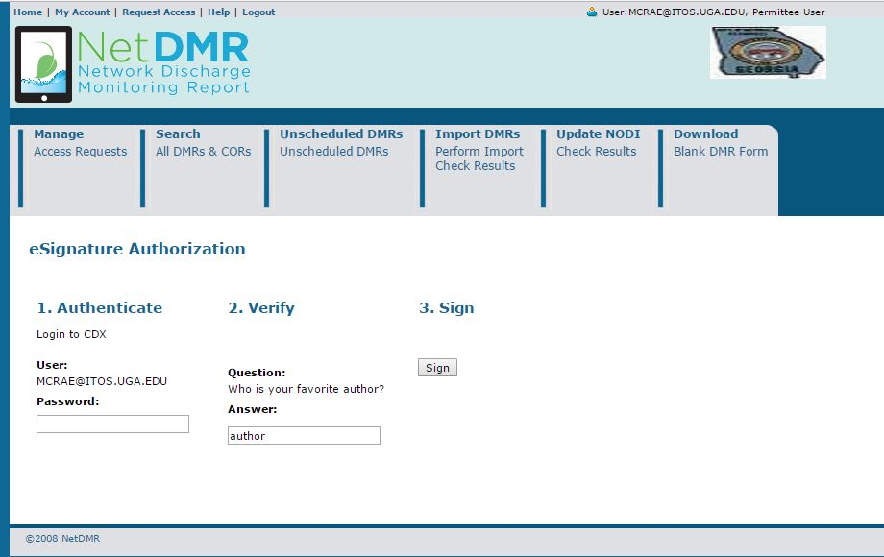
Signing the Subscriber Agreement Electronically
Next you will enter your password, answer a security question and click “Sign”

Slide 55
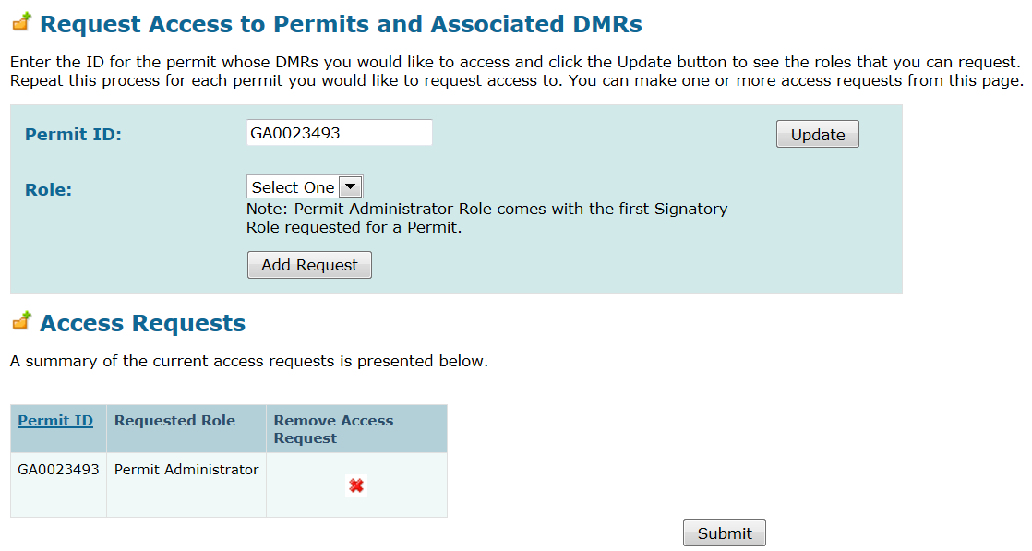
Adding a Request for Access

Slide 56
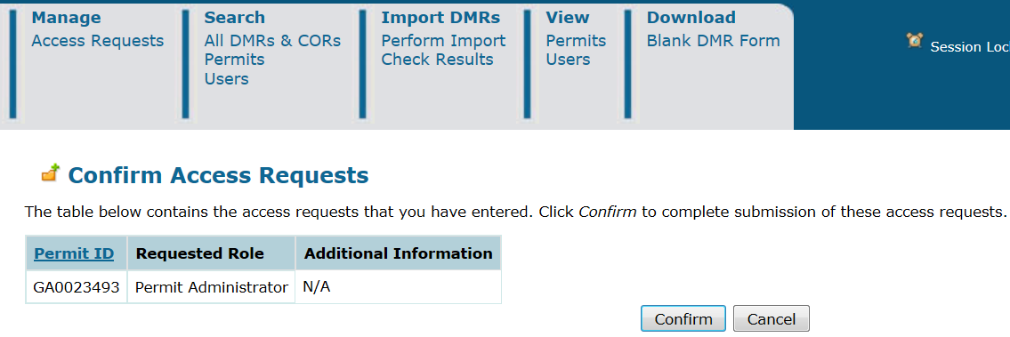
Adding a Request for Access

Slide 57
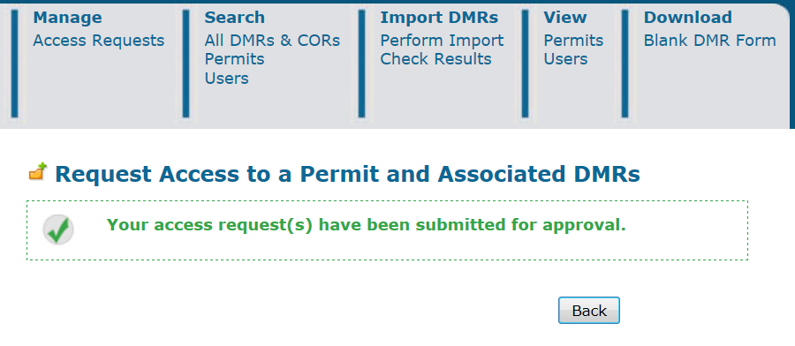
Adding a Request for Access

Slide 58
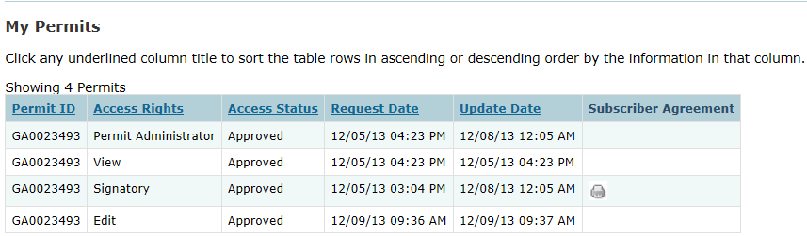
Verifying access rights
The bottom of the ‘My Account’ page will look like this.
You will see a list of the permits that you’ve requested access to, and whether you’ve been approved or not.
If your signatory role is still pending, call EPD. If your Edit or other role is pending, contact your Permit Administrator at your facility.

Slide 59
Help in finding your Permit Number
https://www3.epa.gov/enviro/facts/pcs-icis/search.html
If you are unable to find your facility’s permit ID, use this one for the training: GA0049247

Slide 60

Module 2: Getting inside NetDMR
Understanding the Permit Administrator Role within NetDMR

Slide 61
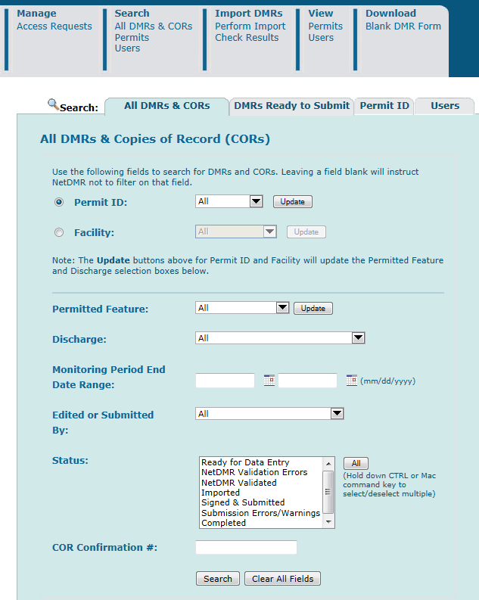
This is the first screen you will see when you log back in to NetDMR. It should look different than the home screen you had when you first logged into NetDMR

Slide 62
How do you as Permit Administrator check on requests for access? Click on “Access Requests” in the upper left hand corner. Check this frequently as you will not be notified when new requests are made.

Slide 63
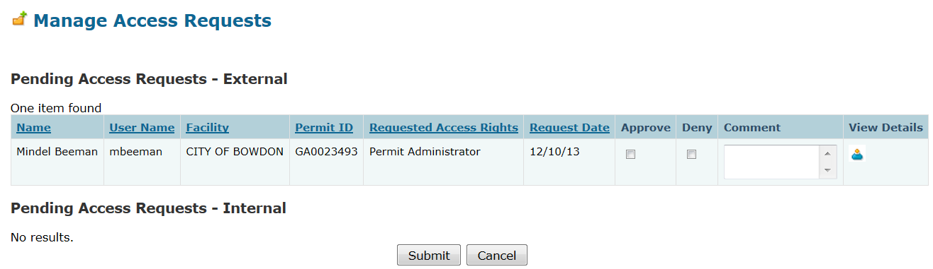
Responding to requests for access: Edit, View, Permit Administrator
Only EPA or EPD can approve Signatory requests. You cannot!

Slide 64
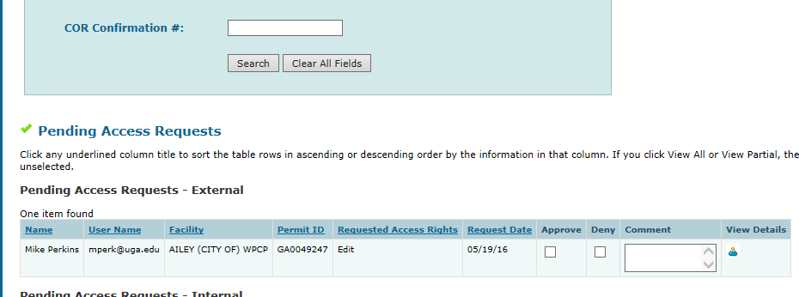
Pending Access Requests are also located
at the bottom of the search page.

Slide 65
What if assistance is needed while completing a DMR?
EPD can only see your DMRs once they have been signed by the person with the Signatory role (which may be the Administrator).
They must request access within NetDMR in order to see an in-progress DMR.
EPD’s request will appear as “Partial DMR” under “Requested Access Rights”. This access can be revoked after the problem is resolved

Slide 66
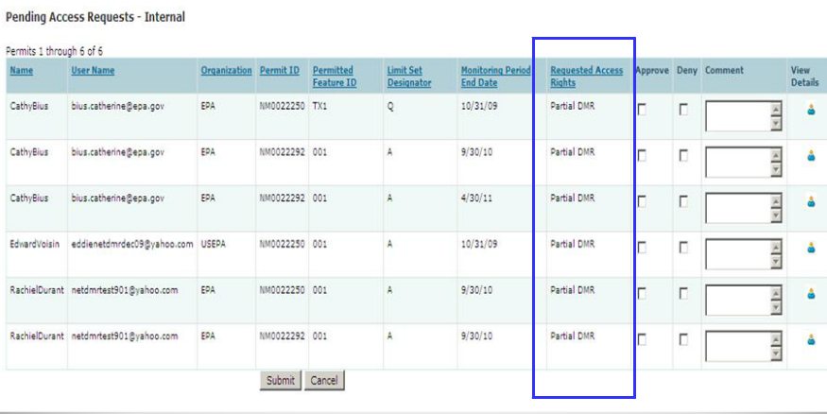
If EPD or EPA request permission to view your DMR, you will see this:

Slide 67
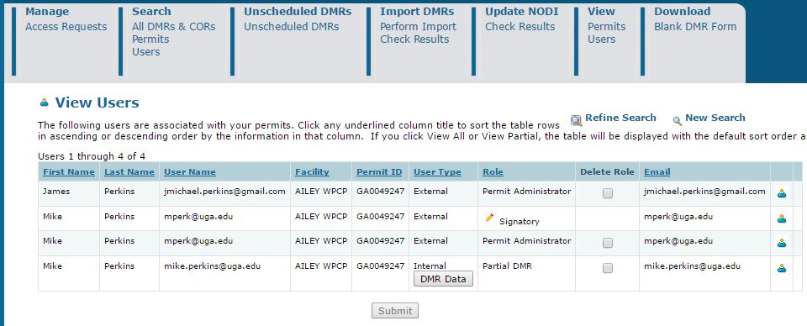
The Permit Administrator manages access, and can delete roles.

Slide 68
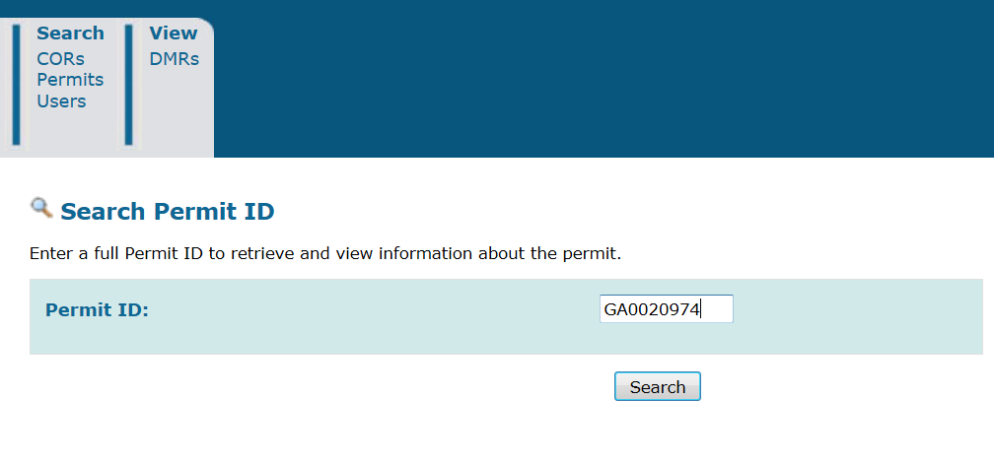
Searching for your permit

Slide 69
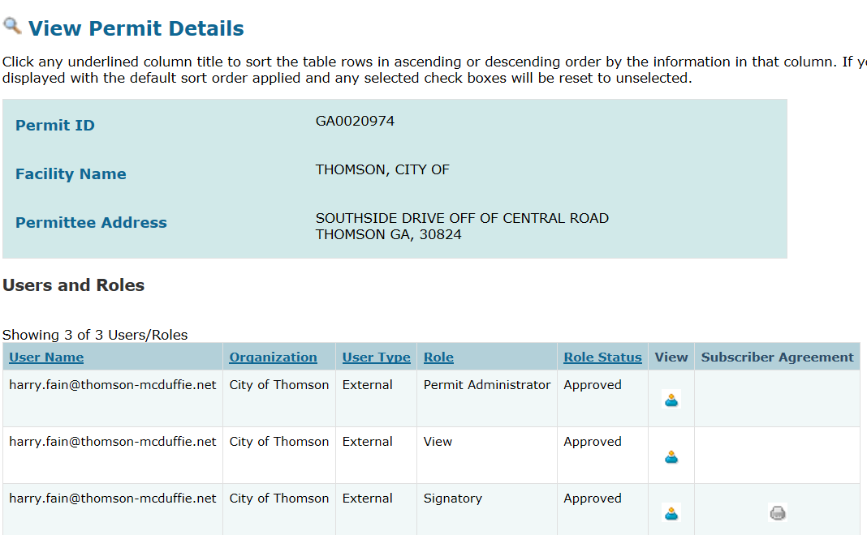
Viewing permit details
*Note: You can also get to this screen from the View Permits menu
Role
User Details

Slide 70
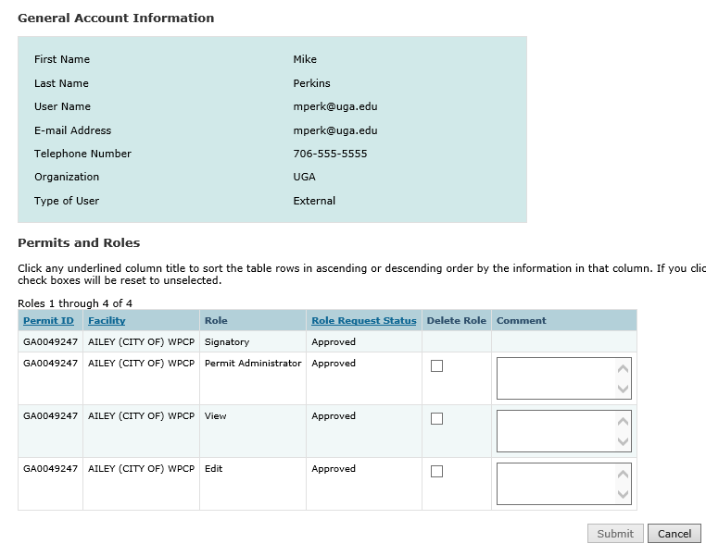
User Details

Slide 71

So, if you are the Permit Administrator, you can view and see all users and their roles associated with your permits.

Slide 72

Module 3:
Entering DMR data
cccooperagency.wordpress

Slide 73
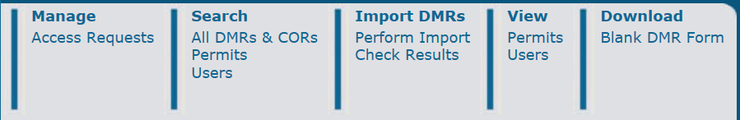
Entering DMR data electronically
If your Role has been approved, you can begin viewing and entering data into DMRs
Remember: Edit and Signatory Roles can ALL enter data into DMRs. The Permit Administrator and View Role can only see DMR CORs.
Click on “Search All DMRs and CORs”.

Slide 74
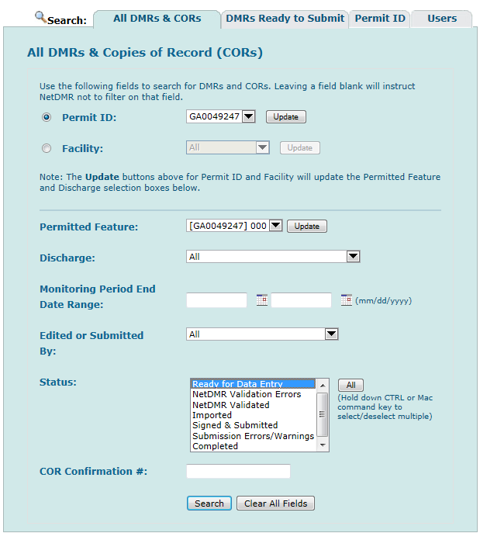
Your permit numbers will be here. Always click on “Update”!
If needed, enter the permitted feature here. Always click “Update”!
If there are lots of DMRs for this facility, enter a date range for the monitoring period here
Choose a DMR status here. If you want to find all DMRs that are ready to be filled, select “Ready for Data Entry”, and click on SEARCH

Slide 75
Understanding DMR status values for searching your DMRs
Ready for data entry: no data has been entered yet
NetDMR Validation Errors: there’s a problem with the data entered for this DMR
NetDMR Validated: all the data has passed the checks
Imported: The DMR has been imported but not validated, signed, or submitted
Signed and Submitted: a COR has been generated
Submission Errors/Warnings: Something is wrong with the data according to the ICIS-NPDES validation and it won’t accept it
Completed: Signed, submitted, and accepted!
Completed – Cannot be Corrected: COR has been generated
Update NODI Pending – NODI codes have been applied by user for entire DMR, waiting for comit

Slide 76
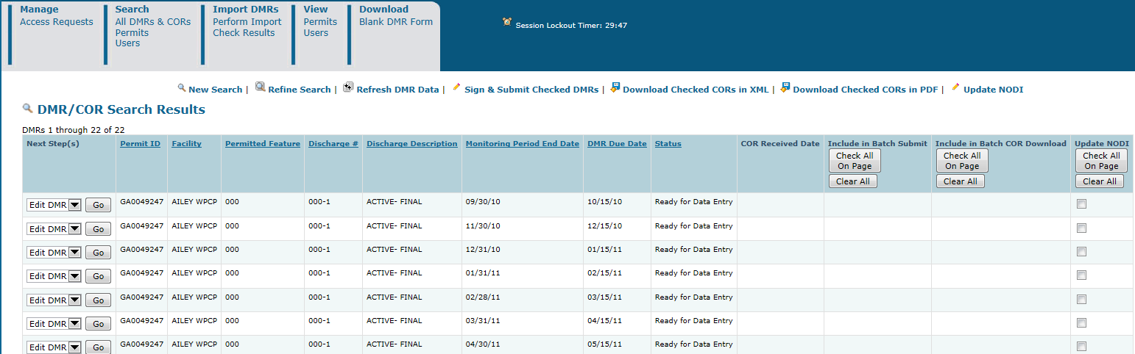
A list of DMRs for the permitted facility you entered will appear on the screen.
Left side of the page
Left side of the page
Right side of the page

Slide 77
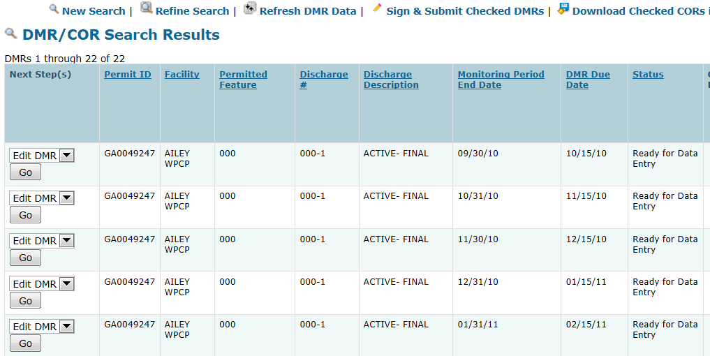
On the left side of the page, NetDMR will tell you the “Next Steps”. It also shows DMR information.

Slide 78
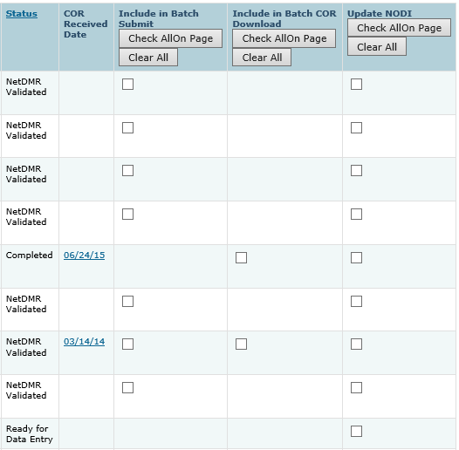
On the right hand side of the page is bulk operation options. We will discuss NODI in more detail.

Slide 79
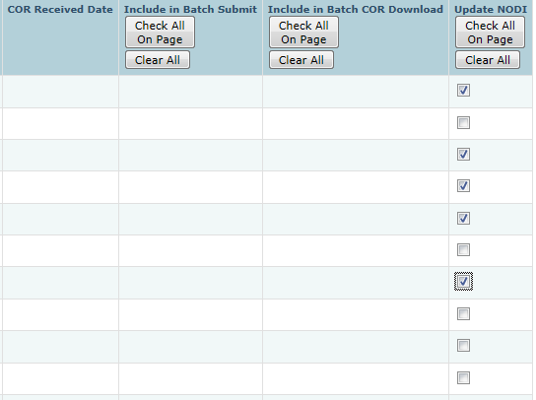
The “NODI” (No Data) Field
On this page, you are also able to pick more than one DMR if they all have the same reason for No Data (NODI) such as if there was no discharge at all, frozen conditions, etc.
To do that, click on the box in the right column and put a little check mark in it.
Then click on “Update NODI” in the upper right of the page.

Slide 80
The “NODI” (No Data) Field
M – Laboratory Error
1 – Wrong Flow
2 – Operation Shutdown
4 -- Discharge to Lagoon/Groundwater
5 – Frozen Conditions
7 – No Influent
8 – Other (See Comments)
9 -- Conditional Monitoring – Not Required This Period
A – General Permit Exemption
B – Below Detection Limit/No Detection
C – No Discharge
D – Lost Sample/Data Not Available
E – Analysis Not Conducted/No Sample
F – Insufficient Flow for Sampling
G – Sampling Equipment Failure
H – Invalid Test
I – Land Applied
J –Recycled – Water-Closed System
K – Natural Disaster
L – DMR Received but not Entered
Q – Not Quantifiable
S – Fire Conditions
V – Weather Related
W – Dry Lysimeter/Well
X – Parameter/Value Not Reported
There are lots of reasons why you may not have data to enter into a DMR.
There is a list of possible reasons, and each reason has a unique code you have to enter in the right place
We will discuss NODI codes again later.

Slide 81
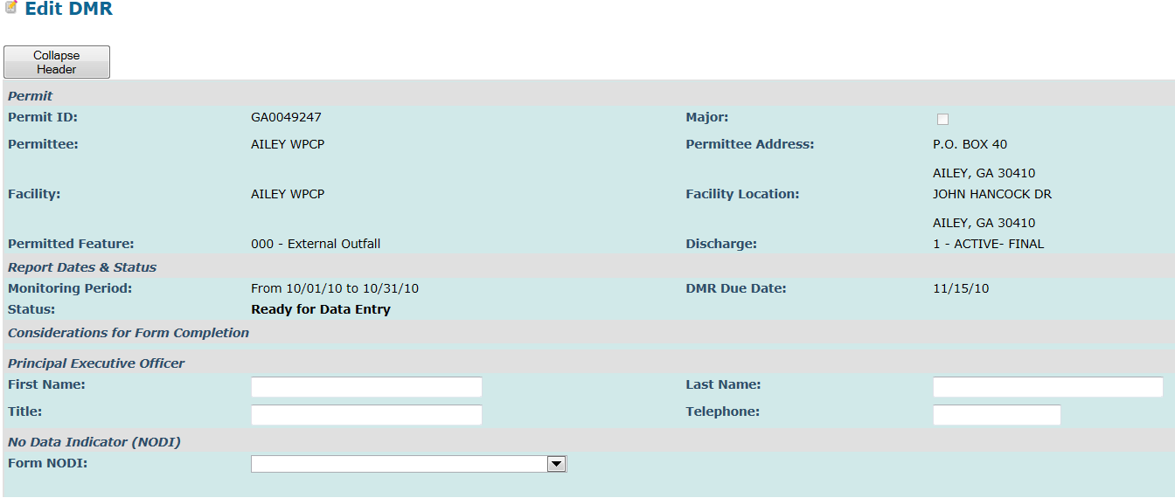
Select a DMR Ready for Data Entry
At the top of the page you will see the “Collapsible “Header”
This gives you general (but important) information about the permit. There are some fields that you can fill out here.

Slide 82

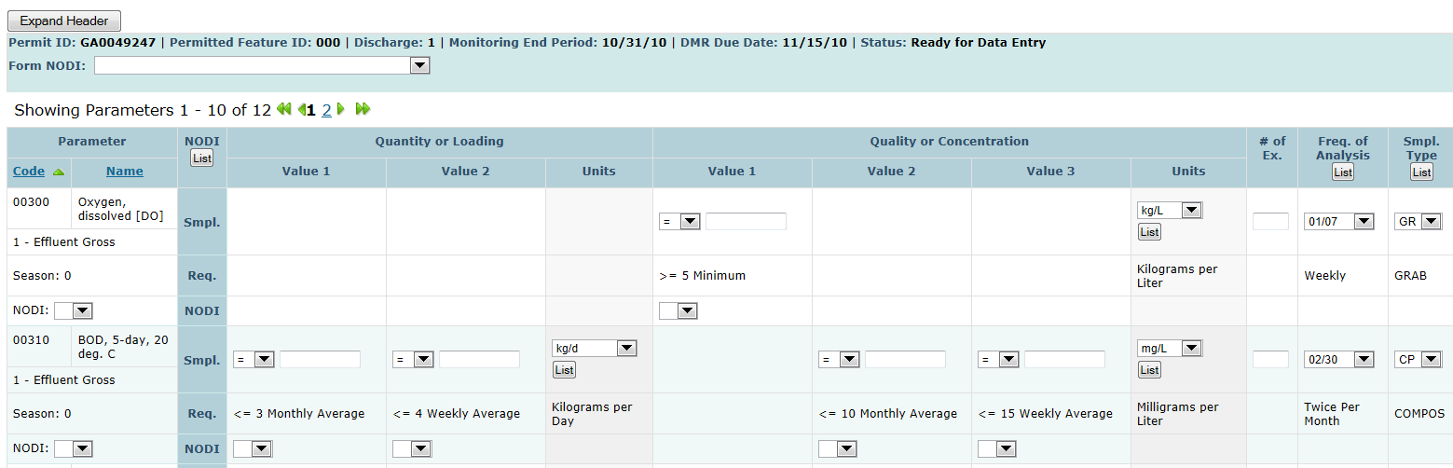
Entering discharge data
When you collapse the Header, you see the DMR
If you see a blank space, you can enter data there
There are three types of blank spaces for you to enter data. The first is the parameter value.

Slide 83

Entering discharge data
The second place is for a NODI code
You can enter this at the left side where it says “NODI”, or in the blank box directly under the place where the parameter data would have gone

Slide 84
Entering discharge data
The third place to enter data is in the column labeled “# of Ex.” This is where you enter the number of excursions.

Slide 85
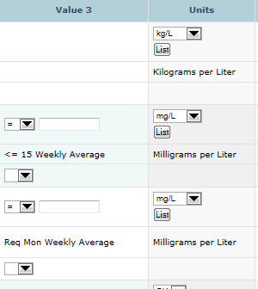
Entering Units
Units: Click on the “List” button to see the available units. The form should already be populated with the correct units but you may change it if your units are different. You will get a “soft error” if you change the expected units.

Slide 86
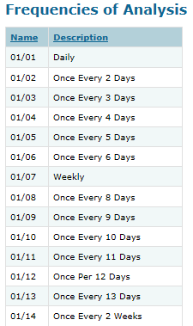
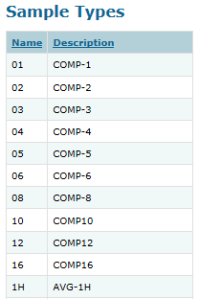
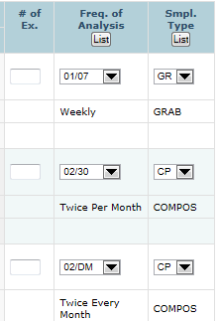
“Freq. of Analysis” or “Smpl. Type” columns
Frequency of Analysis: Should already be there, but if you did it differently you have to choose from the list.
Sample Type: Should already be there, but if you want to enter something different you have to choose from the list.

Slide 87
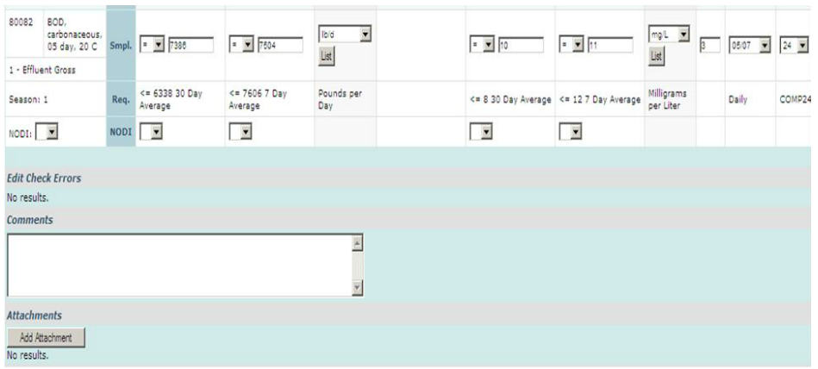
Attachments and Comments
(at the bottom of the DMR)
Each file attachments can’t be larger than 20Mb, so use a .zip file if needed.
File name cannot have any spaces! This is the biggest reason for attachments not working
File extensions cannot be .com, .exe, .dll, or vbs

Slide 88
Attachment Requirements
If your facility submits any attachments with its current paper DMR’s you must include these same attachments (in an electronic format) when you submit the facility’s NetDMR, e.g., an operating monitoring report (OMR)

Slide 89
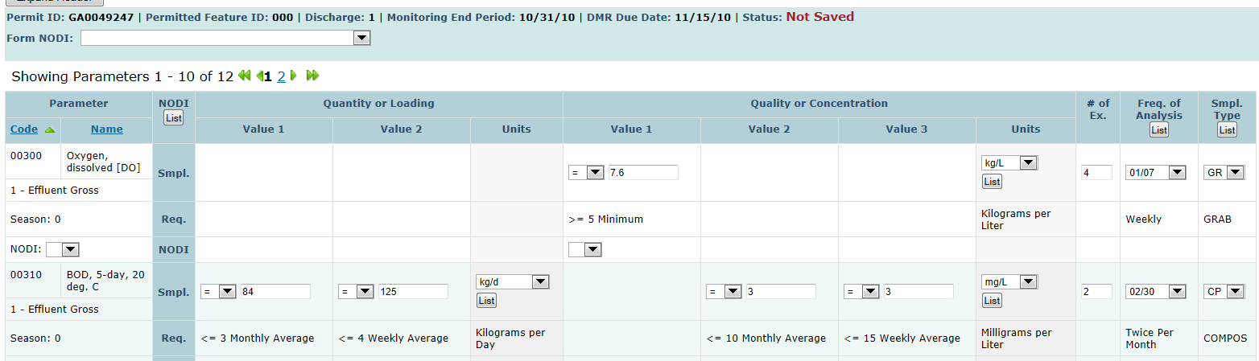
Start filling in the DMR. As soon as you do, it will read “Not Saved” at the top of the DMR.

Slide 90
Keep filling in the DMR!
You don’t have to finish the DMR all at once.
You can pause or log out, but…
Save your work. Why?
Because session will time out after 30 minutes if you don’t make any edits. If you haven’t saved your work, you will lose it!

Slide 91
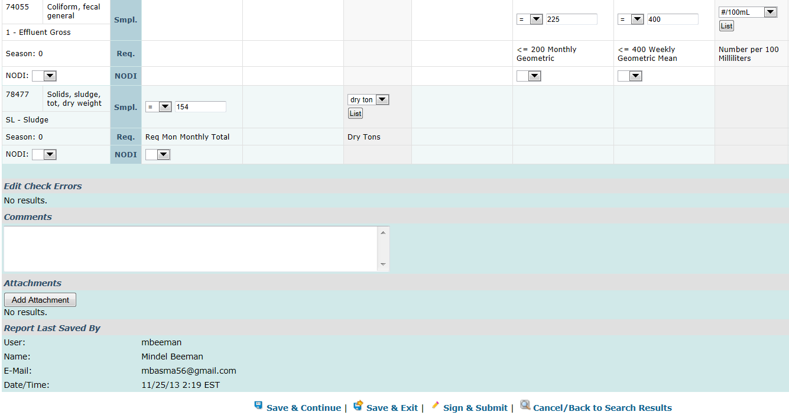
SAVE YOUR DATA!

Slide 92

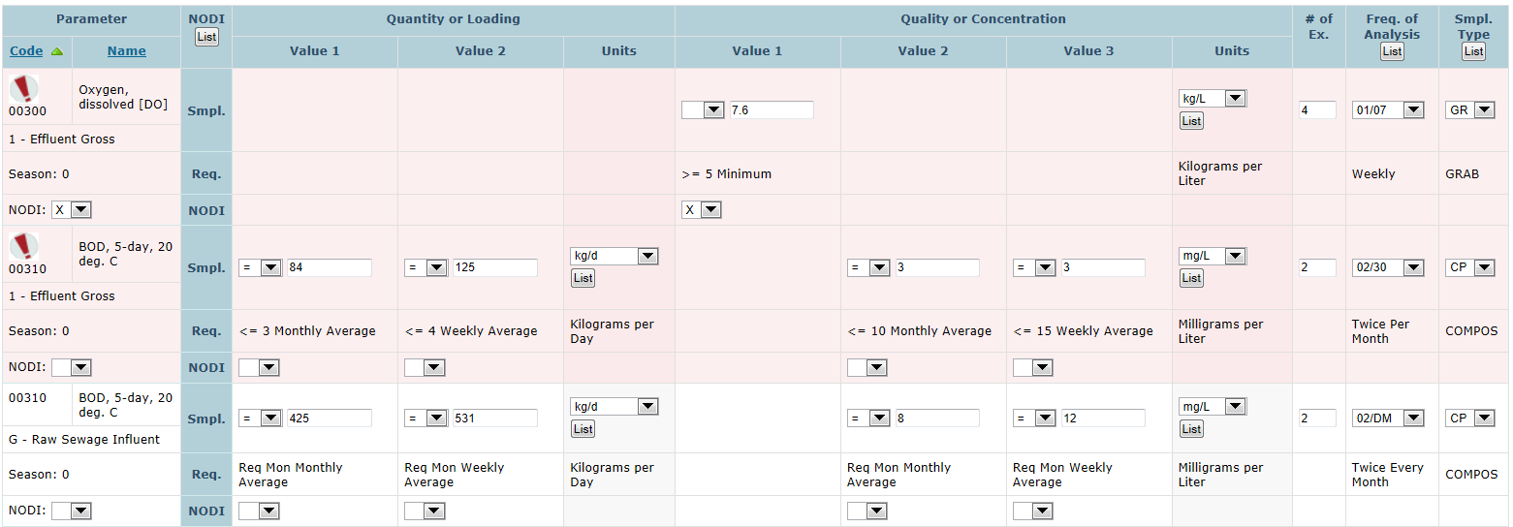
To err is human…
If you have errors on your DMR, this will appear at the top of your screen

Slide 93
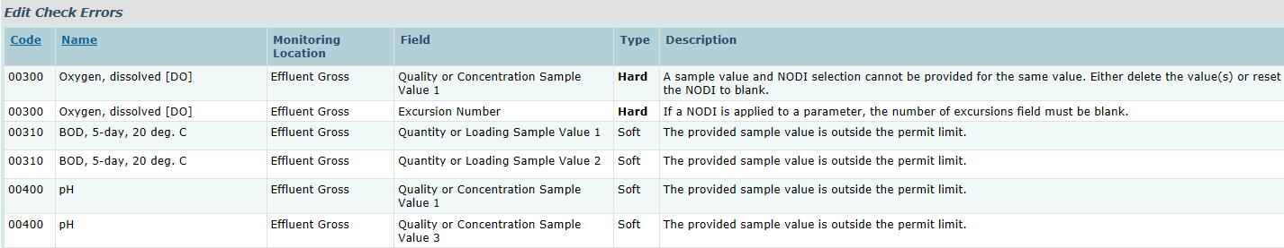
“Soft” errors versus “Hard” errors
If you have errors on your DMR, this will appear at the bottom of your screen

Slide 94
“Soft” errors versus “Hard” errors
Hard errors are a mistake in the way you entered the data like entering data when you also entered NODI
Soft errors are usually parameter values that exceeded the permit limit. You will also get a soft error if you change units from what the system is expecting
Your DMR cannot be validated and signed until all Hard errors are fixed and Soft errors are acknowledged

Slide 95
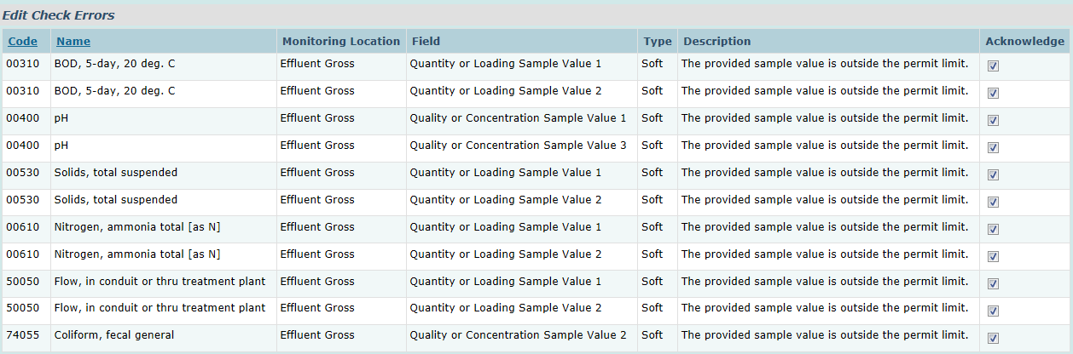
“Soft” errors must be acknowledged before you can save your data
“Hard” errors must be fixed before you can save your data and sign the DMR!
After you acknowledge all soft errors and correct all hard errors, Save Your Data again!

Slide 96
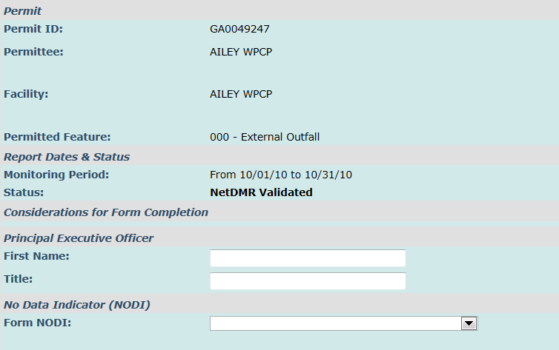
Look what happens!

Slide 97
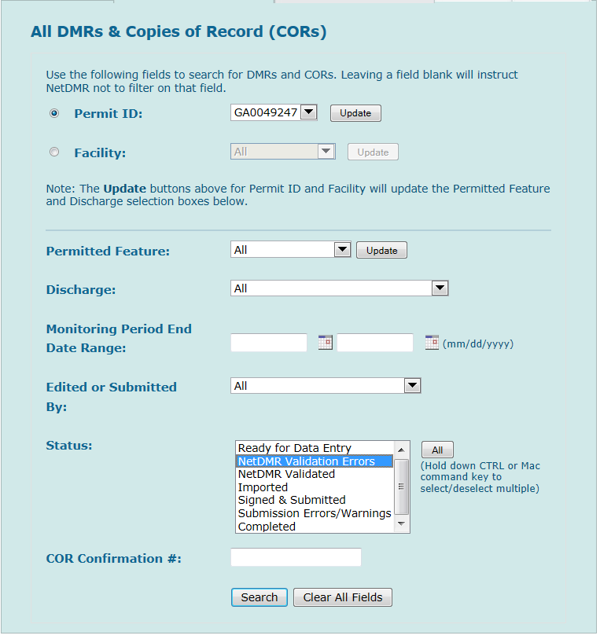
Using Status to check for DMRs with Validation Errors

Slide 98

If you do a validation check, you may see that there are still some DMRs that need attention

Slide 99


You will see the errors on each DMR immediately.

Slide 100

Using Status for Signatories to find DMRs ready for submission

Slide 101

DMRs Ready to Submit tab

Slide 102

Signing validated DMRs
You MUST have the Signatory Role!
You can batch submit as many as 100 DMRs at one time

Slide 103

This is what you will see at the top of the page when you are about to sign and submit a DMR

Slide 104

This is what you will see at the bottom of that same page when you are about to sign and submit a DMR
Case sensitive!

Slide 105

Confirmation!

Slide 106
Now you can move onto the NetDMR Production Environment:
This is where you will edit, sign, and submit real NetDMRs.
Notice that the word “test” DOES NOT appear on the web address!
netdmr.epa.gov/netdmr/

Slide 107
Additional Information
EPA help site for NetDMR:
  http://www.epa.gov/netdmr
EPD NetDMR assistance site:
  http://epd.georgia.gov/netdmr
Importing DMRs. The site above provides instructions on importing DMRs.
  Also see Appendix B and C in NetDMR User Guide:
    http://epd.georgia.gov/netdmr/documents/netdmr-permittee-and-data-provider-user-guide

Slide 108
Customer Service
NetDMR Customer Support
  Call Center at 1-877-227-8965 (toll-free)
  Email to NPDESeReporting@epa.gov
CDX - Account information, including passwords, resend your Verification email
  Call 888-890-1995 (toll-free) or (970) 494-5500 for International callers
  helpdesk@epacdx.net
  Hours of operation is Monday thru Friday, 8 am – 6 pm Eastern

