Slide 1
Drought Indicators Report
Georgia Environmental Protection Division
February 2016

Slide 2
Background
Pursuant to the Rules for Drought Management, Section 391-3-3-.04 Drought Indicators and Triggers, the Director of EPD monitors climatic indicators and water supply conditions to assess drought occurrence and severity, and its impact upon the ability of public water systems to provide adequate supplies of water. These indicators and conditions may include, but not be limited, to the following:
U.S. Drought Monitor;
Precipitation;
Streamflow;
Groundwater;
Reservoir levels;
Short term climate predictions;
Soil moisture; and
Water supply conditions.

Slide 3
Background
The Rules require EPD to report on current climatic indicators at least semi-annually or monthly when any part of the state has experienced at least two consecutive months of severe drought.
This report compares current conditions to historical levels (and/or reservoir rule curves) for each of the following indicators:
  Precipitation during the prior 3, 6, and 12 months;
  Streamflow at the select United States Geological Survey gages;
  Groundwater levels at select United States Geological Survey monitoring wells; and
  Reservoir levels at Allatoona Lake, Lake Hartwell, Clarks Hill Lake, and Lake Lanier.
The following sections of this presentation provide the data and information sources analyzed by EPD in developing this drought indicators report for conditions as of December 31, 2015.

Slide 4
Drought Indicator Analysis Summary
Drought Monitor - According to the US Drought Monitor, the only area of the state showing any signs of dryness are 14 counties along the coast which are experiencing abnormally dry conditions.
Precipitation - For most of the state, precipitation has been well above normal.
Streamflow - With the exception of some USGS gages in southeastern Georgia, where there has been less rainfall, streamflow measured at USGS gages in the rest of the state have been normal or above normal.
Groundwater – Groundwater levels throughout the state are mostly near, at, or above normal for this time of year.
Reservoir Levels – All of the state’s major reservoirs are at or near full pool or are operating around their operational rule curves.
Short-term Climate Prediction - The Climate Prediction Center outlook for February – April 2016 calls for an equal chance of above or below normal temperatures and above normal precipitation for most of the state.
Soil Moisture – While there is a slight deficit in soil moisture in southeastern Georgia due to abnormally dry conditions, abundant rainfall throughout the rest of state has resulted in soil moisture levels adequate for healthy plant growth.
Water Supplies – Water supplies were not assessed as part of this report since drought impacts would not be expected under the present conditions .

Slide 5
US Drought Monitor
Data Source:
http://droughtmonitor.unl.edu/

Slide 6
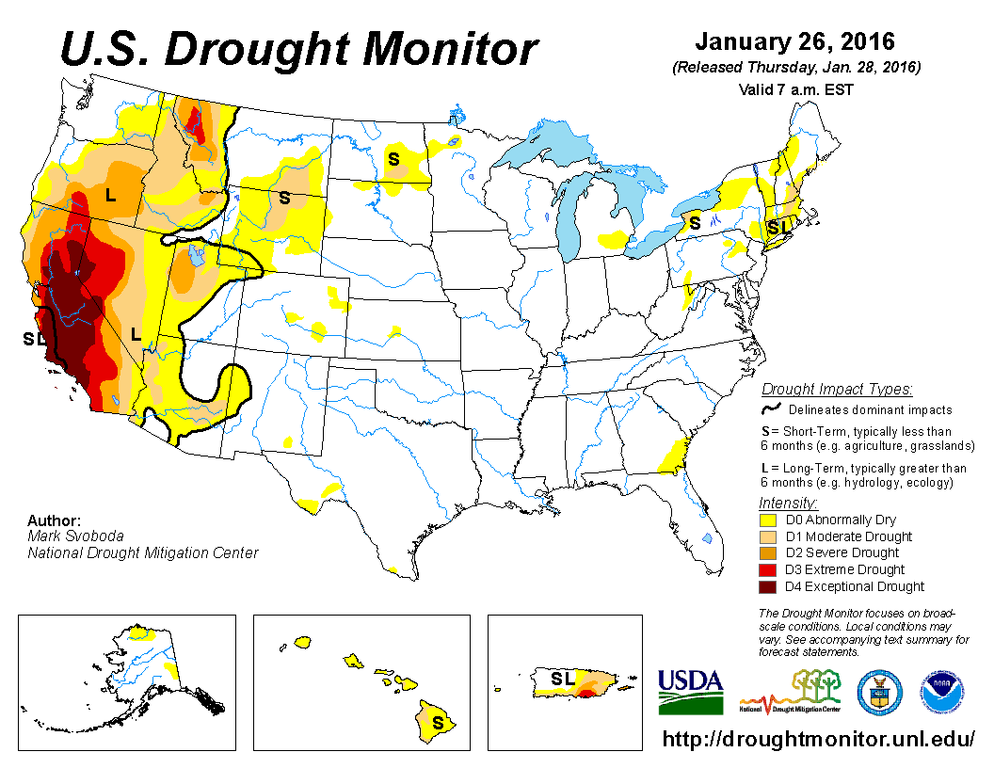

Slide 7
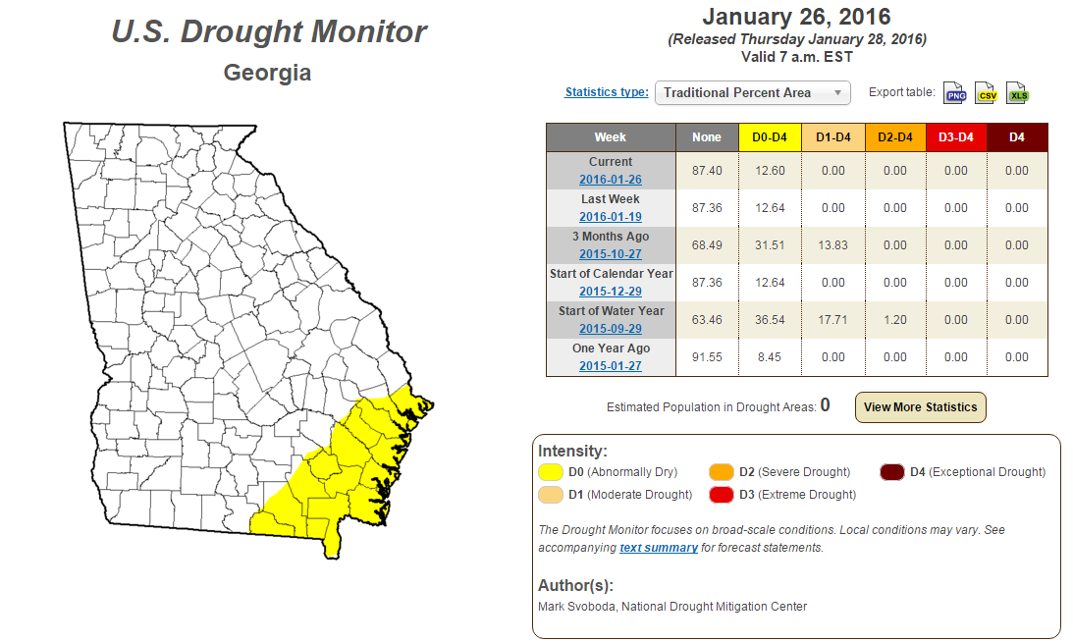

Slide 8
3, 6, and 12 Month
Percent of Normal Precipitation
Data Source:
http://climate.ncsu.edu/drought

Slide 9
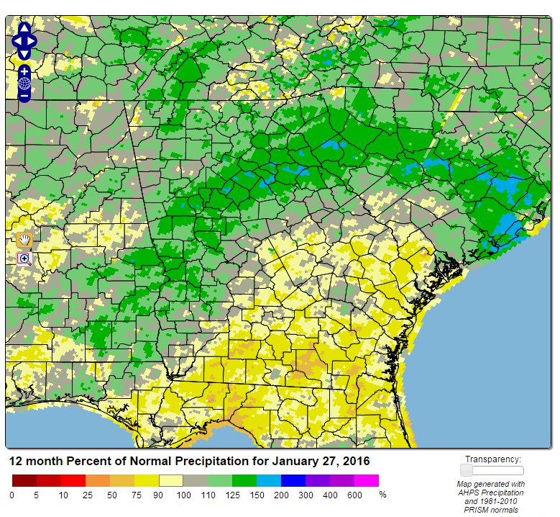
3 Month Percent of Normal Precipitation

Slide 10
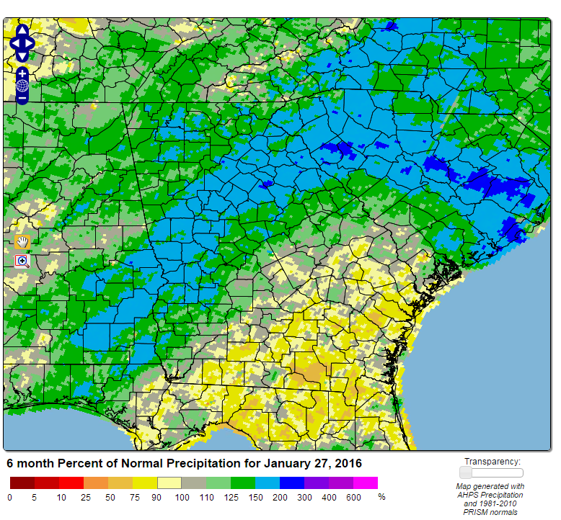
6 Month Percent of Normal Precipitation

Slide 11
12 Month Percent of Normal Precipitation

Slide 12
Soil Moisture Conditions
Data Source:
http://nsstc.uah.edu/aosc/lawn_garden_se.html

Slide 13
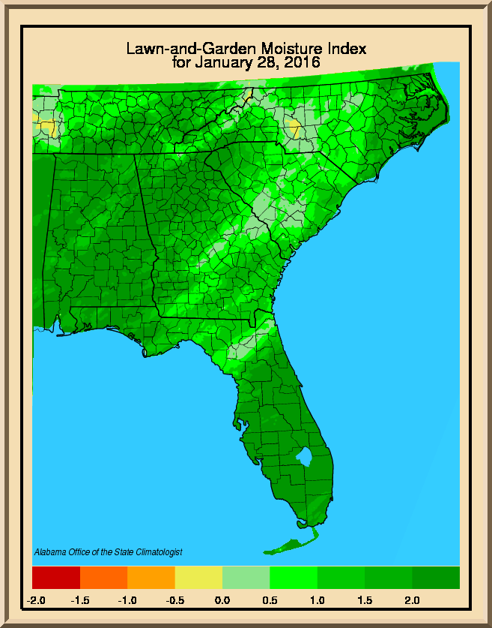
The lawn-and-garden moisture index measures the capacity of current soil moisture to sustain healthy lawns and gardens. Positive values on the scale indicate adequate precipitation while negative values indicate a precipitation deficit.

Slide 14
Streamflow Conditions
Data Source:
USGS Website

Slide 15
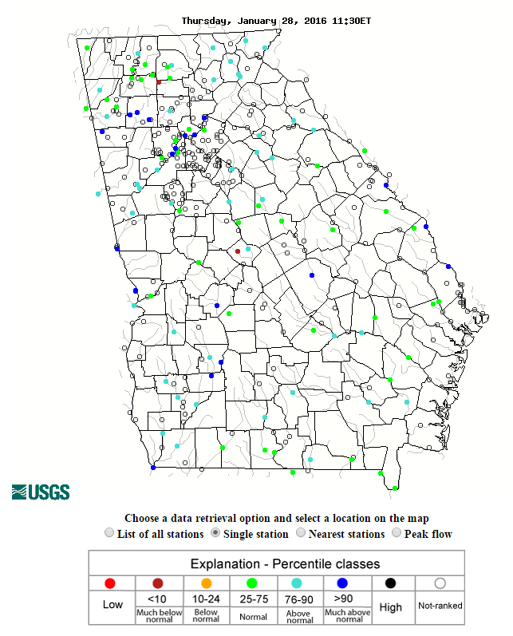
Current (Daily) Conditions of All Available USGS Gages

Slide 16
Streamflow Monitoring
As shown on the following slide, EPD Monitors 34 USGS stream gages in 13 of the State’s major river basins to assess drought conditions.
These gages were selected because each has:
  Long-term and relatively complete records for recent decades; and
  Relatively low consumptive water use implications and streamflows are not heavily influenced by dams.
Note: Hydrologic conditions of major rivers with streamflows that are heavily influenced by dams can be assessed by reviewing status of major storage reservoirs

Slide 17
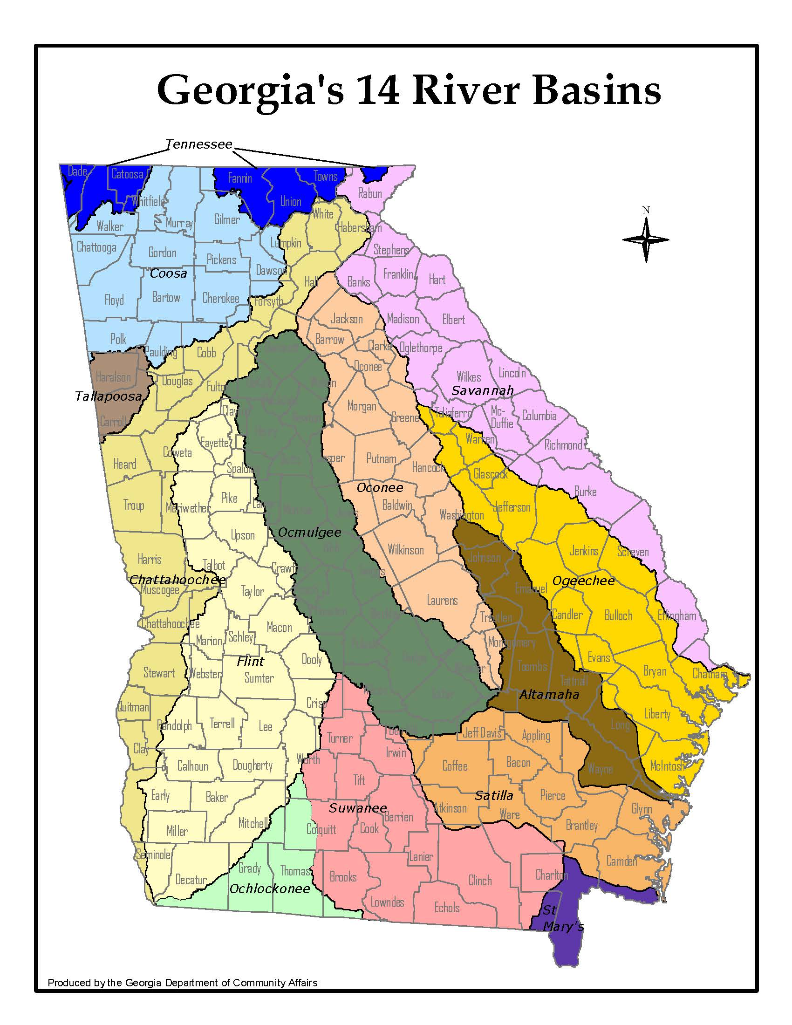
USGS Stream Gages Monitored by EPD to Assess Drought Conditions
1
2
6
22
Gage# Basin Gage Name
1 Tennessee LOOKOUT CREEK NEAR NEW ENGLAND
2 Tennessee NOTTELY RIVER NEAR BLAIRSVILLE
3 Coosa Chattooga River at Summerville
4 Coosa TALKING ROCK CREEK NEAR HINTON
5 Coosa Etowah River at Canton
6 Chattahoochee Chattahoochee River at Cornelia
7 Chattahoochee Chestatee River near Dahlonega
8 Chattahoochee New River at GA 100 NEAR CORINTH
9 Chattahoochee Upatoi Creek at Columbus
10 Flint Flint River at GA26 near Montezuma
11 Flint Flint River at Albany
12 Flint Ichawaynochaway Creek at Milford
13 Flint Spring Creek near Iron City
14 Ocmulgee ALCOVY RIVER ABOVE COVINGTON
15 Ocmulgee Ocmulgee River at Macon
16 Ocmulgee TOBESOFKEE CREEK NEAR MACON
17 Ocmulgee TUCSAWHATCHEE CREEK NEAR HAWKINSVILLE
18 Oconee MIDDLE OCONEE RIVER NEAR ATHENS
19 Oconee LITTLE RIVER NEAR EATONTON
20 Oconee Oconee River at Dublin
21 Altamaha OHOOPEE RIVER NEAR REIDSVILLE
22 Savannah CHATTOOGA RIVER NEAR CLAYTON
23 Savannah Broad River near Bell
24 Savannah BEAVERDAM CREEK NEAR SARDIS
25 Savannah BRIER CREEK AT MILLHAVEN
26 Ogeechee CANOOCHEE RIVER NEAR CLAXTON
27 Ogeechee Ogeechee River near Eden
28 Ochlockonee OCHLOCKONEE RIVER NEAR THOMASVILLE
29 Suwanee Withlacoochee River near Pinetta FL
30 Suwanee Alapaha River at Statenville
31 Suwanee SUWANNEE RIVER AT US 441, AT FARGO
32 Satilla Satilla River near Waycross
33 Satilla LITTLE SATILLA RIVER NEAR OFFERMAN
34 St Mary ST MARYS RIVER NEAR MACCLENNY FL
3
4
7
5
14
18
23
8
19
15
24
25
16
9
20
10
17
26
21
27
11
12
33
32
13
28
30
31
29
34

Slide 18
Streamflow Graphs
For each of the 34 gages, EPD has prepared a graph that shows monthly average streamflow from January 1, 2015 through December 31, 2015;
To help put these streamflow conditions into perspective, for comparison purposes, each graph also shows:
  Monthly average streamflows for the years 2007 and 2011 when streamflows were at or near recorded low levels across much of the state; and
  A statistical composite of historical conditions showing the “driest” 50, 20, 10, and 5 percent of all recorded monthly average stream flows at the same gage.

Slide 19
How to Read the Streamflow Graphs
Example #1: Etowah River at Canton
The streamflow graph for Gage #5, USGS Etowah River gage at Canton shows :
  Average stream flow for May 2015 was 1008 cfs. The statistical composite of all historical data for this gage shows that average streamflow in May has historically been lower than May 2015 about 50% of the time; about 50% of the time in May it has been higher.
  Average stream flow in May 2011 was 726 cfs. The statistical composite of all historical data for this gage shows that average streamflow for May has historically been lower than May 2011 only 20% of the time; 80% of the time in May it has been higher.
  Average stream flow in May 2007 was 512 cfs. The statistical composite of all historical data for this gage shows that average streamflow for May has historically been lower than May 2007 only 5% of the time; 95% of the time in May it has been higher.
  The lowest recorded average stream flow for May was 480 cfs.

Slide 20
How to Read the Streamflow Graphs
Example #2: Flint River at Albany
The streamflow graph for Gage #11, USGS Flint River gage at Albany shows:
  Average stream flow for May 2015 was 3361 cfs. The statistical composite of all historical data for this gage shows that average streamflow in May has historically been lower than May 2015 about 50% of the time; about 50% of the time in May it has been higher.
  Average stream flow in May 2011 was 1575 cfs. The statistical composite of all historical data for this gage shows that average streamflow for May has historically been lower than May 2011 only 10% of the time; 90% of the time in May it has been higher.
  Average stream flow in May 2007 was 1291 cfs. The statistical composite of all historical data for this gage shows that average streamflow for May equal to the historically lowest recorded average stream flow for May.

Slide 21
Back to Map

Slide 22
Back to Map

Slide 23
Back to Map

Slide 24
Back to Map

Slide 25
Back to Interpretation
Back to Map

Slide 26
Back to Map

Slide 27
Back to Map

Slide 28
Back to Map

Slide 29
Back to Map

Slide 30
Back to Map

Slide 31
Back to Interpretation
Back to Map

Slide 32
Back to Map

Slide 33
Back to Map

Slide 34
Back to Map

Slide 35
Back to Map

Slide 36
Back to Map

Slide 37
Back to Map

Slide 38
Back to Map

Slide 39
Back to Map

Slide 40
Back to Map

Slide 41
Back to Map

Slide 42
Back to Map

Slide 43
Back to Map

Slide 44
Back to Map

Slide 45
Back to Map

Slide 46
Back to Map

Slide 47
Back to Map

Slide 48
Back to Map

Slide 49
Back to Map

Slide 50
Back to Map

Slide 51
Back to Map

Slide 52
Back to Map

Slide 53
Back to Map

Slide 54
Back to Map

Slide 55
Groundwater Levels
Data Source: USGS

Slide 56
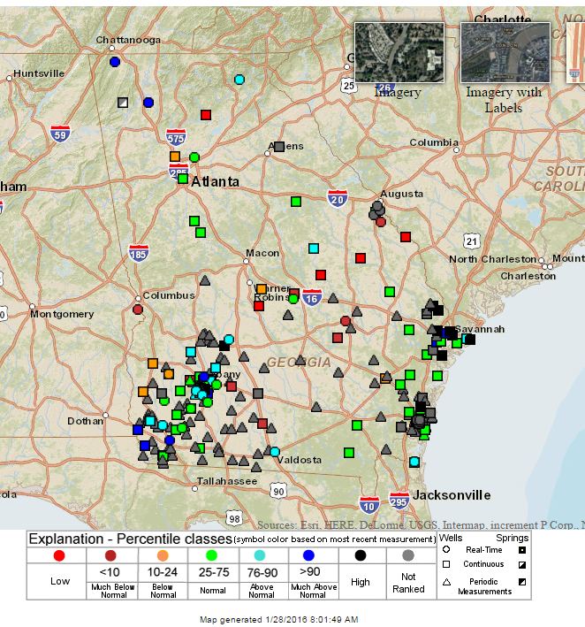
Short Term (Daily) Conditions of All Available USGS Monitoring Wells in Georgia as of January 2016

Slide 57
Rationale for Choosing USGS Monitoring Wells
EPD monitors 15 groundwater USGS monitoring wells shown on the following slide to assess drought conditions. These wells were selected for monitoring because they have:
Long-term monitoring records consisting of three decades or more of data; and
Real-time monitoring that represents the most up-to-date conditions.

Slide 58
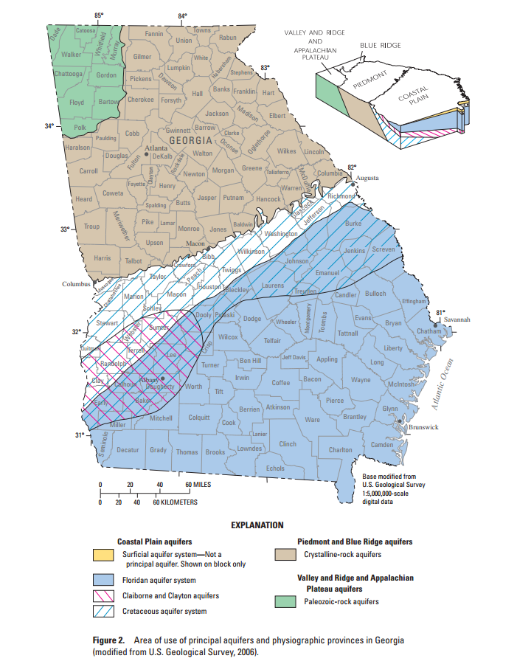
USGS Wells Monitored by EPD to Assess Drought Conditions
  Flint Basin
  1. 11AA01
  2. 09M007
  3. 13L180
  4. 12M017
  5. 08K001
  6. 11K003
  7. 12K014
  8. 13J004
  9. 08G001
  10. 10G313
  11. 09F520
  Oconee Basin
  12. 21T001
  Altamaha Basin
  13. 26R001
  Savannah Basin
  14. 30AA04
  Suwanee Basin
  15. 19E009
1
14
12
13
2
3
4
5
6
7
8
9
10
11
15

Slide 59
Groundwater Level Graphs
For each of the 15 groundwater wells, EPD has prepared a graph that shows monthly average groundwater levels from January 1, 2015 through December 31, 2015;
To help put these levels into perspective, for comparison purposes, each graph also shows:
  Monthly average levels at that same well for the years 2007 and 2011 when groundwater levels were at or near recorded low levels across much of the state; and
  And a statistical composite of historical conditions at that same gage showing the “lowest” 50, 20, 10, and 5 percent of all recorded monthly average levels at the same well.

Slide 60
How to Read the Groundwater Level Graphs
Example: Well #11, 09F520, Flint River Basin
The groundwater level graph for Well #11, USGS 09F520 shows:
  The average monthly groundwater level for May 2015 was 47ft below land surface. The statistical composite of all historical data for this well shows that monthly average groundwater levels in May have historically been lower than May 2015 about 50% of the time; about 50% of the time in May they have been higher.
  The average monthly groundwater level in May 2011 was 52ft below land surface. The statistical composite of all historical data for this well shows that average monthly groundwater elevation levels for May have historically been lower than May 2011 only 10% of the time; 90% of the time in May they have been higher.
  The average monthly groundwater level in May 2007 was 53ft below land surface. The statistical composite of all historical data for this well shows that average monthly groundwater levels for May have historically been lower than May 2007 only 5% of the time; 95% of the time in May it has been higher.
  The lowest recorded average monthly groundwater level for May was 53ft below land surface.

Slide 61
Back to Map

Slide 62
Back to Map

Slide 63
Back to Map
Notes:
30AA004

Slide 64
Back to Map

Slide 65
Back to Map

Slide 66
Back to Map

Slide 67
Back to Map

Slide 68
Back to Map

Slide 69
Back to Map

Slide 70
Back to Map

Slide 71
Back to Interpretation
Back to Map

Slide 72
Back to Map

Slide 73
Back to Map

Slide 74
Back to Map
Notes:
30AA004

Slide 75
Back to Map

Slide 76
Reservoir Levels
Data Source:
US Army Corps of Engineers

Slide 77
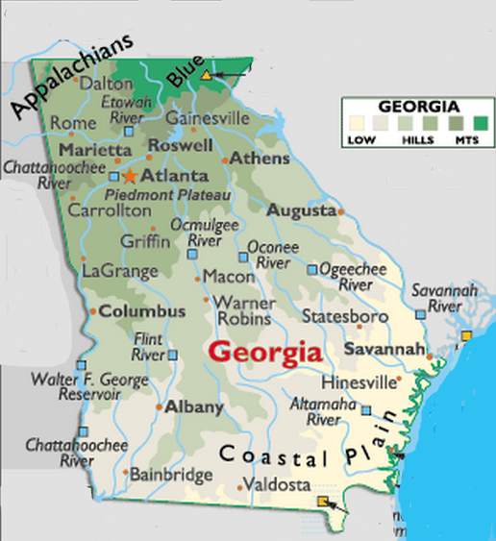
Coosa Basin
1. Carters
2. Allatoona
Chattahoochee Basin
3. Lanier
4. West Point
5. W.F. George
Savannah Basin
6. Hartwell
7. Thurmond
1
2
3
6
7
4
5
EPD monitors the water levels of seven reservoirs to assess drought conditions.

Slide 78
Reservoir Elevation Graphs
The following graphs show the reservoir elevation curves for January 1, 2015 through December 31, 2015.
Each graph also shows the Action Zone Divides (or Levels) for each reservoir
  Zone 1 is the top layer of the conservation pool
  Zone 2 is the layer below Zone 1
  Zone 4 is the lowest layer in the conservation pool
  There is no conservation storage below the bottom of Zone 4
To put 2015 reservoir elevations into perspective, elevations for 2007 and 2011 are also shown.

Slide 79
Back to Map

Slide 80
Back to Map

Slide 81
Zone 1
Zone 2
Zone 3
Zone 4
Back to Map

Slide 82
Zone 1
Zone 3
Zone 2
Zone 4
Back to Map

Slide 83
Zone 1
Zone 2
Zone 3
Zone 4
Back to Map

Slide 84
Level 1
Level 2
Level 3
Level 4
Back to Map

Slide 85
Level 1
Level 2
Level 3
Level 4
Back to Map

Slide 86
Climate Prediction Center
3-monthTemperature and Precipitation Probability Outlook and Seasonal Drought Outlook
Data Source:
http://www.cpc.ncep.noaa.gov/

Slide 87
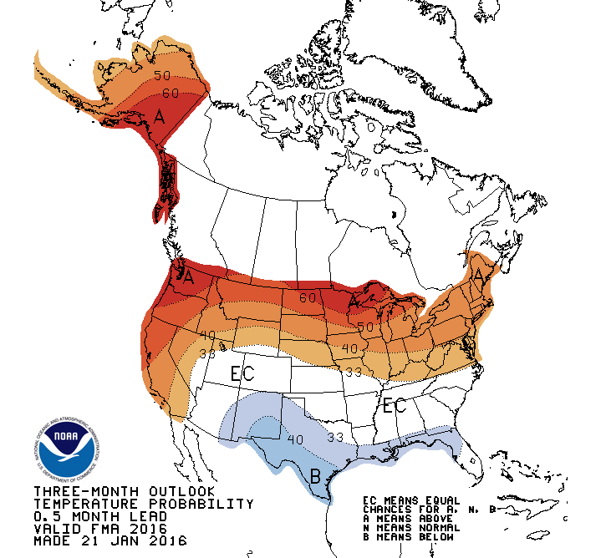
Temperature Outlook
The Climate Prediction Center 3-month temperature probability outlook for February – April 2016 calls for a 33% chance of below normal temperatures in extreme south Georgia with an equal chance of above or below normal temperatures throughout the rest of the state.

Slide 88
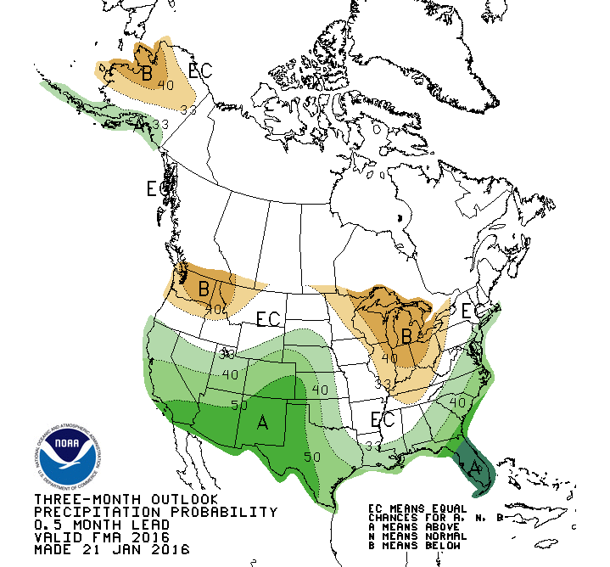
Precipitation Outlook
For February - April 2016, there is an equal chance of above or below normal precipitation in extreme northwest Georgia while the rest of the state has a 33%-50% probability of above normal precipitation as you move from northwest to southeast across the state, with the highest probability of above normal precipitation occurring along the coast.

Slide 89
