Slide 1
Demonstrating Progress Toward Improving Water Supply Efficiency
Tim Cash, Bill Frechette, Johanna Smith, Wei Zeng Georgia Environmental Protection Division
Version 1.0
May 2019

Slide 2
Presentation Outline
What is Water Loss?
How do we Track It?
Why Track Water Loss?
Water Loss Tracking Requirements in Georgia
Where We Are – The Present
Permit Renewals & Modifications – The Future
Demonstration of Progress
Resources
Notes:
Brian

Slide 3
What is water loss?
The difference between the volume of water supplied and the volume of water billed to customers
Expressed as “Non-Revenue Water” (Use this term instead of “Unaccounted-for-Water”)
Water Supplied
Billed Consumption
Non-Revenue Water
Notes:
Brian

Slide 4
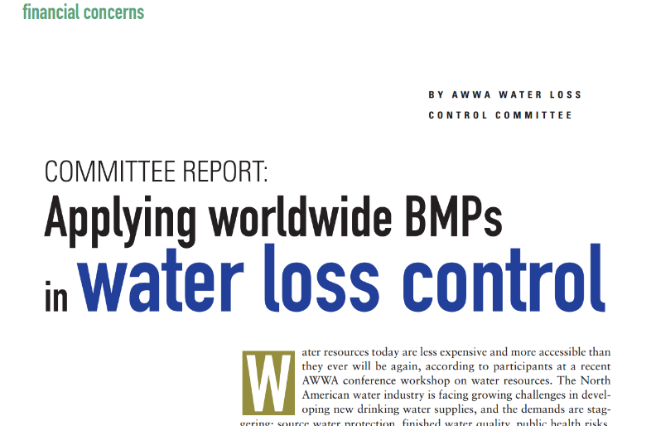
Tracking Water Loss
AWWA M36 Methodology
Industry Best Practice since 2003
All water is “Accounted For”
Standard Definitions and Procedures
Georgia Requirement began in 2011
Notes:
Brian

Slide 5
AWWA M36 Water Balance
Own
Sources
Total
System
Input
( allow
for
known
errors )
Water
Exported
Authorized
Consumption
Billed
Authorized
Consumption
Revenue
Water
Billed Water Exported
Water
Supplied
Billed Metered Consumption
Billed Unmetered Consumption
Unbilled
Authorized
Consumption
Non-
Revenue
Water
Unbilled Metered Consumption
Water
Imported
Unbilled Unmetered Consumption
Water
Losses
Apparent
Losses
Unauthorized Consumption
Customer Metering Inaccuracies
Systematic Data Handling Errors
Real
Losses
Leakage on Mains
Leakage on Service Lines
Leakage & Overflows at Storage
Notes:
Brian

Slide 6
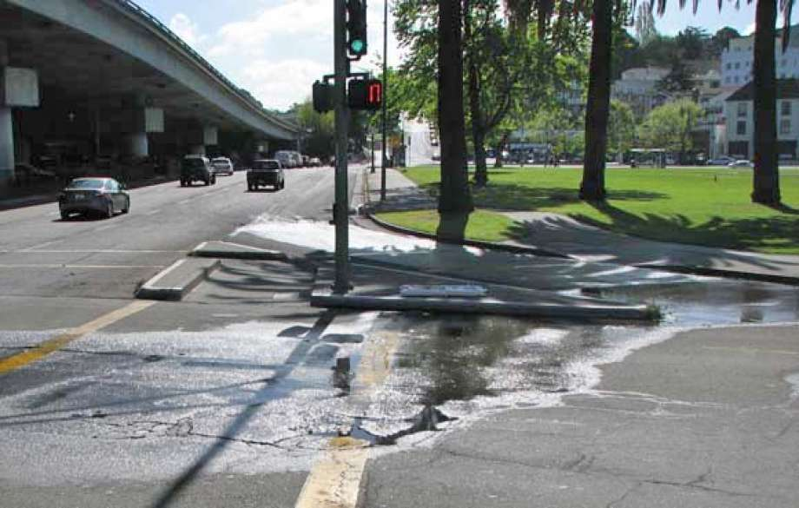
Real Losses
Also called Physical Losses – Water that enters the distribution system, but never reaches a user
Examples Include:
Leakage on transmission and distribution mains
Storage tank overflows
Service Line leakage up to customer meter
Reducing real losses extends the water resource
Leak on Grand Avenue in Oakland, CA (April 11, 2008)
https://www.sfgate.com/bayarea/article/Oakland-Leaking-water-main-on-Grand-Avenue-3220180.php
Notes:
Brian

Slide 7
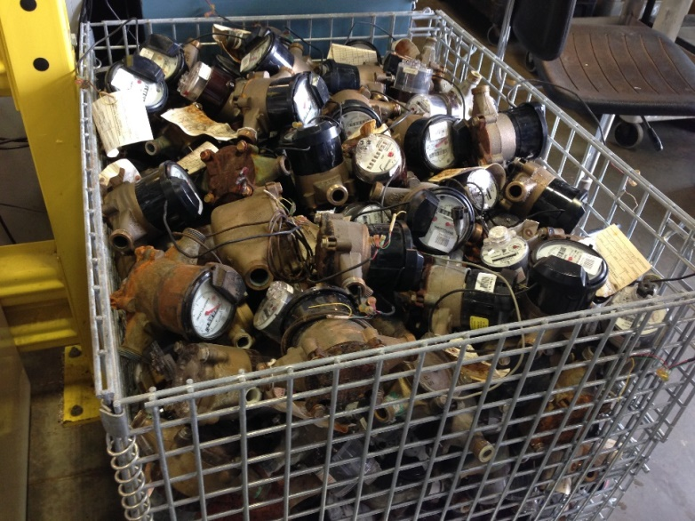
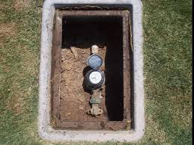
Apparent Losses
Also called Paper or Economic Losses – Water that reaches a user, but is not properly measured or paid for
Theft
Customer metering inaccuracies
Data handling errors
Reducing Apparent losses does not create any new water, but increases utility revenue
Associated values may be different than those of Real Losses
Blazing the Path – Georgia’s Water Loss Control Program, 2018
https://www.townofclaytonnc.org/Public-Works/water-sewer.aspx
Notes:
Brian

Slide 8
Why track water loss?
Reduction in water utility operating costs
Address Real Losses to reduce production costs
Address Apparent Losses to reduce water produced but not billed
Fits into the big picture of water conservation and water efficiency, which demonstrates responsible water stewardship
EPD permits water withdrawals based on demonstrated need and reasonable use
Water Efficiency
Demand Side Conservation
Supply Side Conservation
Customer Behavior
Technology
Leakage Reduction
Metering Accuracy
Water Loss Assessment and Control is here
Notes:
Brian

Slide 9
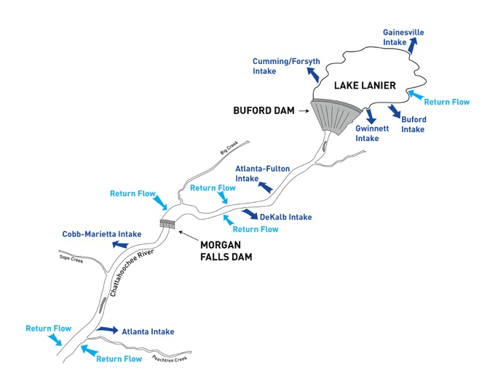
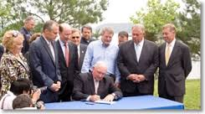
Tracking water loss in georgia
Originated with the Water Stewardship Act (WSA) enacted by 2010 Georgia General Assembly
Recognizes imminent needs to:
Create a culture of water conservation in the State of Georgia
Plan for water supply enhancement during future extreme drought conditions and water emergencies
https://atlantaregional.org/natural-resources/water-wars/tri-state-water-wars-background-and-history/
Notes:
Johanna

Slide 10
Rules for Public Water Systems to Improve Water Supply Efficiency
Georgia Rule 391-3-33 enacted to implement WSA
Applies to:
Systems serving >3,300 individuals
All permit renewals and modifications to increase permitted water withdrawal limits
Requirements Include:
Conduct Annual Water Loss Audits (due March 1)
Development of Water Loss Control Program (as of July 2016)
Development of individual goals to set measures of water supply efficiency (defined by water system)
Demonstration of progress toward improving water supply efficiency
Notes:
*Go through quickly, more detail later in the slides

Slide 11
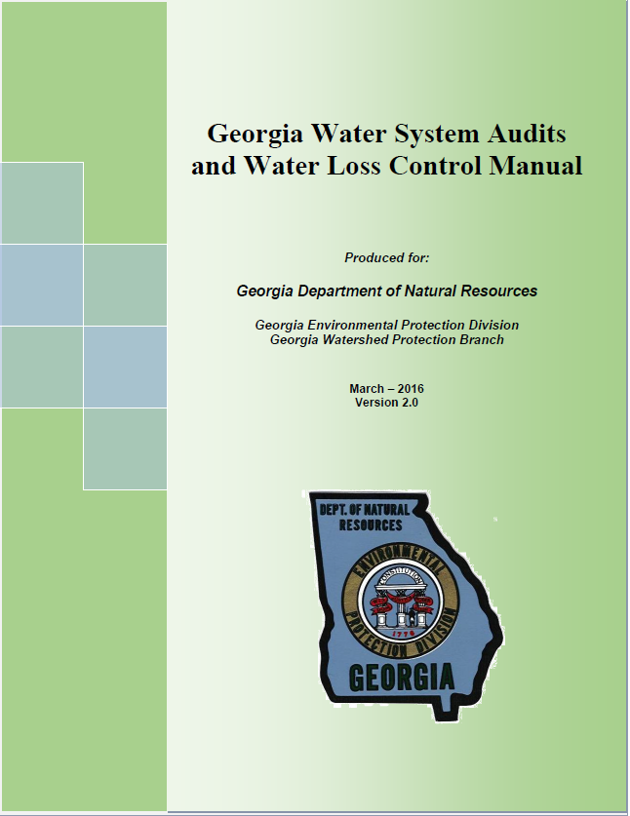
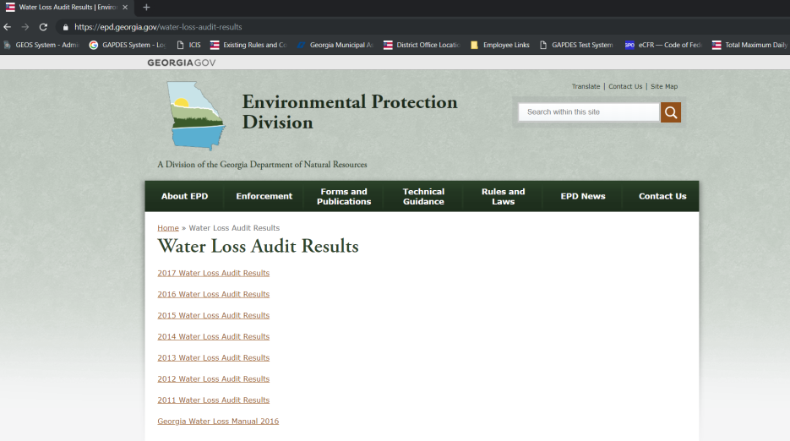
The Present
7 Years of Validated Water Audits Online (https://epd.georgia.gov/water-loss-audit-results)
Georgia Water Loss Control Manual Version 2.0 (3rd edition – Green Cover)
New water withdrawal applications now under development to help with submission of relevant information
Outreach and Guidance for Demonstrating Progress in Improving Water Efficiency under development
Notes:
Johanna

Slide 12
Permit renewals & modifications The Future
Reminder, the Rules for Public Water Systems to Improve Water Supply Efficiency require the following:
Conduct Annual Water Loss Audits (due March 1)
Development of Water Loss Control Program (as of July 2016)
Development of individual goals to set measures of water supply efficiency
Demonstration of progress toward improving water supply efficiency
Notes:
Johanna

Slide 13
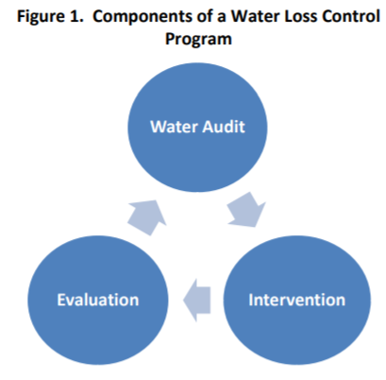
Water loss control program
EPD will begin asking for submission as part of permit application package
If you don’t yet have one, submission may be required in the permit
Must include goals and timelines, which may become enforceable through permit. May include:
Infrastructure Leakage Index (ILI)
Data Validity Score (DV)
Apparent Losses
Real Losses
Economic Level of Leakage (ELOL)
May consider other applicable goals (i.e. Metro District Water Loss Targets)
Reference: Water Audits and Water Loss Control for Public Water Systems, Environmental Protection Agency (EPA)

Slide 14
Permit renewals & modifications The Future
Reminder, the Rules for Public Water Systems to Improve Water Supply Efficiency require the following:
Conduct Annual Water Loss Audits (due March 1)
Development of Water Loss Control Program (as of July 2016)
Development of individual goals to set measures of water supply efficiency
Demonstration of progress toward improving water supply efficiency
Notes:
Johanna

Slide 15
Demonstration of progress
What is Progress? (from Rule 391-3-33)
Improvement of Data Validity Score (DV)
Development and implementation of a Water Loss Control Program
Improvement in performance measures once a reliable DV score has been achieved
Apparent Losses
Real Losses
Economic Level of Leakage has been achieved and maintained
How does EPD evaluate it?
Data trends and comments available from past Water Audits
EPD may request a narrative explaining variability and any programs or measures you have implemented to reduce water loss
If a narrative cannot be produced that explains progress, conditions may be included in the permit to help accomplish it

Slide 16
How do we recognize progress?
Example 1
Sharp decrease in Real Losses / Connection / Day
Consistent increase in DV
Real Loss = 65% decrease (2012 – 2017)
DV = 22% increase (2012 – 2017)

Slide 17
How do we recognize progress?
Example 2
Consistent decrease in Real Losses / Connection / Day
Sharp increase in DV
Real Loss = 20% decrease (2012 – 2017)
DV = 72% increase (2012 – 2017)

Slide 18
How do we recognize progress?
Example 3
Sharp decrease in Real Losses / Connection / Day
Sharp & stable increase in DV
Real Loss = 78% decrease (2012 – 2017)
DV = 54% increase (2012 – 2017);
DV = 3% decrease (2014 – 2017)

Slide 19
How do we recognize progress?
Example 4
Consistent decrease in Real Losses / Length of Main / Day
Consistent increase in DV
Real Loss = 56% decrease (2011 – 2017)
DV = 18% increase (2011 – 2017)

Slide 20
How do we recognize progress?
Example 5
Consistent increase in Real Loss / Connection / Day
Sharp increase in DV
Real Loss = 192% increase (2011 – 2017)
DV = 18% increase (2011 – 2017)

Slide 21
How do we recognize progress?
Example 6
Variable Real Loss / Connection / Day
Sharp increase in DV
Real Loss = 19% increase (2011 – 2017)
DV = 36% increase (2011 – 2017)

Slide 22
resources
Georgia Water Loss Control Manual
http://epd.georgia.gov/sites/epd.georgia.gov/files/related_files/site_page/GA%20Water%20Loss%20Manual%20V2.0_Final_3-15-18%20Update.pdf
American Water Works Association Water Loss Control Resources
https://www.awwa.org/Resources-Tools/Resources/Water-Loss-Control
Water Research Foundation Leakage Component Analysis Tools
http://www.waterrf.org/Pages/Projects.aspx?PID=4372
Georgia Association of Water Professionals (GAWP) Water Loss Auditing Guidance
https://gawp.site-ym.com/page/WaterLossAudits
Georgia Rural Water Association (GRWA) Water Loss Technical Assistance Program
http://www.grwa.org/news.cfm?id=6146
Water Audits and Water Loss Control for Public Water Systems (EPA)
https://www.epa.gov/sites/production/files/2015-04/documents/epa816f13002.pdf
Notes:
Johanna

Slide 23
resources
GAWP Advanced Water Loss Control Workshop
May 21, 2019, 10:00 AM – 3:30 PM
GAWP Headquarters – Greene Room
Interpreting Audits Results / Next Steps
Understanding Components of Real and Apparent Losses
Tools Available
Leakage Component Analysis (LCA) Model
Data Needed for LCA Tool
Utility Case Studies
Register by May 19, 2019
Notes:
Johanna

Slide 24
Questions?
Johanna Smith
Surface Water Unit Manager
Water Supply Program
Phone: 404-656-6937
Email: Johanna.Smith@dnr.ga.gov
Wei Zeng
Water Supply Program Manager
Phone: 404-463-2883
Email: Wei.Zeng@dnr.ga.gov
Bill Frechette
Groundwater Unit Manager
Water Supply Program
Phone: 404-656-6937
Email: Bill.Frechette@dnr.ga.gov
Tim Cash
Water Supply Program
Phone: 404-463-3948
Email: Tim.Cash@dnr.ga.gov

